Slide 1
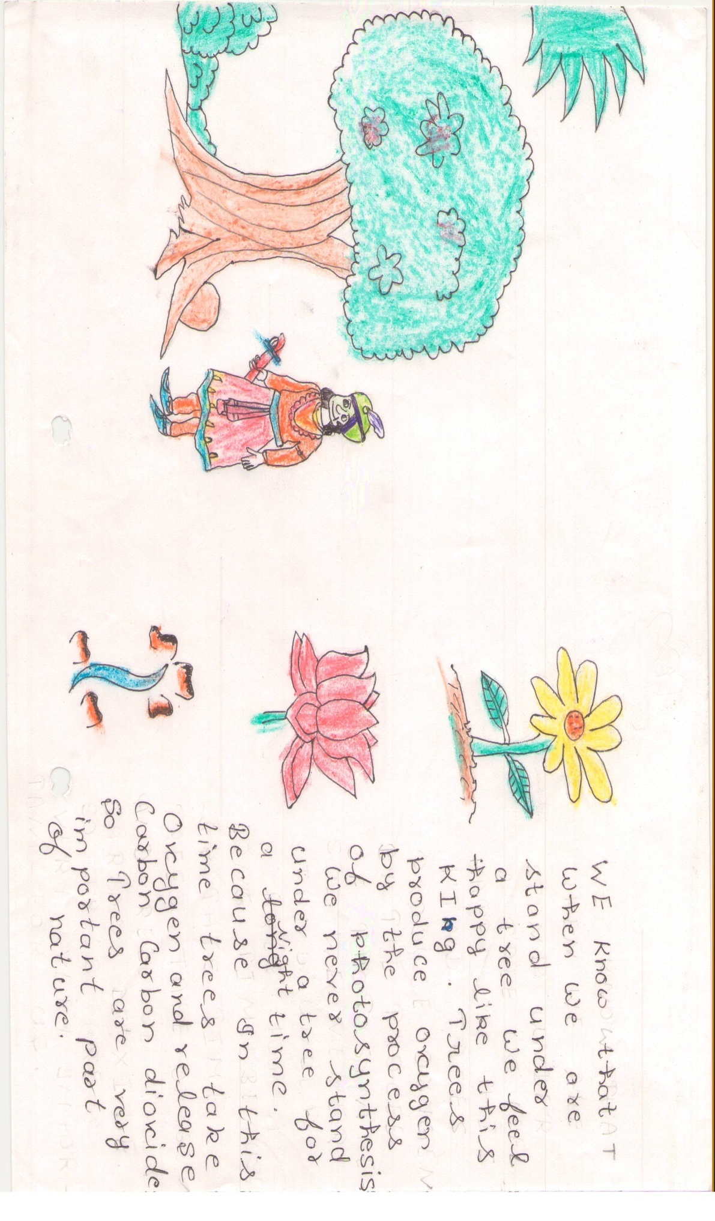
Clean India…Green India

Slide 2
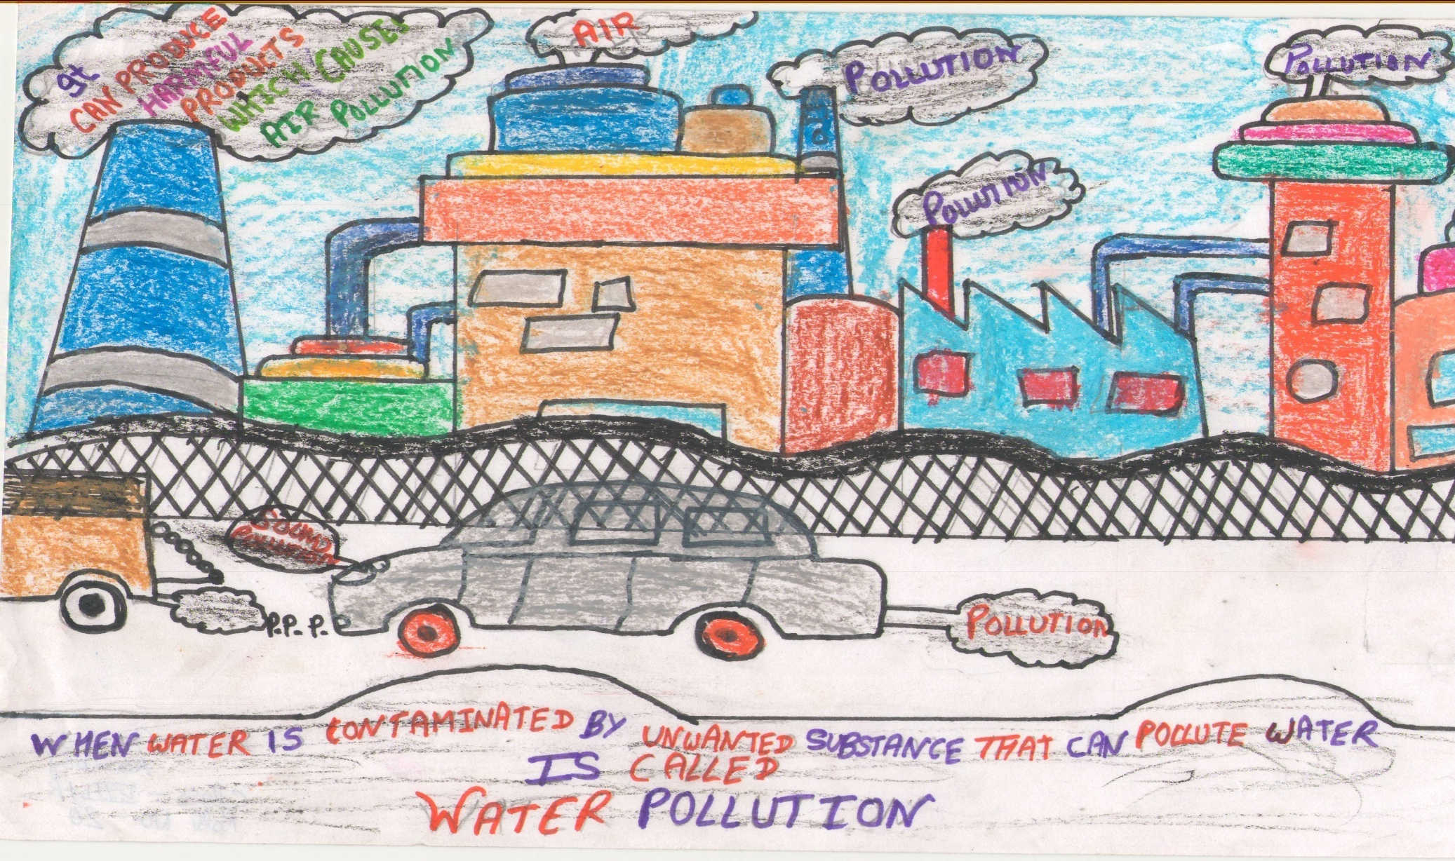
Pollution-free India

Slide 3
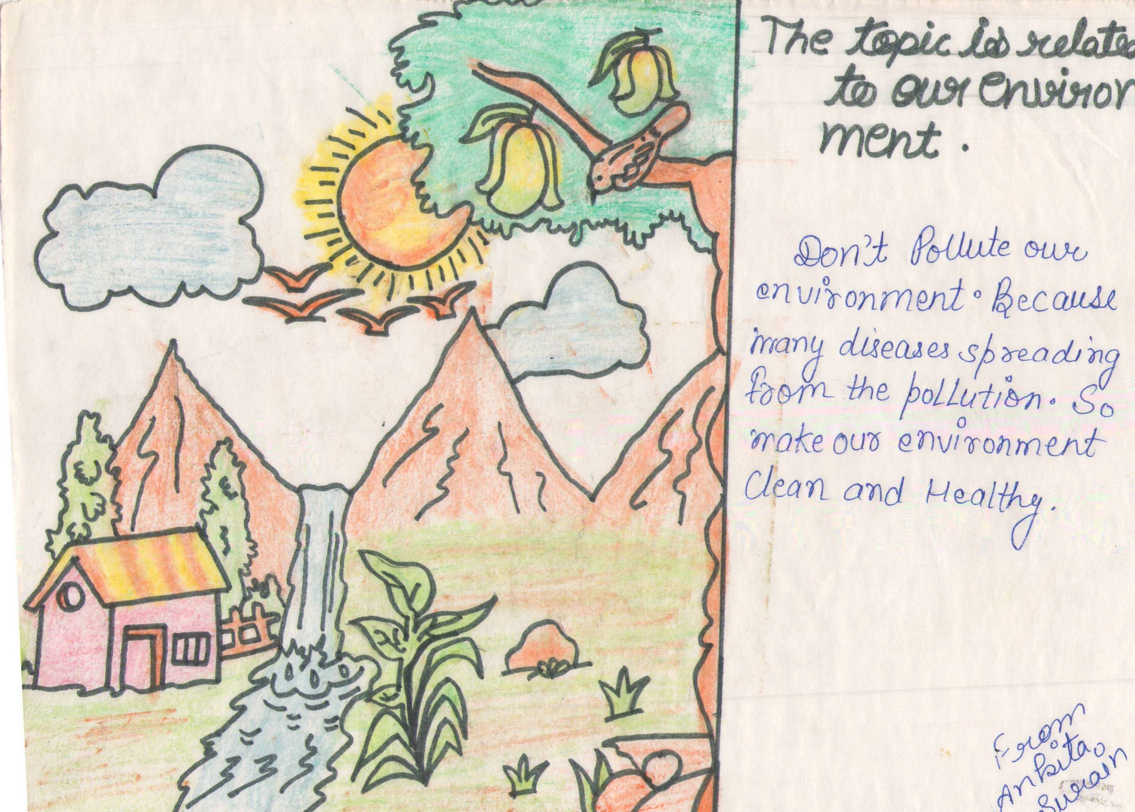
Clean India...Green India

Slide 4
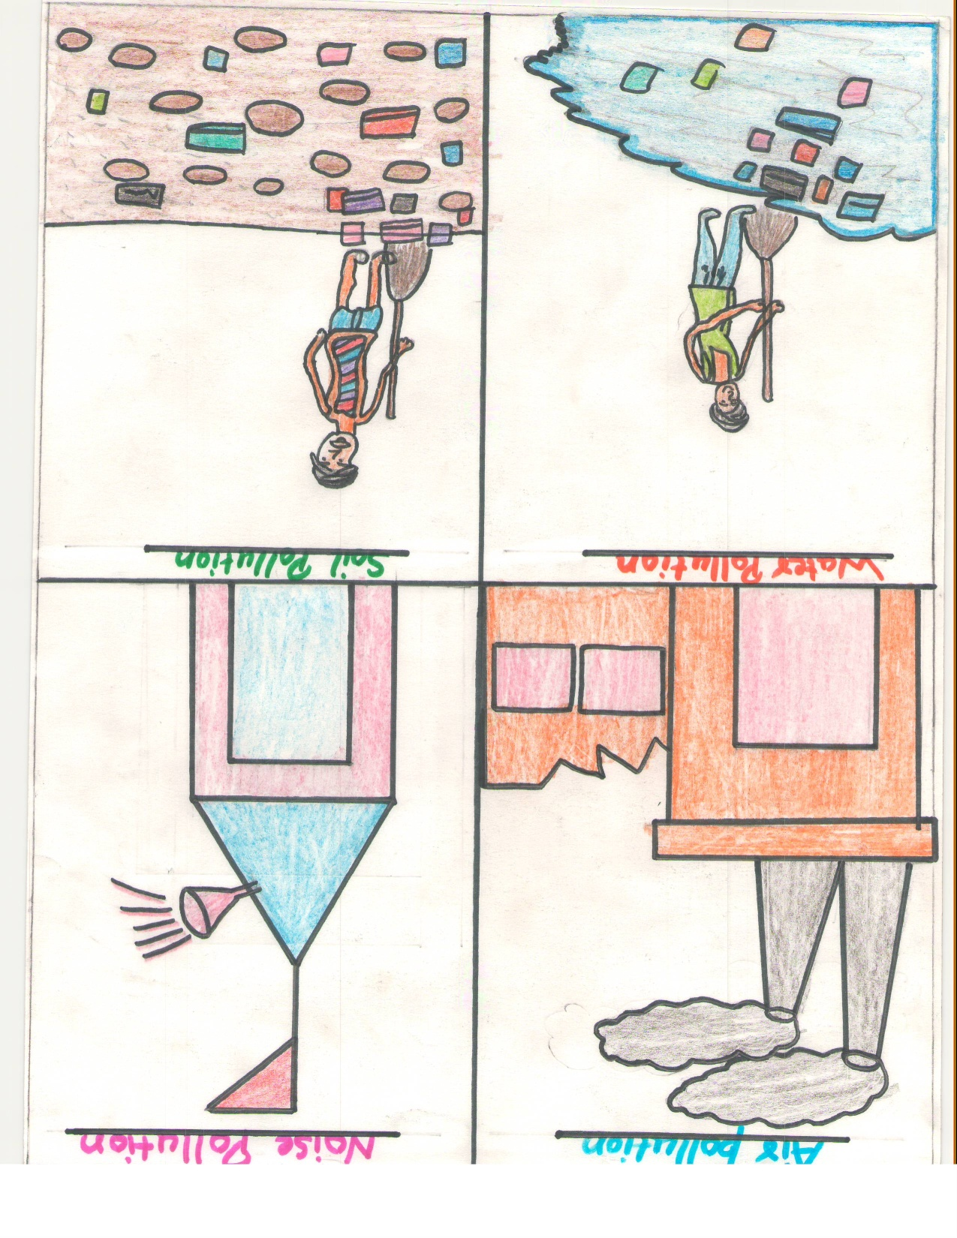
No space for Pollution

Slide 5
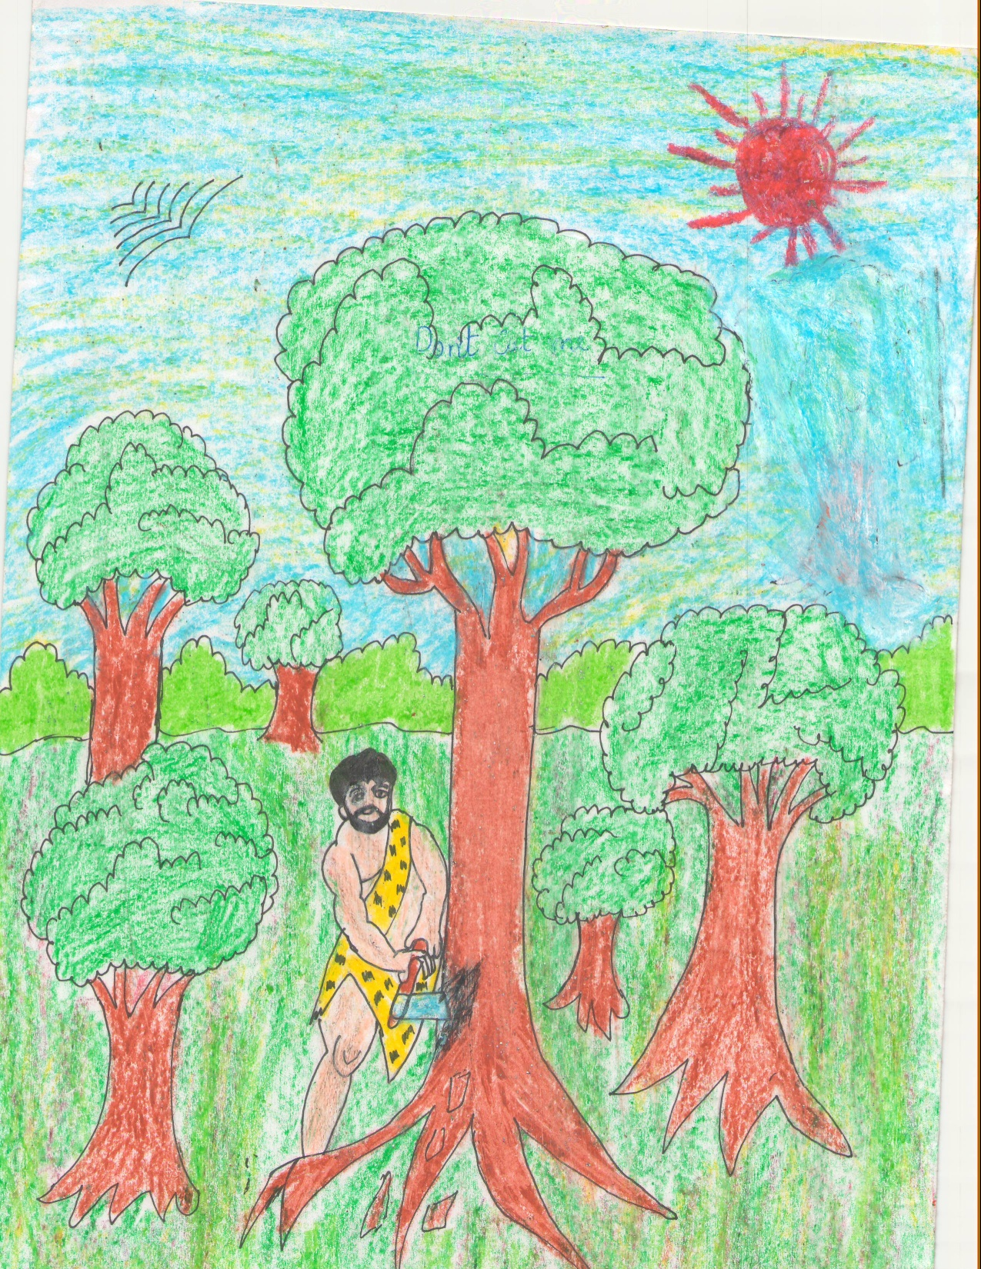
Be Civilized,Don’t Cut Trees

Slide 6
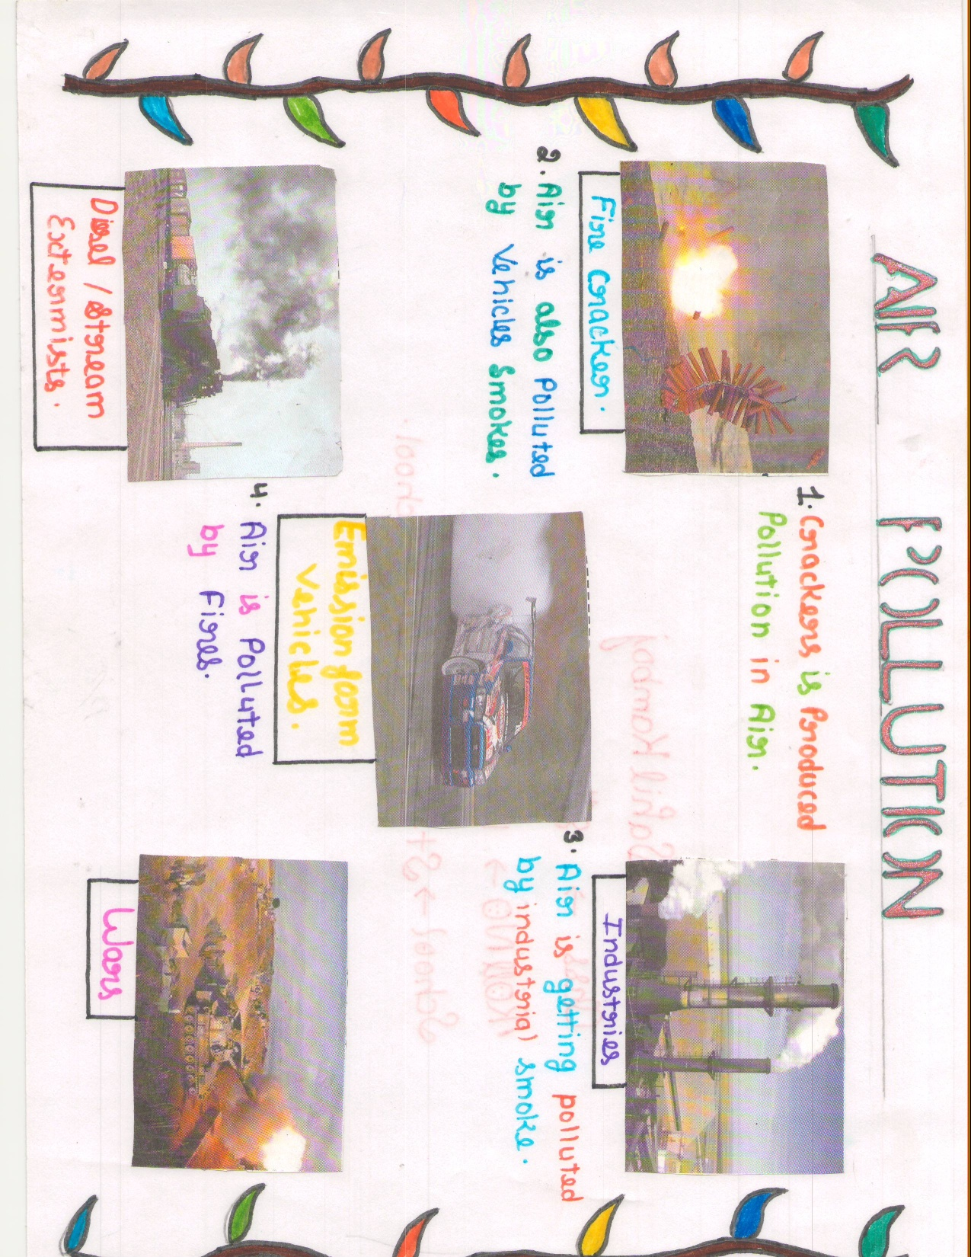
No Space for Pollution in Life

Slide 7
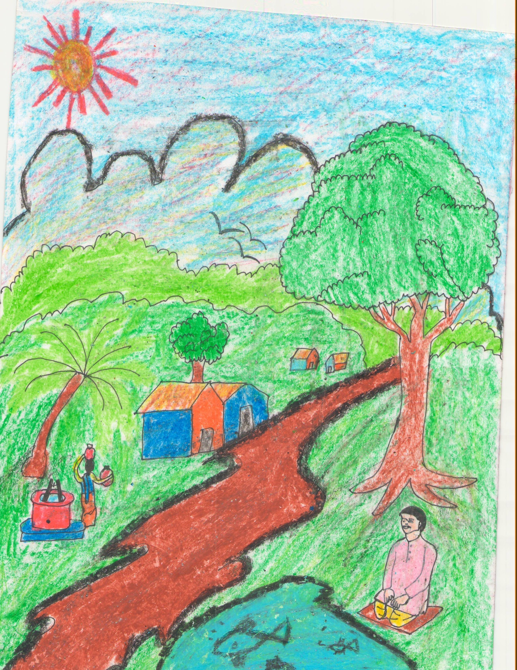
Trees Give Us Peace

Slide 8
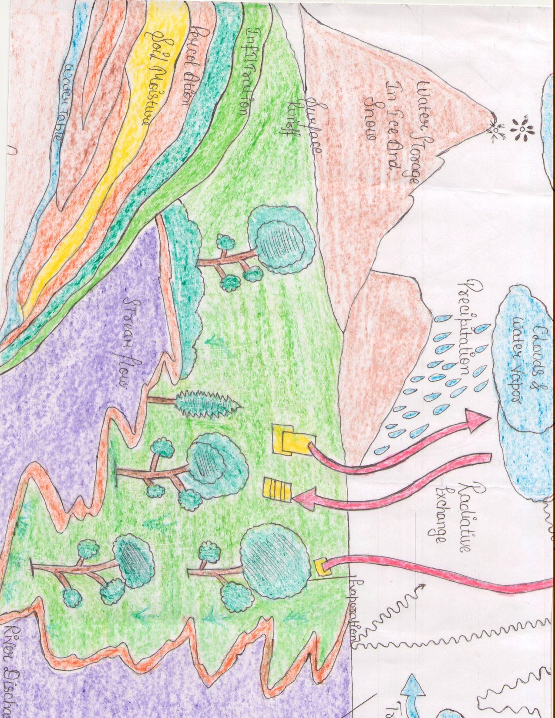
See,how trees are helpful

Slide 9
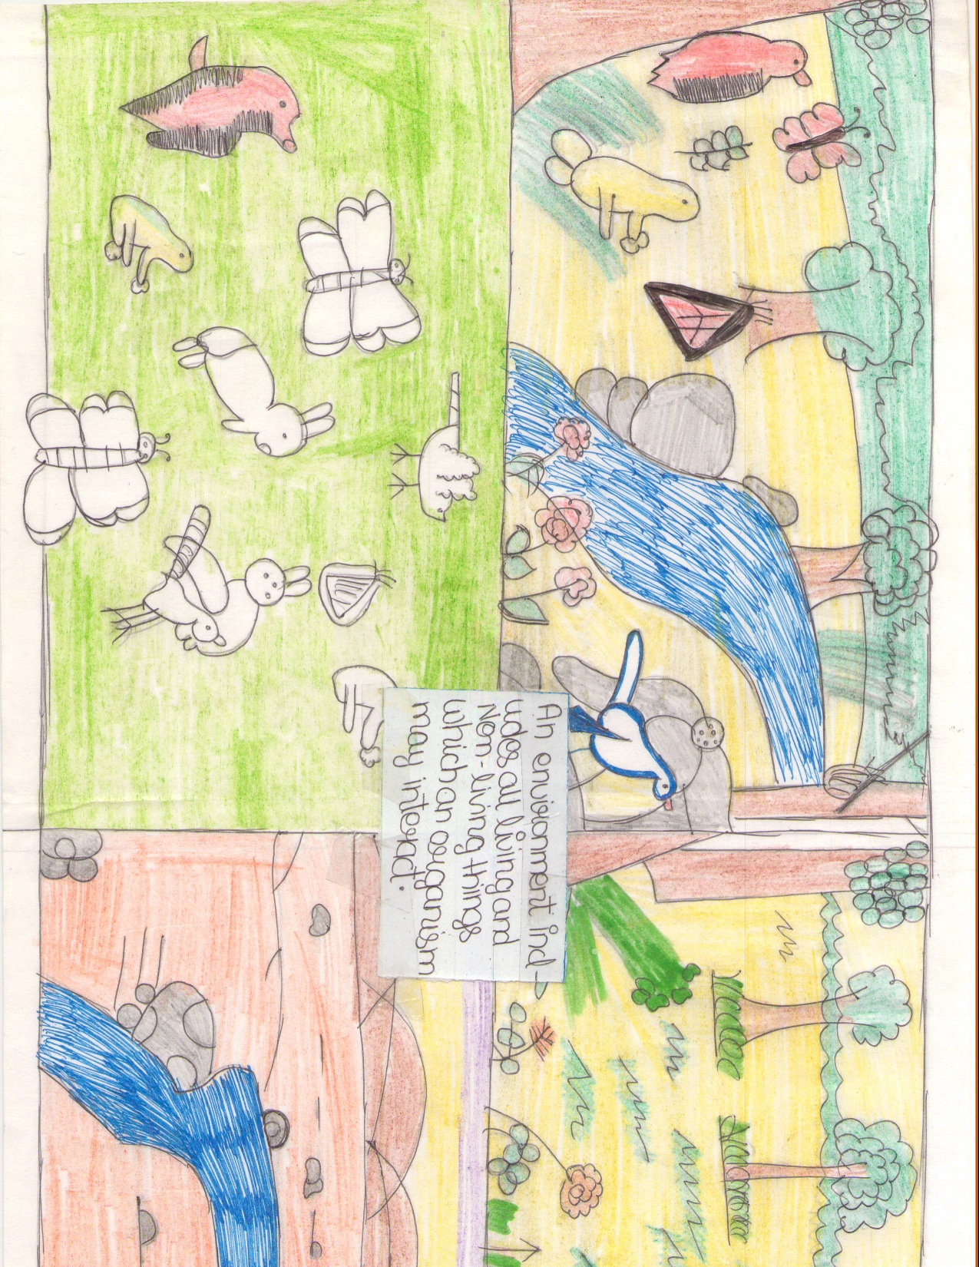
Clean India..Green India

Slide 10
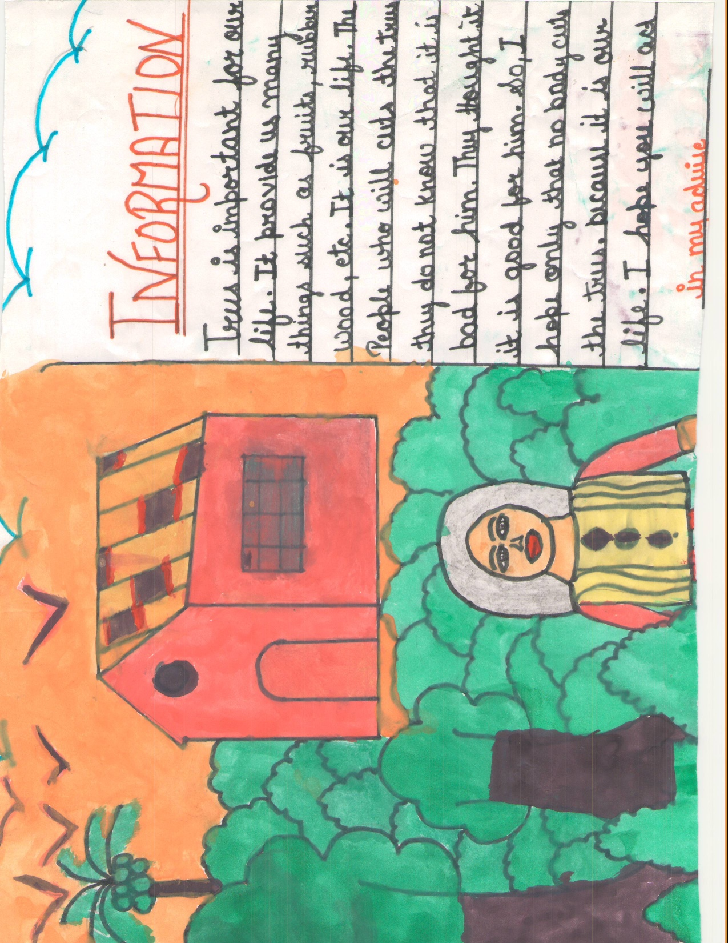
Importance of Trees in Life

