Slide 1
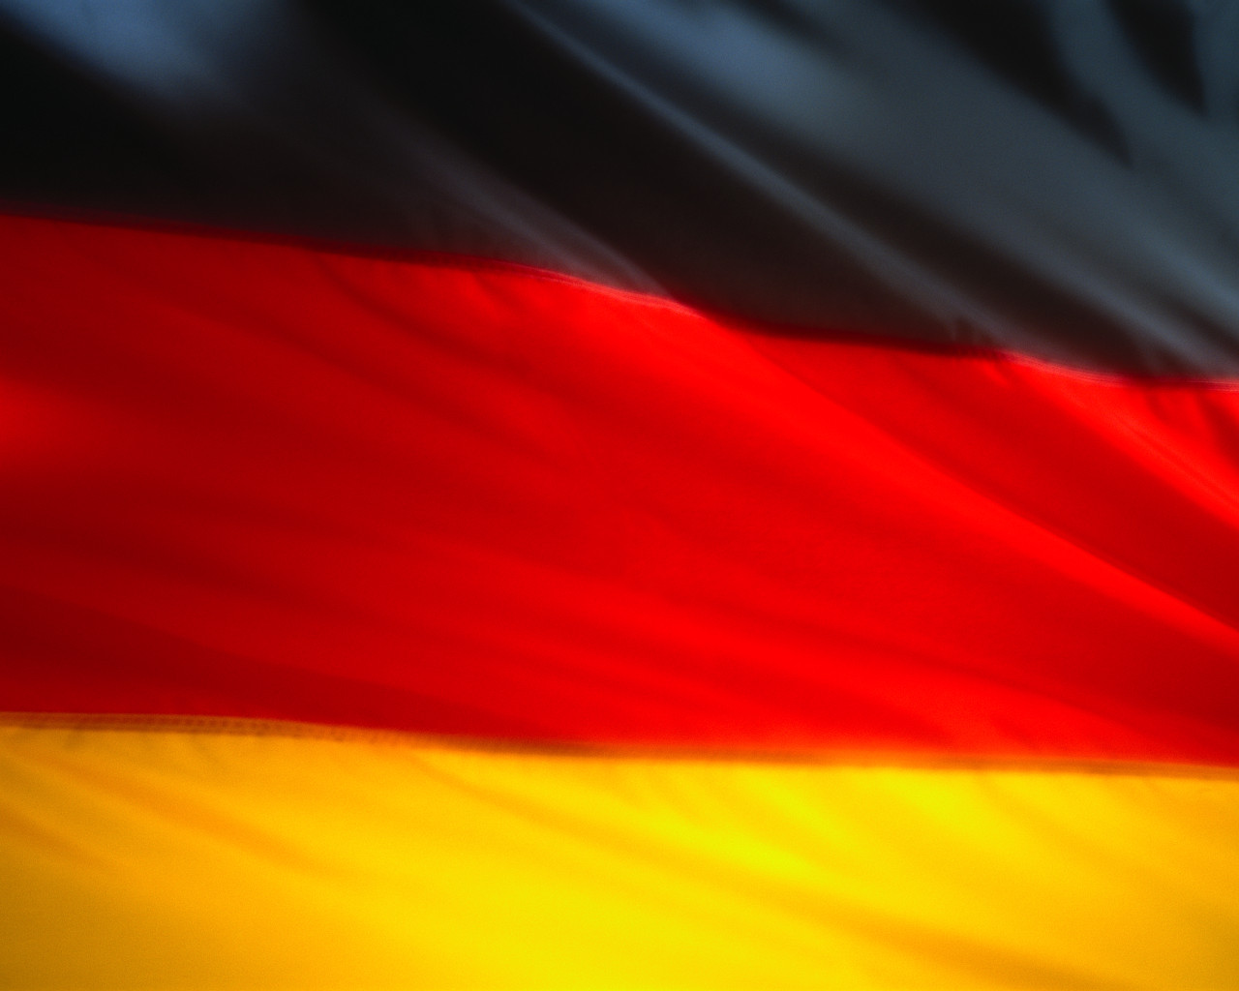
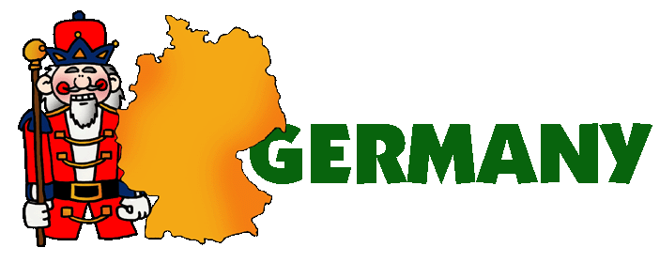
10 SW Present…

Slide 2
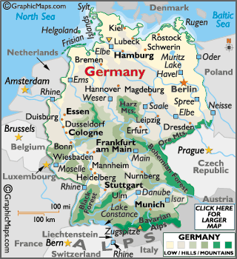
BASIC FACTS
Deutschland
Location
Population
Capital
INTERESTING FACTS
The working week
Schools
Answering the phone
Bier (Beer)
Notes:
Welcome to 10SW’s assembly on everyone’s favourite country Germany!!
The German for Germany is actually ‘Deutschland’ also Great Britain is ‘Großbritannien ‘
Deutschland is located in the centre of Europe and shares its border with Austria, Belgium, Czech Republic, Denmark, France, Luxembourg, the Netherlands, Poland, Switzerland.
The population of ‘Deutschland’ is about 82.7million which is over 20million more than the population of Britain which has a population of about 61.4 million.
The capital of Deutschland is Berlin which has a population of 3.47 million inhabitants.
Some more random yet interesting facts are:
Unlike Britain The working week in Germany also includes Saturday! However, Schools are not really full time in Germany as they all finish at 1pm or thereabouts. So, the kids are sent home for the whole afternoon with homework to do, and as there are more and more families where both parents are working, it creates a bad situation. Kids are often left by themselves, or can be found on the streets because there are not enough after-school daycare spaces available and after school activities. There is a push to change of this system, but nothing has been done yet.
When answering the phone, Germans do not say Hi or Hello or Hallo, they first say their surname.
Germans really do love beer; they rank second in world-wide beer consumption per person after Ireland. Bier is officially considered a food in Bayern, where the normal size beer glass is not a pint but a liter.

Slide 3
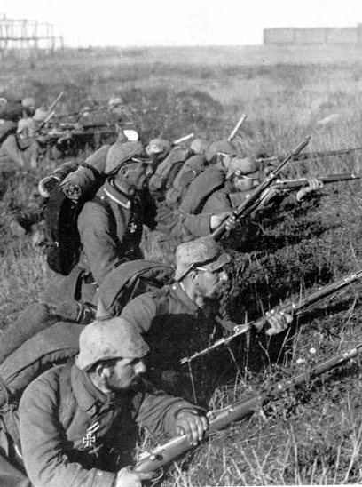
GERMAN HISTORY
First World War (1914-1918)
German Empire and Austria
France, Great Britain and Russia with Serbia.
As it progressed more countries joined in.
15million casualties.
Notes:
The First World War began in 1914, lasting four years. It was fought between the German Empire and Austria, on the one side. With
France, Great Britain, and Russia
together with Serbia, on the other.
As the war progressed, other countries in Europe, Asia, Africa and America also joined in, including in 1917 the
USA, whose entry was to prove decisive.
The War resulted in almost 15 million casualties and The German military defeat was followed
by political upheaval.

Slide 4
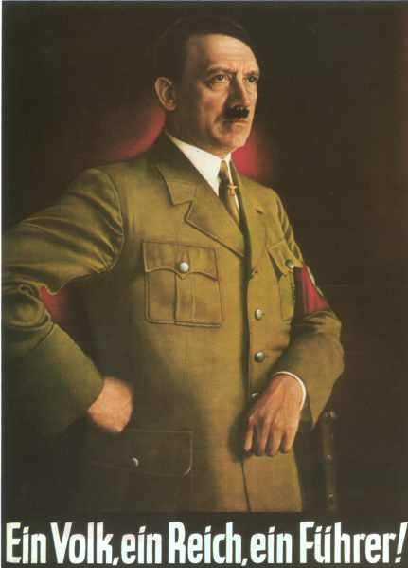
GERMAN HISTORY
Adolf Hitler
The Holocaust
Second World War
Germany invaded Poland
Great Britain and France declared war on Germany.
60million deaths
Notes:
You probably don’t need an introduction to the man on the screen. Hitler is probably the most well known person associated with Germany although he was actually Austrian born.
He and his party were responsible for the Holocaust which was the planned and the industrially perfected murder of six million European Jews. Roma, homosexuals and other people that the Nazis deemed ”unwanted” or “not worthy of living” were also victims. In an unimaginable extermination program these persons were exploited, tortured, humiliated and murdered in death factories and concentration camps.
On September 1, 1939 at 4.45a.m. Hitler invaded neighboring Poland without having declared war. As a consequence, Great Britain and France declared war on Germany. The Second World War lasted six years and resulted in the loss of 60 million lives.

Slide 5
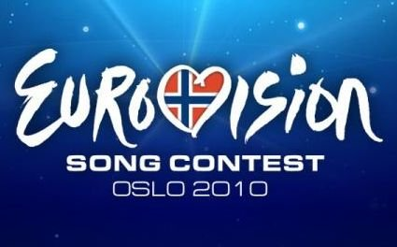
Notes:
On a more recent and lighter note, Germany with the exception of 1996 have participated in every Eurovision Song Contest since its beginning in 1956. No other country has been represented as often.
Germany, along with the United Kingdom, France and Spain, is one of the "Big Four" countries that are automatically qualified to the final, regardless of the placing. This is due to being the largest financial contributors to the contest.
Germany has won two contests, in 1982 and 2010. We are going to show you this years winning entry from Germany because we thought it would be a bit more interesting than playing the National Anthem.

Slide 6
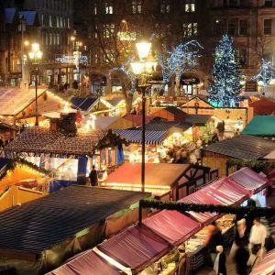
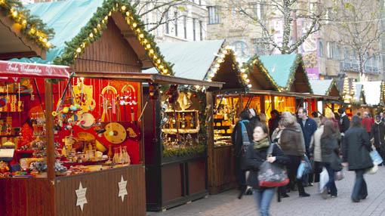
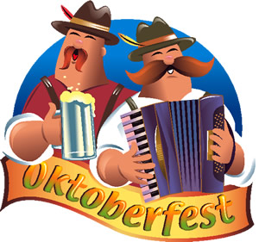
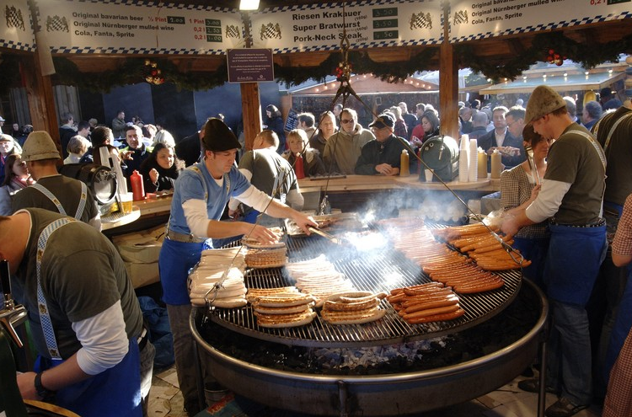
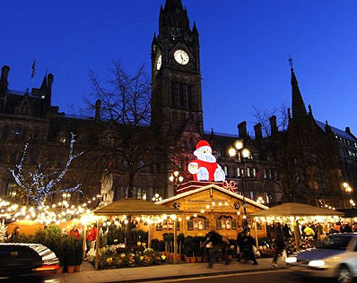
Notes:
There is nothing that celebrates German culture like Oktoberfest. Oktoberfest is a 16-day festival held each year in Munich, running from late September to early October. It is one of the most famous events in Germany and the world's largest fair, with some six million people attending every year. It is an opportunity for Germans to celebrate their heritage.
Other cities across the world also hold Oktoberfest celebrations, modeled after the Munich event.
Actually all the photos in this slide are of Manchester. Every year there is a German Christmas market which is based on Oktoberfest. There are a number of German stalls, lots of food and beer.

Slide 7
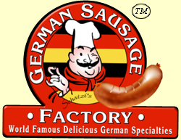
brätwurst
Notes:
One of the major attractions to the German markets is the bratwursts. Which are one of Germany’s most famous exports.
Brätwurst came from the word "Brato" originally meant hacked meat, intestines and the other part of the word is wurst which means sausage.
There are a number of different types of bratwurst including:
Blutwurst—blood sausage, which comes in many varieties; it is eaten sliced and cold or fried like black pudding
Frankfurter—the genuine German variety (not the same as an American frankfurter) contains finely chopped lean pork with a bit of salted bacon fat, and is smoked; reheat in simmering liquid
Wienerwurst—believed to be the origin of American frankfurter; beef and pork flavored with coriander and garlic
We have a bratwurst here who would like to try it?
Is it nice?
What does it taste like?
How does it compare to the sausages we eat in England?

Slide 8
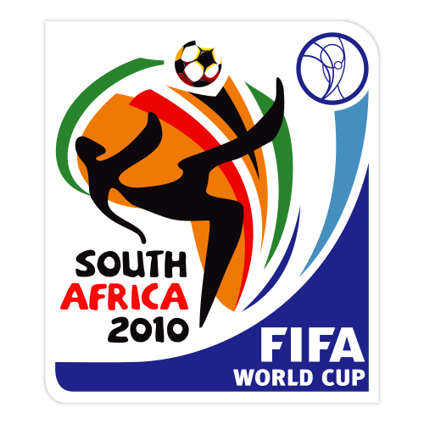
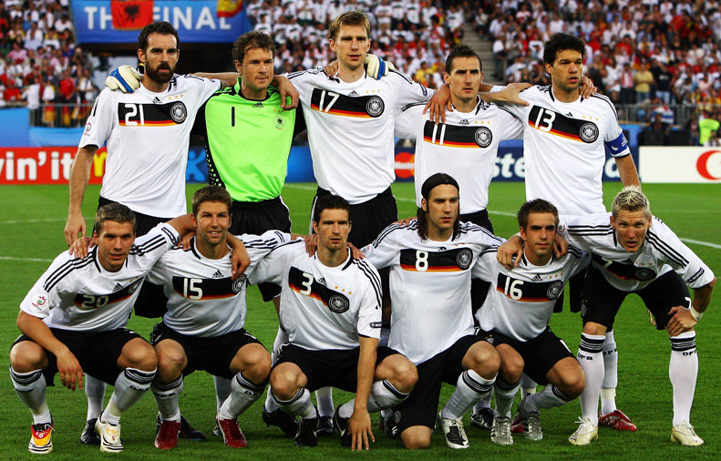
Notes:
Three-time World Cup winners Germany are usually there or thereabouts and the current national side will have high expectations.
They have previously won the world cup in 1954, on home soil in 1974 and in Italy in 1990, the team now coached by Joachim Low are aiming to hoist the most prestigious for the fourth time.
The Germans' consistent success is based on deep reserves of experience, finely-honed tactical know-how, and the ability to rise to the occasion when the chips are down. Their qualifying campaign merely served to emphasise the enduring nature of those attributes.
However, their most experienced player Michael Ballack was ruled out just before the tournament (he his the one on the top right of the photo with the arm-band on). This is also the youngest team Germany have ever taken to the world cup with an average age of just 24.9.

Slide 9
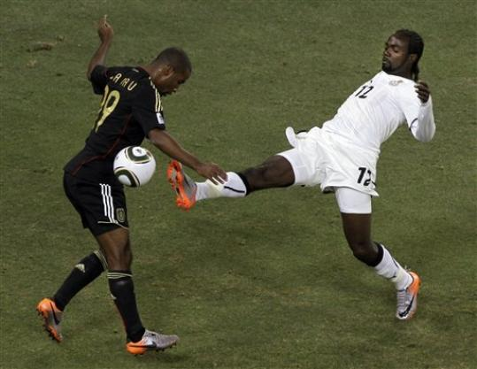
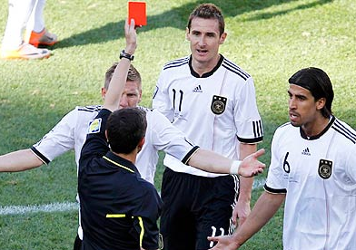
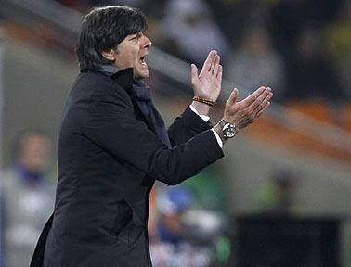
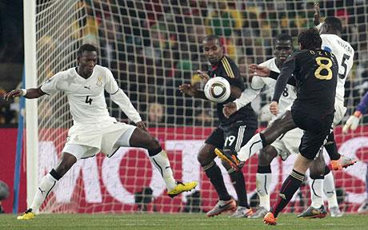
Notes:
Germany have had an up and down World Cup so far. They were the team of the tournament after the first round, beating Australia 4-0 but then went and lost to Serbia 1-0 with one of their stars Klose was sent off and Lukas Podolski becam only the 2nd German to ever miss a penalty in the world cup.
Despite the loss Germany qualified top of their group after beating Ghana 1-0 setting up a tie with England in the knockout stages. And we all know what happened in that game, so say I'll say no more!
Germany have never gone more than 20years without winning the World Cup and last won it in 1990 so this could be there year!?!

Slide 10
Our Challenge to You!!
Guten Morgen = Good Morning
Guten Tag = Good Day
Dankeschön = Thank you
Mittwoch = Wednesday
Auf Wiedersehen = Goodbye
Das ist gut! = That is good!
Das ist nicht so gut! = That is not so good!
Notes:
Our challenge to you is to try and embrace a little bit of German culture. We feel you can do this today by speaking a bit of German so here are a few words for you to try:

Slide 11
Dankeschön und
Auf Wiedersehen!

