Slide 1
YEAR 9 ENTERPRISE DAY 2010

Slide 2
Learning Objectives
Demonstration of your enterprise capability
Develop an understanding of what is meant by a businesses core values
Appreciate the importance of team working in improving your learning and performance

Slide 3
FIFA’s Mission
'Develop the game, touch the world, build a better future'

Slide 4
FIFA’s Core Values
Authenticity. We believe that football must remain a simple, beautiful game played by, enjoyed by and touching the lives of all people far and wide
Unity. We believe it is FIFA´s responsibility to bring people and countries together through football regardless of gender, ethnic background, faith or culture
Performance. We believe that FIFA must strive to deliver football of the highest quality and as the best possible experience for both players and fans
Integrity. We believe that, just as the game itself, FIFA must be a model of fair play, tolerance, sportsmanship and transparency

Slide 5
Summary of Fifa’s “Core Values”
Accept ALL Cultures
FAIR PLAY
RESPECT
Unity
Team work
Fun
Success

Slide 6
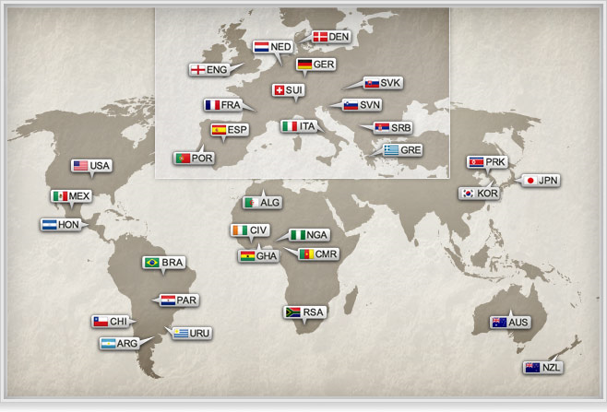

Slide 7
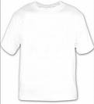
Activity One
In your pair, you are to design a T-Shirt that could be sold at the World Cup.
The T-Shirt is to be themed by one of the ‘core values’ of FIFA as well as be representative of the country you have randomly chosen out of the hat!

Slide 8
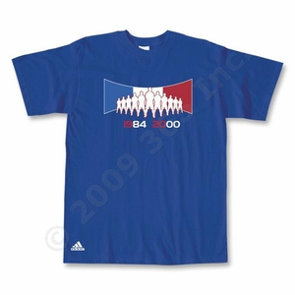
France
Core Value: TEAMWORK
OR UNITY

Slide 9
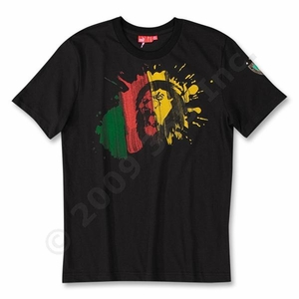
Cameroon
Core Value: ACCEPT ALL CULTURE

Slide 10
Spain
Core Value: UNITY

Slide 11
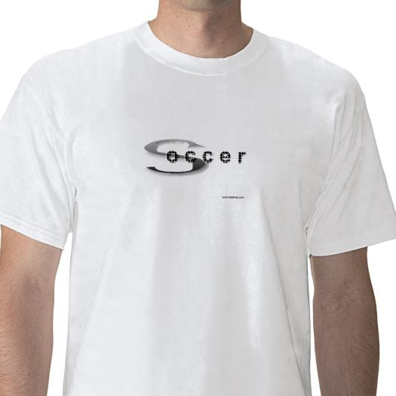
South Africa
Core Value:
ACCEPT CULTURE OR SUCCESS

Slide 12
Activity Two
Your t-shirt will be sold via FIFA.com, in their online shop.
Write 250 words explaining the rational of your design
Think about...
What FIFA value does it represent?
Where did the inspiration for your design come from?
What are you trying to suggest through the imagery of your design?

Slide 14
Business Administration and Finance
Key Themes
Develop the skill needed to run a business.
You have the opportunity to set up and run your own business in school.
Look at how you should manage your personal finances and business finance.
Find out why teamwork and communication is so important to a business.
Learn in and out of the classroom from experts such as: O2, Manchester United, The Trafford Centre.

Slide 15
Business Administration and Finance
The Course
The qualification is the equivalent to 7 GCSE’s
The learning is 100% applied to running your own businesses with the support of business such as;
The course is delivered across 6 periods a week with 2 more periods of Additional Learning time in a subject of your choice
The assessment is largely coursework based with 2 examined topics
Part of the course involved ‘the project’ which is a portfolio of work on a subject/interest/hobby of your choice

Slide 16
BTEC Firsts
The qualification is the equivalent to 4 GCSE’s
The assessment is entirely coursework based
An applied approach to learning delivered over 6 periods a week
Topic areas include: finance, marketing, communication, running a business online etc...

Slide 17
WINNERS!!!!

