Slide 1
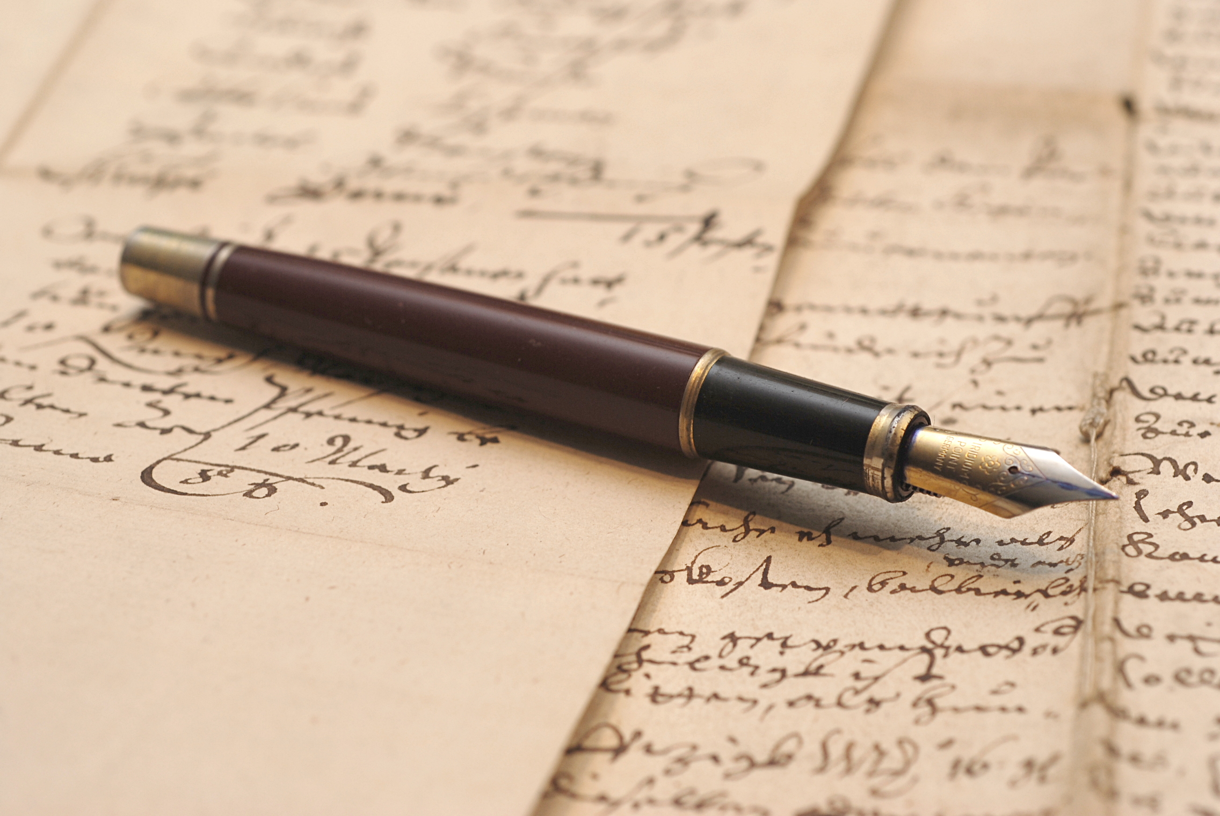
Languages

Slide 2


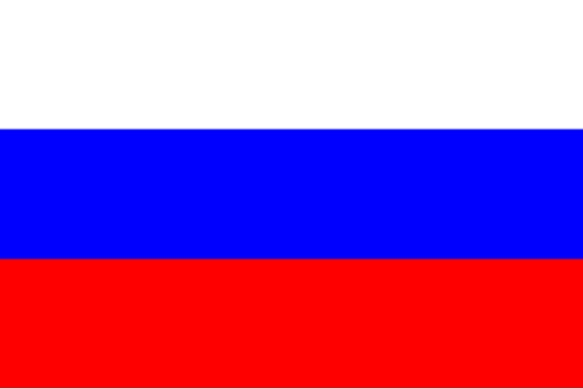

Objective of this activity
To learn and remember names of basic colours, animals and numbers in Slovakian, Russian and Hungarian!

Slide 3

Animals
FOX!
Liska (Lishka)

Slide 4
WOLF!
Волк (Volk)

Slide 5
RABBIT!
Nyul

Slide 6
BEAR!
Medved

Slide 7
DEER!
Олень (Olen)

Slide 8
SPLAT!

Slide 9
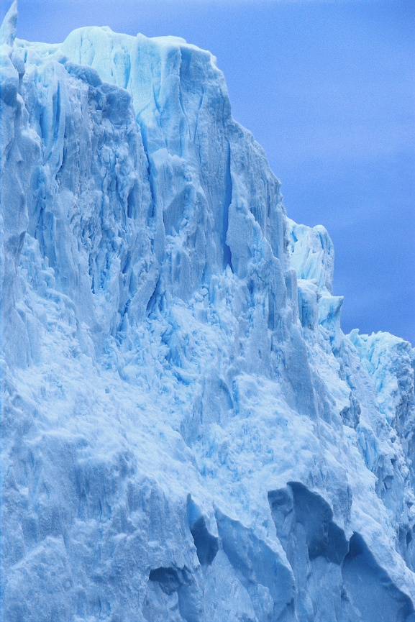
Colours
BLUE!
Kek

Slide 10
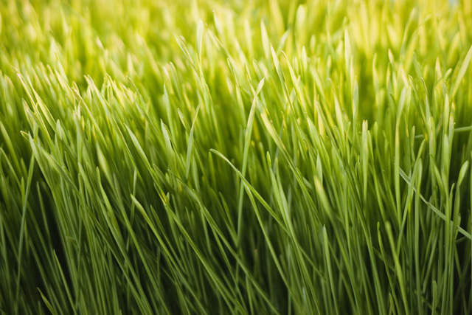
GREEN!
Zelena

Slide 11
BLACK!
Черный (Cherniy)

Slide 12
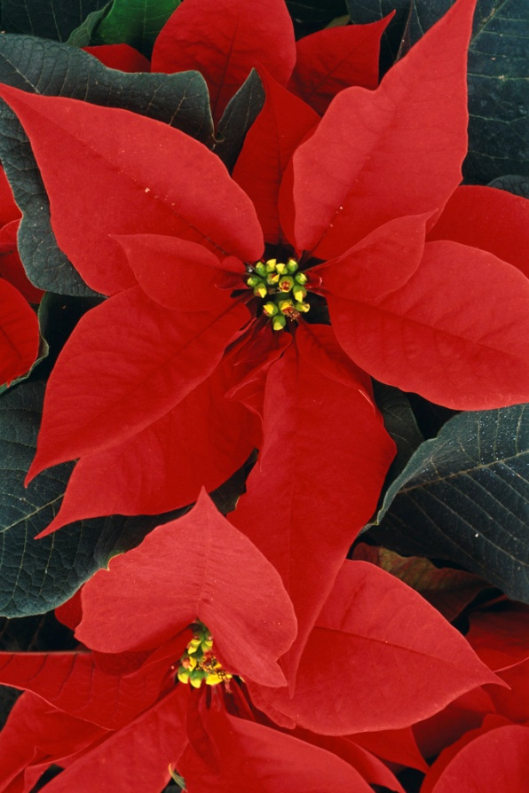
RED!
Piros

Slide 13

YELLOW!
Zlta (jilta)

Slide 14
Matching game
Blue Zlta
Green Piros
Red Kek
Yellow Черный
Black Zelena

Slide 15
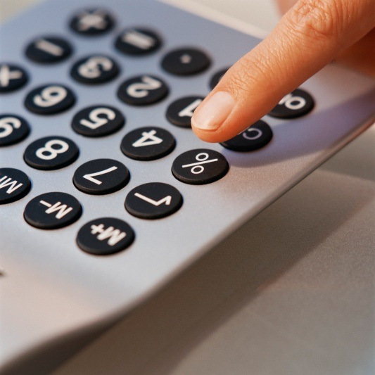
Numbers
1- один (odin)
2- два (dva)
3- три (tree)
4- четыре (cheteeree)
5- пять (pyat)
6- шесть (shest)
7- семь (sem)
8- восемь (vosem)
9- девять (devyat)
10- десять (desyat)

Slide 16
Numbers
1- egy
2- kettő
3-három
4-négy
5-öt
6-hat
7-hét
8-nyolc
9-kilenc
10-tíz

Slide 17
Numbers
1- jeden
2- dva
3-tri
4-štyri
5-pät
6-šest
7-sedem
8-osem
9-devät
10-desat

