Slide 1
WAX MUSEUM IN INDIA
SIDDHAGIRI MUSEUM – KOLHAPUR , MAHARASHTRA, INDIA
ONE OF THE FINEST PROJECTS IN INDIA

Slide 2
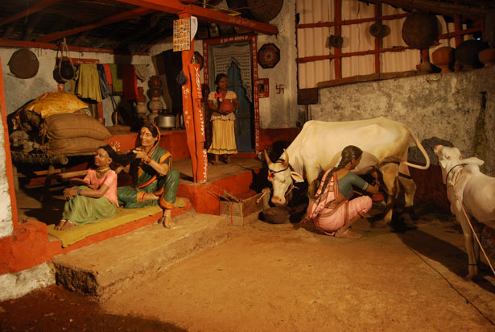
A NORMAL HOUSEHOLD

Slide 3
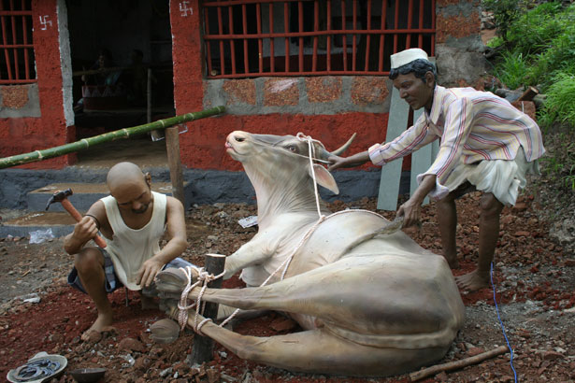
PLACING HOOVES OF THE CATTLE

Slide 4
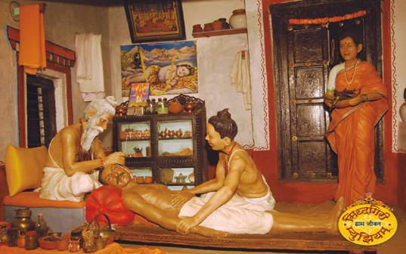
AYURVEDIC TREATMENT

Slide 5
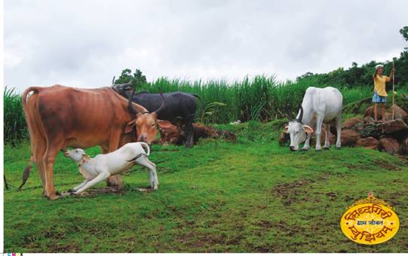
GRAZING CATTLE

Slide 6
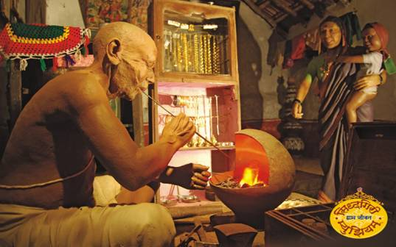
A GOLDSMITH

Slide 7
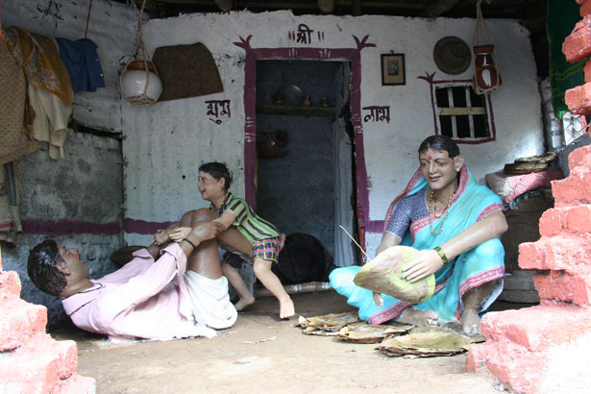
A HAPPY FAMILY

Slide 8
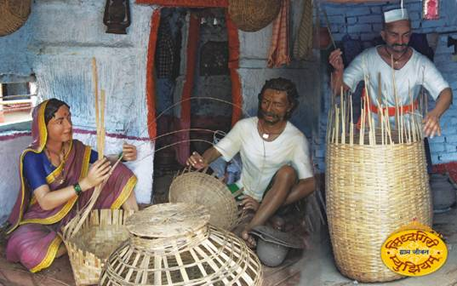
WEAVING BASKETS

Slide 9
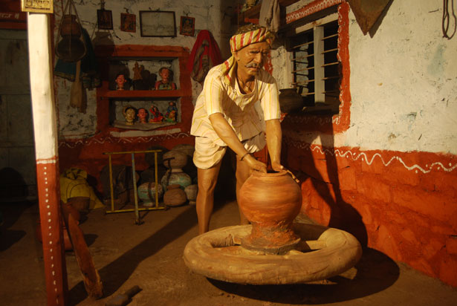
A POTTER AND HIS WHEEL

Slide 10
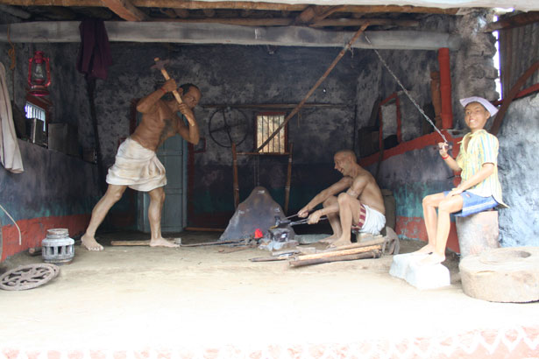
IRONSMITHS

Slide 11
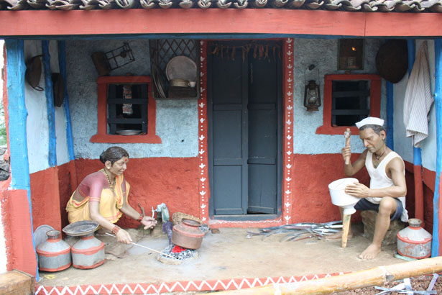

Slide 12
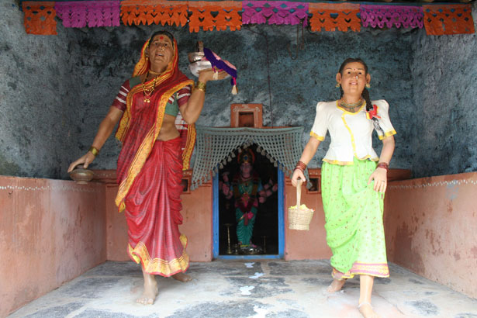
PLACE OF WORSHIP - TEMPLE

Slide 13
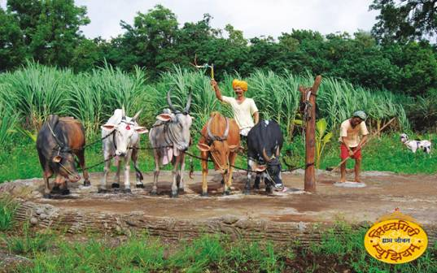
TILLING THE LAND

Slide 14
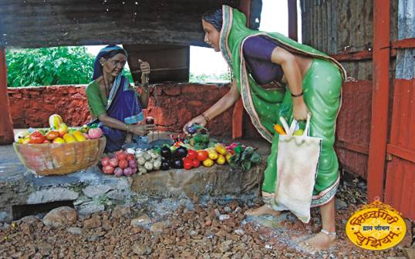
A VEGETABLE VENDOR

Slide 15
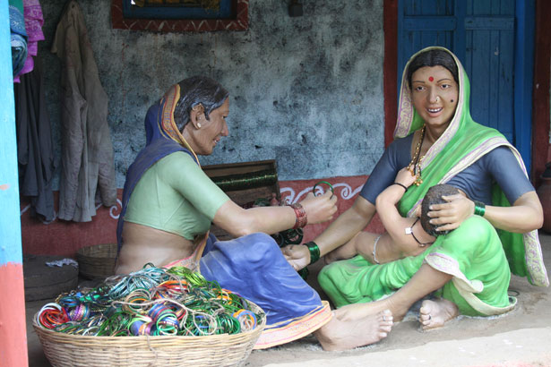
A BANGLE-SELLER

Slide 16
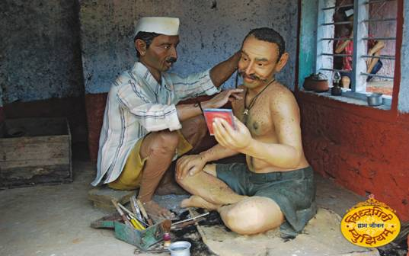
A BARBER

Slide 17
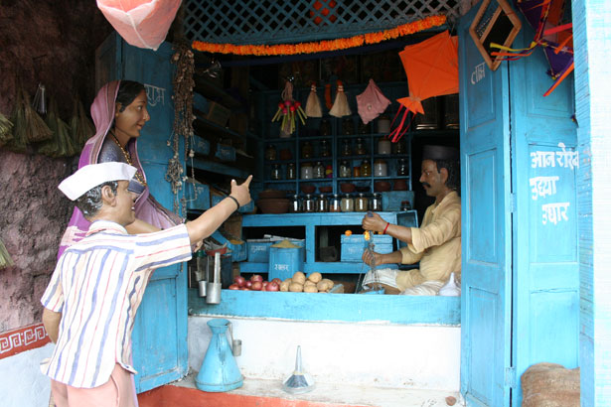
A GROCERY SHOP

Slide 18
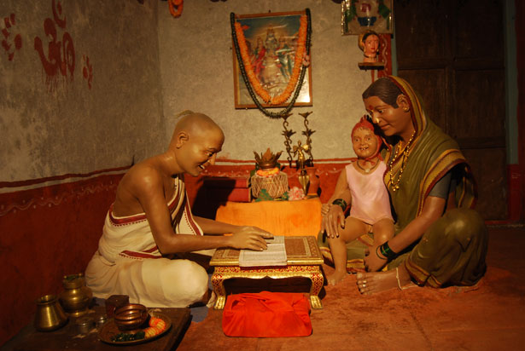
TEACHING AND LEARNING VEDAS

Slide 19
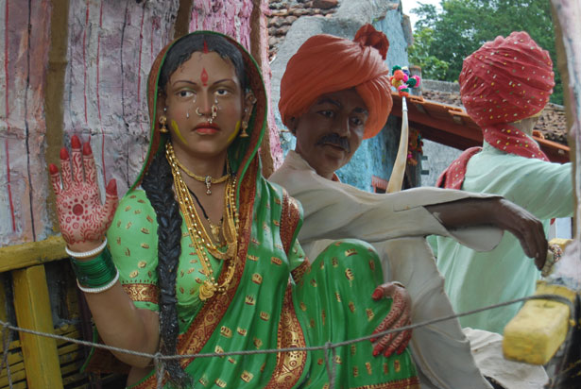
A NEWLY MARRIED COUPLE

Slide 20
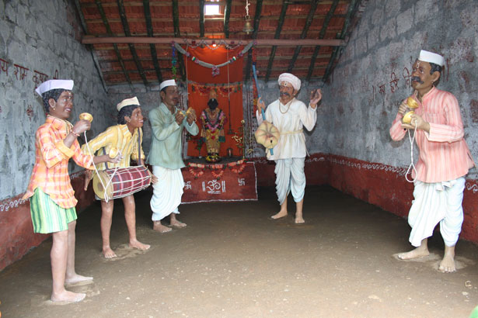
FOLK ENTERTAINMENT

Slide 21
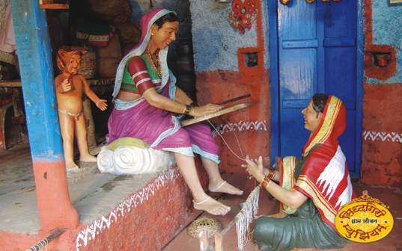
WEAVING CLOTH

Slide 22
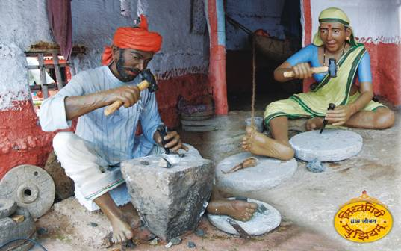
CHISELLING STONE

Slide 23
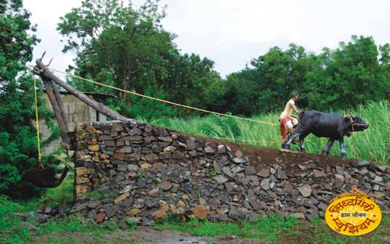
WATERING THE FIELDS

Slide 24
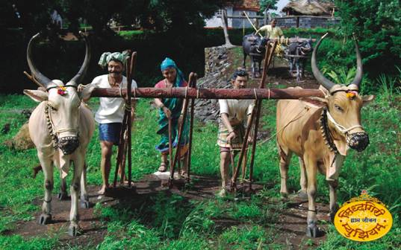
PLOUGHING THE FIELDS

Slide 25
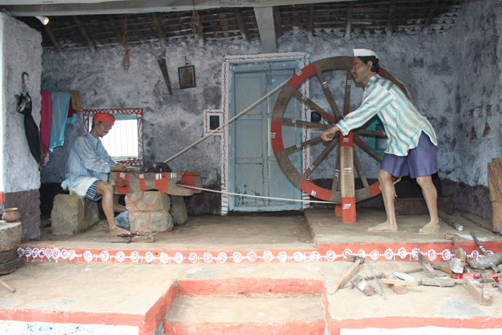
MAKING TOOLS FOR FARMING

Slide 26
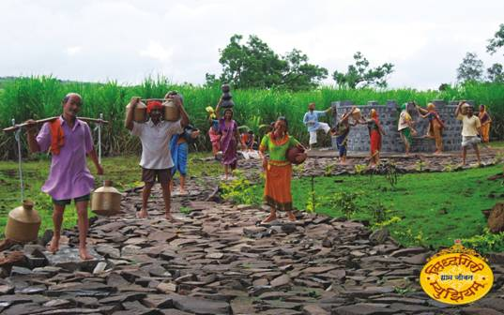
DRAWING WATER FROM THE WELL

Slide 27
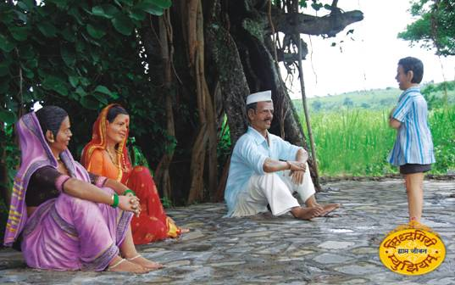
RECITING MANTRAS

Slide 28
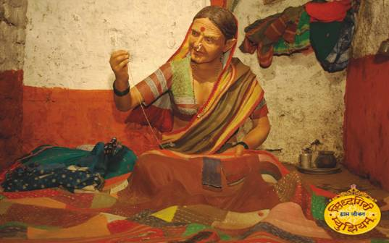
A FEMALE TAILORESS

Slide 29
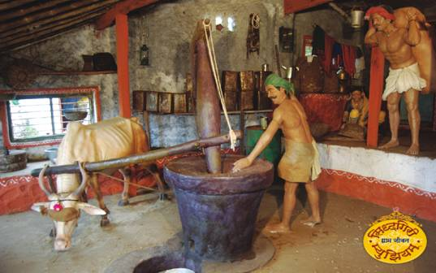
EXTRACTING OIL

Slide 30
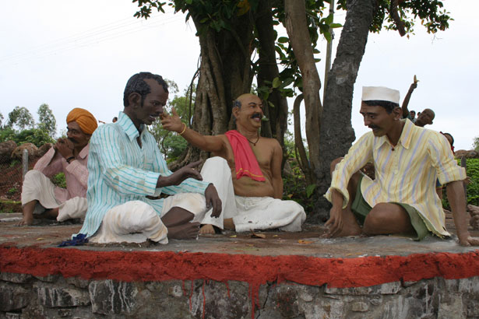
A VILLAGE CHAUPAL – MEETING PLACE

Slide 31
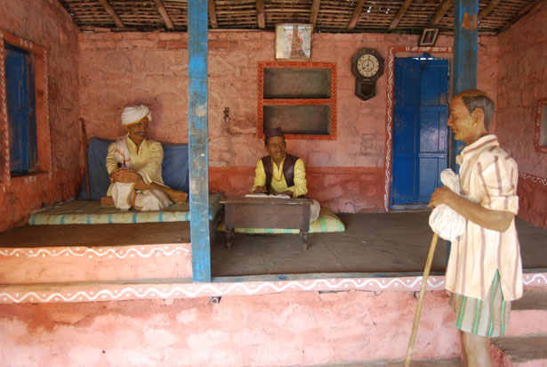
THE MONEYLENDER

