Slide 1

Victorian Houses
By Nailah and Rebecca

Slide 2
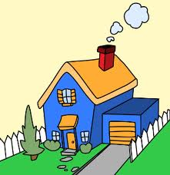
INTRODUCTION
We have been studying victorians houses and decide to make a presentation on victorian houses . We hope you enjoy watching our presentation.

Slide 3
VICTORIAN HOUSES
The Victorian period is the time when Queen Victoria ruled Britain.
With the beginning of the railways and new manufacturing processes, previously locally produced building materials became available all over the country. This meant the end of all houses in the local area being built using the same building materials. Houses made of local stone, timber and straw could now, for example, be built of bricks from Bedfordshire and slate from North Wales.
The new mass produced bricks were cheaper and required less preparation and maintenance, so for the first time all over the country new mansions, chapels, cottages, barns and factories were made from the same material irrespective of region.

Slide 4
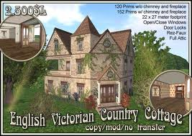
Victorian villas
Rich Victorians favoured villas ( not the same as Roman villas), whilst the emerging middle classes of Victorian England lived in superior terraces with gardens back and front and a room for servants in the attic.

Slide 5
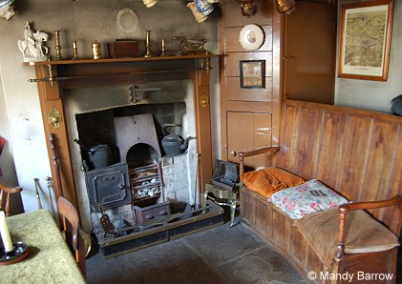
Inside a victorian house
Many people in Victorian times lived in homes without any of the modern comforts we take for granted today. People had to manage without central heating or hot water from the tap – instead they had open fires and heated water on a big cooker called a range.
Most Victorian houses had a fireplace in every room.

Slide 6
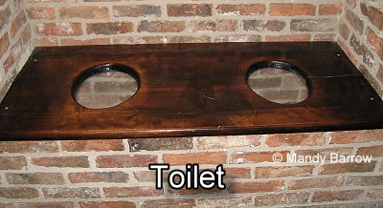
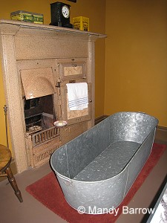
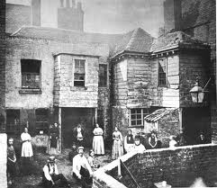
Inside a Poor Victorian House
Not all Victorian houses were nice. Some houses were hardly houses at all. Poor Victorians lived in huts or tiny little flats. Sometimes up to 12 people could live in each flat and sometimes a flat could be as small as 1 room. About 10 flats shared the same toilet. The bath wasn’t a luxury bath like we have today it was like a giant tin dish .

Slide 7
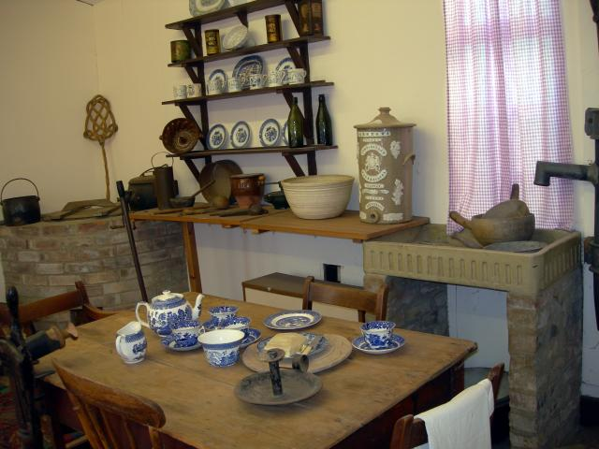
Victorian kitchen
An enormous amount of work was involved in feeding the Victorian family, which usually had a large number of children. Well off families would employ at least one servant. In poorer families the children would help.
All the cutting, chopping, mincing, grating, beating and mixing of food had to be done by hand. By Victorian times a wide range of hand operated implements had been made especially for use in the kitchen.

Slide 8


Thank you for watching

