Slide 1
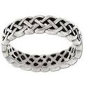
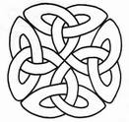
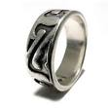
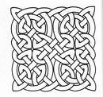
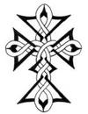
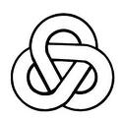
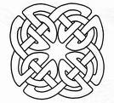
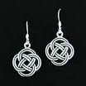
Pattern: Shape: Form: Celtic and India Patterns
This lesson I am learning to..
How a Celtic knot is formed
At the end of the lesson I will have..
Practiced some Celtic knots
I know I have
succeeded because..
I have a variety of patterns and ideas

Slide 2
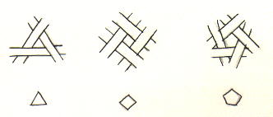
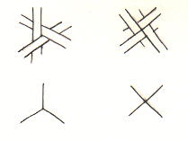
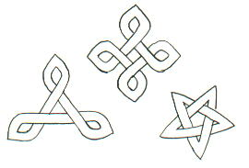

Slide 3
Pattern: Shape: Form: Celtic and India Patterns
This lesson I am learning to.. Know the difference between Indian Mehdi Patterns and and Celtic Knots
At the end of the lesson I will have..
Created a Mehdi Inspired Hand design
I know I have
succeeded because..
I have a variety of patterns and ideas

Slide 4
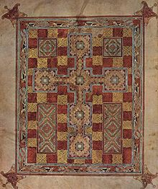
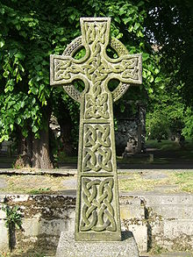
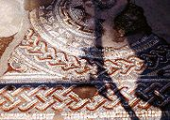
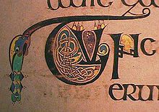
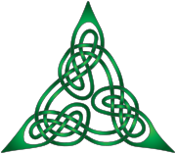
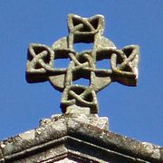
Celtic Knots Stylized Decoration Interlaced Patterns Christian Monuments Manuscripts Ornamental Roman Empire
Celtic Cross
Lindesfarne Mosaic
Roman Mosaic England
Lindesfarne Gospels
Book of Kells
Roman Spain

Slide 5
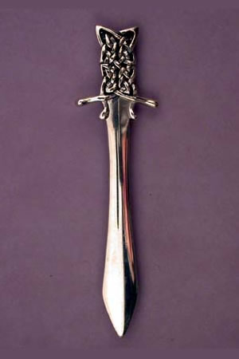
Celtic Knots Stylized Decoration Interlaced Patterns Christian Monuments Manuscripts Ornamental Roman Empire

Slide 6
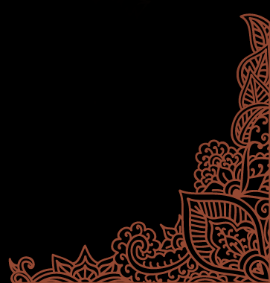
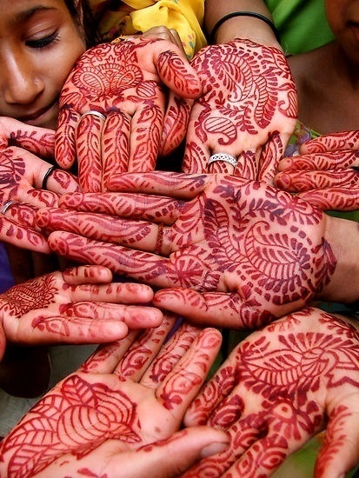
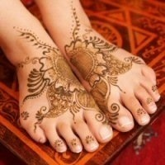
HENNA
Mehndi
Notes:
6

Slide 7
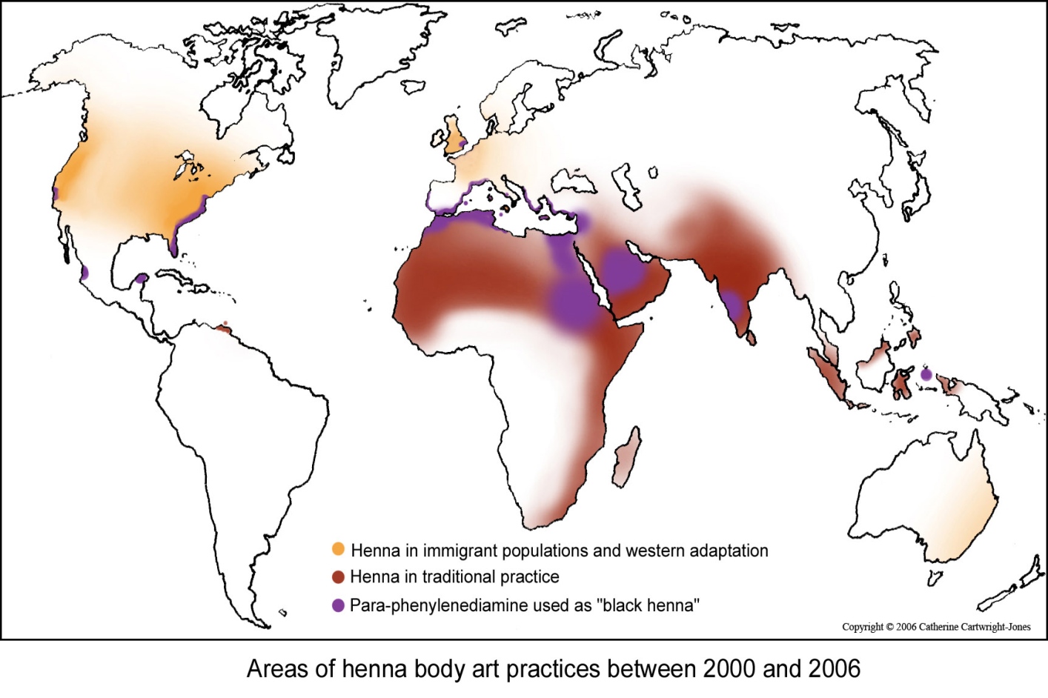
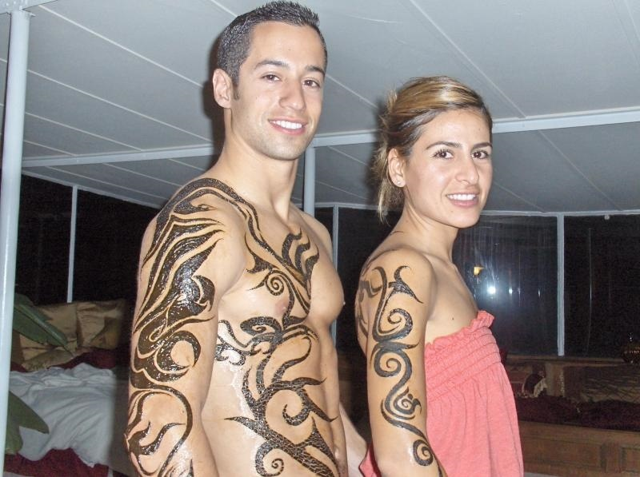
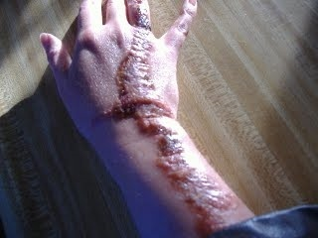
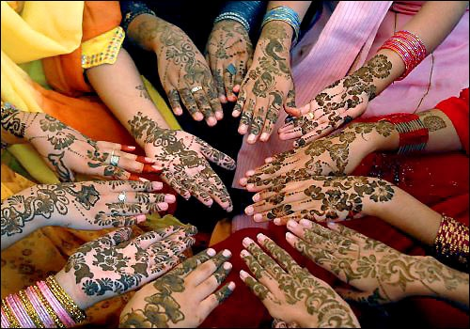
Western Henna
Traditional Henna
Black Henna
Notes:
7

Slide 8
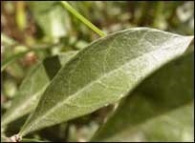
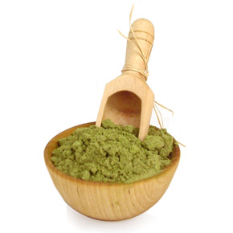
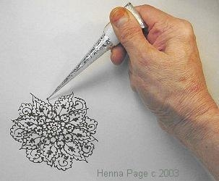
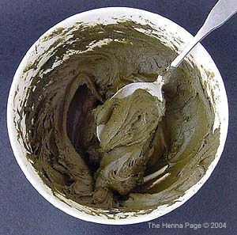
First the leaves
are collected
and dried out.
HENNA
Is made form a plant that grows
in hot climates, for example ;
Africa, Asia and India
Then they are
crushed
into a powder.
Then water and
oils are added
to make a paste.
The henna is then
put into a cone.
Now it is ready to
use to make
temporary Tattoo's
Notes:
8

Slide 9
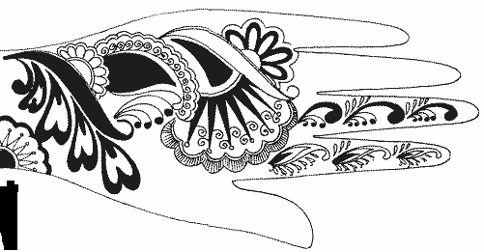
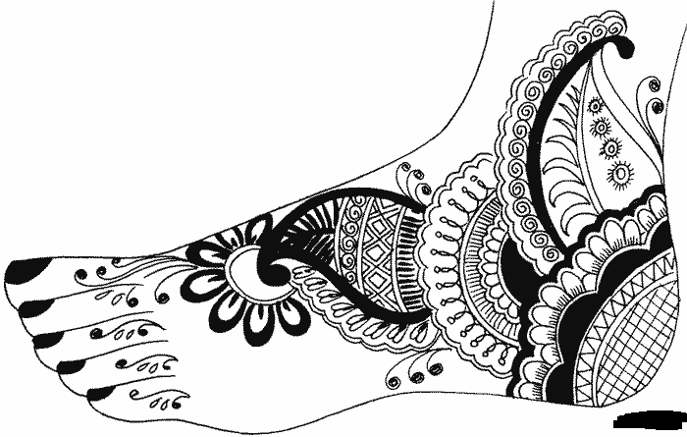
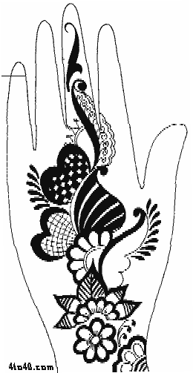
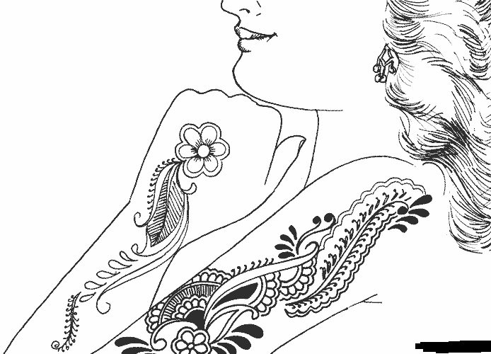
HENNA
Traditional
Notes:
9

Slide 10
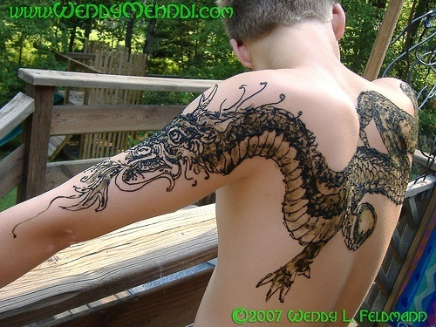
HENNA
Western
Notes:
10

Slide 11
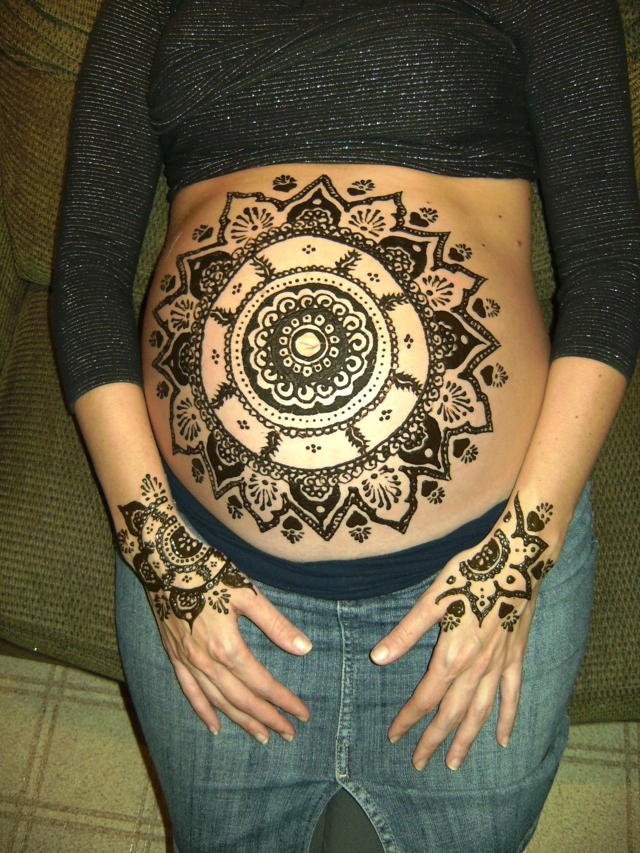
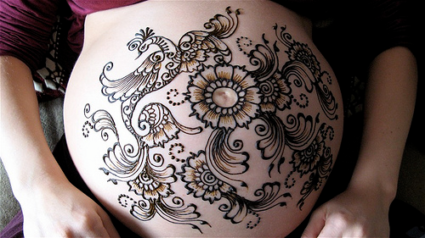
HENNA
Bellies and Hair Dye
Notes:
11

Slide 12
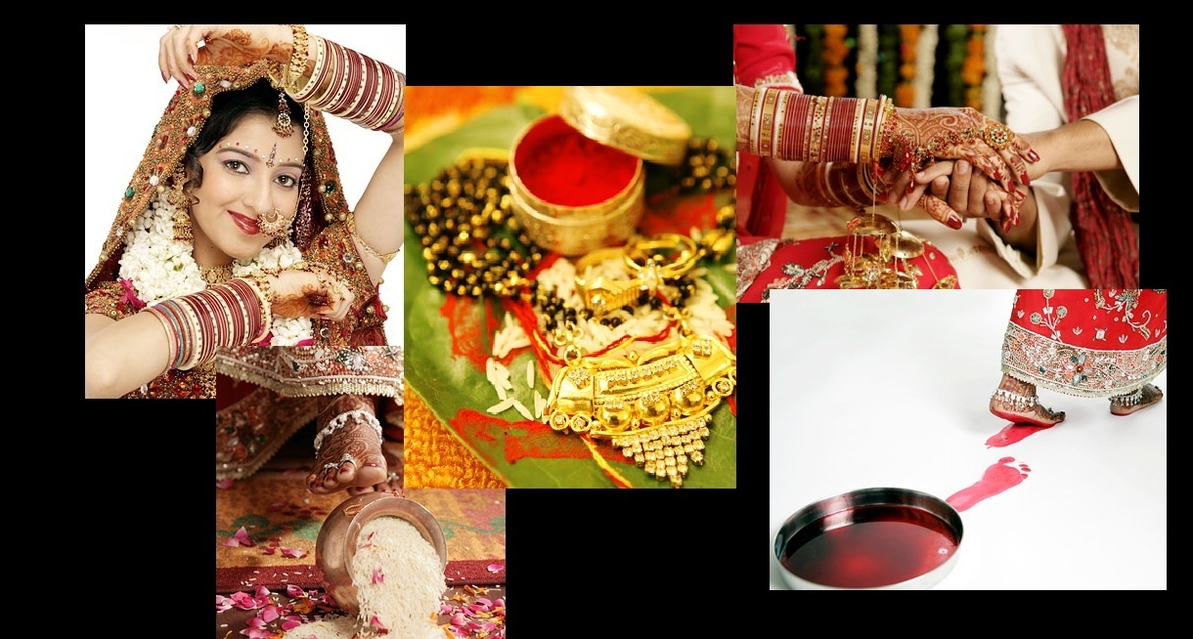
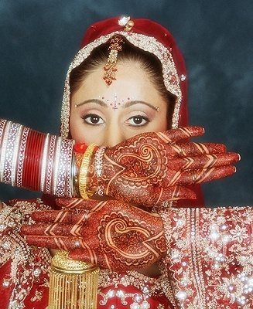
HENNA
Weddings
Notes:
12

