Slide 1
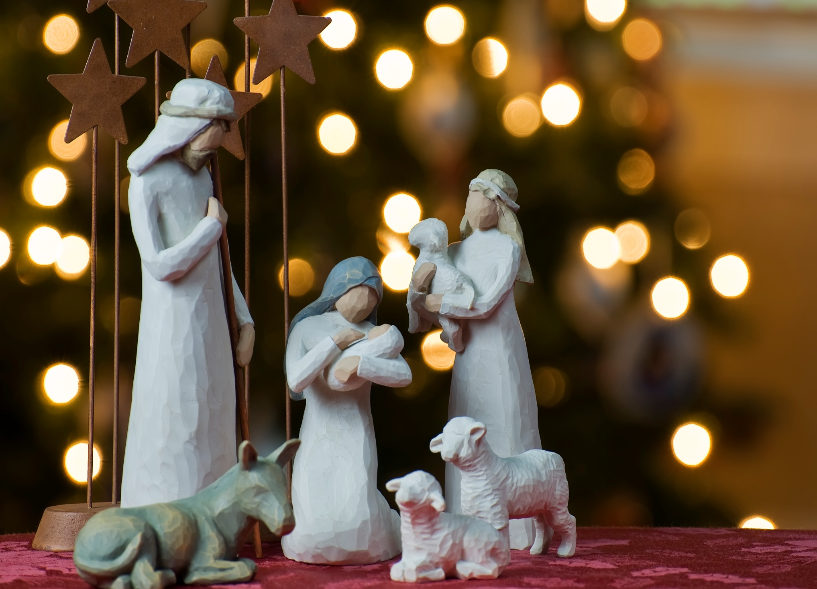
Merry Christmas

Slide 2
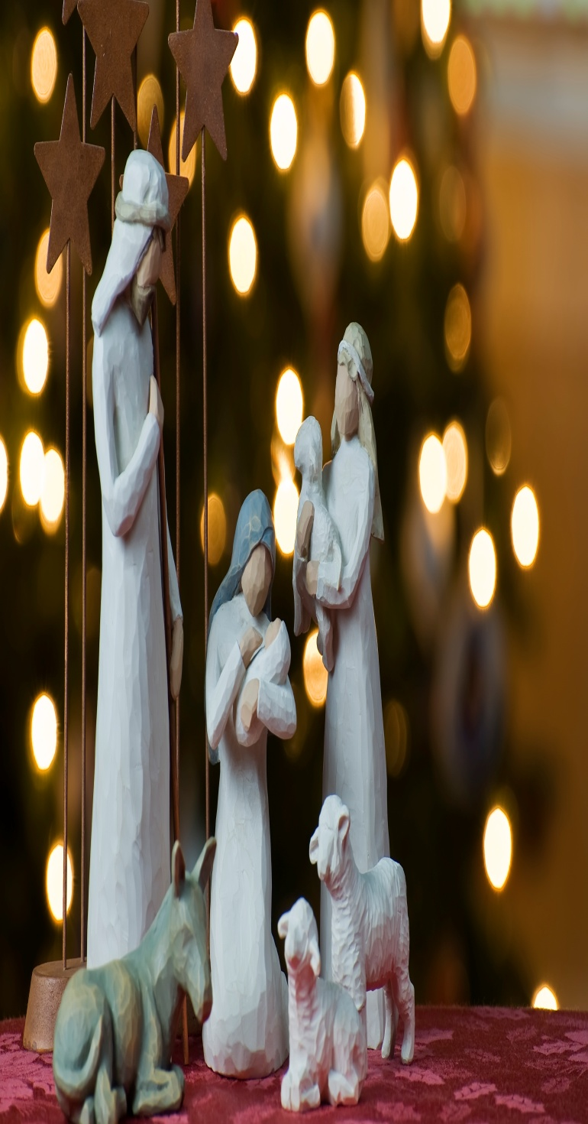
Christmas or Christmas Day (Old English: Crīstesmæsse, literally "Christ‘smass") is an annual commemoration of the birth of Jesus Christ celebrated generally on December 25^{[2][3][4]} as a religious and cultural holiday by billions of people around the world. A feast central to the Christian liturgical year, it closes the Advent season and initiates the twelve days of Christmastide.^{[7]} Christmas is a civil holiday in many of the world's nations,^{[8][9][10]} is celebrated by an increasing number of non-Christians

Slide 3
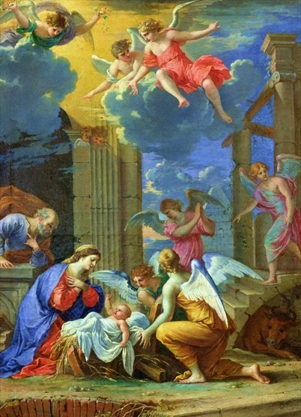
Christmas Day is celebrated as a major festival and public holiday in countries around the world, including many whose populations are mostly non-Christian. In some non-Christian countries, periods of former colonial rule introduced the celebration (e.g. Hong Kong); in others, Christian minorities or foreign cultural influences have led populations to observe the holiday. Countries such as Japan and Korea, where Christmas is popular despite there being only a small number of Christians, have adopted many of the secular aspects of Christmas, such as gift-giving, decorations and Christmas trees.

Slide 4
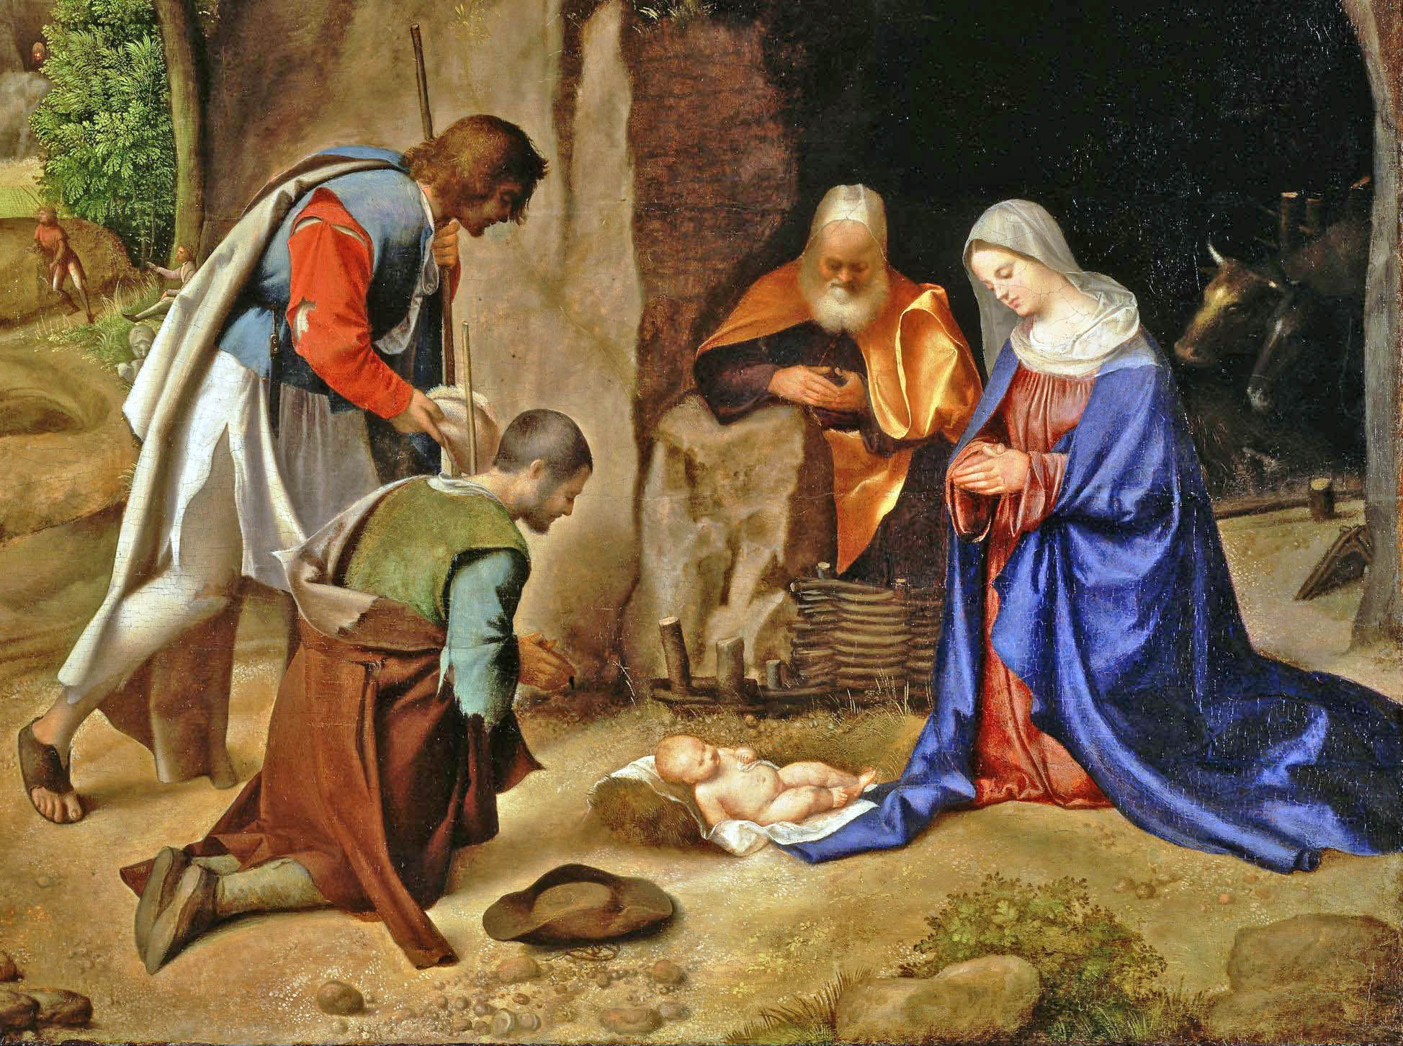
Christians celebrate the birth of Jesus to the Virgin Mary as a fulfillment of the Old Testament's Messianic prophecy.^{[38]} The Bible contains two accounts which describe the events surrounding Jesus' birth. Depending on one's perspective, these accounts either differ from each other or tell two versions of the same story ^{[39]} ^{[40][41][42]} These biblical accounts are found in the Gospel of Matthew, namely Matthew 1:18, and the Gospel of Luke, specifically Luke 1:26 and 2:40. According to these accounts, Jesus was born to Mary, assisted by her husband Joseph, in the city of Bethlehem.

Slide 5
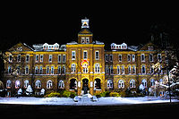
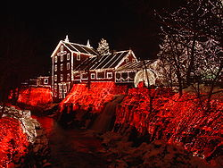
The practice of putting up special decorations at Christmas has a long history. In the 15th century, it was recorded that in London it was the custom at Christmas for every house and all the parish churches to be "decked with holm, ivy, bays, and whatsoever the season of the year afforded to be green".^{[46]} The heart-shaped leaves of ivy were said to symbolize the coming to earth of Jesus, while holly was seen as protection against pagans and witches, its thorns and red berries held to represent the Crown of Thorns worn by Jesus at the crucifixion and the blood he shed

Slide 6
Prepared By:-
Gurleen Dhod
VA

