Slide 1
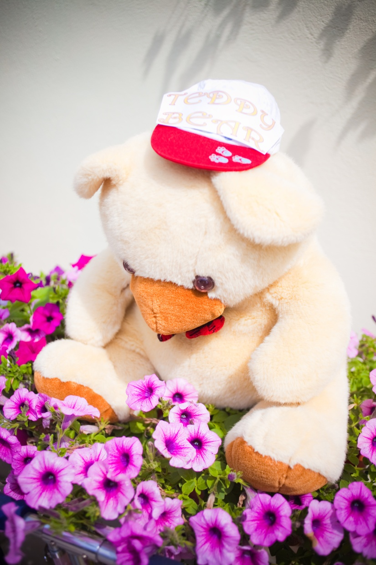
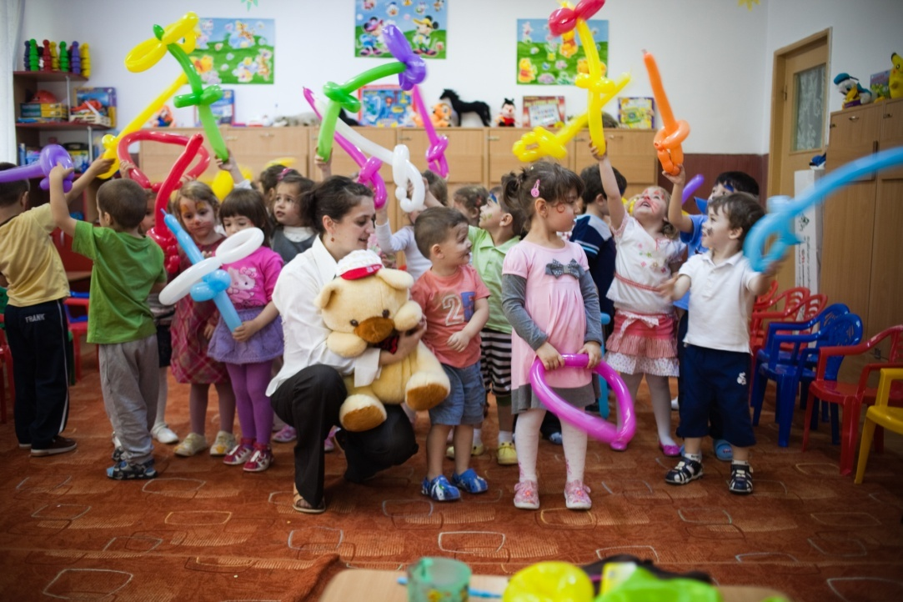
Teddy Bear arrives in Romania
Kids from Blue Flower Kindergarten -Bucharest –Romania, celebrated together with Teddy Bear
The International Children Day.

Slide 2
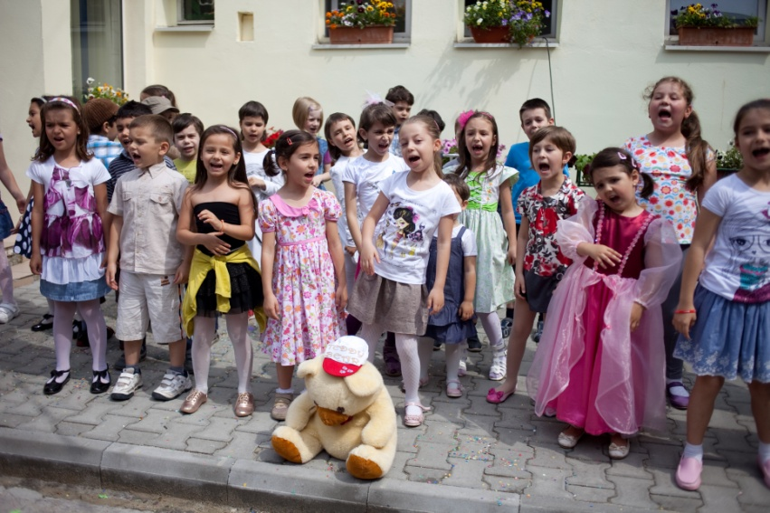
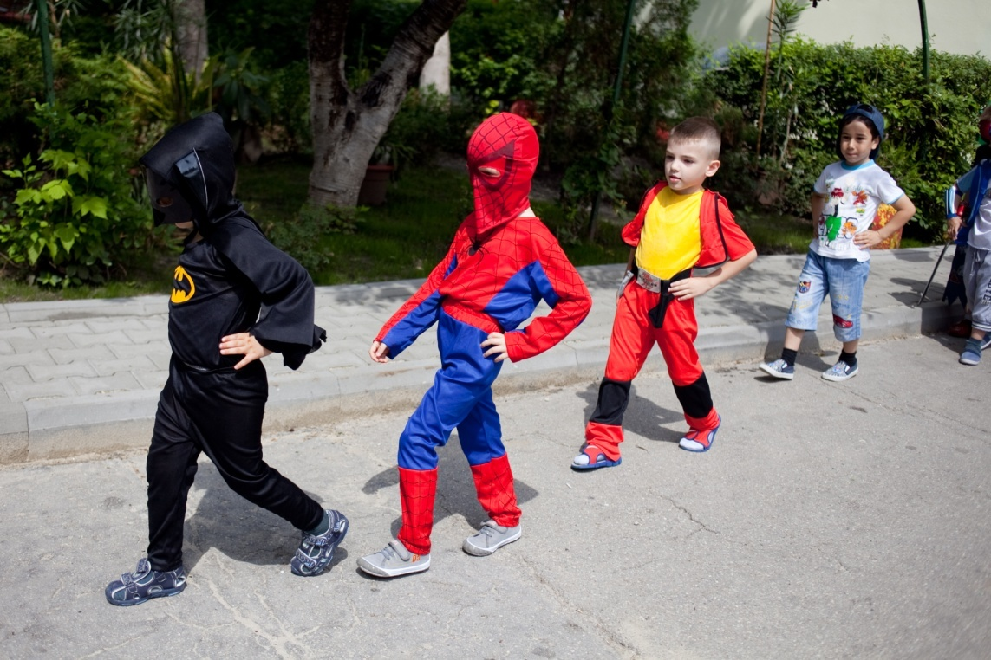
We’ve sang, danced and we’ve presented an exhibition of costumes inspirited by popular characters known by us.

Slide 3
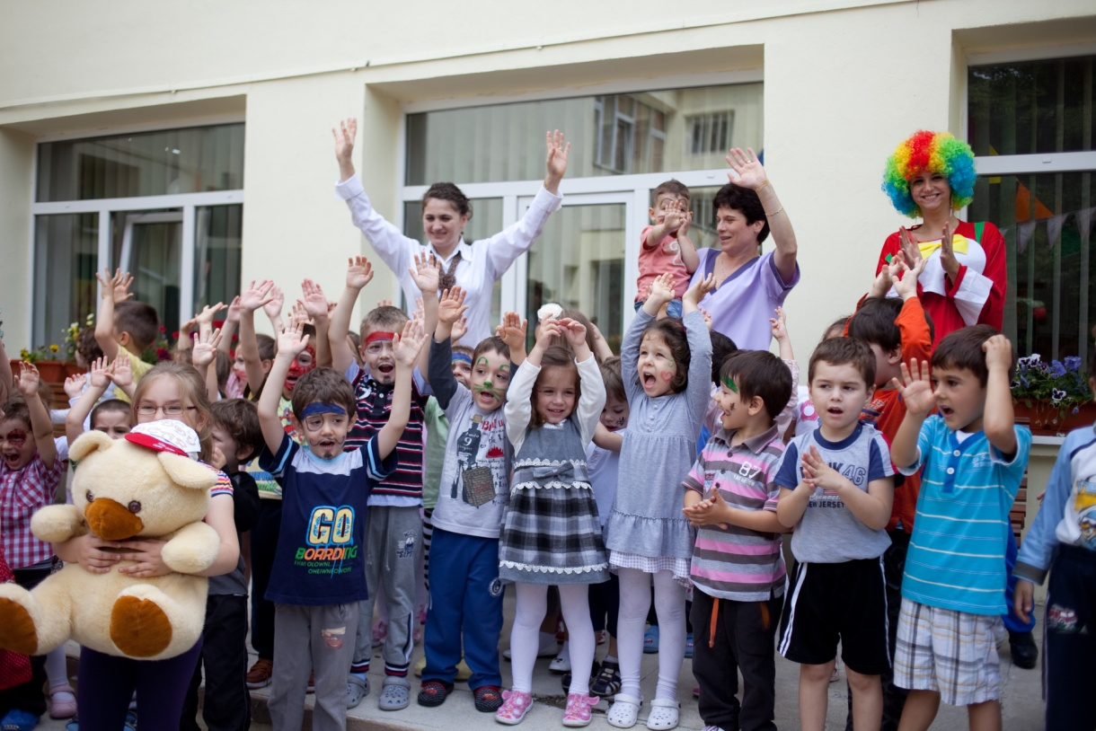
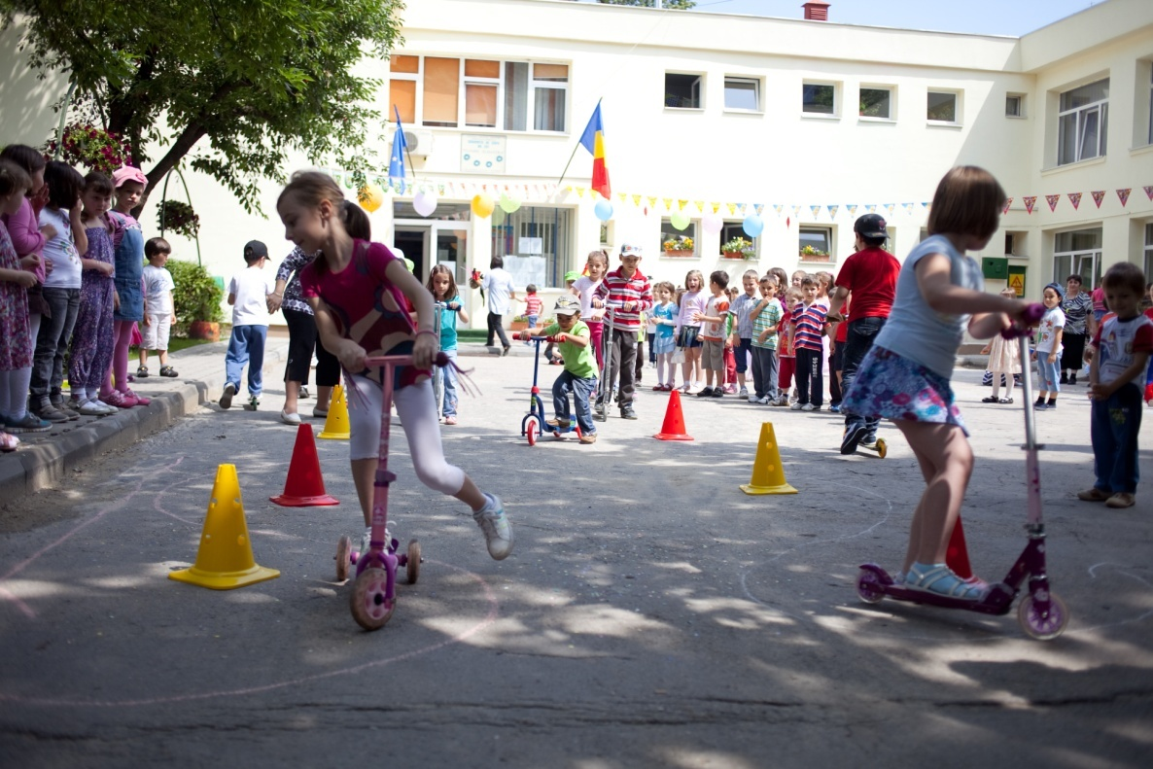
We’ve participated on sports competitions and we cheerily fill up with joy.
Elena asked Teddy Bear :
How was your day? Did you enjoyed your stay?
I had an wonderful day!
I am so happy that I was here today. I am looking forward to see you next time said Teddy Bear.

