Slide 1
Nippon: The Source of the Sun
Welcome to the world of Japan as we take you on a ride to its culture and festivals

Slide 2
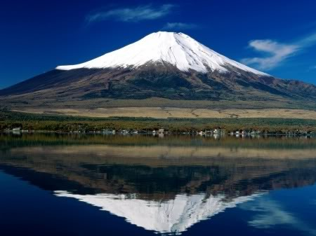
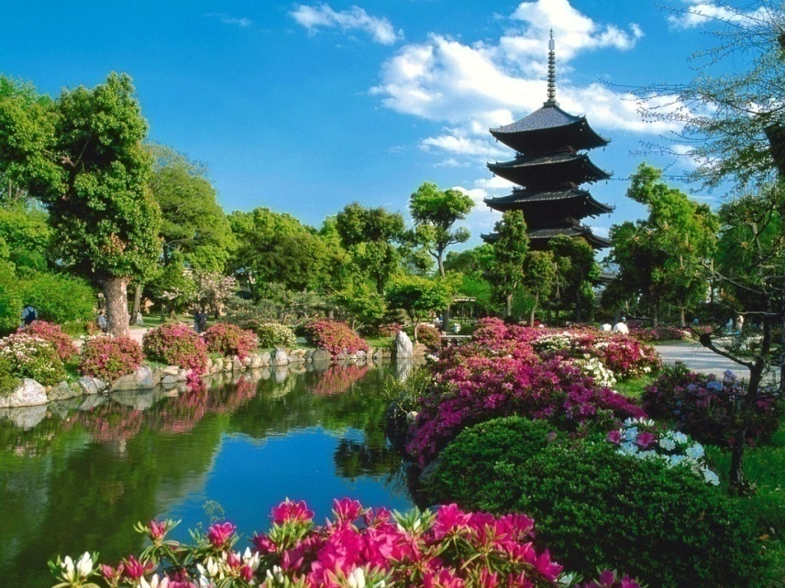
Japan: Overview
Japan is a unique blend of culture and festivals. It houses the oldest religion of the world – Shintoism. This is where you would find the endemic pink-faced monkeys. This is where you would experience the beautiful cherry blossom festival. Thus is the beauty of Japan.

Slide 3
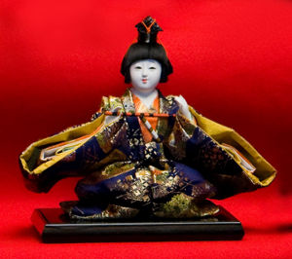
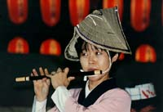
Japan Festivals
Japanese celebrate many festivals like :-
Cherry Blossom
New Years Eve
Doll Festival
Star Festival
Sapporo Snow Festival
Sanja Festival

Slide 4
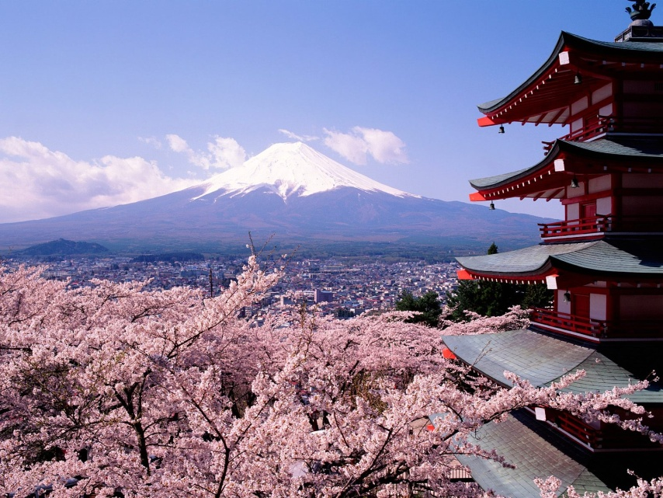
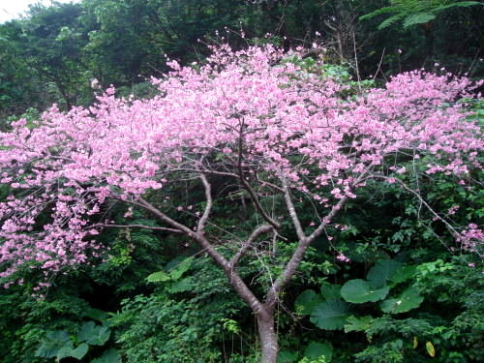
Cherry Blossom Festival
The most beautiful festival in Japan is the cherry blossom festival. It is delightful to watch the trees blossom gorgeous pink flowers giving the tree the look of a giant pink flower itself.
The festival is celebrated with great fervor and enthusiasm; people dance, sing, enjoy and make merry, courtesy to the cherry!
The cherry blossom is a symbol of a short lived beauty in Japan. The climax of this pink party bash is a night time event with a lot of illumination, reflecting cherry blossoms.

Slide 5
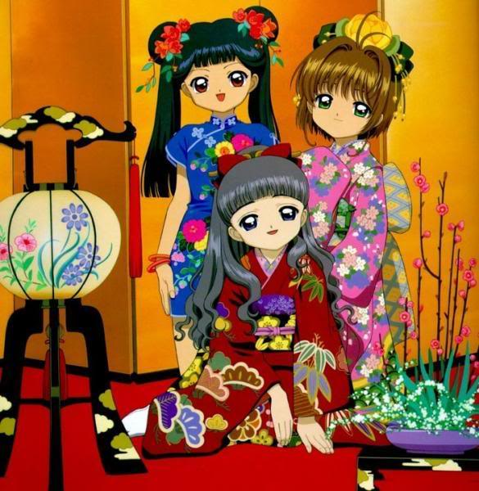
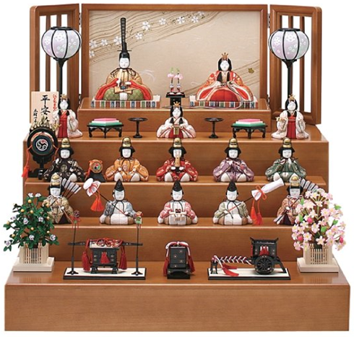
Doll Festival
The doll festival also known as hinamatsuri is held in the spring season on March 3. The Japanese observe this festival to pray for the healthy growth of the young girls in their kimonos and visit friends houses and help arranging the dolls which are of the ancient period kings and queens standing which their attendants on a tiered platform.
For the feast its usually the diamond shaped rice cakes and rice malt sakes. Young girls sing, dance and enjoy their childhood.

Slide 6
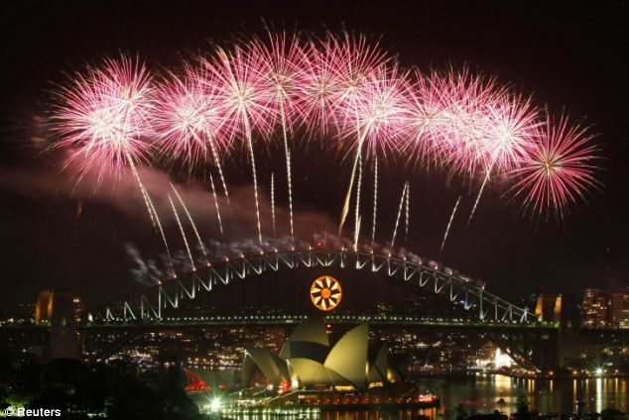
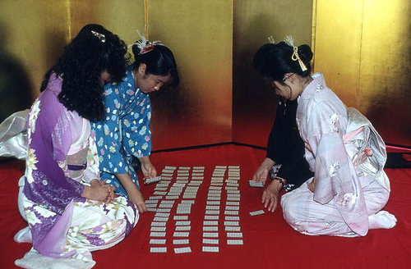
Japanese New Year
The Japanese celebrate New Years Day on Jan 1 each Year. Japanese people eat a special selection of dishes during the New Year celebrations called osechi, a soup called ozoni and sweetish, they have a ritual of sending postcards to their near and dear ones.
The Japanese have a custom of giving money to children on new years day in decorated Envelopes some shops give free gifts to spread happiness wherever they can.

Slide 7
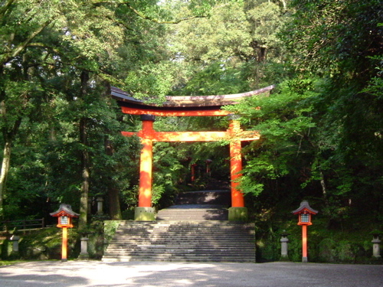
Japan Religions
The main religions of the Japanese are Shintoism, the oldest in the world and the Buddhism. The word Shinto means "Way of the Gods". Shinto is a religion in where practice (actions) and ritual, rather than words, are of the utmost importance. Shinto is characterized by the worship of nature, ancestors, with a strong focus on ritual purity, involving honoring and celebrating the existence of Kami. Kami are defined in English as "spirit", "essence" or "deities” that are associated with many understood formats.

Slide 8
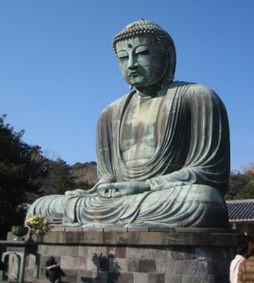
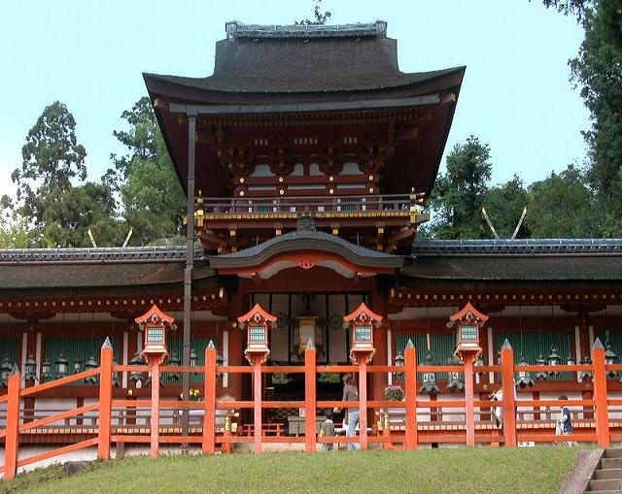
Japan Religions
It is generally accepted that the vast majority of Japanese people take part in Shinto rituals, while most would also practice Buddhist ancestor worship. Due to the syncretic nature of Shinto and Buddhism, most "life" events are handled by Shinto and "death" or "afterlife" events are handled by Buddhism -- for example, it is typical in Japan to register or celebrate a birth at a Shinto shrine, while funeral arrangements are generally dictated by Buddhist tradition

Slide 9
Nippon: The Source of the Sun
Thank You
Class – VIII-A
Class teacher – Ms. Snehlata Vashisht

