Slide 1
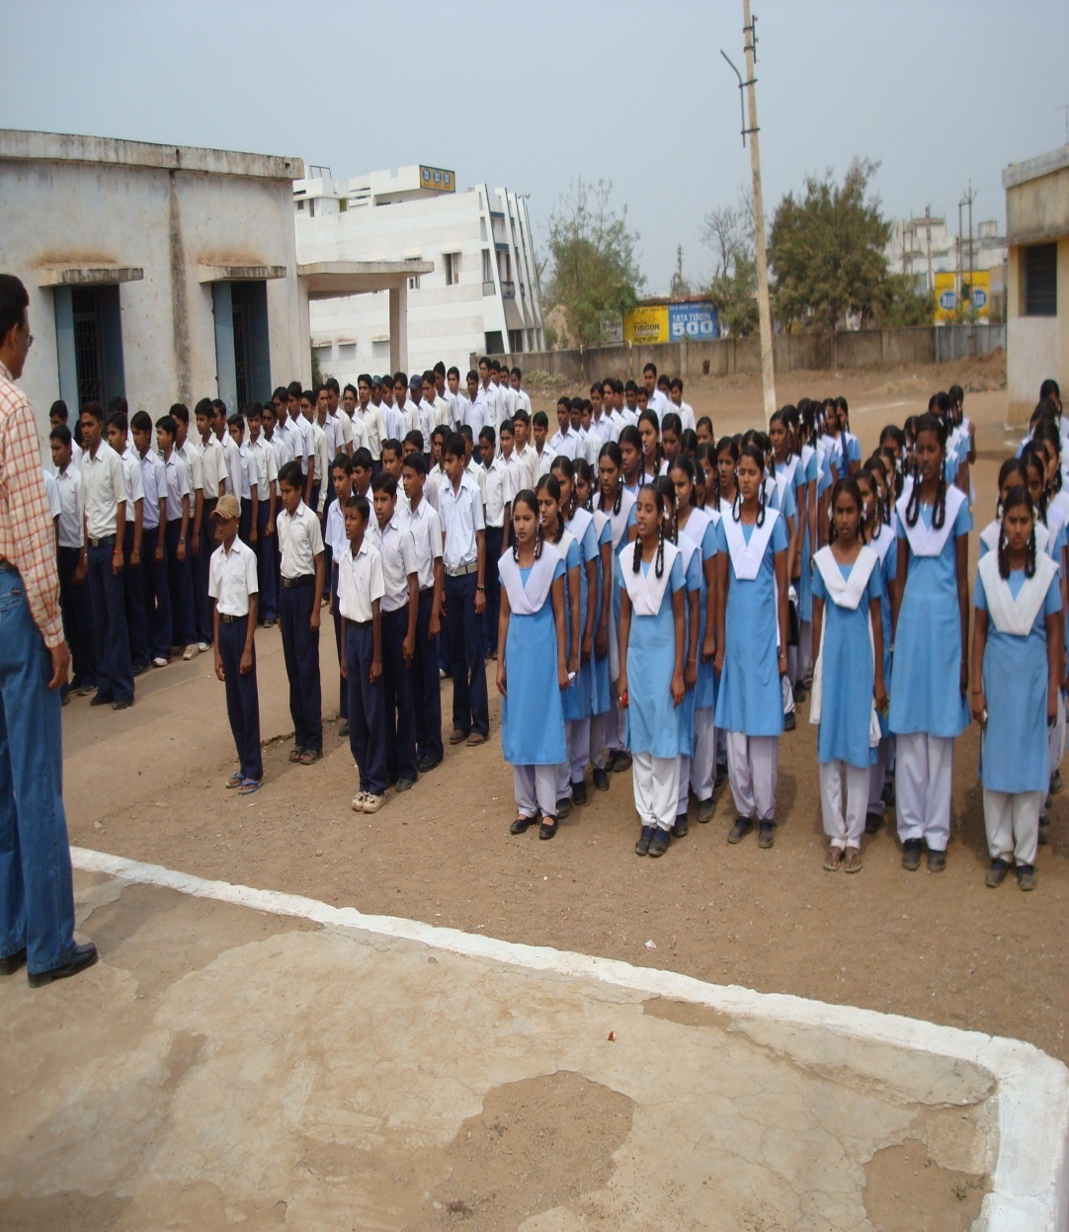
School at a glance
The vision of our school is to make good quality education available , accessible and affordable to all the students .To achieve this vision our school is trying to develop the potential of every individual child .So that our student become independent minded and socially aware adult ,equipped with knowledge ,skill and attitude which help them lead a full life as a best citizen and play a positive role in the life of community.

Slide 2
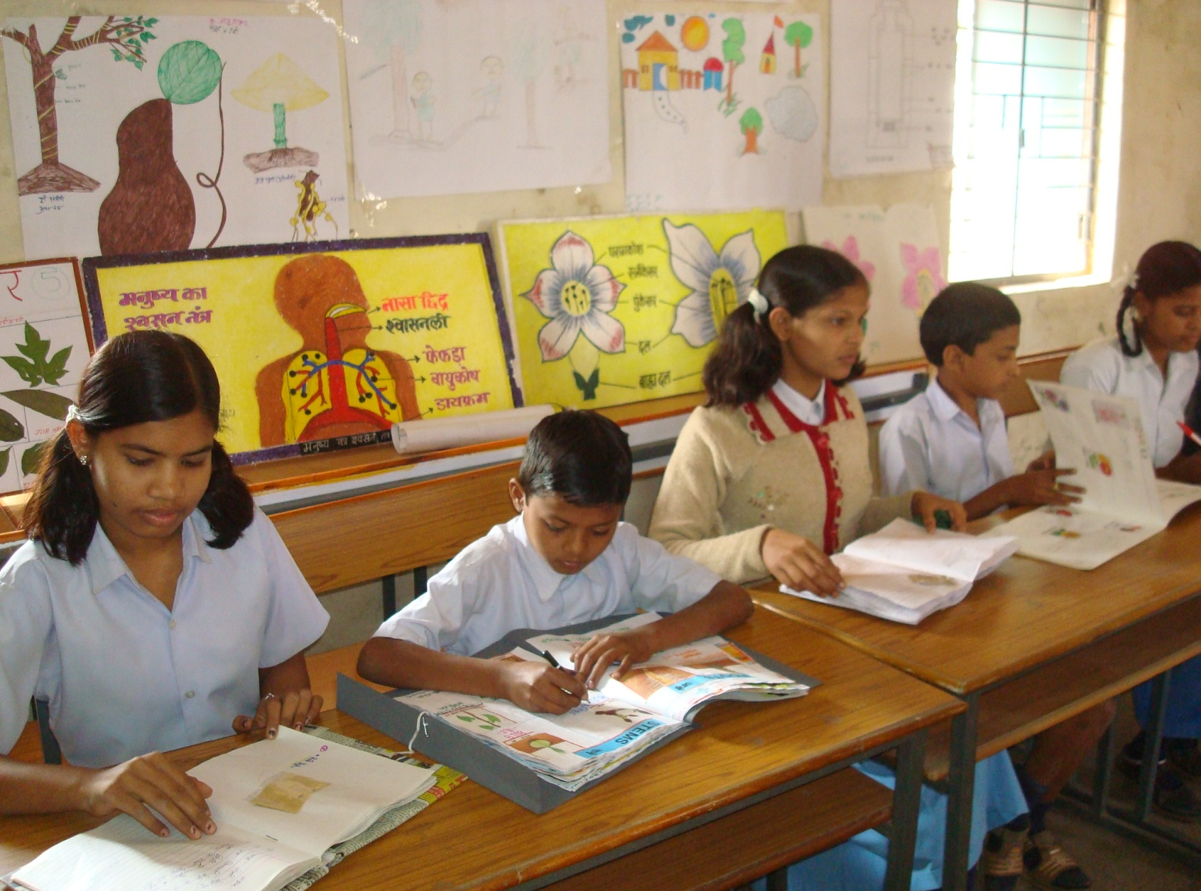
As a whole our effort is to develop mental capability with a analytic
view of the students towards any subject with a winning approach.

Slide 3
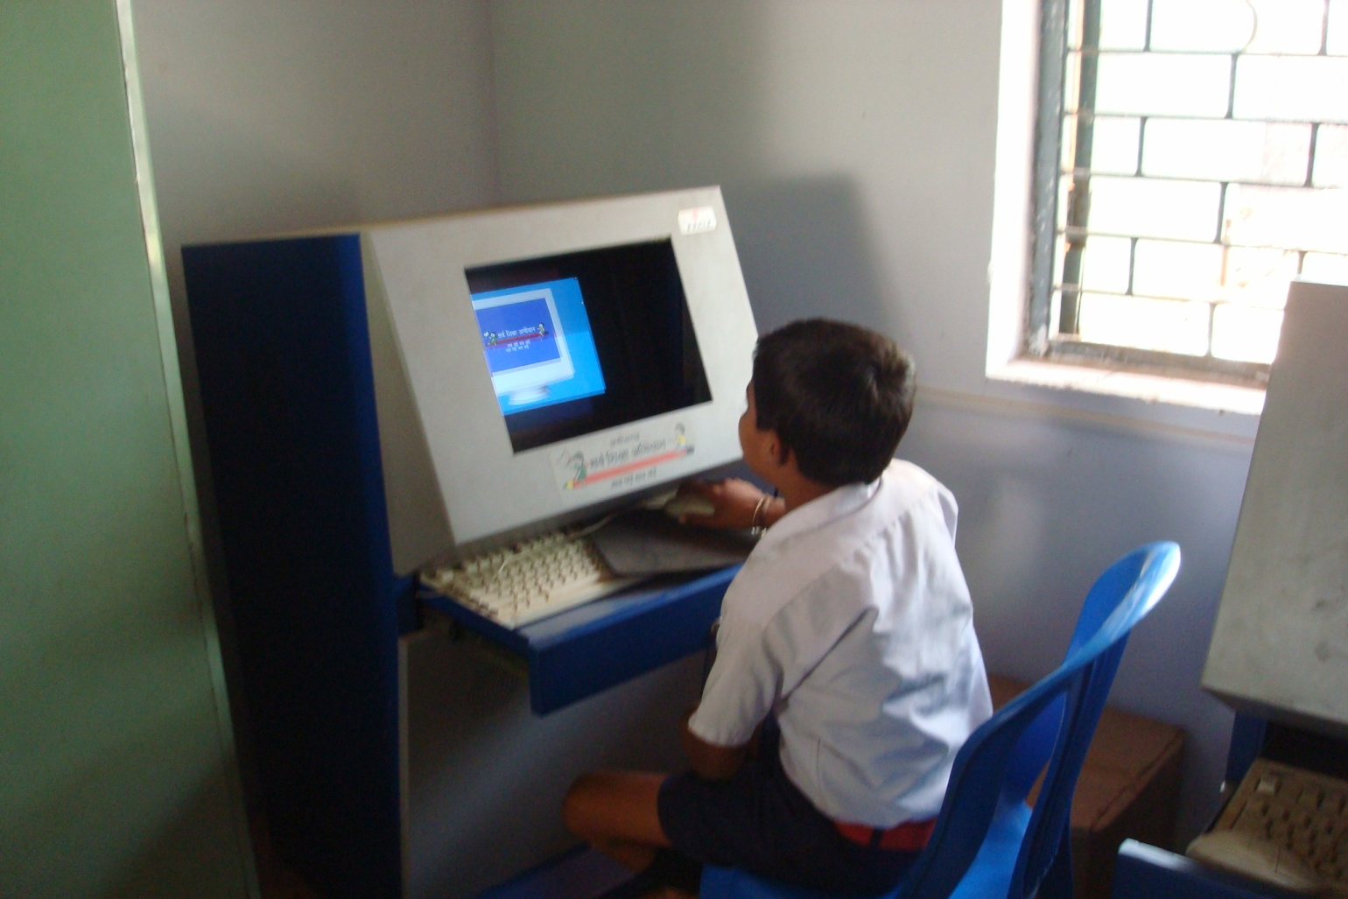
Students in our school should develop literacy, numeracy, thinking , reasoning skills, learning skill to acquire knowledge, practical and technical skill .As well as social, political ,civic awareness ,cultural and aesthetic awareness should also be develop

Slide 4
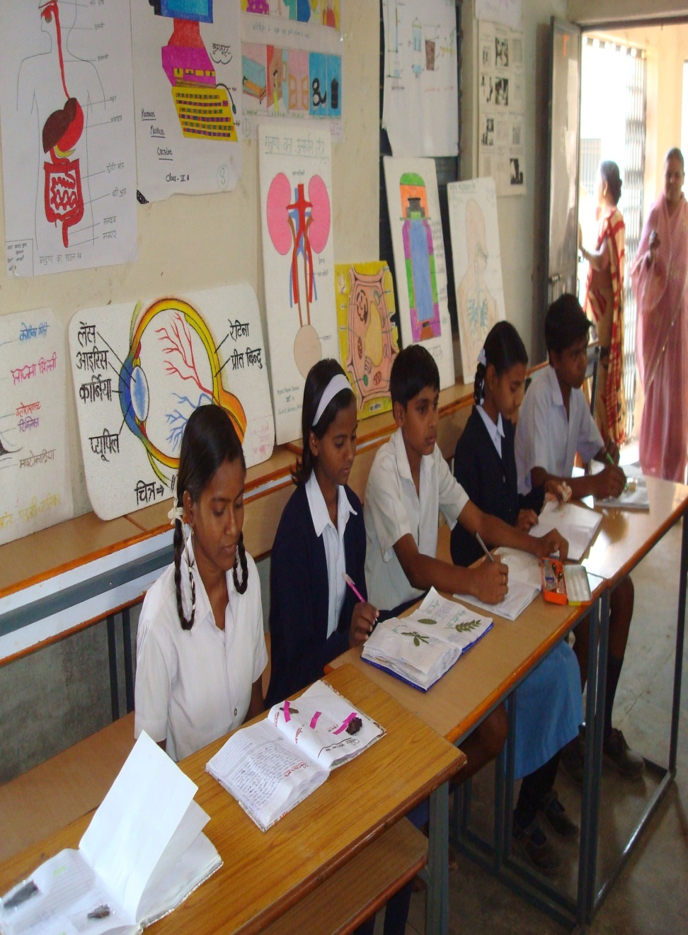
OUR MOTO ….? “TEACH CONCEPT RATHER THAN CONTENT”
We have a responsibility to our children to prepare them for the demands of the 21 ^{st} century. Outdated structures and approaches must be replaced with engaging ,contents rich experiences that will enable our students to achieve at higher levels and to compete successfully in the world.

Slide 5
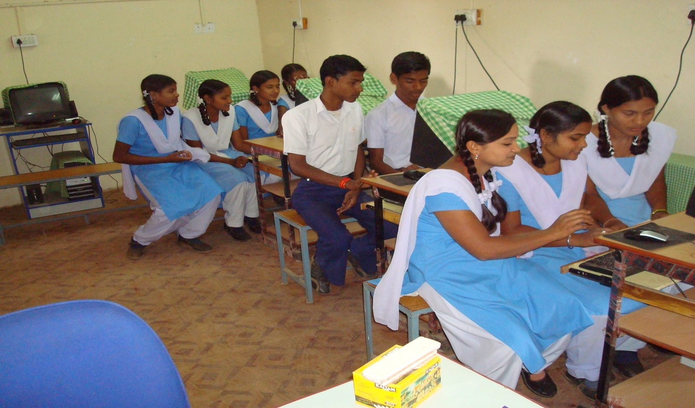
ICT IN SCHOOLS
The ICT policy in education sets out clear goal and priorities for school education .Within these goals ,institutional development level are articulated and targets for each school. For implementing ICT in schools development levels have also been established .

Slide 6
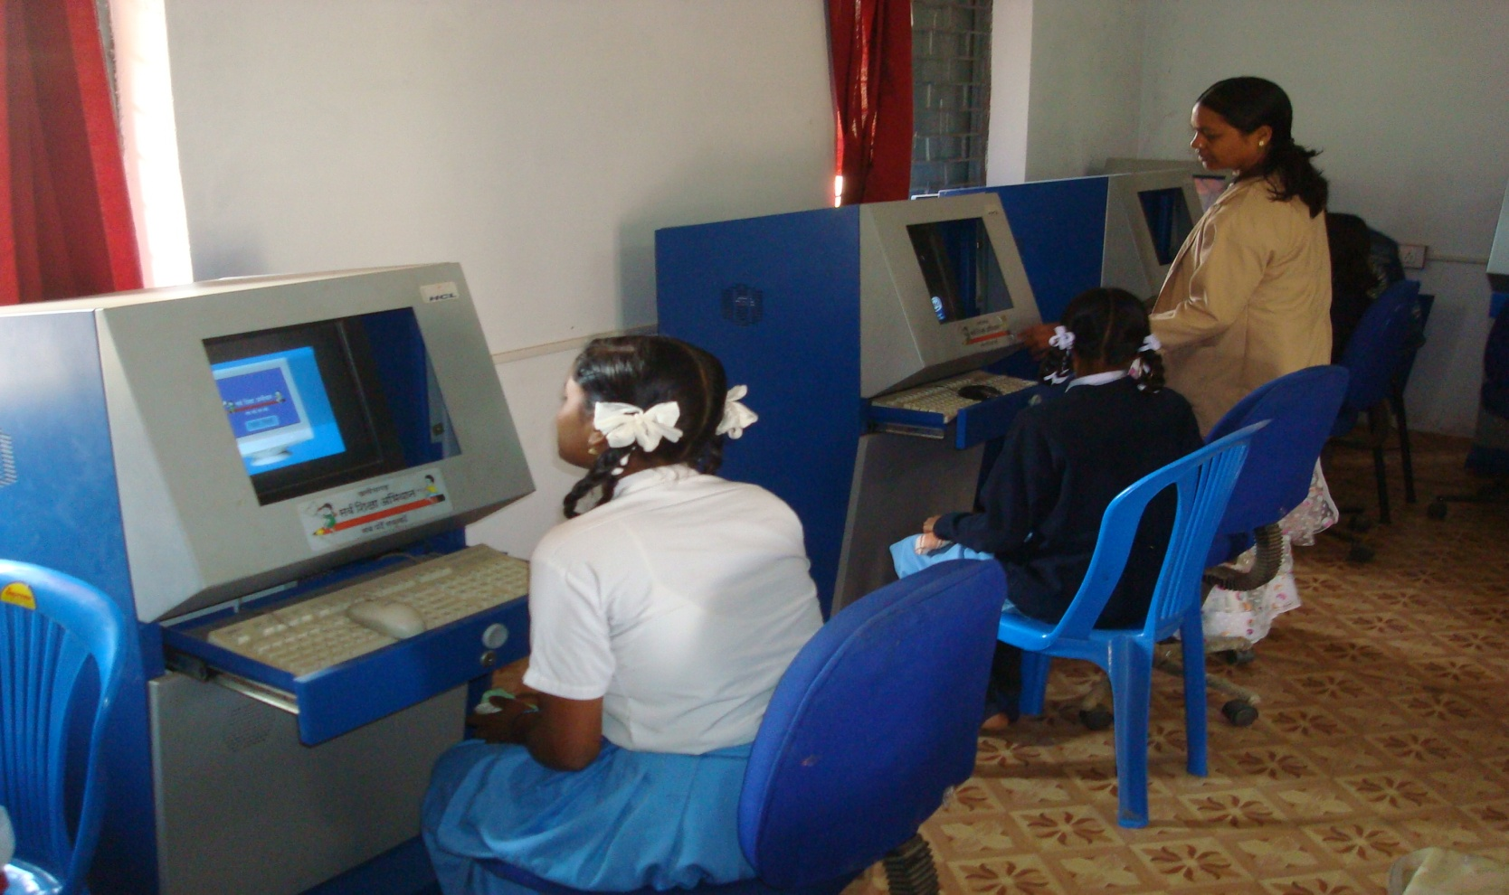
Guiaence and counseling: guidance and counseling in school is very essencial In terms of its proactive as well as remedial role .Guidance and counseling service can help in promoting students retention ,and better scholastic performance in curricular areas facilitating adjustment and career development of student developing right attitudes towards studies and self work.
For stress release of students teaching should be done for 5 days and I day should be for co-scholastic activities i.e. yoga ,cultural and sports work shops,etc.

Slide 7
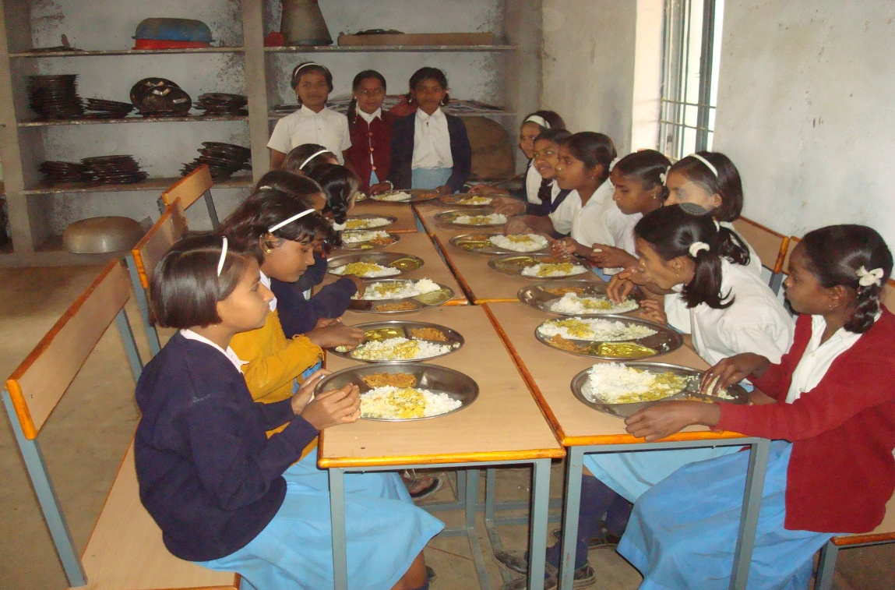
MID DAY MEAL IN SCHOOLS
The main objective of the mid day meal scheme is to boost
enrolment and reduce drop-outs.
Our government is providing every child of age group 6-14
Very nutritious meal every day

Slide 8
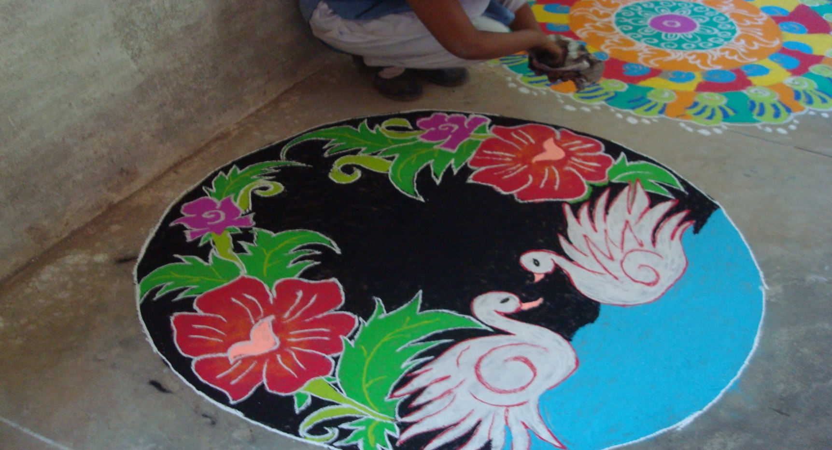
THE FUTURE
We cannot always build the future of our
students
But we can build our students for future

