Slide 1
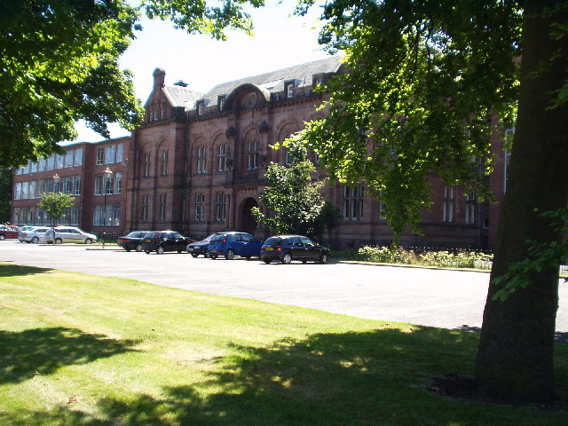
Paisley grammar
By Ismail Nizami

Slide 2
Contents
Introduction
All about me
Night before school
First day of school
The subjects that I study
Other aspects of the school
Extra curricular activities
Conclusion

Slide 3
INTRODUCTION
I am going to tell you about my first impression at Paisley Grammar and I hope you enjoy my presentation.

Slide 4
All about me
Hi my name is Ismail Nizami. I am 12 years old and I am in S1. I have got black hair and light brown eyes.

Slide 5
The night before school
I was really excited starting a new school but I was also scared because it is a new school for me and I had so much responsibility like carrying my school bag to every class instead of leaving it one class or going out for lunch.

Slide 6
First day at school
I was really scared and nervous because everyone kept on staring at me and it was a new school and I did not know anyone.

Slide 7
After a few days
After few days I was fine and happy because I made lots of friends and I got used to the school .

Slide 8
THE SUBJECTS IS STUDY
The subjects I study are:
English, P.E., German, music, geography, math, science, computing, wood work, art, F.T.T., RE.
My favourite subjects are computing, woodwork and F.T.T and R.E.

Slide 9
COMPUTING
I like computing because I am very good at
computer.
At computing we do all sorts of work on the computers like power points, spreadsheets, and table

Slide 10
WOOD WORK
I like woodwork because it is fun making stuff out of wood and it is and it is an amazing subject .
In woodwork you make stuff out of wood like candle holders and spatula s.

Slide 11
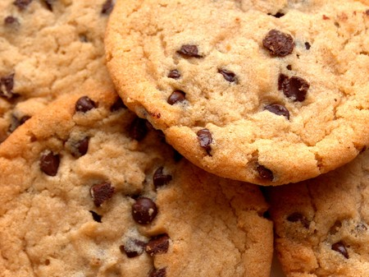
F.T.T.
Food Technology and Textiles (F.T.T.) is where you learn to cook and sew.
I like F.T.T . Because I am good at cooking and I have good skills in cooking and it is fun!
In F.T.T. you cook a lot of things like apple crumble, chocolate chip cookies, etc.

Slide 12
R.M.E.
I LIKE RME BECAUSE IT IS FUN LEARNING ABIUT DIFFERENT R ELIGIONS AND KNOW MORE ABOUT RELIGIONS.

Slide 13
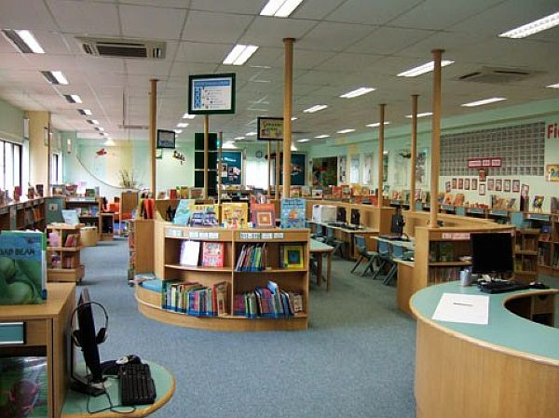
OTHER ASPECTS OF THE SCHOOL
THERE ARE MANY ASPECTS OF THE SCHOOL LIKE CANTEEN, LIBRARY, MUSIC ROOM, MEMORIAL HALL AND MUCH MORE !

Slide 14
EXTRA- CURRICULAR ACTIVITES
I AM IN THE ECO COMITEE GROUP. IN THE ECO COMMITEE WE DECIDE TO HAVE A ECO WEEK EVERY YEAR AND WE DO A RECYCLING FASHION SHOW.
THERE ARE OTHER EXTRA CURRICULAR LIKE PUPIL COUNCIL.

Slide 15
THE END

Slide 16
Conclusion
I hope you like my presentations and it has given you good information about Paisley Grammar.

