Slide 1
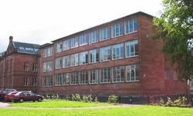
Paisley Grammar School
1.9
By Shreya and Sabrina

Slide 2
Hello
We are going to tell you about Paisley Grammar School.
We enjoy coming to school a lot , we've got a lot of stuff to do. There are so many clubs to go to if you are bored or anything. We also have a homework club if you are needing any help. We also have a library where you can go on the computer also take out books. Mrs Gordon is the teacher that runs the library.
READ ON TO FIND OUT MORE ...

Slide 3
General Information
Name – Paisley Grammar school
Address- Glasgow road, paisley
Postcode-PA1 3RP
Email Address- enquiries@paisley-gs.renfrewshire.sch.uk
Phone number- 01418893484
Fax Number- 01418872059
Head Teacher- Caroline Amos

Slide 4
School Clothing
Navy blue Blazer with school badge
White or light blue blouse or shirt
School tie
Navy blue/black skirt
Black tailored trousers or tailored shorts
Navy blue v-neck pullover or v-neck sweatshirt
Black shoes
PE Kit
Pale blue polo shirt with school badge
Navy blue shorts or track suits
Training shoes

Slide 5
Clubs
Netball – s1 to s6
Basketball – s1 to s6
Football – s1 to s6 (Boys and Girls)
Street dance
Running
Movie club
Multi Cultural group
Science club
Quiz club

Slide 6
Departments
Science
Biology
Physics
Chemistry
English
Maths
Technical
Graphics and Design
Wood Tech
Food text Textiles
Music
Art
Physical Education
I.T
Religious Education
Personal and social education
Modern languages
German
French
Social subjects
Geography
History
Modern studies

Slide 7
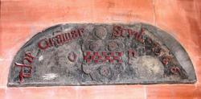
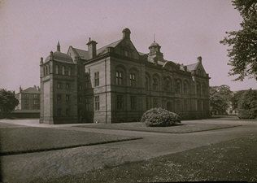
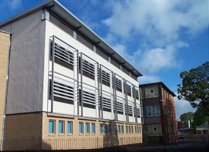
Picture Gallery
Paisley grammar in 1930.
School Badge
Paisley grammar now

Slide 8
Thank you for looking at our PowerPoint.
We hope you have enjoyed it.
☺

