Slide 2
Introduction
Paisley Grammar is a
good school, we study
a variety of different
subjects in 1st year like:
Technical
Modern Languages
English
I.T
Social Subjects
Maths
Science
Art
Music
F.T.T
Religious Education
P.E
PSE
I.D

Slide 3
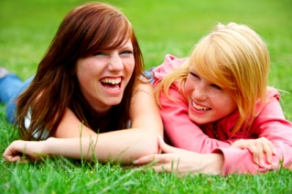
First Impressions
My first impression of Paisley Grammar that it was a
HUGE building compared to my primary school but you
get used to it after a while.
I also liked meeting new people and gaining new friends
and sometimes losing old ones.
I personally love the music department because of it’s
variety of instruments and we’re very lucky with all
the equipment we get.
I felt nervous and confused by not knowing what to do
our say but I settled in fairly quickly and have lots of
good friends!

Slide 4
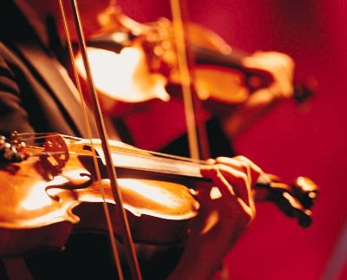
Subjects
My favourite subjects are art, english and music.
English: English is not just about reading and writing it’s
about stuff like literacy too. I love english because I
love reading all kinds of different stories.
Music: At music in 1st year you get to learn to play two
instruments and play them all the way up to 2nd year.
You also get the opportunity to join loads of bands
and orchestras too.
Art: I’ve always loved art, ever since I was 2 years old I
drew. Apparently I’m good at it but all you do is practise
and that will help you.

Slide 5
Conclusion
Paisley grammar is a great school and we are very lucky with all the facilities we have here.
So I hope you enjoyed watching this!

