Slide 1
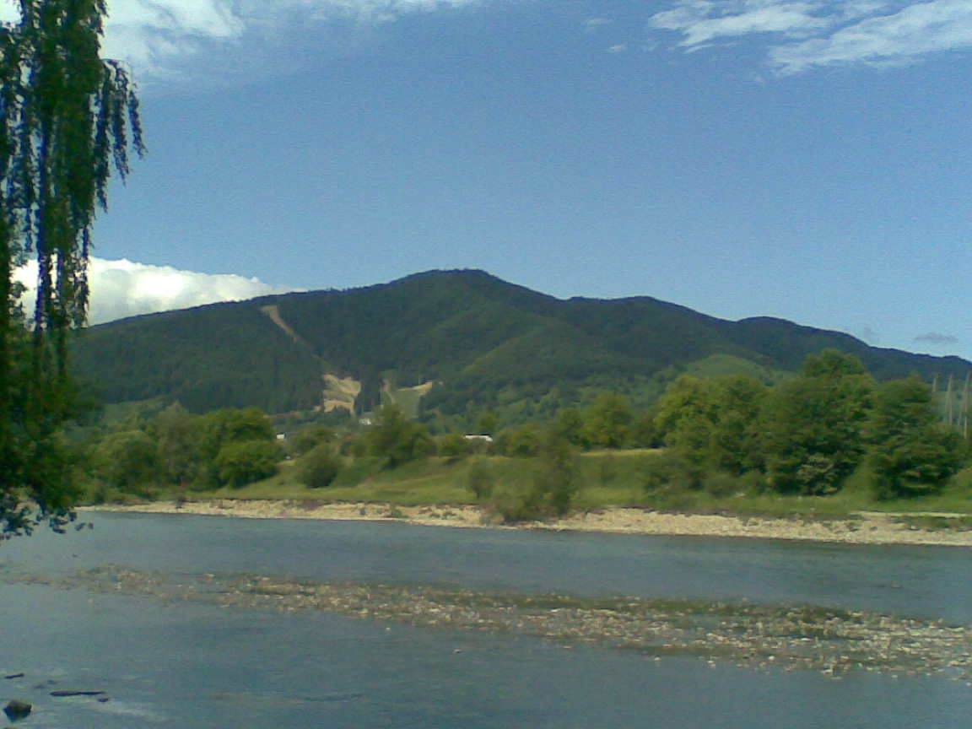
DREAM DESTINATION

Slide 2
Aim Summary
The project Dream Destination is a part of the international online project with the same title. The aim of this project is to study the places in different countries for educational, tourist and historic purposes. The project is to promote global culture, assimilate beneficial aspects of different cultures.
Our contribution is about Bukovyna and Chernivtsi as tourist dream destination. Preparing our resources we tried to show tourist attractions for people with various interests, to present the beauty of our nature, historical sights, places to go and things to do. So our project consists of five parts.

Slide 3

Welcome to Bukovyna!

Slide 4
A TOWN FOR ALL SEASONS

Slide 5
CHERNIVTSI – HISTORY IN STONE
Chernivtsi attracts attention of visitors by beauty of ancient architecture

Slide 6
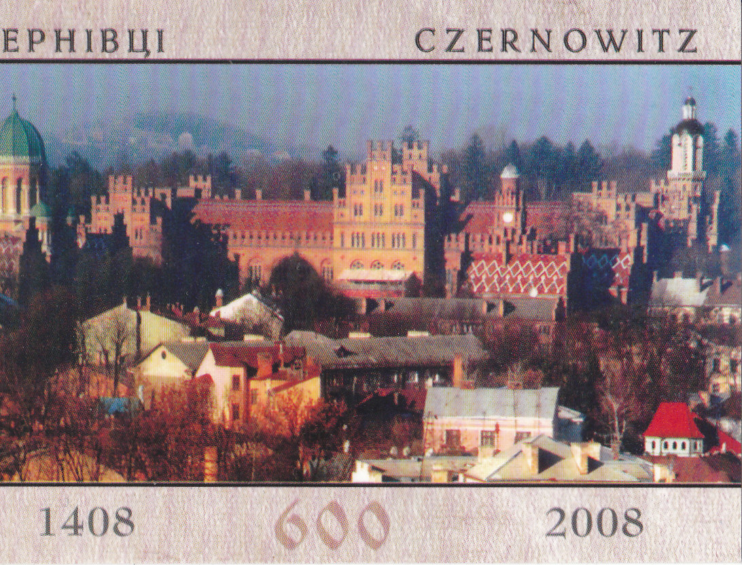
THE OLD CENTRE OF OUR TOWN
Many historical buildings in Chernivtsi are real works of art – churches, cathedrals, museums, administrative buildings and apartment houses.
Chernivtsi is one of the few cities in Ukraine with such a number of monuments of architecture.
Most of the monuments are in the old centre of our town – in Olha Kobylianska Street, I.Franko Street, Holovna Street.

Slide 7
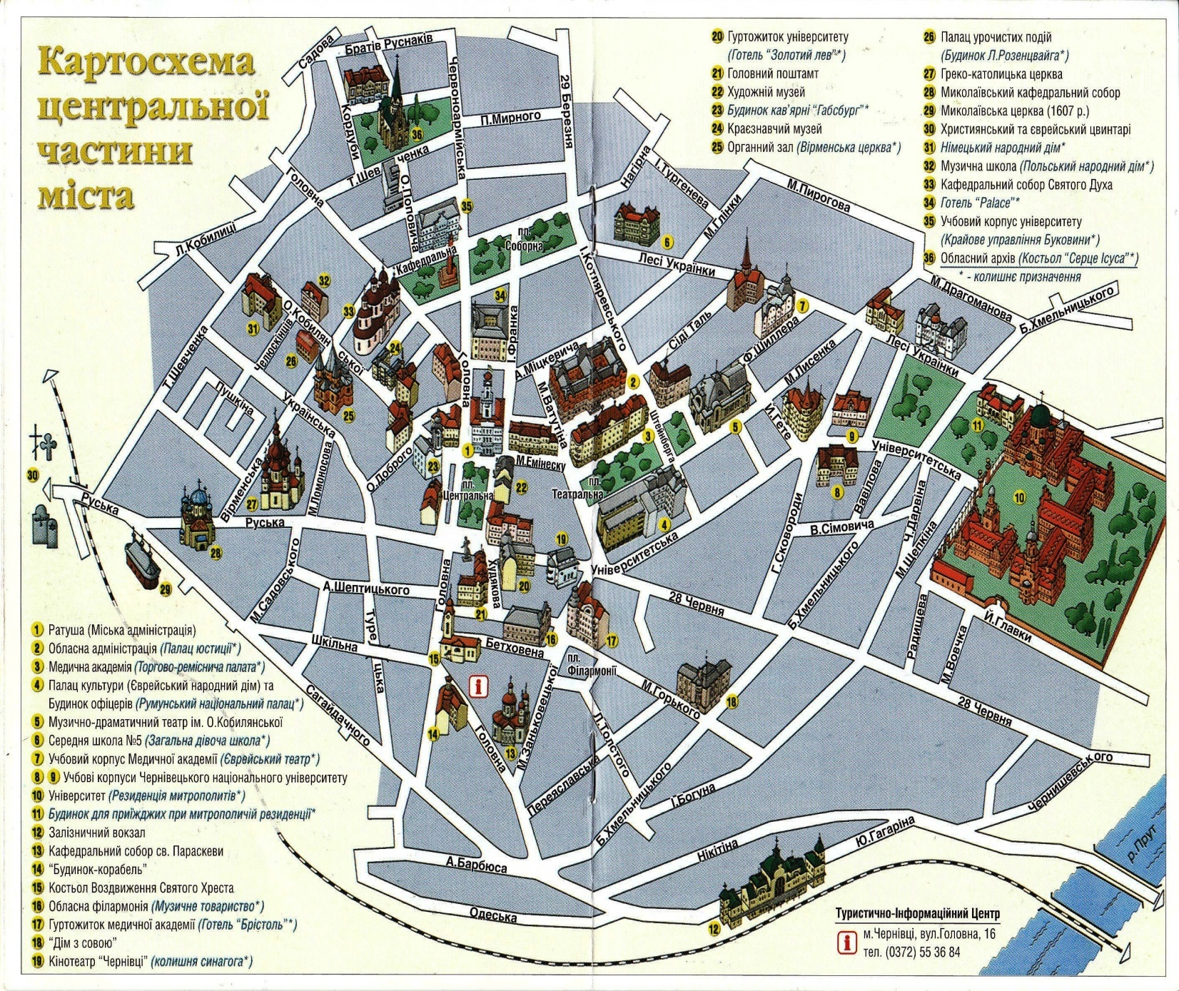
The Central Part of Our Town
  1.The Town Hall.
2.The Former Justice Palace
5. Drama Theatre.
10. Chernivtsi National University.
12. Railway Station.
14. Ship-building.
17. Hotel Bristol (now the students’ hostel of Medical University).
22. Art Museum.
24. The Regional Study Museum.

Slide 8
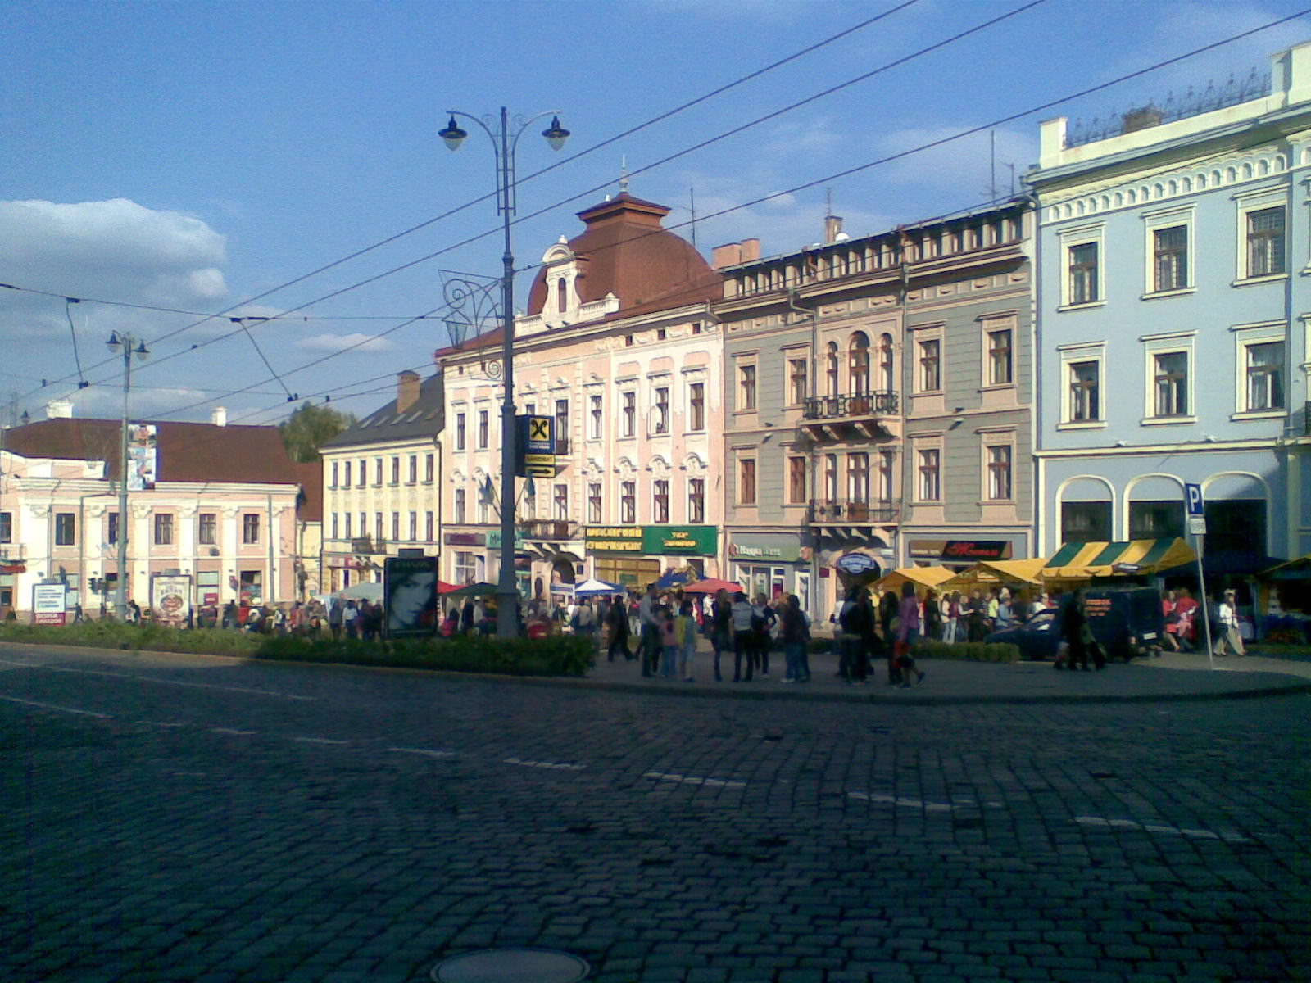
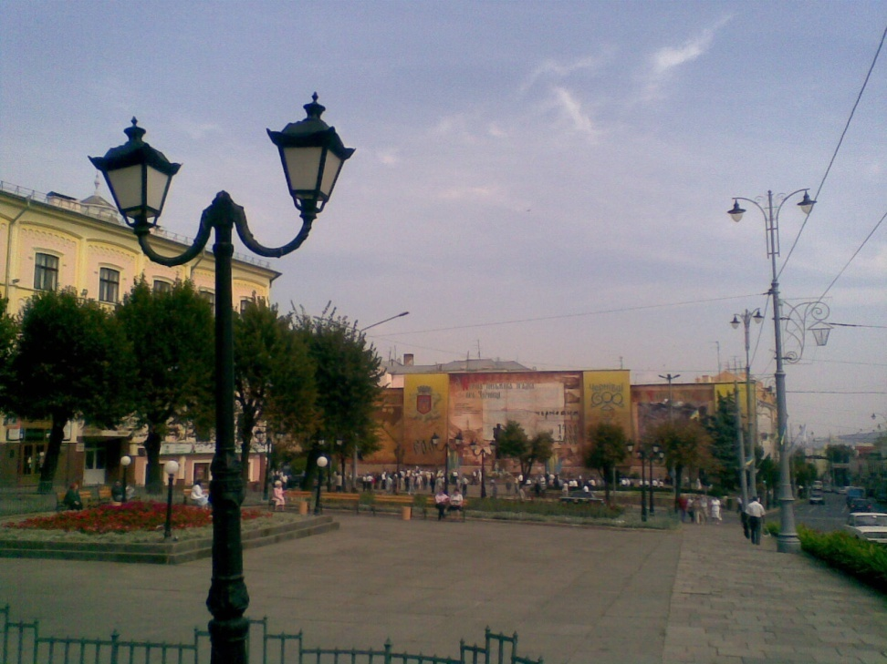
Central Square of Chernivtsi is surrounded by many historical buildings which are real masterpieces of architecture.

Slide 9
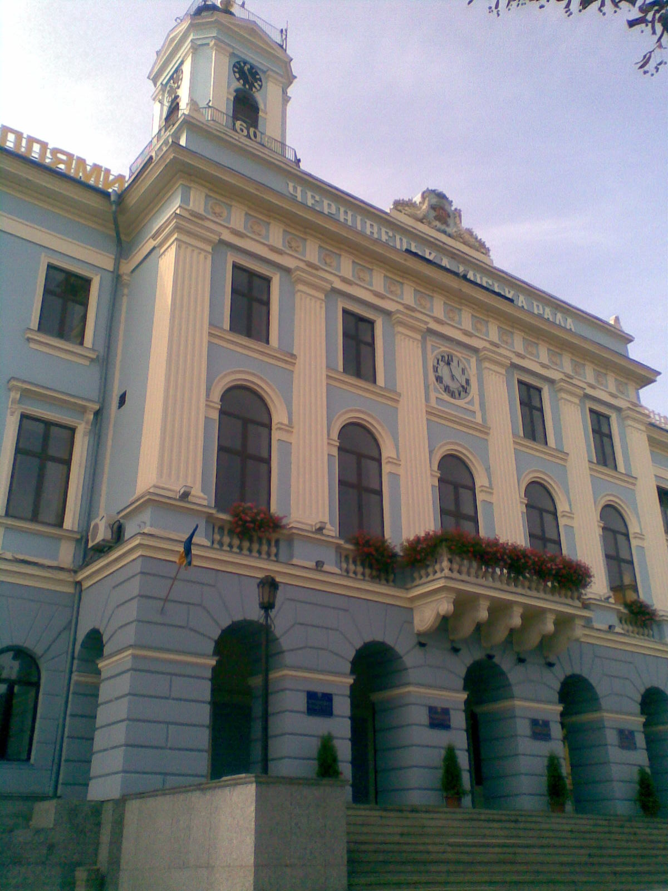
The Town Hall
The Town Hall is the administrative centre of Chernivtsi and the real adornment of Central Square. It is also one of the main symbols of our town
The Town Hall was built in 1848. It is decorated with two clocks which were ordered in Prague by Chernivtsi governor Anton Kohanovsky.

Slide 10
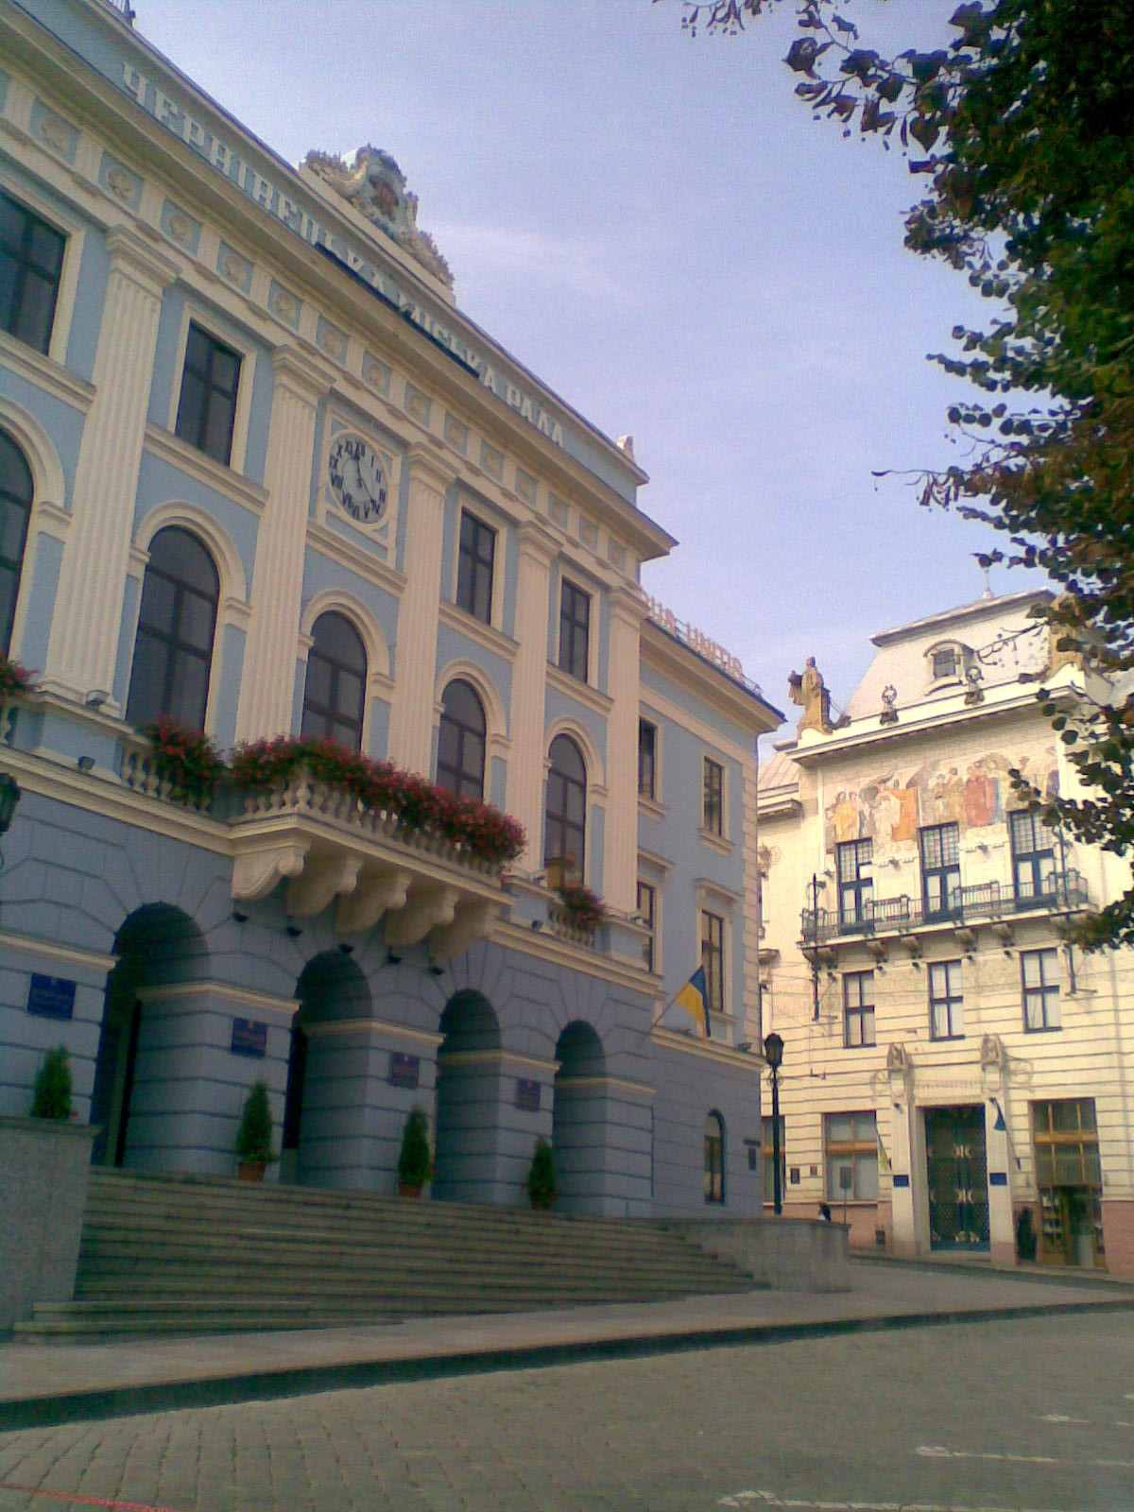
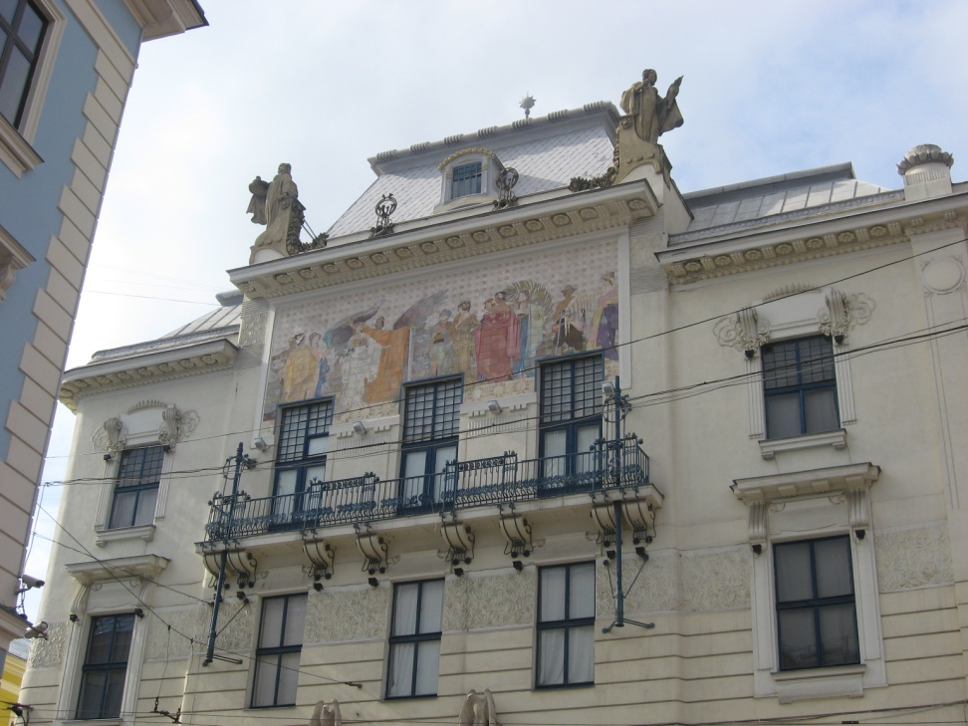
Near the Town Hall there is a building of the Art Museum. In the past it used to be the administrative building of the savings-bank. The façade of the building is decorated with a mosaic picture . The allegoric figures symbolize economic prosperity of the land.

Slide 11
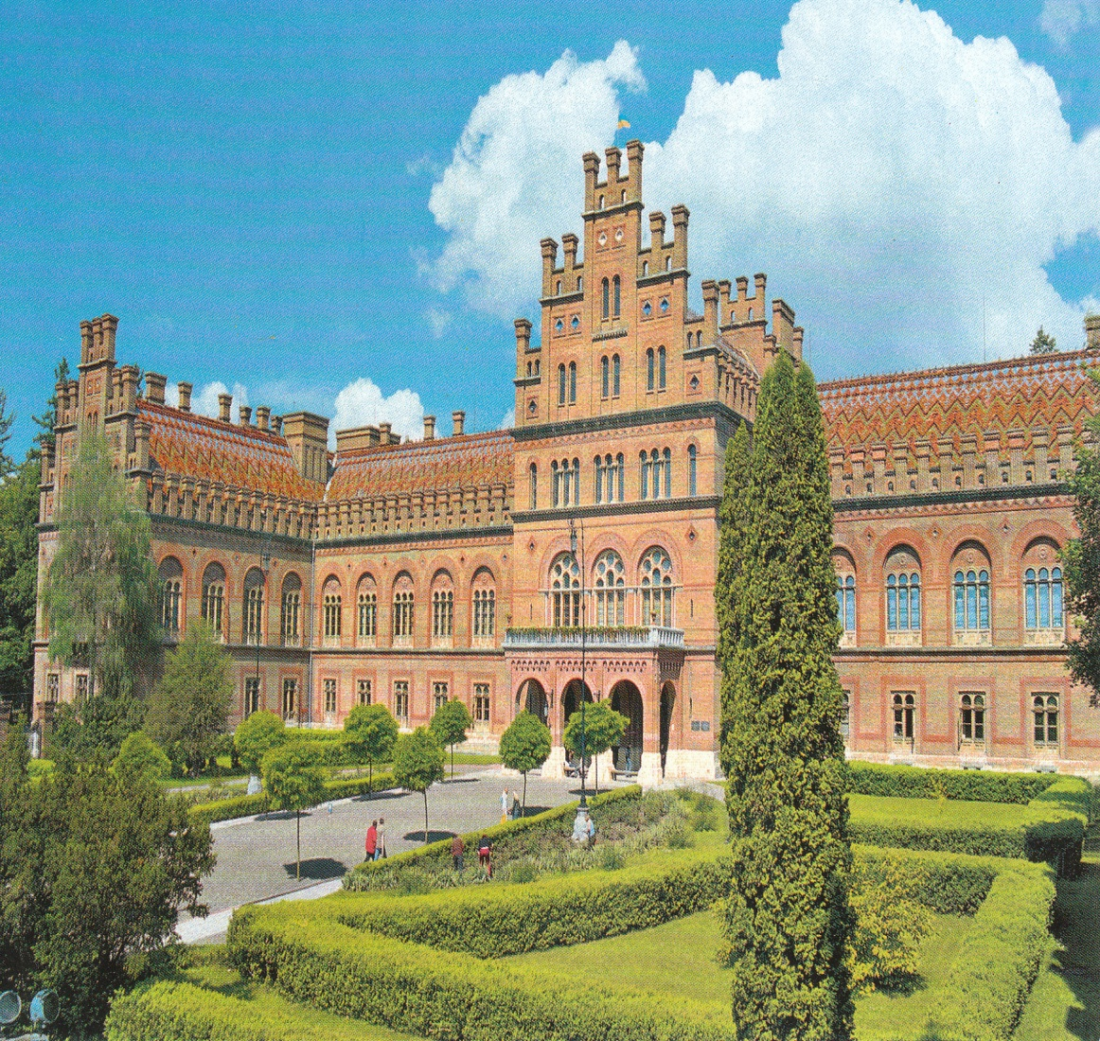
Chernivtsi University
(Former Residence of Bukovinian Metropolitans)
This Palatial Complex is an architectural symbol of Chernivtsi.
It is the best work of outstanding Austrian architect Joseph Glavka.
Today here is Chernivtsi National University named after Yuriy Fedkovych.

Slide 12
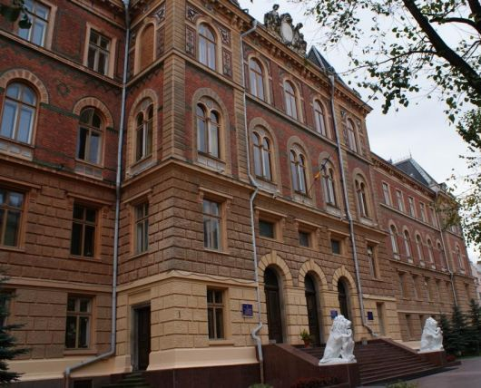
Building of Former Justice Palace

Slide 13
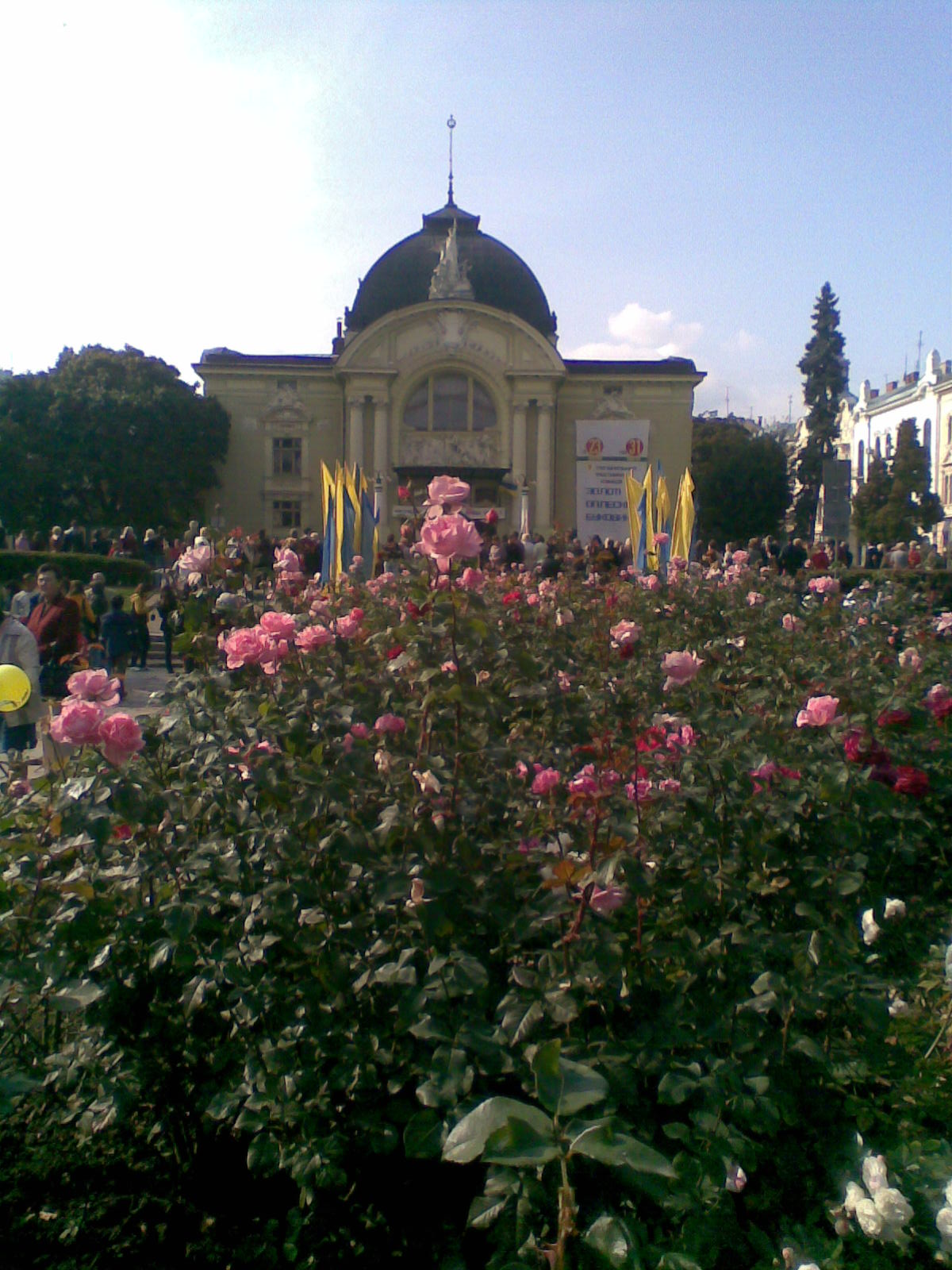
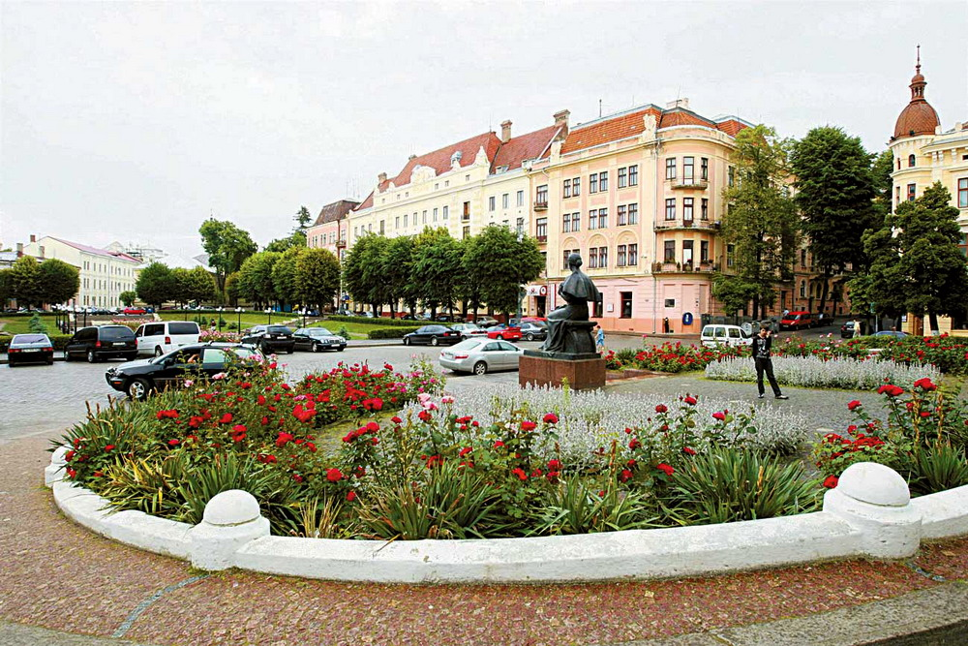
Theatre Square is considered to be the most beautiful square of our town. In the centre of this square there is Olha Kobylianska Drama Theatre built in 1905. The theatre was designed by Viennese architects Felkner and Hemler.

Slide 14
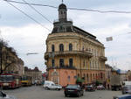
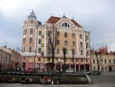
The ship-house and the hotel Bristol
The ship-house in Holovna Street reminds a real ship in the torrent of people and cars.
The hotel Bristol was built in early XX century. On the ground floor there was a restaurant.
Now the building is a students’ hostel.

Slide 15
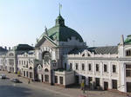
Chernivtsi Railway Station – the main gateway to our town was built in 1908 in the modern style. The building attracts our attention with charming moulding of women’s heads, sculptural compositions and different style roofs.

Slide 16
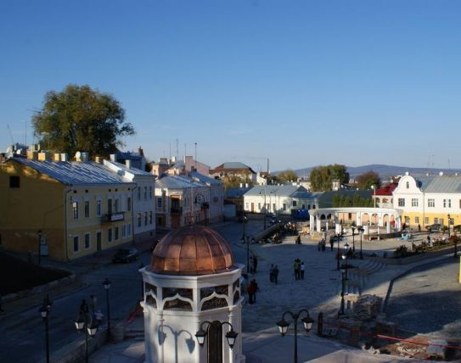
Turkish Square – historical centre of Chernivtsi
Long ago the forefathers of the present inhabitants made their settlement near the Turkish Well.

Slide 17
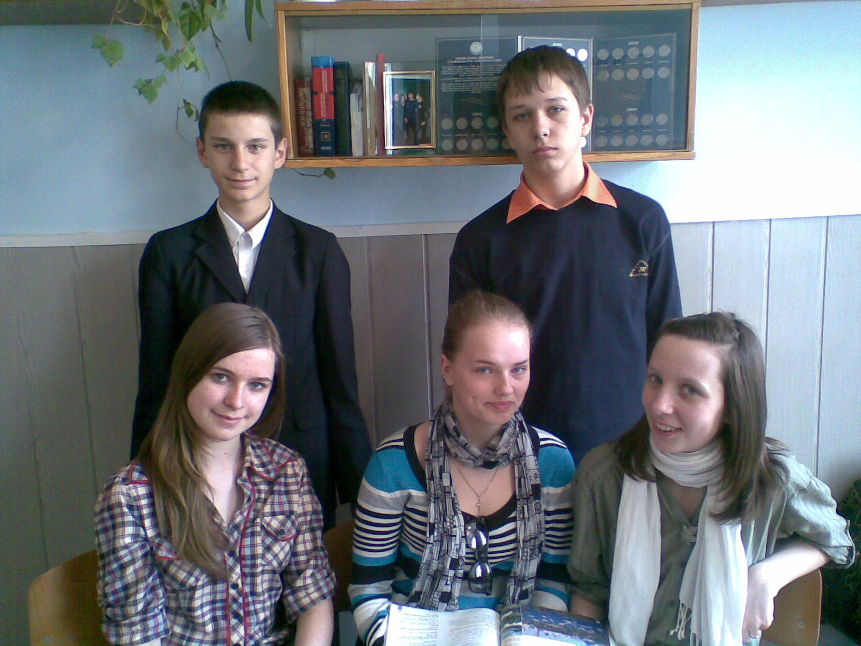
Thanks for watching!
Yevhen,
Valentyn,
Anastasia,
Yulia,
Yaryna.
Class9B, school # 6, Chernivtsi, Ukraine

