Slide 1
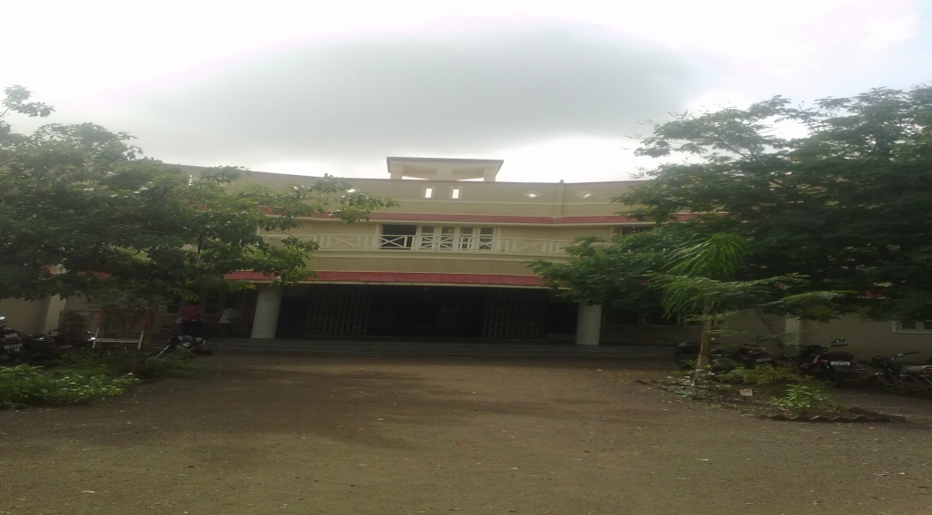
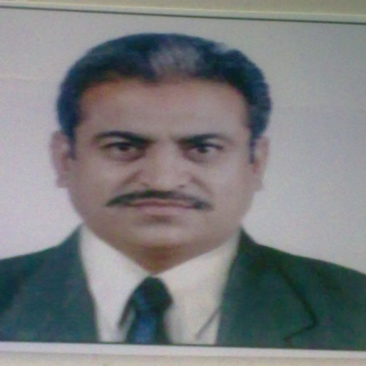
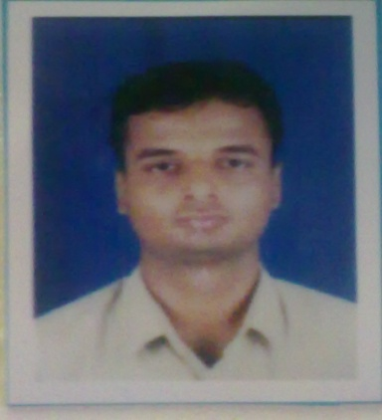
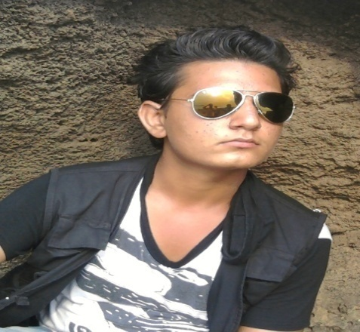
SHREE D.S.V.K. HIGH SCHOOL
JASDAN DIS. RAJKOT (CLUSTER-B)
“CELEBRATION OF THE WORLD ENVIRONMENT DAY”
Principal, D.S.V.K. High school B.V.Boricha.
Link Tr. Ketan K. Bagatharia
Email Id-ketanbagatharia@ymail.com
1st PrizeWINNER
Gida Shiladitya B. Std-11 A

Slide 2
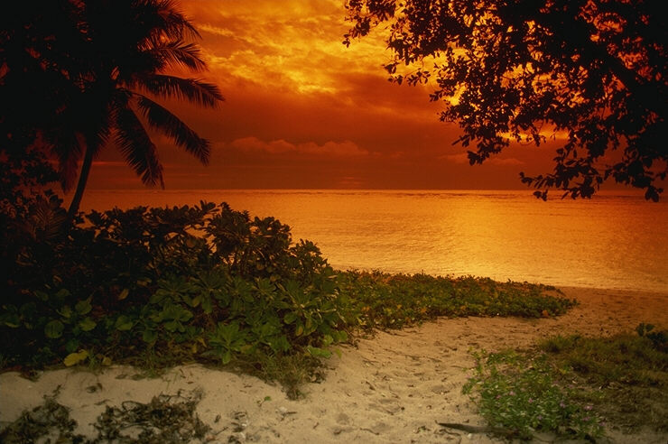
THE ENVIRONMENT DAY
Hello Friends…….
“THE ENVIRONMENT DAY”, We all know about this day as well as we also celebrates this DAY with our friends and family because this day is too important to our lives so that we have to plant so many trees to save our Environment.

Slide 3
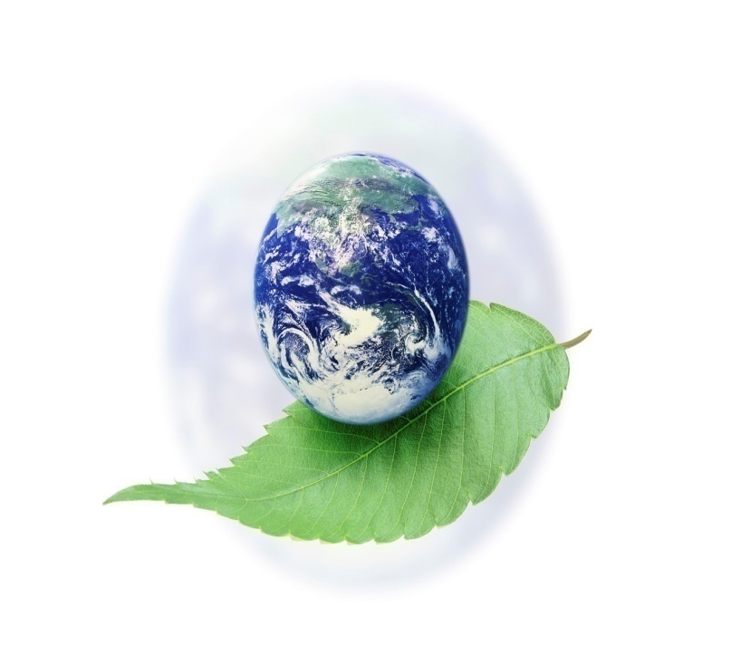
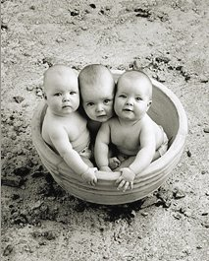
World Environment Day is considered one of the most important events on the global environmental calendar. It is celebrated every year on 5 June in more than 100 countries around the World. The Day is one of the principal vehicles through which the united Nations stimulates worldwide awareness of the environment and enhances political attention and action.

Slide 4
How can you celebrate World Environment Day?
World Environment Day can be celebrated in many ways, including street rallies, bicycles parades, green concerts, essay and poster competitions in schools, tree planting, recycling efforts, clean-up campaigns and much more. In many countries, this annual event is used to enhance political attention and action.

Slide 5
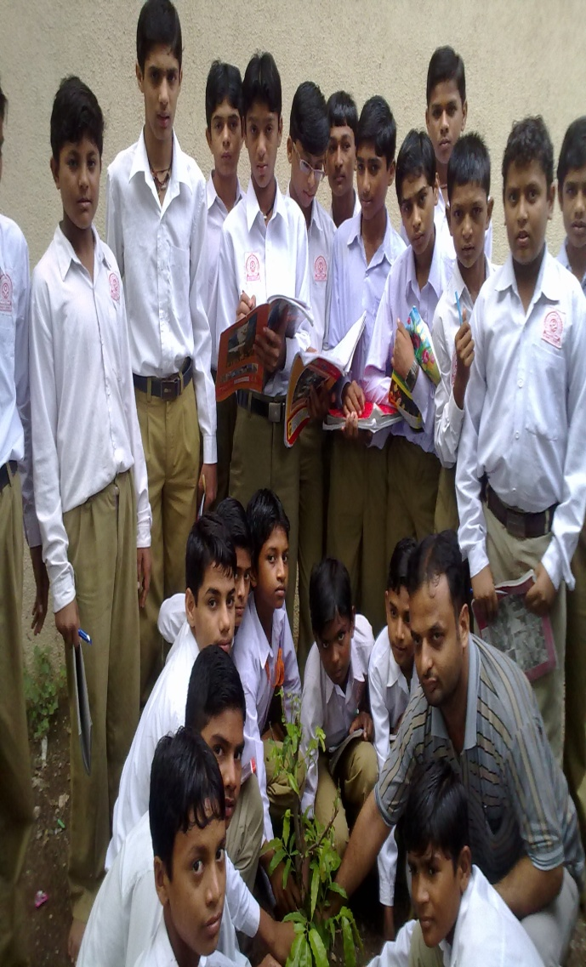
Kids are the greatest learners. They learn fast and better than an adult person. All the parents try to teach their kids values of life. They make sure their kid is getting best of education and learning everything that he or she will require in the future to make his own destiny. The learning process of children begins with their birth. Children aren't born understanding the importance of everything in their surroundings. They have no clue about nature and its significance. However, children learn a great deal by observing others, especially their parents. If kids are watching their parents to be disrespectful and insensitive towards nature and environment, they will also become like them. It is the responsibility of parents to present model behavior to their children. Parents can instill a sense of respect and kindness for nature in their kids.

Slide 6
The purpose of World Environment Day is to educate and encourage people to indulge in daily ecological friendly activities which will help us in preserving the nature. One should learn to live a green life by following simple steps. Small changes make huge impact and that’s why all of us need to contribute our bit to the environment.

Slide 7
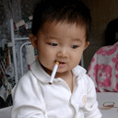
Eco-friendly activities are planned all over the world on World Environment Day. Various means like green concerts, recycling efforts, street rallies, tree planting, clean-up campaigns, and bicycle parades etc are organized all over the world on June 5. It is a wonderful way to remind people of their responsibilities towards the nature.

Slide 8
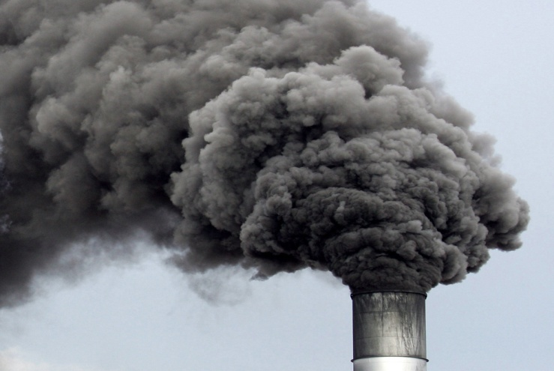
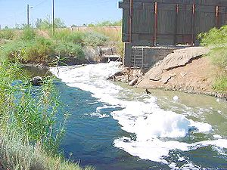
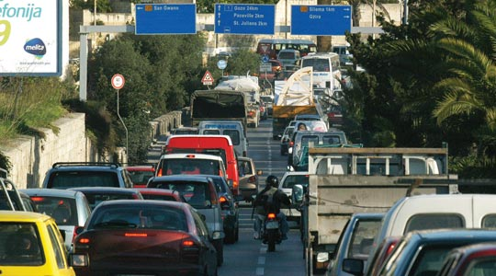
“POLLUTION”
There are many type of pollutions but major three are as follows: AIR POLLUTION, WATER POLLUTION, NOISE POLLUTION it’s so harm to our environment so try to be Eco-friendly.

Slide 9
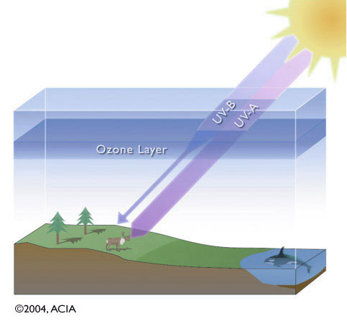
What is Ozone?
-Ozone is a colorless odorless gas made of oxygen.
-The ozone layer protects life on earth from the sun's harmful ultraviolet rays. But the ozone layer is 10 - 30 miles above the earth; this is far above the air that we breathe. This protective shield becomes weaker when certain gases are able to travel to the ozone layer and destroy the ozone molecules. These destructive gases come from products like refrigerators, air conditioners, cleansers, and aerosol cans (used for spray paint and hairspray). The gases are called halons and CFCs - for chlorofluorocarbons

Slide 10
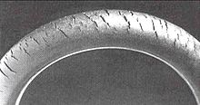
Ozone cracking
-Ozone gas attacks any polymer possessing olefinic or double bonds within its chain structure, such as natural rubber , nitrile rubber, and styrene-butadiene rubber. Products made using these polymers are especially susceptible to attack, which causes cracks to grow longer and deeper with time, the rate of crack growth depending on the load carried by the product and the concentration of ozone in the atmosphere. Such materials can be protected by adding antiozonants , such as waxes, which bond to the surface to create a protective film or blend with the material and provide long term protection. Ozone cracking used to be a serious problem in car tires for example, but the problem is now seen only in very old tires.
Ozone cracking in natural rubber tubing

Slide 11
LET’S SHARE OUR THOUGHTS
-What you think about pollution and effect on developing country like India ?
-Is there any role of developed country to spread maximum pollution ?
-Any comments or suggestion……..

Slide 12
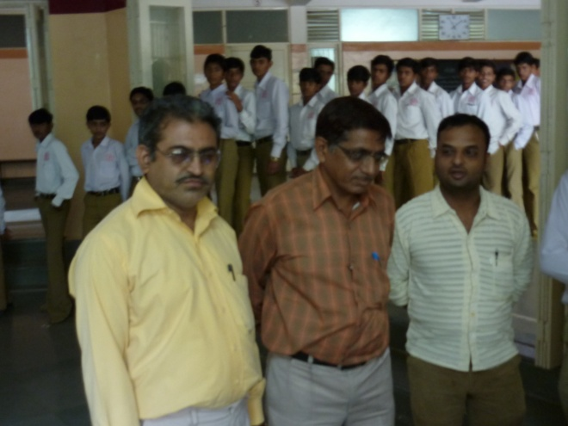
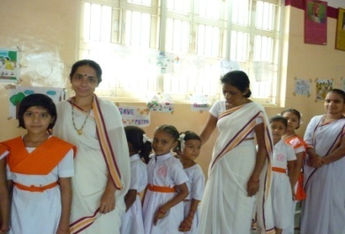
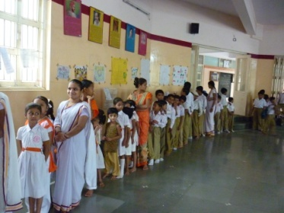
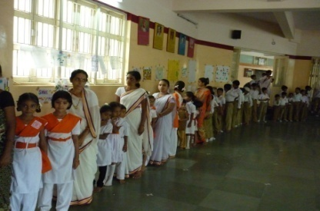
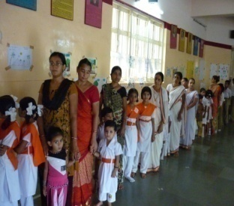
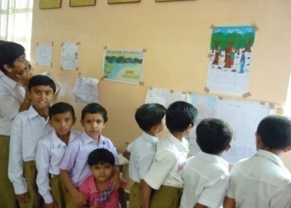
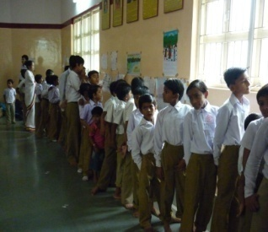
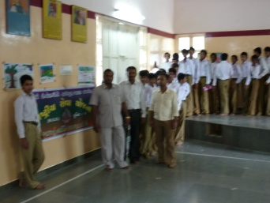
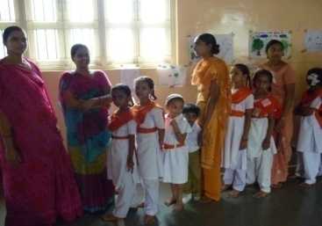
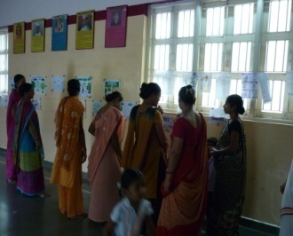
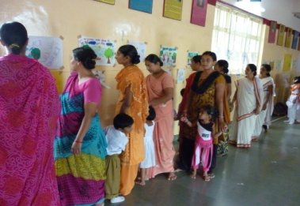
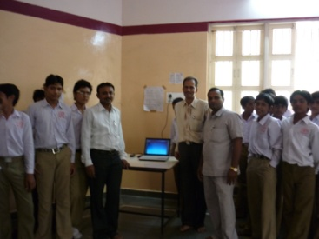
Exhibition of photo drawing and poster
Inaugurated by education inspector Mr. kanabar & school principal Mr. B.V.Boricha with them Tr.K.K.Bagatharia

Slide 13
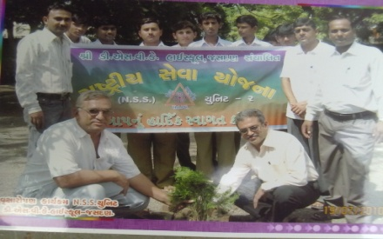
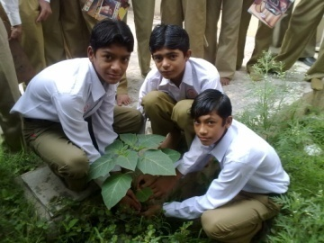
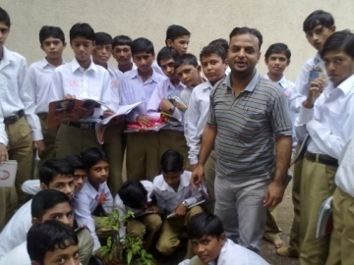
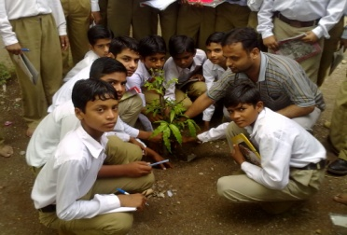
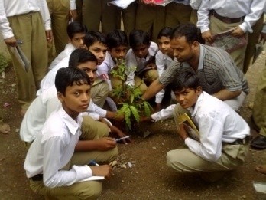
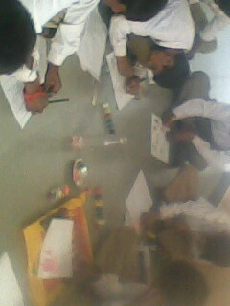
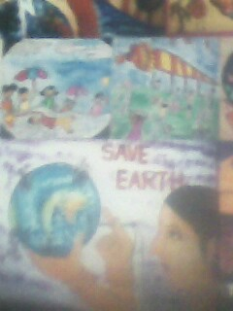
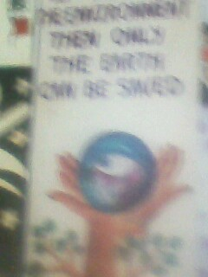
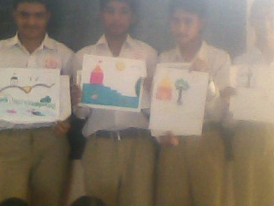
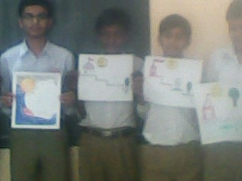
SCHOOL ACTIVITY
Tree plantation
Drawing, Photographs & Poster

Slide 14
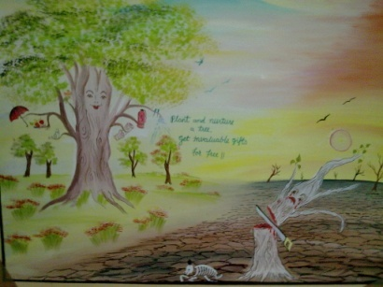
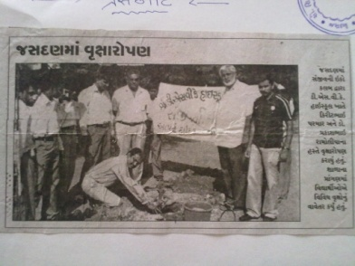
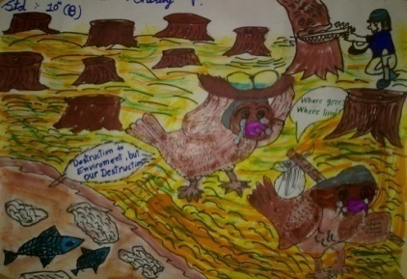
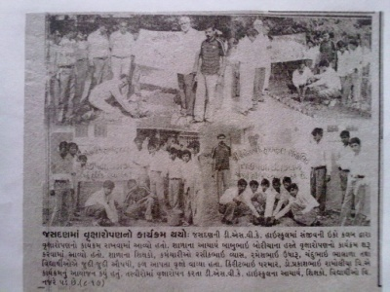
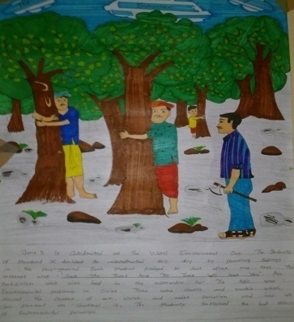
Winners
THANK YOU
THINK GREEN,MAKE THE EARTH GREEN

