Slide 1
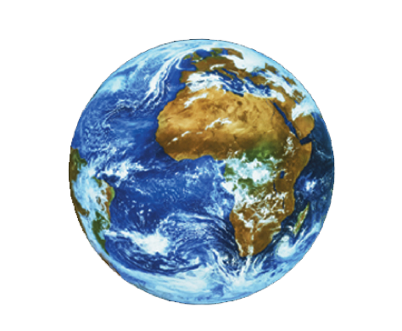
OUR ENDANGERED PLANET

Slide 2
EARTH (OUR HOME)
Earth (or the Earth) is the third planet from the sun, and the densest and fifth-largest of the eight planets in the solar system. It is also the largest of the Solar System's four terrestrial planets. It is sometimes referred to as the world the Blue Planet or by its Latin name, Terra . Home to millions of species including humans, Earth is currently the only place in the universe where life is known to exist. The planet formed 4.45 billion years ago, and life appeared on its surface within a billion years

Slide 3
Earth is home to millions of species of plants and animals, including humans. Earth is the only place in the universe where life has been confirmed to exist. Due to elements like water, oxygen and the right temperatures life is possible on only this planet. However, human beings have forgotten the importance of this unique planet that is why the members of the nature club of Vidya Devi Jindal School have taken the responsibility to show you the different ways humans are destroying their own lives in 4 different stages as well as what our school is doing to protect life. So read on!

Slide 4
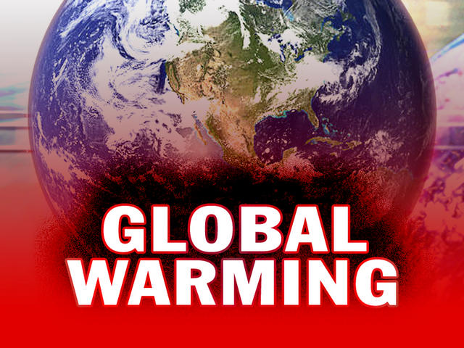

Slide 5
Global warming is a slow but steady rise in Earth's surface temperature.^{[1]} Temperatures today are 0.74 °C (1.33 °F) higher than 150 years ago.^{[2]} Most of the warming is because of people burning coal and oil. Some of the warming is because humans are cutting down trees. Warmer temperature will cause the sea level to increase. Rain and snow amounts will change. Some areas will get more rain, while some get less. Sea ice and glaciers will melt. Deserts will increase in size in some areas and decrease in others. Colder areas will warm faster than warm areas. Strong storms will become more likely and farming will not make as much food. These effects will not be the same over the entire Earth. The changes from one area to another are not well known.

Slide 6
C ARBON FOOT PRINT

Slide 7
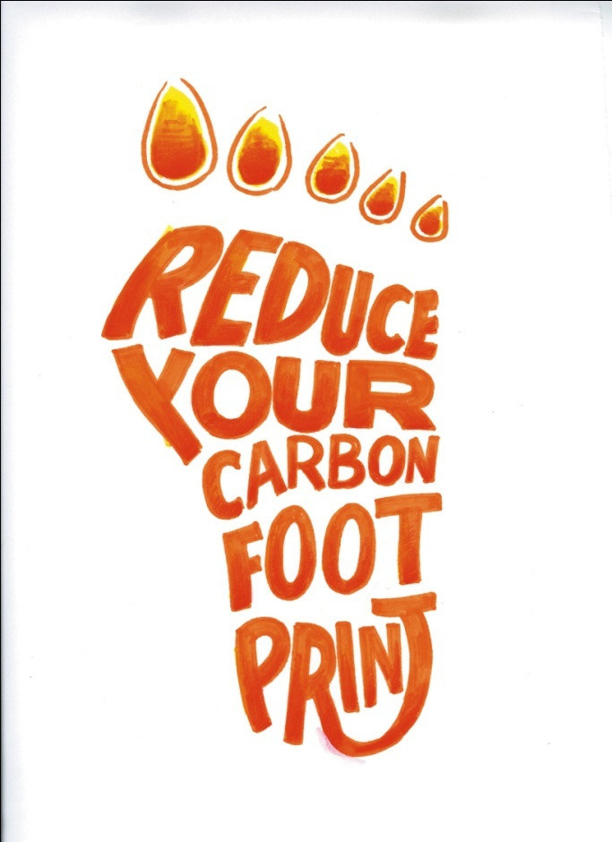
:
A carbon footprint is a measure of the impact our activities have on the environment, and in particular climate change. It relates to the amount of greenhouse gases produced in our day-to-day lives through burning fossil fuels for electricity, heating and transportation etc. The carbon footprint is a measurement of all greenhouse gases we individually produce and has units of kg of carbon dioxide equivalent.

Slide 8
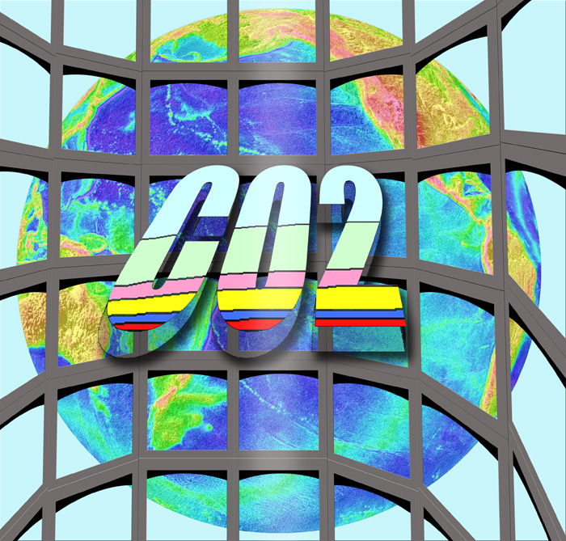

Slide 9
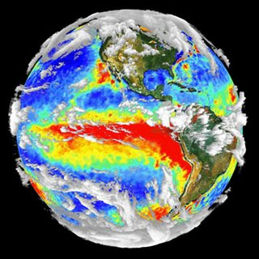
Greenhouse gases reflect radiation from the Earth and stop it from being lost into space. This causes the Earth's temperature to be higher than it would be without greenhouse gases. The name for this is the "greenhouse effect."
Most greenhouse gases are natural - water vapor is the most common, and causes most of the greenhouse effect on Earth. Other greenhouse gases are carbon dioxide, methane, nitrous oxide and ozone. A natural greenhouse effect is not bad. Without greenhouse gases, the earth would be 150 to 3000 degrees Celsius colder, and life would probably not be possible here.
However, humans are adding too much more greenhouse gases to the atmosphere. Mainstream Science believes that this has caused the planet's average temperature to rise. The most important greenhouse gas that humans add to the atmosphere is carbon dioxide which there is less then 1% in the atmosphere.

Slide 10
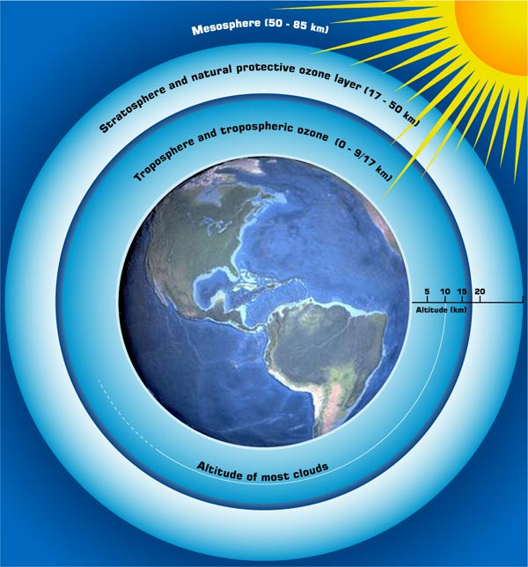
OZONE LAYER DEPLETION

Slide 11
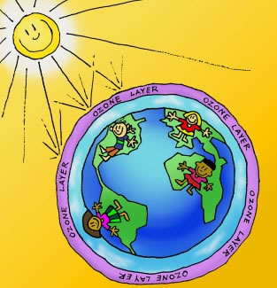
The ozone layer is a layer of ozone high up in the Earth's atmosphere (stratosphere). In the region between about 10 kilometers and about 50 kilometers above ground, the atmosphere contains more ozone (O₃). The exact amount of ozone that can be found varies, the seasons influence it; it is also different in different places on the earth. ^{[1]} This layer can absorb between 93 and 99 percent of the ultraviolet radiation from the sun.^{[2]} This radiation is dangerous to many living organisms on earth.
Over the last hundred years the ozone layer has been damaged by man-made chemicals, especially ones called CFCs (chlorofluorocarbons). CFCs were used in spray cans, but also as solvents or as cooling agents in refrigerators. They have been replaced by other substances for most applications. There is now a hole in the layer over Antarctica. This means that there will be more ozone in the atmosphere, and that diseases of the skin which are related to this UV radiation will be more common

Slide 12
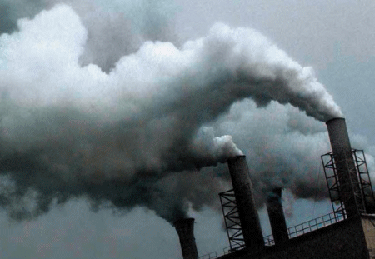
POLLUTION

Slide 13
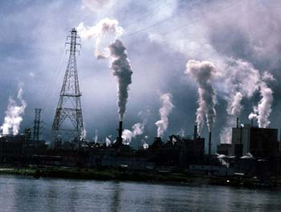
Pollution is the introduction of contaminants into a natural environment that causes instability, disorder, harm or discomfort to the ecosystem i.e. physical systems or living organisms.^{[1]} Pollution can take the form of chemical substances or energy, such as noise, heat, or light. Pollutants, the elements of pollution, can be foreign substances or energies, or naturally occurring; when naturally occurring, they are considered contaminants when they exceed natural levels. the major cause of pollution is the carbon dioxide and smoke released when fossil fuels are burnt

Slide 14
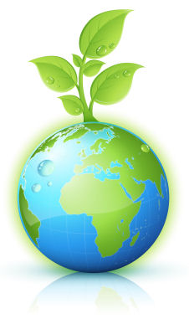
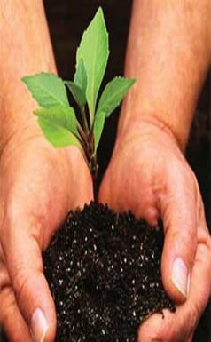
PROJECT : SAVE PLANET EARTH
VIDYA DEVI JINDAL SCHOOL,HISAR
MEMBERS :ALL THE GIRLS OF NATURE CLUB V.D.J.S

Slide 15
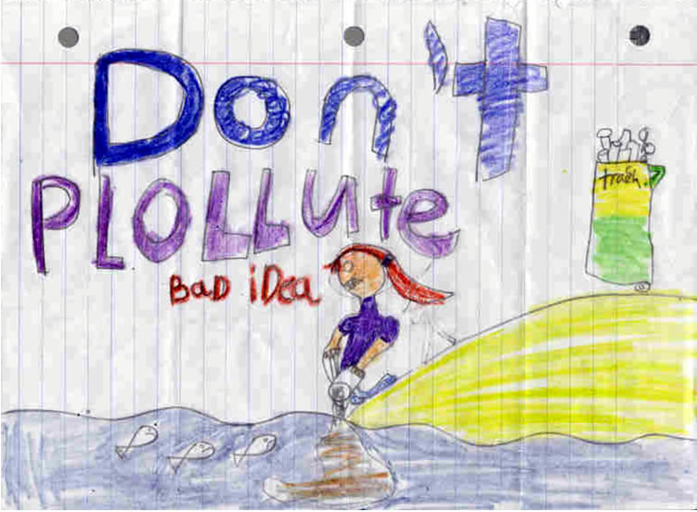
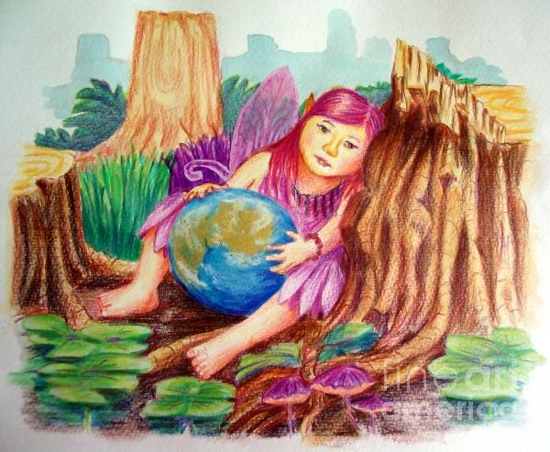
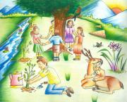
YOUNG ARTISTS
KOMAL- [CLASS 4]
ISHITA - [CLASS 8]
ESHA - [CLASS 6]

Slide 16
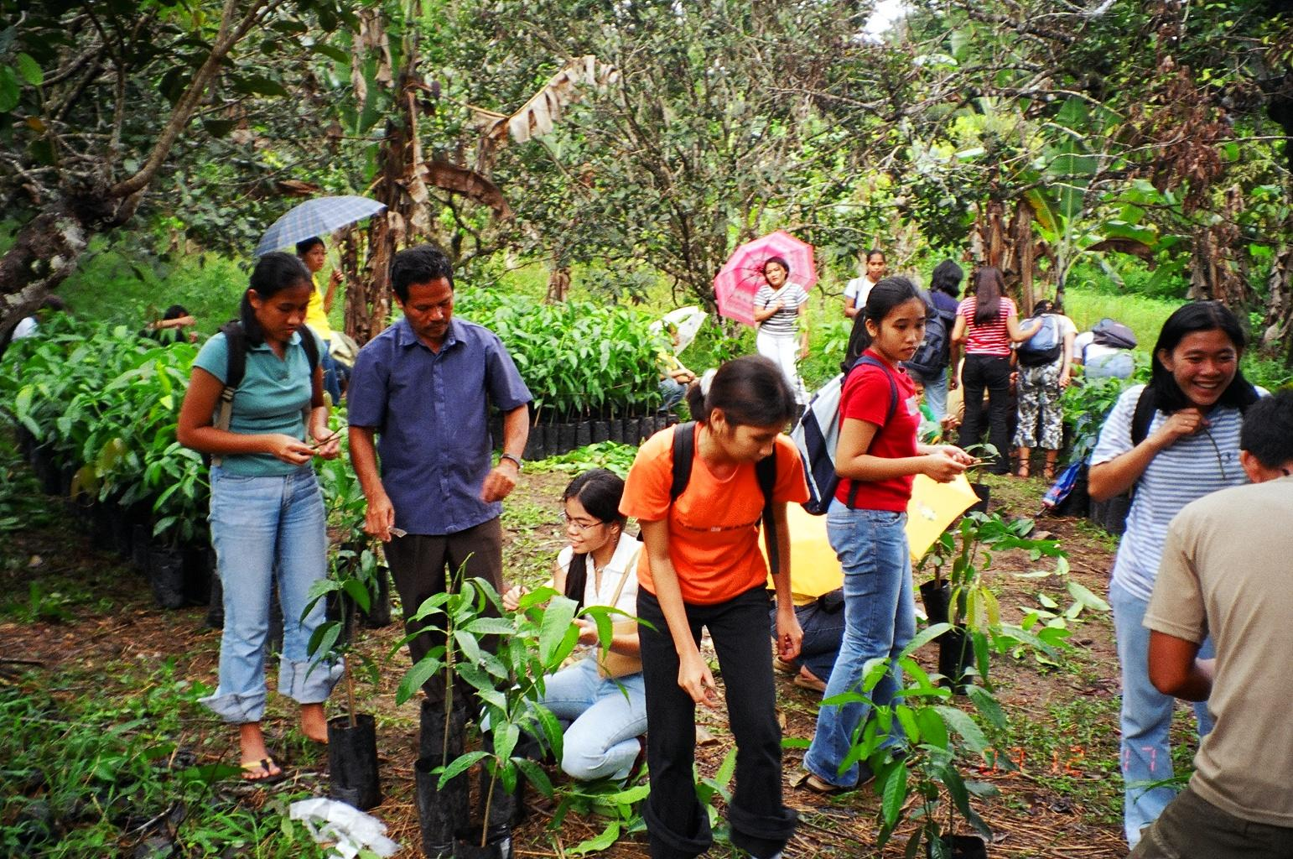
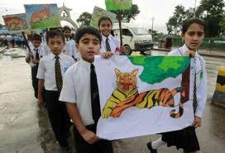
SAVE OUR PLANET
EACH ONE PLANT ONE
SAVE THE TIGER

Slide 17
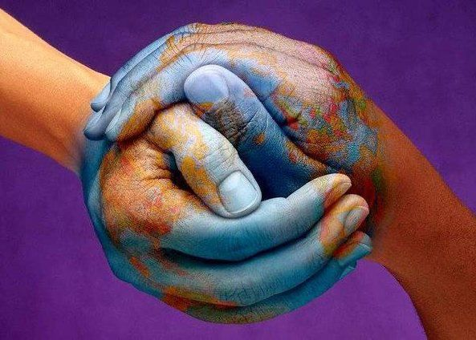
OUR BEST SLOGANS
Clean and Green
Don’t be mean Go green
Earth allows you to stand. Let it stand the way it is.
Earth Day Every Day
Eat, Sleep, Recycle
Embrace the green revolution
Go Green
Go Green for Life
Gotta dream green

Slide 18
YOUNG POETS OF OUR NATURE CLUB
Green is my favorite color
Green revolution the best solution to arrest pollution
I am a friend of nature
I brake for litter
I hear the Eco I live my life by the seed of my plants
Join the green side.
Keep our forests green
Keep our oceans blue
Live Green, Love Green, Think Green
Live the Green Dream
Make conservation a habit.
Make trees not stumps
Nature saves us, we have to save it.
Nurture Nature For Our Future!

Slide 19
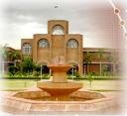
VIDYA DEVI JINDAL SCHOOL wants to save our planet but, can we do it all alone ??????

Slide 20
GO GREEN

