Slide 1
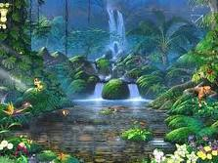
Water falls in the world
S.M.D.C.SENANAYAKA.
NEXT

Slide 2
Click to title
Diyaluma ella.
Bakers ella.
Laxapana ella.
Ramboda ella.
Abardin ella.
Nayagara falls.
Devon ella.
Victoria Falls
Lover’s Leap ella
Kurundu ella.
Olu ella.
Sutherland Falls
Kirindi ella.

Slide 3
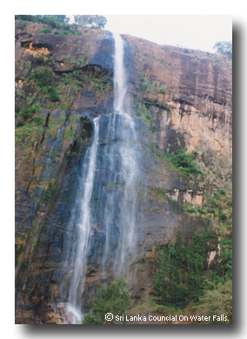
Diyaluma ella
Diyaluma ella is steeped in folklore.
At 171m, this is the third highest fall On one side of the fall the land is covered in deciduous plants. Wildlife found in the area include this enchanting fall visible from the Koslande highway may disappear due to in Sri Lanka. The fall is located along the Koslande - Welawaya road in the Badulla District. Koslanda is the nearest town to the fall, 6km away, and Welawaya is 13km away.
BACK
NEXT

Slide 4
Diyaluma ella is steeped in folklore
One story tells of how a king had fallen in love with a young woman belonging to a lower caste. This affair enraged the king's subjects so the lovers decided to flee. Arriving at the site of the fall, they began climbing upwards. The king made it to the top but the creeper the woman was hanging onto became entangled in rocks and she plunged to her death. It is said that the tears shed by the king in his grief were collected by a deity and turned into the fall as it stands today. RL Brohier, a scientist and historian from the UK who served in the Surveyor General's Department, kept records detailing his intimate knowledge of Sri Lanka and its inhabitants. Amongst them was a story concerning Diyaluma Falls, which is said to have village elders stillremember. Two tourists,Harrisand Ashna decided to With a crowd that had gathered below watching the proceedings, Harris's pride was injured. Unwilling to lose faith, he produced a knife and severed the rope, plunging Ashna to her death. He then cut his own rope and fell, their cries mingling with the sound of rushing water. The shattered bodies of the pair were unrecognizable and their blood turned the water red.
BACK

Slide 5
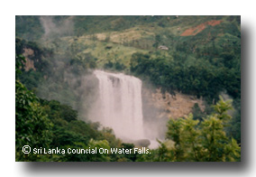
Laxapana ella
This very popular 129m fall is thought to derive its name from the presence of iron ore (laksha) in the rocks over which the water flows. The fall was said to house a labyrinth of tunnels, one of which still exists. a golden melon bobs up and down in the water. The Laksapana Reservoir, where the fall is found, is used by power stations at New Laksapana, Canyon and Polpitye Samanala resulting in a certain amount of water depletion.
BACK

Slide 6
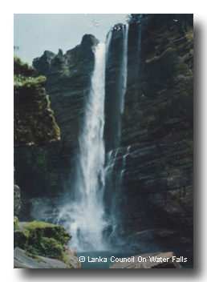
Abardin ella
The impressive 98m fall makes up a section of the Kehelgamuwa River and joins the Maskeli River at Kalugala before flowing into the ocean via the Kelani River. Aberdeen fall is located 6km from the Nuwara Eliya District in the Kehelgamuwa mountain range, which encompasses an area made up of Ginigathhena, Norton Bridge, Lakshapana and Maskeliya. Alternatively, catch a bus from Norton Bridge to Kalawelldeniya and trek from the 3rd mile post for a distance of about 1km, but watch out for wild terrain and abundant leeches (Hirundine spp).
BACK

Slide 7
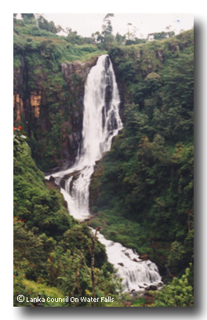
Devon ella
A view of the front of this 97m-high fall is possible from Midigama. It is one of six falls affected by the upper Kotmale hydro-power project. This project has had an adverse impact on the environment. According to Sirisena, an environmentalist, poet and native of the area, Kotmale used to be famous for pure honey and jaggery, both products of the Kithul tree. These trees have disappeared since the introduction of the hydro-power project, which the Japanese government has assisted by providing credit facilities.
BACK

Slide 8
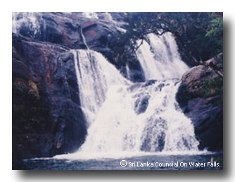
Bakers ella
This 22m fall is noted for the tremendous noise created by water pounding the large rock formation at its foot. Forming part of the Belihul River, it is surrounded by copious giant ferns.
Baker's Falls derives its name from Sir Samuel Baker, a British man who discovered it in 1845. However, Baker is also credited with the short-sighted achievement of having shot 50 elephant, five deer and two buffalos nearby.
Despite the presence of warning signs (that are often removed by confident bathers), the fall, and more specifically the 12m death trap of a plunge pool, has claimed numerous lives.
BACK

Slide 9
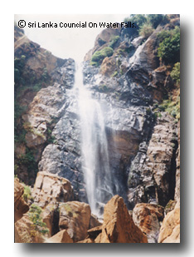
Kurundu oya ella
At 189m, this is the second highest fall in Sri Lanka. From its source, the Kurundu River, the water cascades down into a deep ravine before later joining the Mahaweli River.
Located in the Nuwara Eliya District, to reach the fall take the road from Nuwara Eliya to Kandapola. After 18km the road winds past the Piduruthalagala ravine and the Coodoogala Jungle. Continue for another 11km until the Kurundu River and turn right by a stream.
BACK

Slide 10
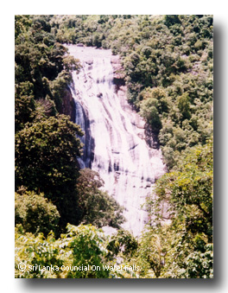
Kirindi ella
The source of this breath-taking, 116m-high fall is the Kirindi Ella (stream), which flows from its starting point 940m up the Kuttapitiya Mountain. The stream travels 13km before the cascading point in the Kaluwaramukalana Jungle. It then flows via the Denawaka River to the Kaluganga River, located in the Bambarakotuwa Jungle. Local villagers say that there is a picture of a tortoise etched into stone here.
At the base of the fall, the water plunges into a deep pool called Diyagathwala.
BACK

Slide 11
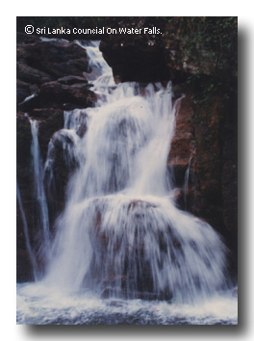
Olu ella
At between 15 and 18m wide, and 100m tall, Olu Falls is an impressive sight. The second highest in the Galle District, it cascades downwards in four streams into a pool at the base known as Olu Dola. The waters then merge with the Wee River, before flowing into the Kelani River, near the Saman Temple at Yatiyantota. The water serves the areas of Mevia and Gilma.
A wooden bridge spans the river and during rainy weather the fall's spray soaks passing villagers. The fall can be found 19km along the road from Yatiyantota town.
BACK

Slide 12
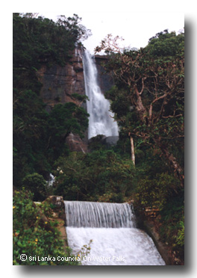
Lover’s Leap ella
This beautiful 30m fall is incipient of the streams and brooks of Sri Lanka's highest mountain, the Piduruthalagala (2524m). It flows over hard granite ledges and the water is collected in a tank and used for drinking. In dry spells, the flow is languid The fall is said to derive its name from the tragic tale of a prince, who while hunting in the jungle, lost his way. He was rescued by a beautiful damsel, and the two became inseparable lovers. But the match was not to the liking of the prince's subjects, so the two decided to immortalise their love by leaping from the top of the fall to their death. death.
BACK

Slide 13
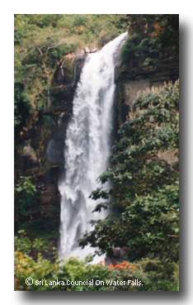
Ramboda ella
The 109m-high double fall is borne of the many convergent brooks in the area that flow into the Puna Oya Reservoir, a tributary of the Kotmala River. Take the Nuwara Eliya to Pusselawa road for 12km. The fall is located 1.5km from the highway at this point. It is 10km from Pusselawa Resthouse.
BACK

Slide 14
NAYAGARA FALLS
Easily the most famous waterfall in North America, this powerful waterfall also ranks as the biggest one by volume with a whopping average of about 750,000 gallons per second (2.8 million Liters per second)! In addition to its raw power, the falls is easily one of the easiest to access and view from all sorts of angles. While its surroundings are a bit less naturesque for many, it clearly makes the upper tier of our list of Top 10 Waterfalls.
BACK

Slide 15
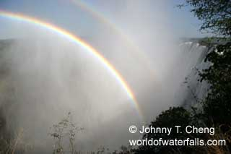
VictoriaFalls
Easily deserving of the top spot on this list (though it finished a very close second), it's the largest singular waterfall in the world spanning a width of 1.7km, a height of 108m, and an average flow of 1 million liters per second! It's no wonder this "smoke that thunders" is considered one of the seven natural wonders of the world and is a UNESCO World Heritage site. Indeed, it's got power, beauty, and it will make you humble and awestruck.
BACK

Slide 16
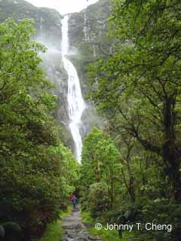
Sutherland Falls
In a country that holds a special place in our hearts, this gorgeous 580m waterfall is easily New Zealand's most spectacular waterfall and makes our list. Given its remote location deep in the wild and beautiful Fiordland National Park (also a World Heritage Area), it's one of many highlights of the Milford Track - said to be one of the finest walks in the world.
BACK

Slide 17
BACK

