Slide 1
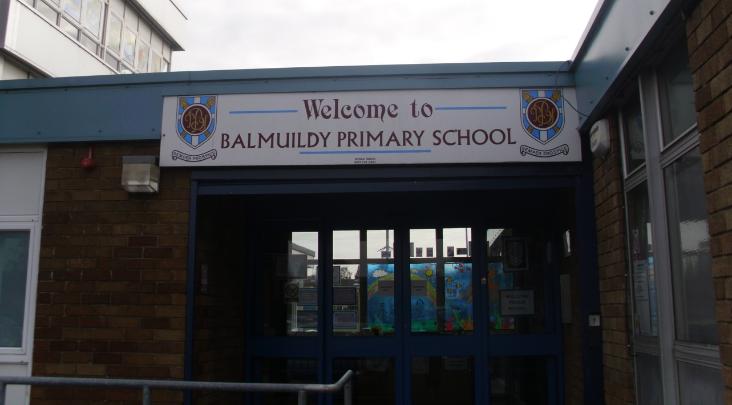
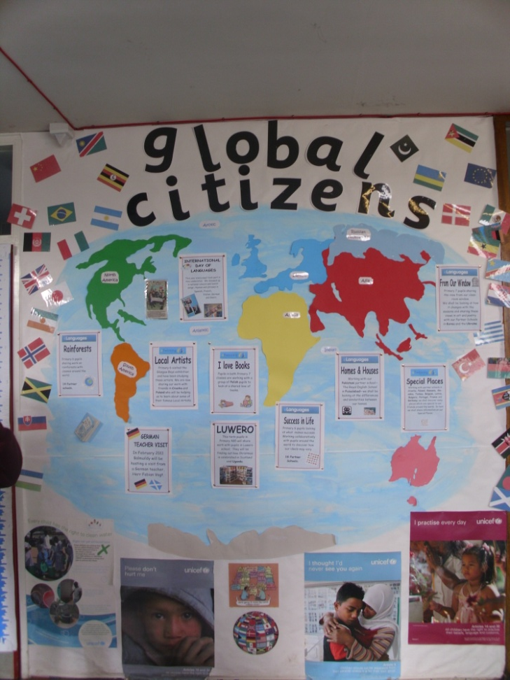
FROM OUR WINDOW –
BALMUILDY PRIMARY SCHOOL
This is our entrance.
We are Global Citizens, working with schools around the world.

Slide 2
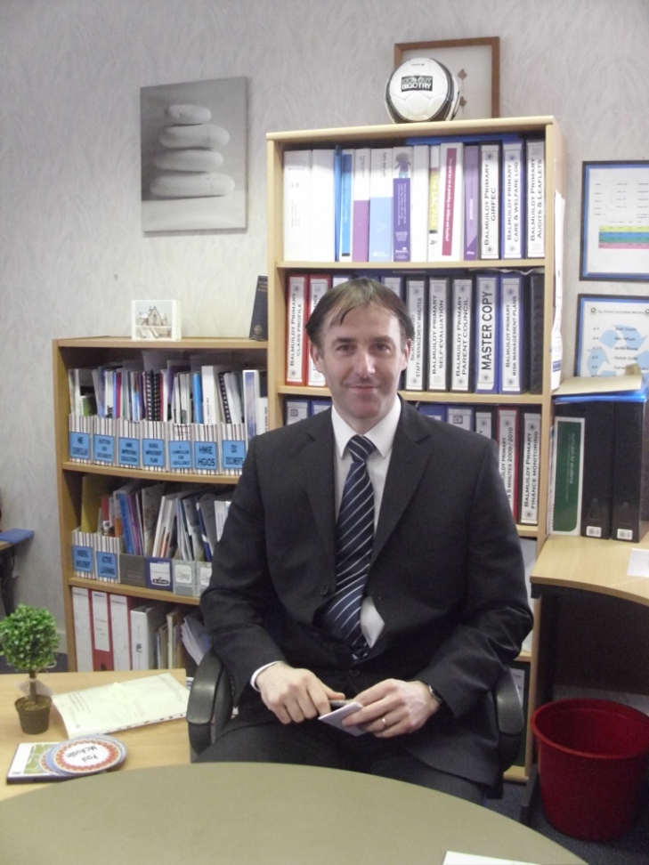
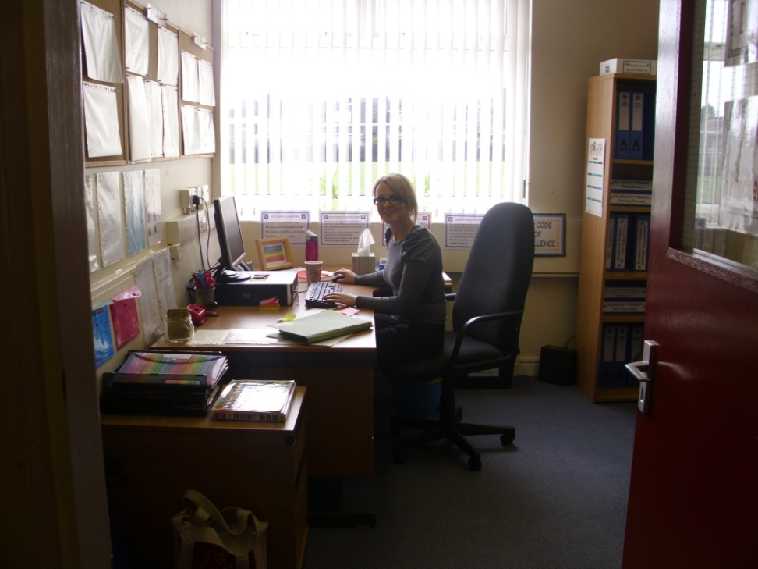
FROM OUR WINDOW –
BALMUILDY PRIMARY SCHOOL
Mr Mckeever, our Head Teacher
Miss Campbell our Acting Depute Head Teacher.

Slide 3
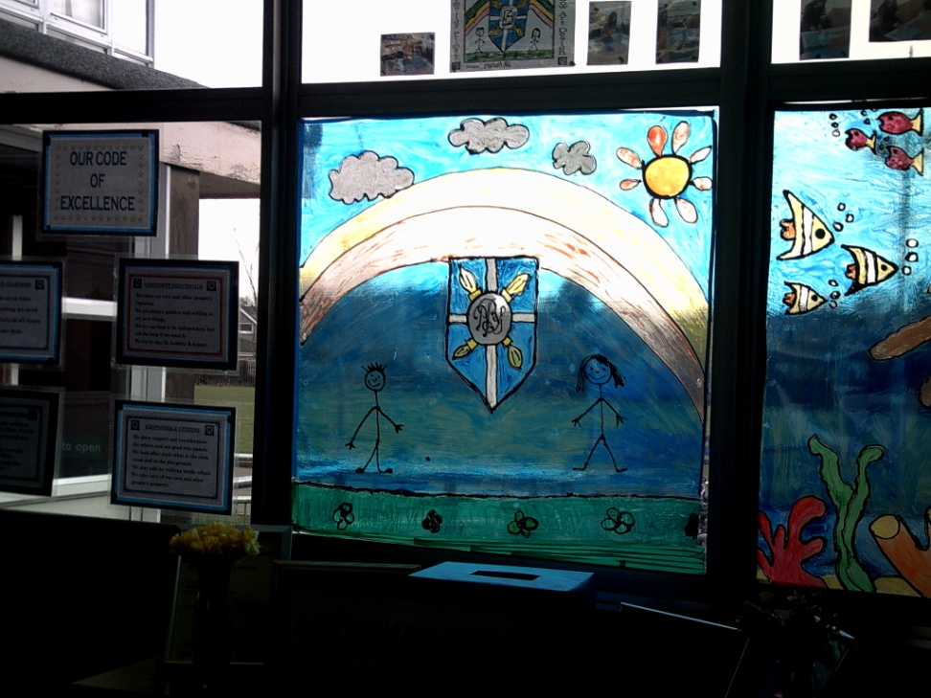
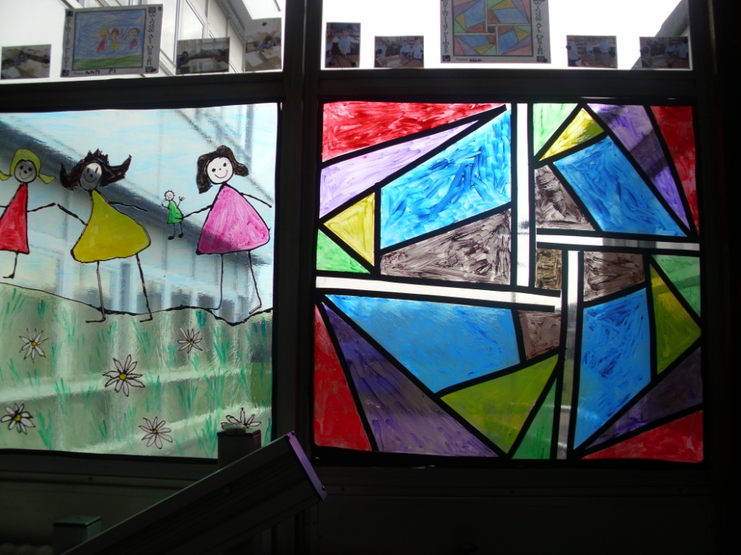
FROM OUR WINDOW –
BALMUILDY PRIMARY SCHOOL
We designed window art to make our view even nicer!
We held a competition to select the designs..

Slide 4
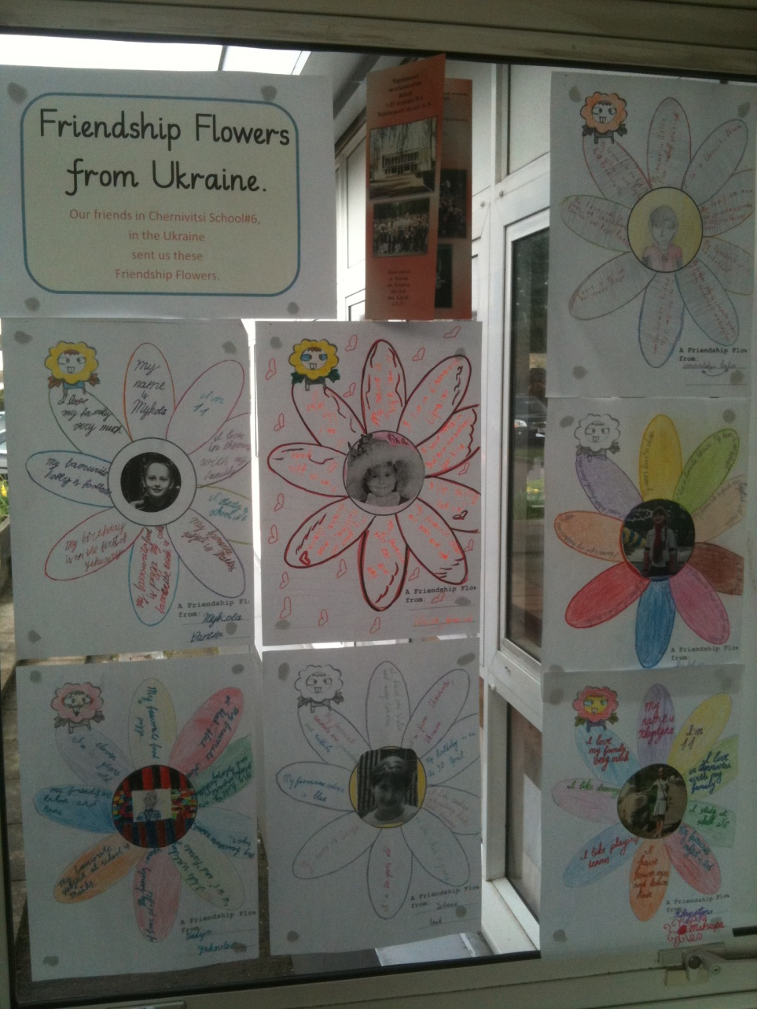
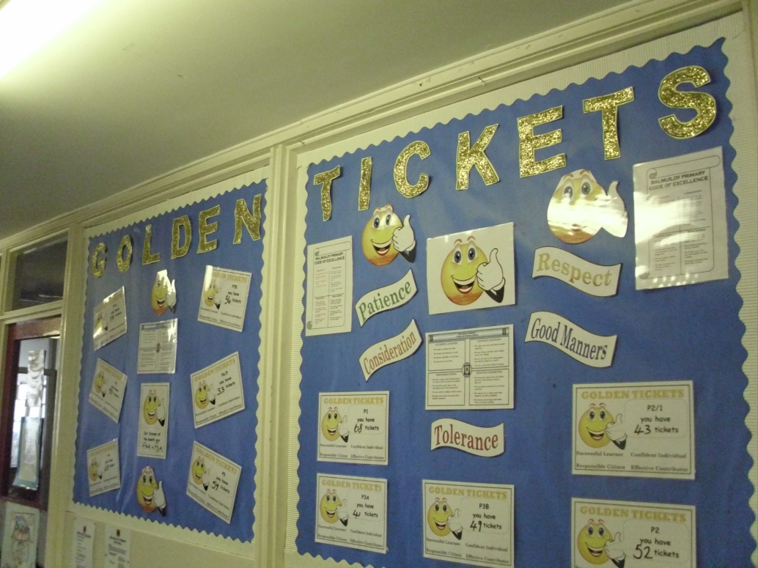
FROM OUR WINDOW –
BALMUILDY PRIMARY SCHOOL
We earn Golden Tickets for good work and good behaviour.

Slide 5
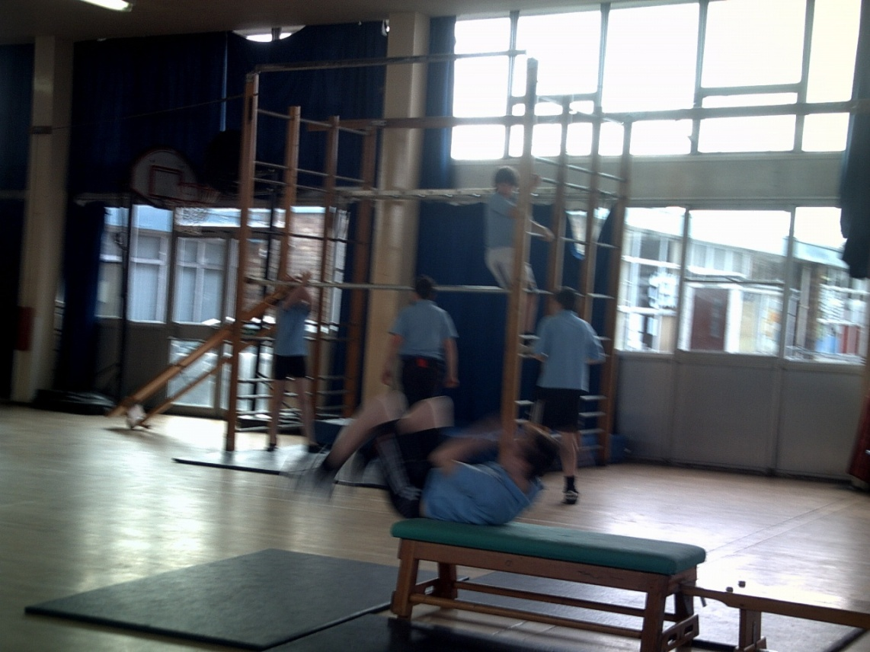
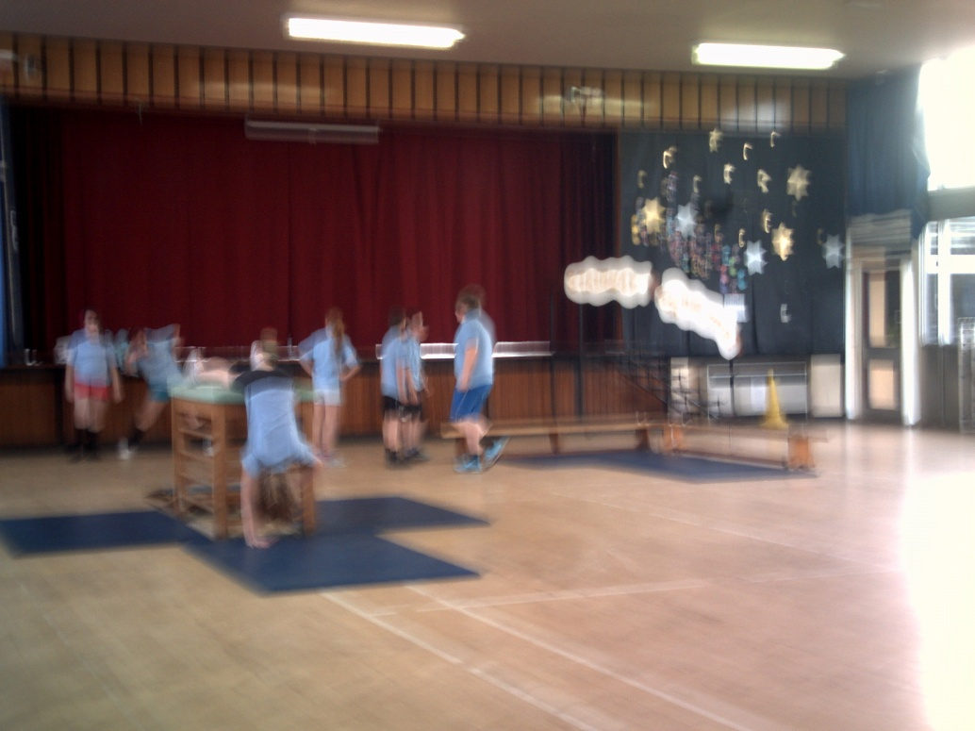
FROM OUR WINDOW –
BALMUILDY PRIMARY SCHOOL
Our gym hall is also our school dining room.

Slide 6
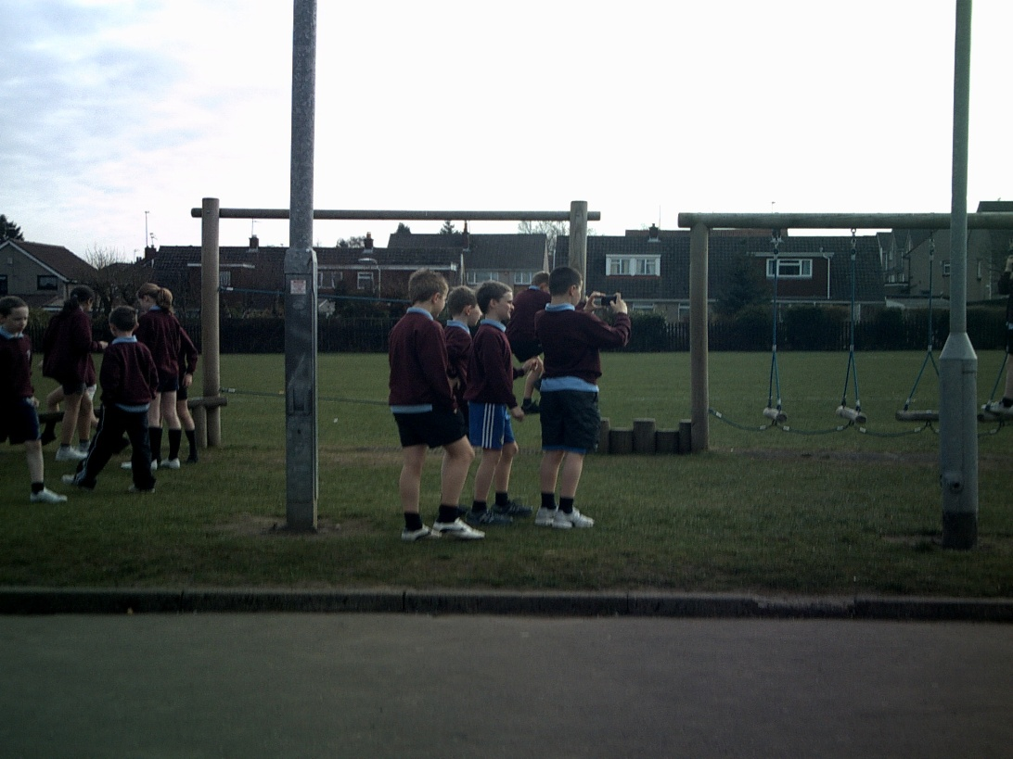
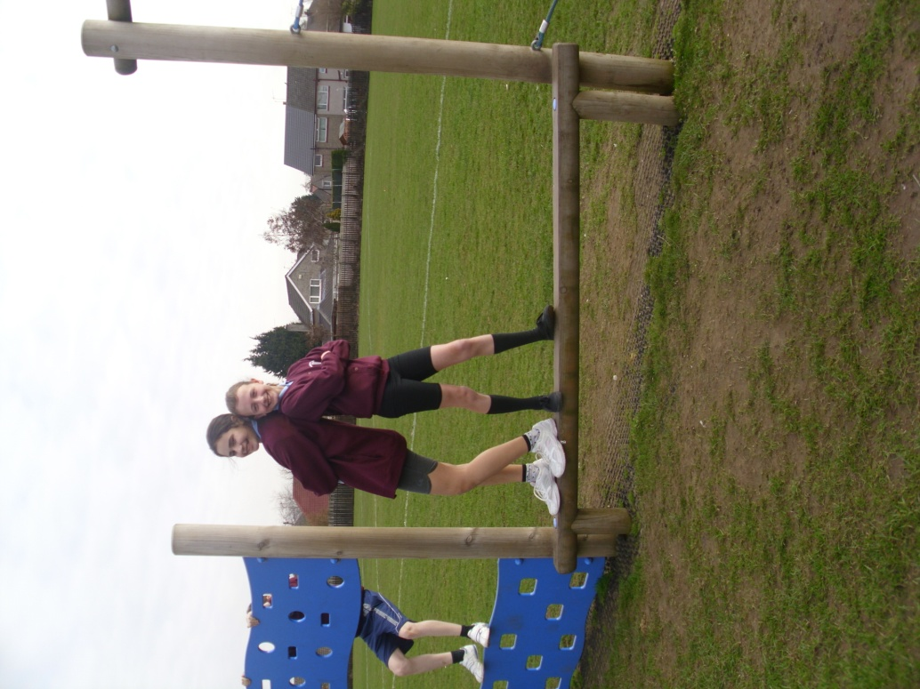
FROM OUR WINDOW –
BALMUILDY PRIMARY SCHOOL
Nicole and Zoe love the Trim Trail!
Taking photos of the Trim Trail.

Slide 7
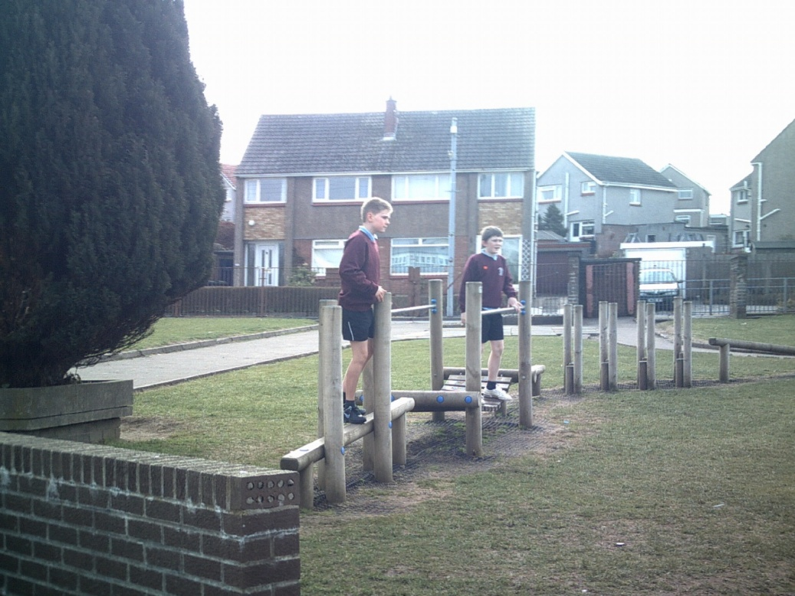
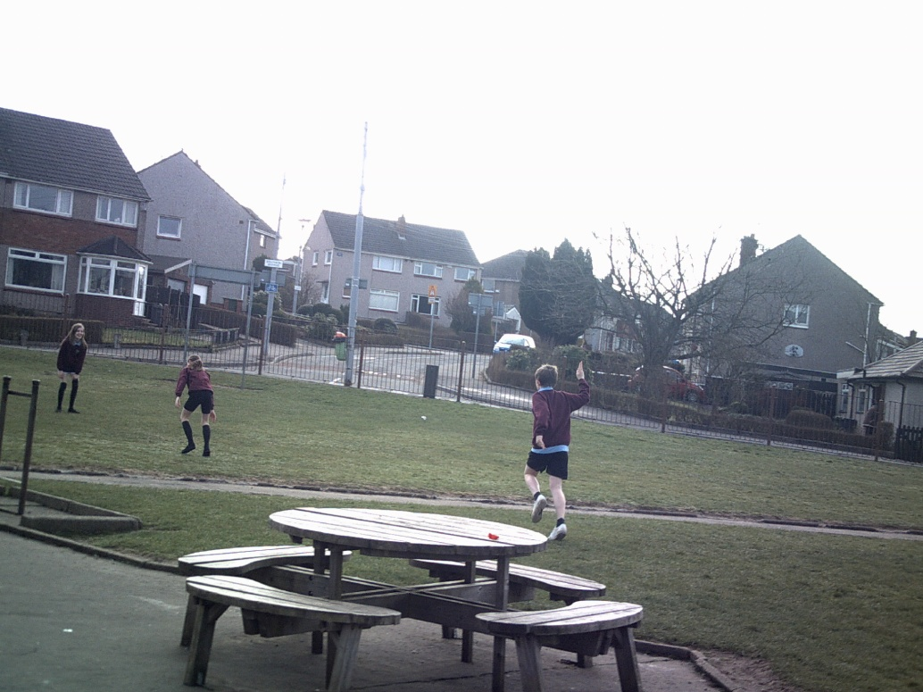
FROM OUR WINDOW –
BALMUILDY PRIMARY SCHOOL
We have lots of places to eat and play outside.

Slide 8
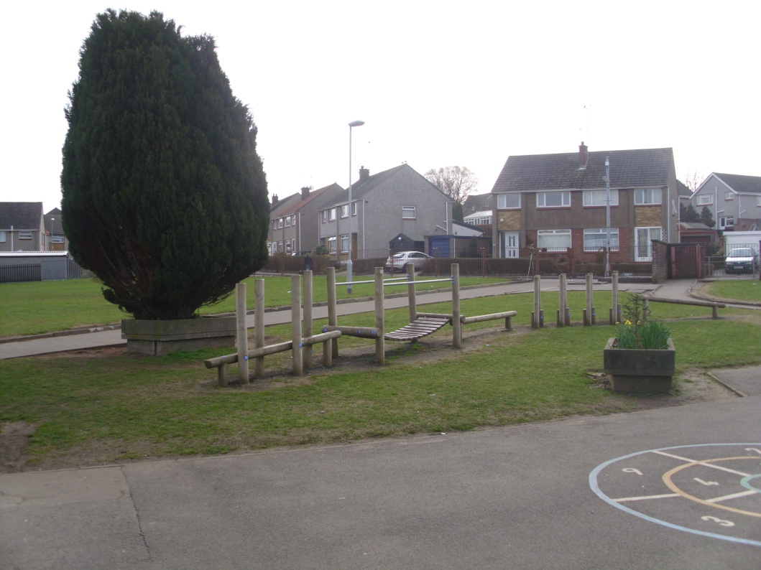
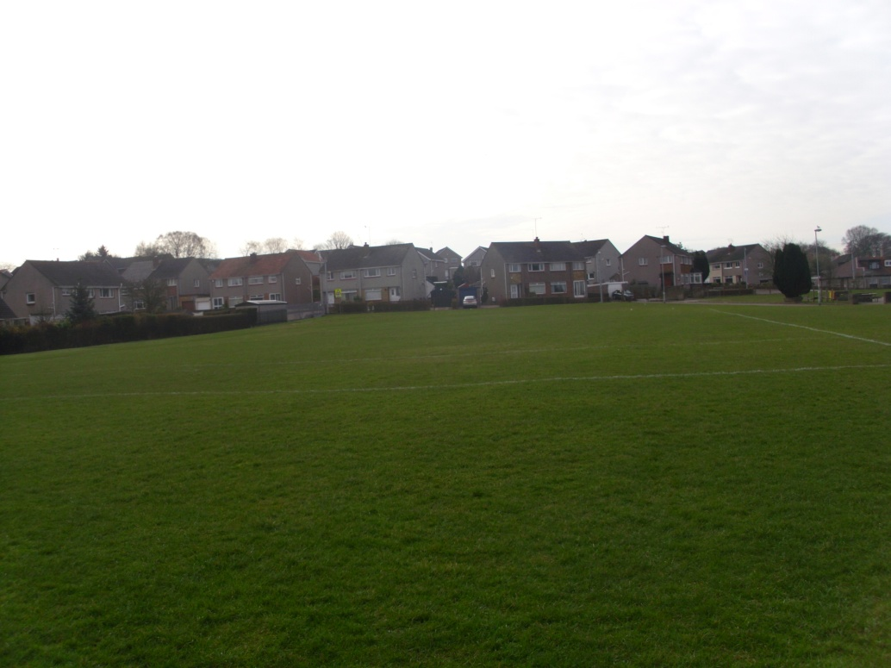
FROM OUR WINDOW –
BALMUILDY PRIMARY SCHOOL
We can see lots of houses from our windows.
We are surrounded by lots of grassy playing fields.

Slide 9
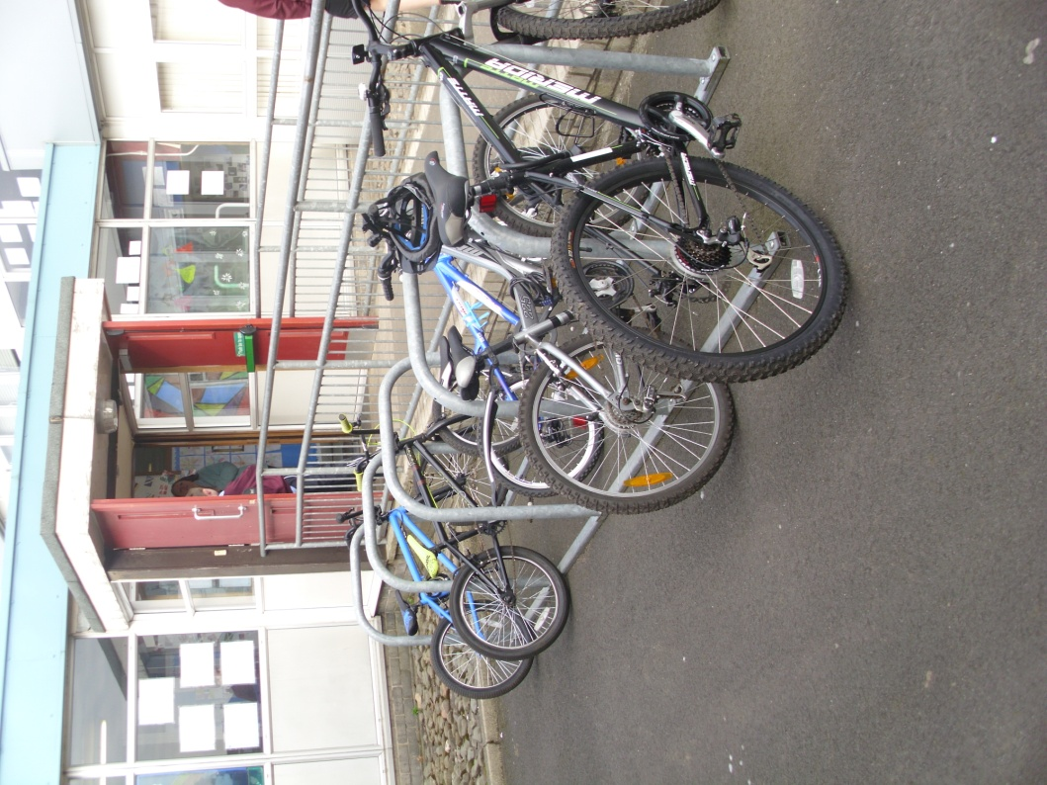
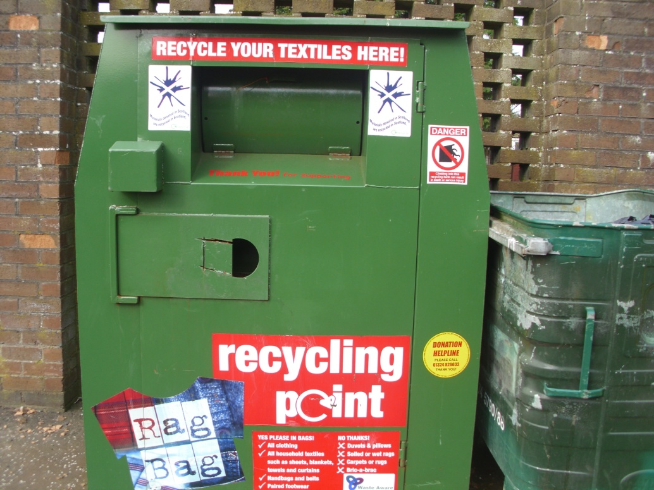
FROM OUR WINDOW –
BALMUILDY PRIMARY SCHOOL
Many pupils cycle to school to stay healthy.
We recycle as much as possible to help the environment.

