Slide 1
MINING INDUSTRY
in Tarnobrzeg

Slide 2
WHAT IS SULPHUR?
Sulphur is an element known from prehistorical times, it is a part of minerals and rocks. In nature it appears alone or in combinations of sulphides, hydrogen sulphide, in organic proteins. Deposits of sulphur were formed in the Tertiary. Fumes of sulphur appear during the volcanic activity.. The output in world Poland is among top ten countries in terms of getting.1, 5 tonnes annually. Poland also produces sulphuric acid and part of it is exported to Eastern Europe. The biggest deposits of sulphur are situated in Tarnobrzeg, as well as in the area of Świętokrzyskie Mountains, Lubaczewki area. Sulphur is extracted with the use of an open-cast method and by melting it in hot water, which is cheaper but unfortunately less effective.

Slide 3
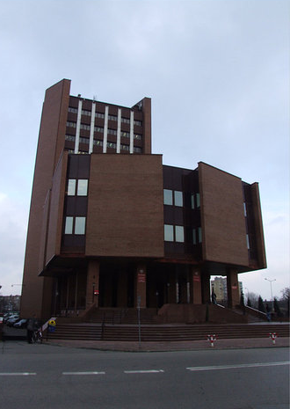
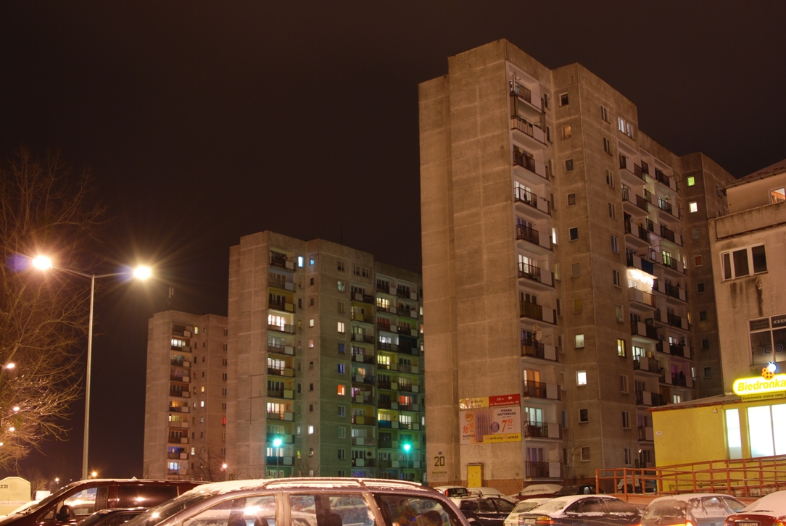
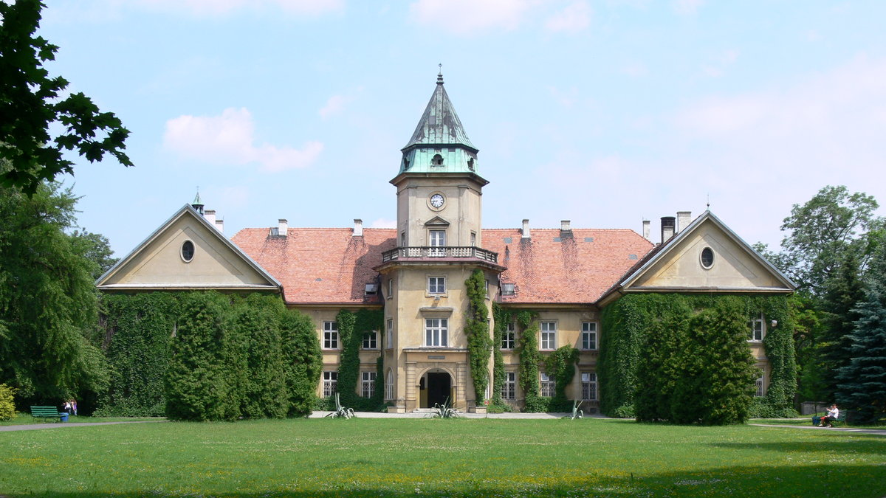
Building development…

Slide 4
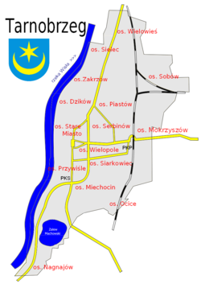
Tarnobrzeg was the center of the extraction and transformation of sulphur and sulphuric acid from 1953 when Stanisław Pawłowski discovered the sulphur deposits in Mokrzyszów ( the part of Tarobrzeg). Unfortunately getting sulphur became economically unprofitable First, the mine was closed in Piaseczno, then mine Machów (after 40 years of extraction of sulfur - mine was the largest opencast Machów sulfur mine in Europe). Finally, in the nineties, the mine were transformed to lake. The latter was operated a little longer, because they "use more modern methods of extraction of sulfur (by underground smelting), which limited the number of needed people to work and result in long-term profitability of production. Currently, mines and Piaseczno Machów flooded by water from the Vistula River, and there are created artificial reservoirs. Since the nineties of the twentieth century in the areas of establishments operating Siarkopol SEZ.

Slide 5
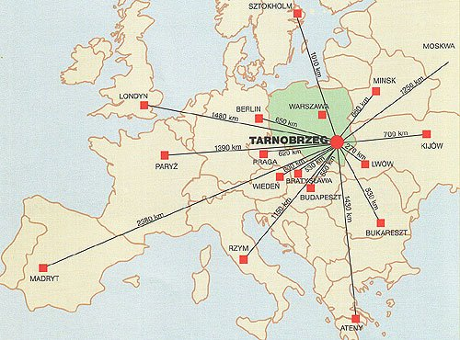
Export of Tarnobrzeg’s sulphur years ago.

Slide 6
About „SIARKOPOL” in Tarnobrzeg
„Siarkopol” TARNOBRZEG CHEMICAL PLANTS, Ltd.
Was established as a result of structural reorganisation of „Siarkopol” Sulphur Mines, which had been one of the leading world producers and exporters of sulphur before.
The products are famous for their quality in the markets of mineral fertilisers, commercial grades of sulphur, bleaching earth and cryolite.
Would like to emphasise flexibility and willingness to meet all requirements and needs of our clients.
Owing to efforts and co-operation with well-known research institutes are yielding good results in a from of new products in offer (new formulas of fertilisers, crop protection chemicals).

Slide 7
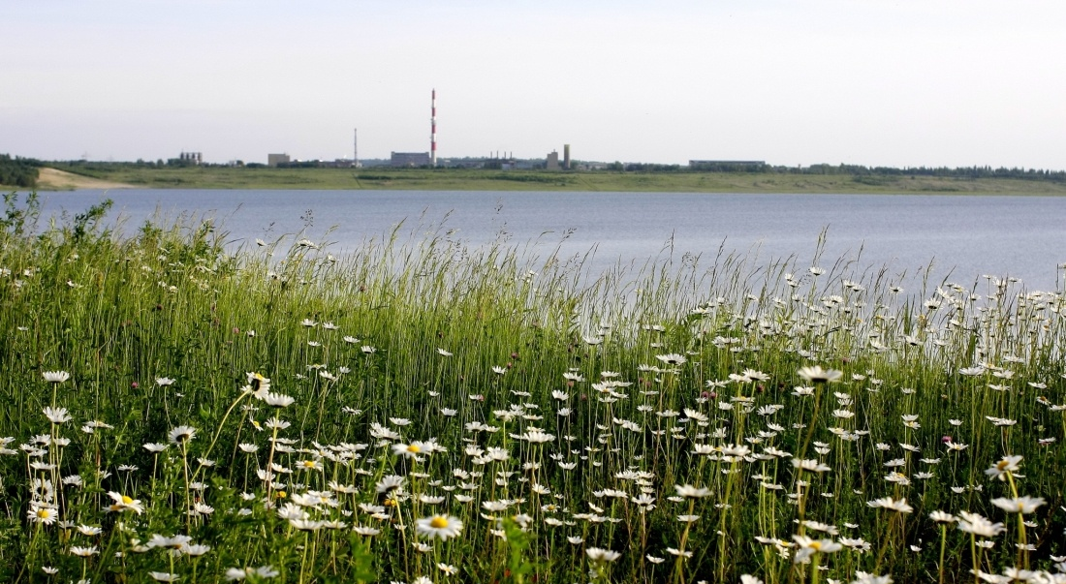
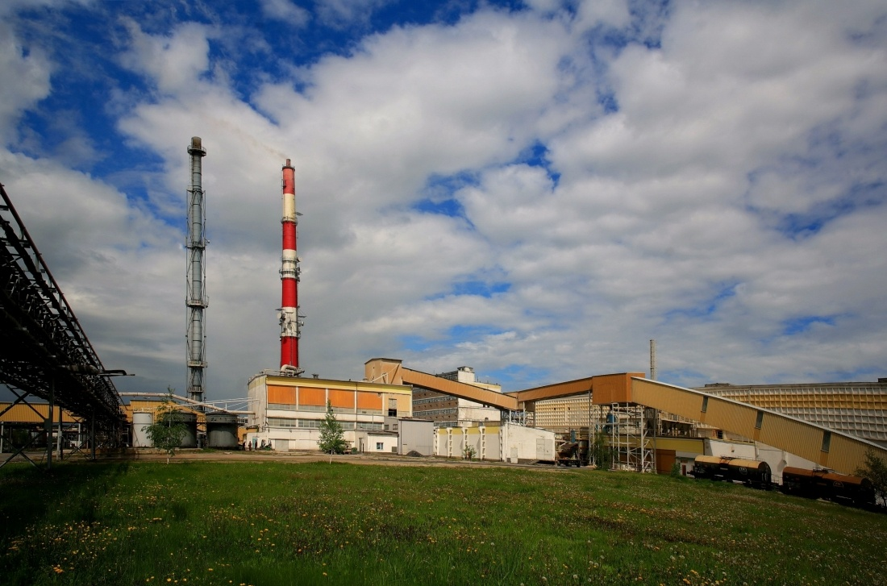
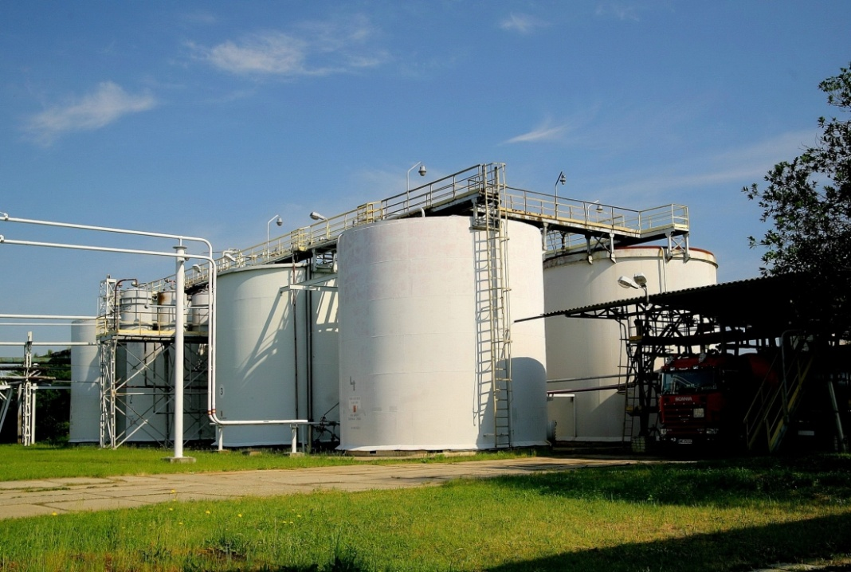
SIARKOPOL TARNOBRZEG

Slide 8
Tarnobrzeg’s Special Economic Area – EURO-PARK WISŁOSAN
was established in 1997. At present the territory of the zone is 1336.44 ha. The zone is located in 12 subzones in 5 provinces:
• Podkarpackie
• Świętokrzyskie
• Mazowieckie
• Lubelskie
• Dolnośląskie
The center of TSSE is Tarnobrzeg.

Slide 9
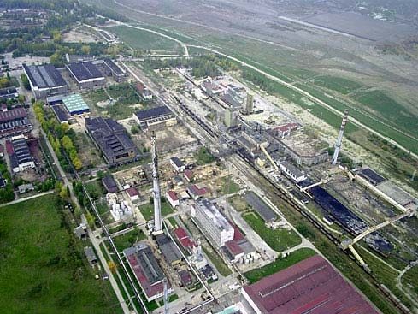
The photo of Tarnobrzeg’s Special Economic Area.

Slide 10
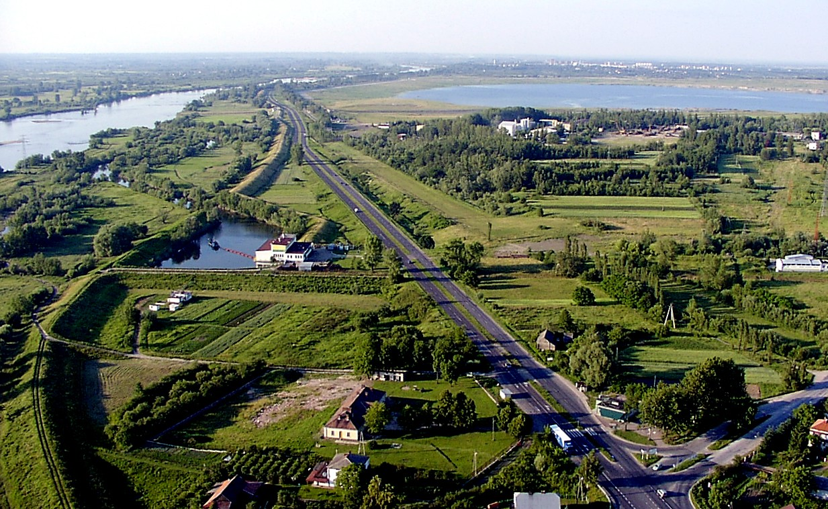
TARNOBRZEG
Machow
lake
The Vistula River
City centre
TSSE
WISŁOSTRADA:
One of the most important roads in Tarnobrzeg

Slide 11
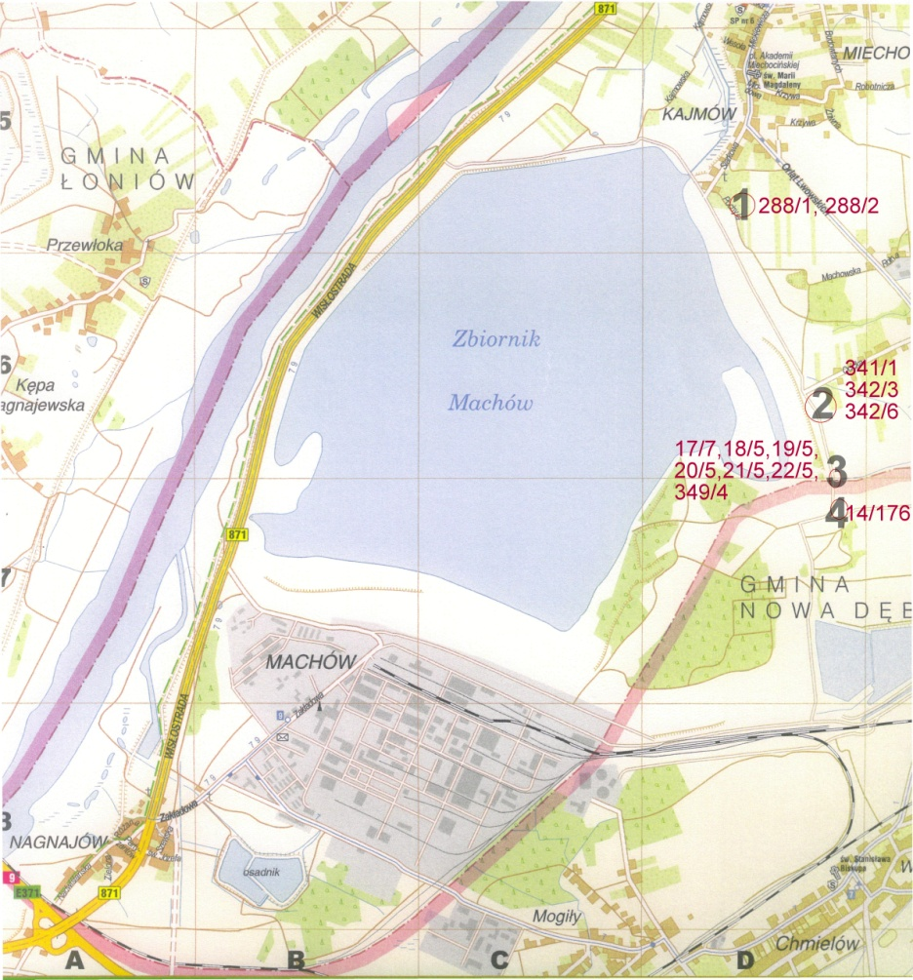
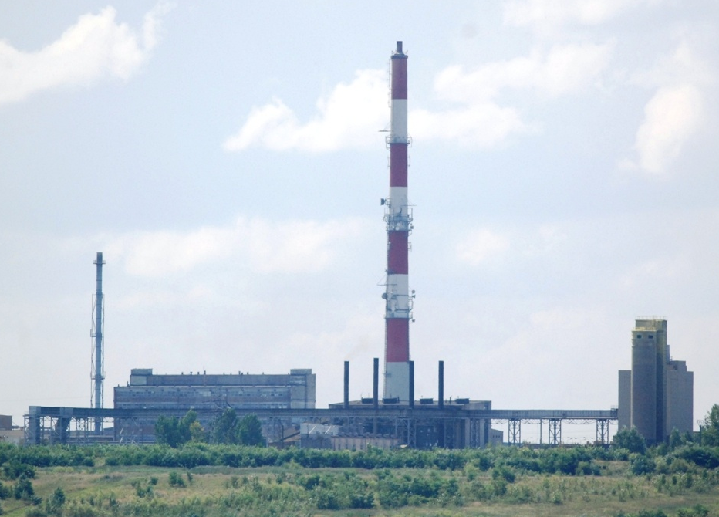
Where is TSSE??
Tarnobrzeg centre

Slide 12
THE END ☺

