Slide 1
CLASSICAL INDIAN DANCES PRESENTED BY Alekhya, VIII A RPVV, TYAGRAJ

Slide 2
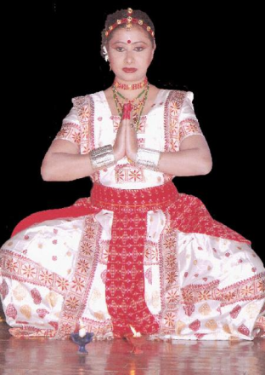
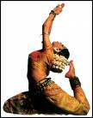
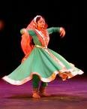
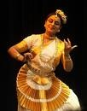
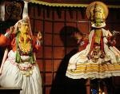
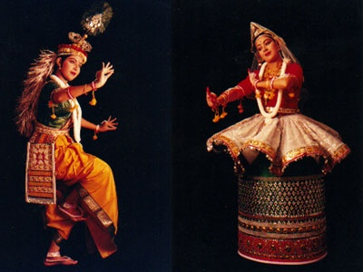
INTRODUCTION - 1
There are eight dances in India that are termed classical. Classical dances of India are, usually, spiritual in content.

Slide 3
INTRODUCTION - 2
Bharata's Natya Shastra (a book on Dance) gives the fundamental principles for every technique and forms of dance. Dance in India, is rooted to age-old tradition. This vast sub-continent has given birth to varied forms of dancing, each shaped by the influences of a particular period and environment. The nation offers a number of classical dance forms, each of which can be traced to different parts of the country. Each form represents the culture of a particular region.

Slide 4
MEANING OF CERTAIN WORDS THAT HAVE BEEN USED IN THE SLIDES
Bhava → Expression
Raga → Melody
Tala → Rhythm
Natyam → Dance
Nritta → Pure Dance
Nrtya → Expressive Dance
Natya → Abhinaya (Mime)

Slide 5
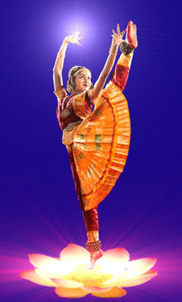
BHARATNATYAM
Bharatanatyam is one of the most popular Indian dances and belongs to Tamil Nadu in South India. The name is derived from the word ‘Bharatha’, and is associated with the Natyashastra, the ancient book on dances. Hence the name Bharatnatyam. Bharatanatyam is based on bhava or mood, raga or music and melody or tala. There are 64 principles of coordinated hand, foot, face and body movements. It is known for its beauty and aesthetic perfection.

Slide 6
ODISSI
Odissi is considered to be one of the oldest surviving dance forms based on archaeological evidence. It owes its origin to the temple dances of the devadasis (temple dancers). Odissi has been mentioned in inscriptions and depicted on sculptures. In Odissi, hand gestures and facial expressions are used to interpret a storyline or theme. The Odissi dancers use their head, bust and torso in soft flowing movements to express moods and emotions. It is a soft, lyrical classical dance which depicts the popular devotion to Lord Krishna and the verses of the Sanskrit play Geet Govinda are used to depict the love and devotion to God.

Slide 7
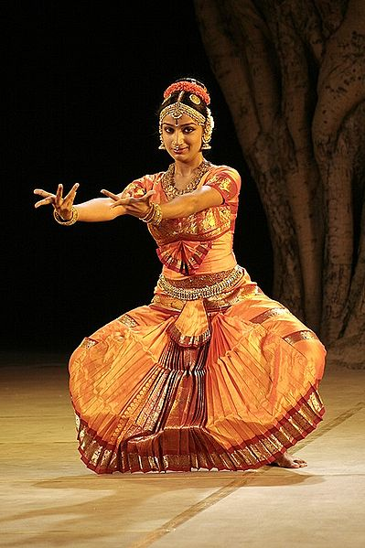
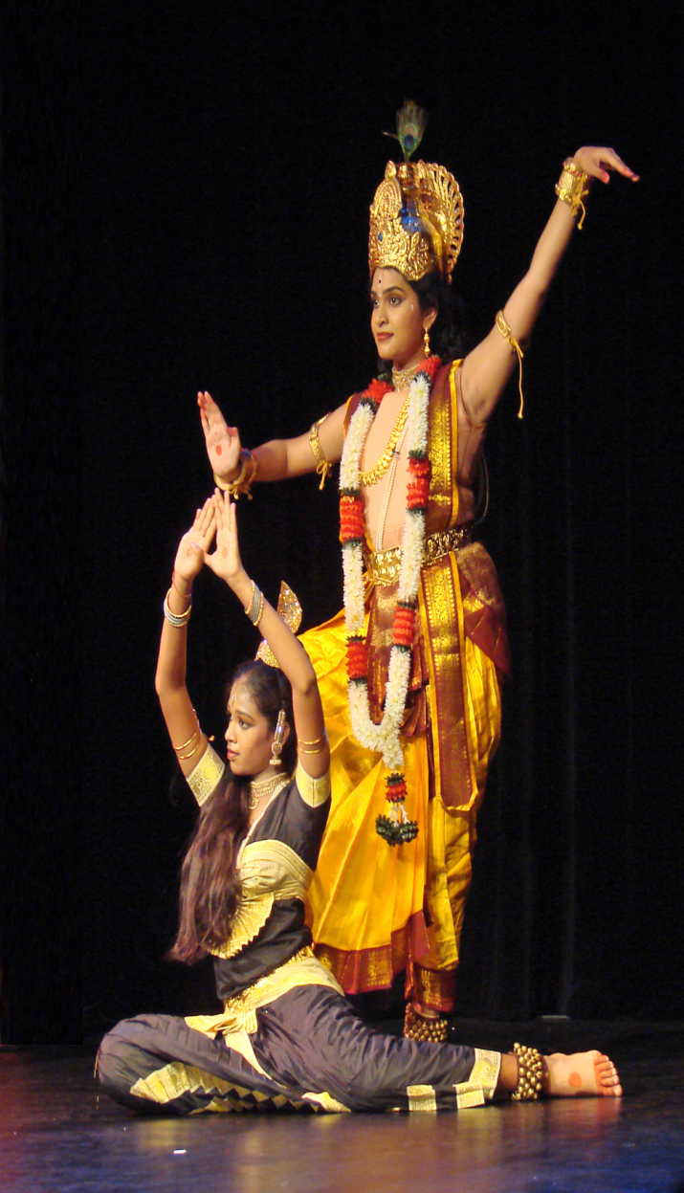
KUCHIPUDI
Kuchipudi, the dance of Andhra Pradesh was for a long time presented only at temples during annual festivals in Andhra.The most popular Kuchipudi dance is the pot dance in which a dancer keeps a pot filled with water on her head and feet kept on a brass plate. She moves on the stage manipulating the brass plate, with the feet kept on its rim and doing some hand movements without spilling a drop of water on the ground. The style is a blend of folk and classical. This is why this technique has greater freedom and fluidity than other dance styles.The costume is simple and the makeup is not so heavy.

Slide 8
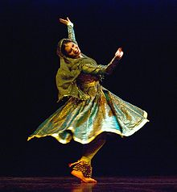
KATHAK
Kathak is characterized by rhythmic footwork danced under the weight of more than 100 ankle bells, spectacular spins, and the dramatic representation of themes from Persian and Urdu poetry alongside those of Hindu mythology.
Its main feature is the fast circular movements of the feet
Traditionally the stories were of Radha and Krishna, but after the Mughals the dance became more entertaining and less religious.

Slide 9
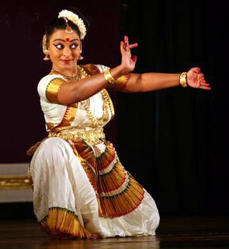
MOHINI ATTAM
Mohini attam, the female semi-classical dance form of Kerala is said to be older than Kathakali. The theme of Mohini attam is love and devotion to God. Its known for its circular movements, delicate footsteps and subtle expressions. Through slow and medium speed, the dancer is able to suggest emotions. It is essentially a solo dance. The Mohini attam dancer maintains a realistic make-up and wears a simple costume, in comparison to costumes of other dances, such as Kathakali. The dancer is dressed in a beautiful white with gold border saree, and white jasmin flowers around a bun at the side of her head.

Slide 10
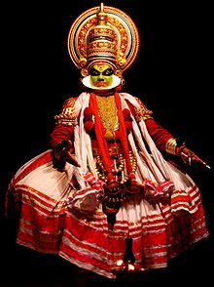
KATHAKALI
Kathakali means a story play or a dance drama and belongs to Kerala in South West India. In Kathakali, actors depict characters from the epics Ramayana and Mahabharata. It is an extremely colourful dance depicting the victory of truth over falsehood.
The dancers wear elaborate costumes, ornaments and crowns. They use a symbolic makeup to portray roles which are character-types and represent various qualities - human, godlike, demonic, etc. In Kathakali, characters never speak. They use hand-gestures and facial expression to narrate the drama.

Slide 11
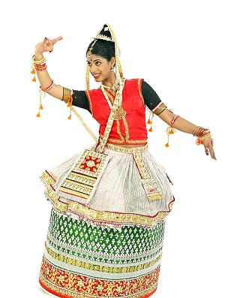
MANIPURI
Manipuri is the classical dance from the Manipur region in the north-east. Manipuri is different in many ways from the other dance forms in India. The body moves with slow, sinuous grace and the undulating arm movements flow into the fingers. The dance form evolved in the 18th century. This dance style consists of circular movement. In ancient texts it has been compared to the movement of the planets around the sun.

Slide 12
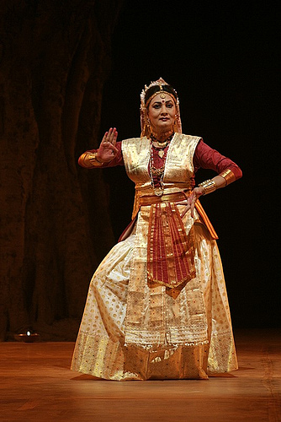
SATTRIYA NRITYA
The core of Sattriya Nritya is usually mythological stories. Traditionally, Sattriya was performed only by male monks in monasteries as a part of their daily rituals or during festivals. Today, Sattriya is also performed on stage by men and women who are not members of the monasteries on themes not merely mythological. This dance encompasses the principles mentioned in Natyashastra - aspects of nritta (pure dance), nrtya (expressive dance), and natya (abhinaya).

Slide 13
ACKNOWLEDGEMENTS
www.bhasabharathi.com/mohiniattam.htm
www.biocrawler.com/w/images/5/55/Bharata_natyam_dancer_medha.JPG
http://2.bp.blogspot.com/_8j1e7tuZj2k/SwEUeMOhNI/AAAAAAAAAFM/vwuEC1fXQpw/s1600/300px-Yamini_Reddy_kuchipudi.jpg
www.dollsofindia.com/dollsofindiaimages/custom_dolls/pd03_l.jpg
http://farm4.static.flickr.com/3136/3081713055_8a8432fafa.jpg
www.lokvani.com/lokvani/a_images/y2006/3350manipuri.jpg
http://en.wikipedia.org/wiki/Kathak
http://en.wikipedia.org/wiki/Kathakali

