Slide 1
Cadet Boarding school № 5
Russia, Moscow

Slide 2
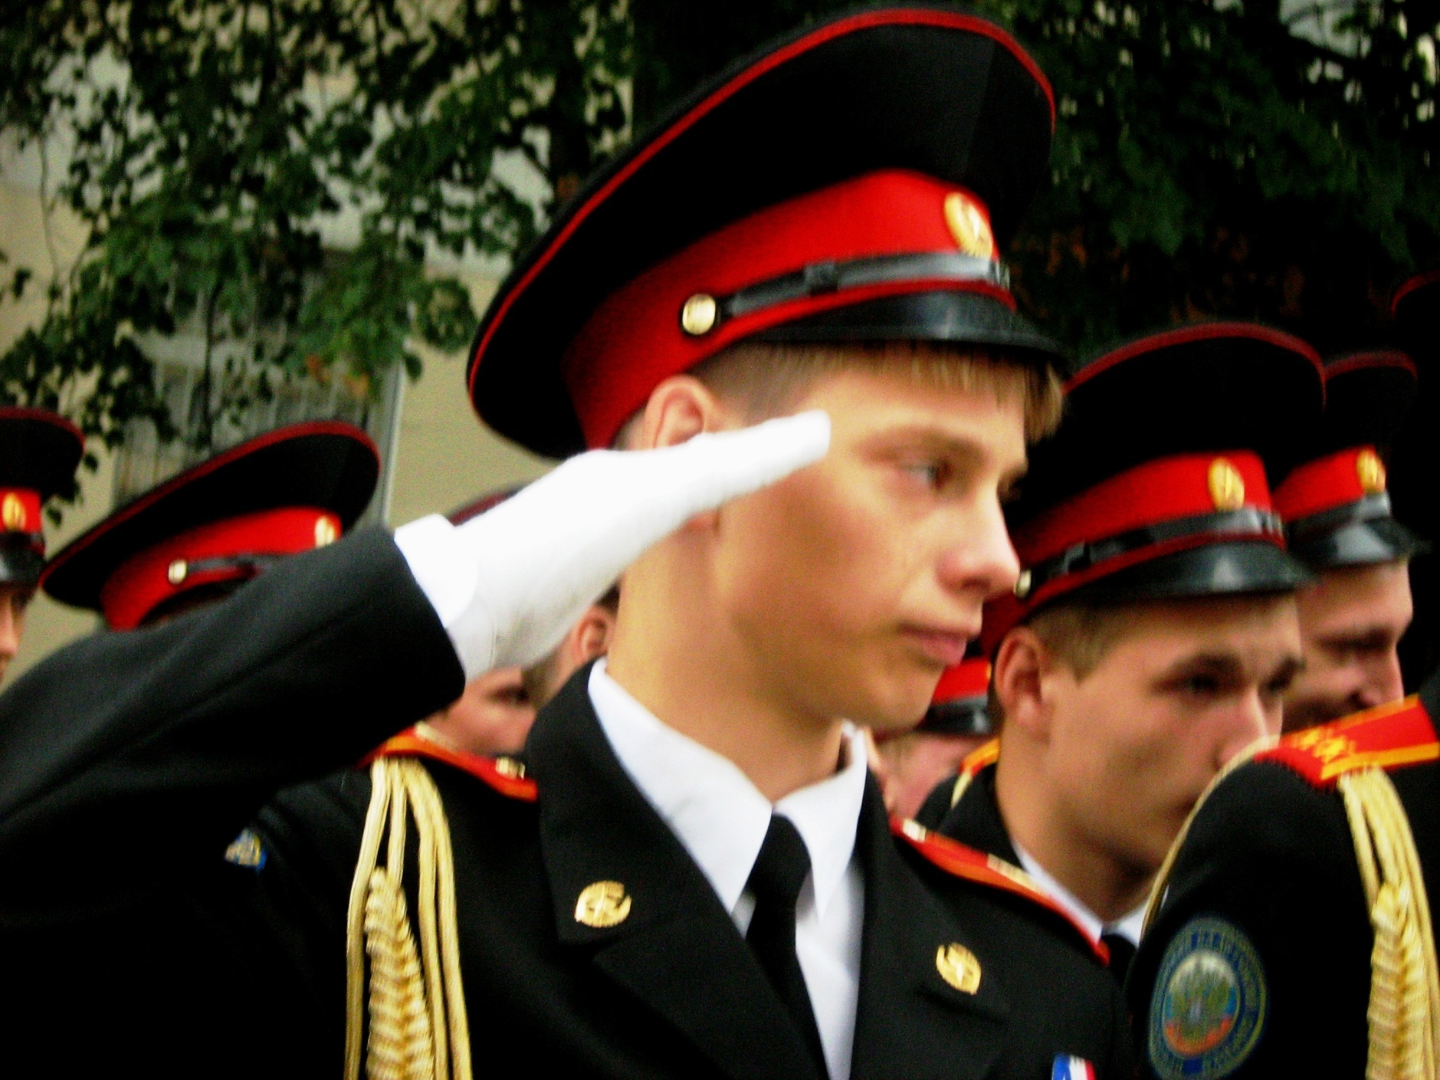

Slide 3
We learn at a Cadet Schoool. It means that we study all usual school subjects but also some extra classes such as drill and Fundamentals of military service.
Some of us want to be colonels or generals but the others choose different professions for their future.
We wear uniform , but we are typical teenagers like you.
We enjoy football and basketball, we listen to modern music and chat in the Net.

Slide 4
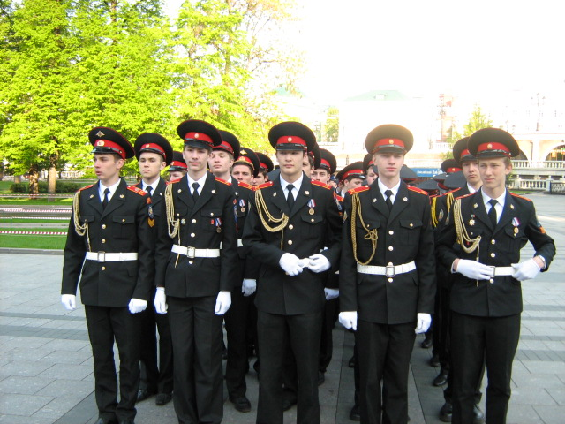

Slide 5
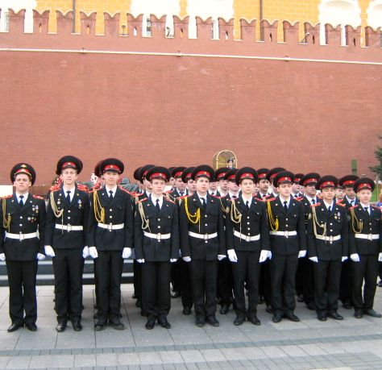
We are participants of main military parades in Moscow

Slide 7
We study and have a lot of hobbies

Slide 8
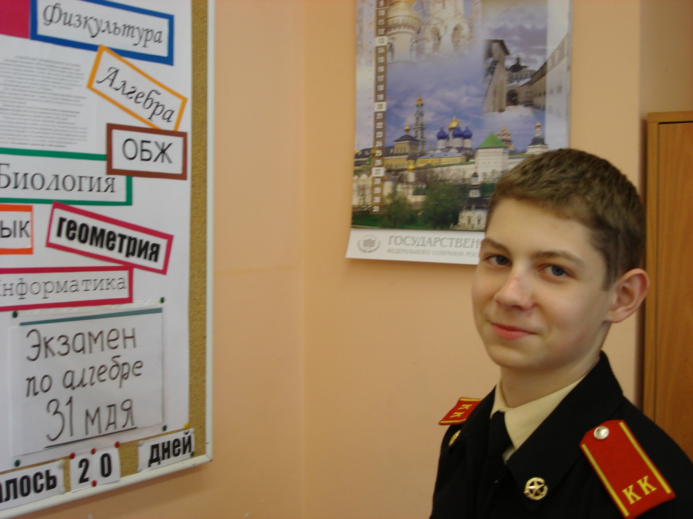

Slide 9
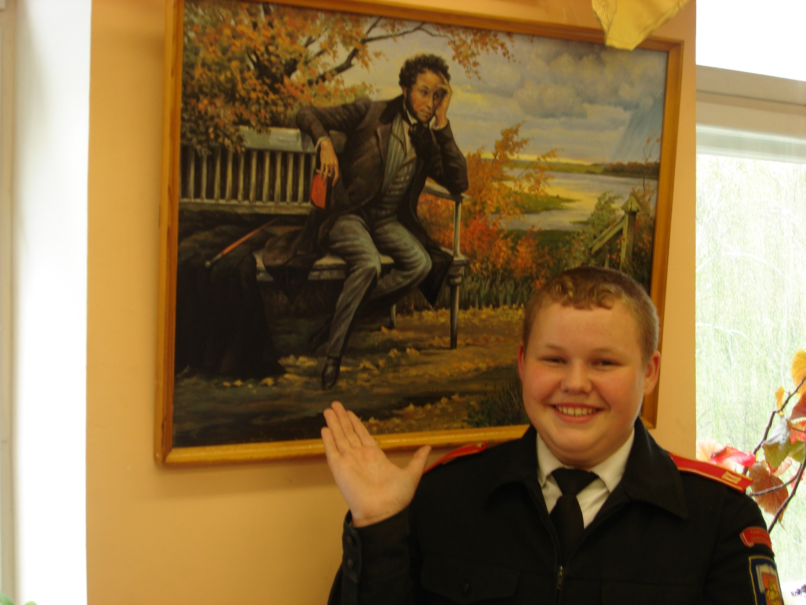

Slide 10
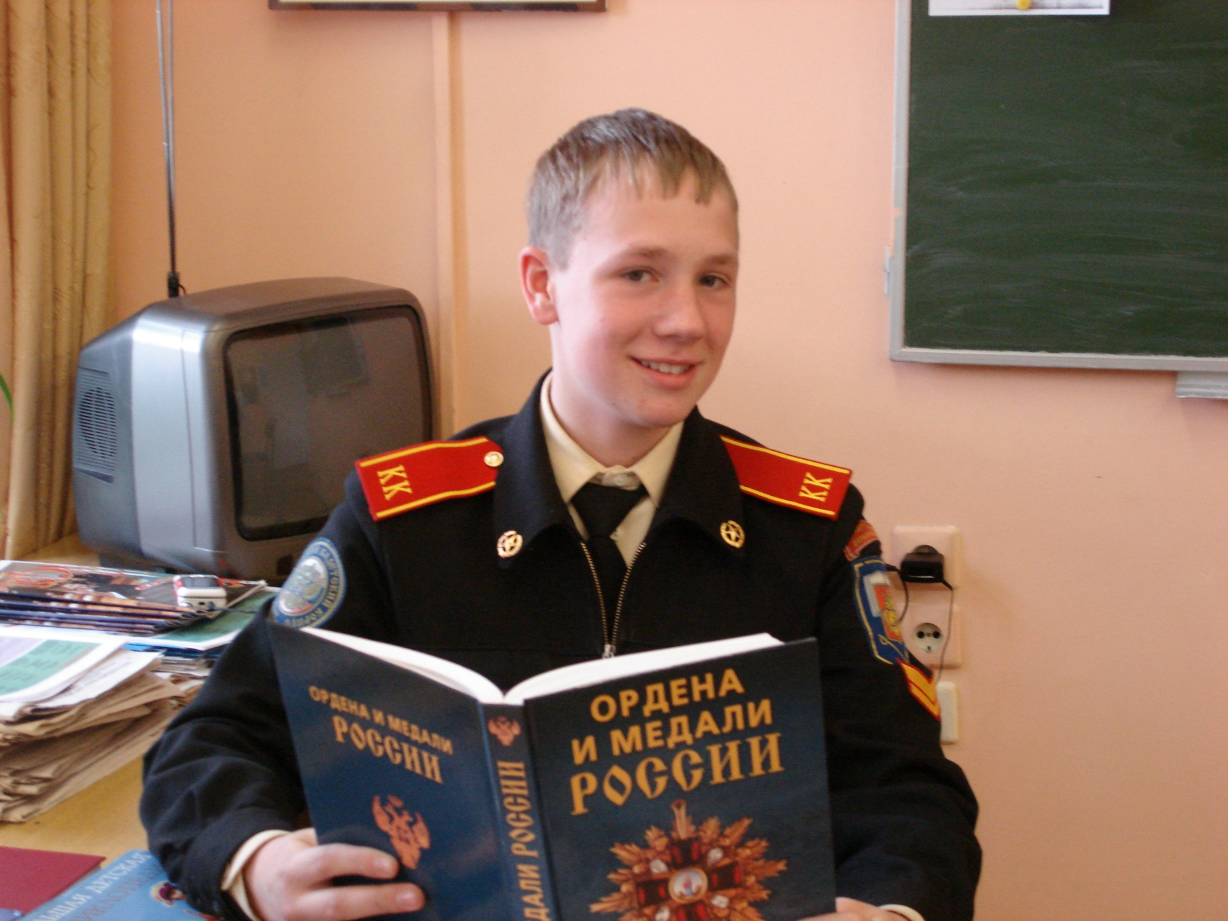

Slide 11
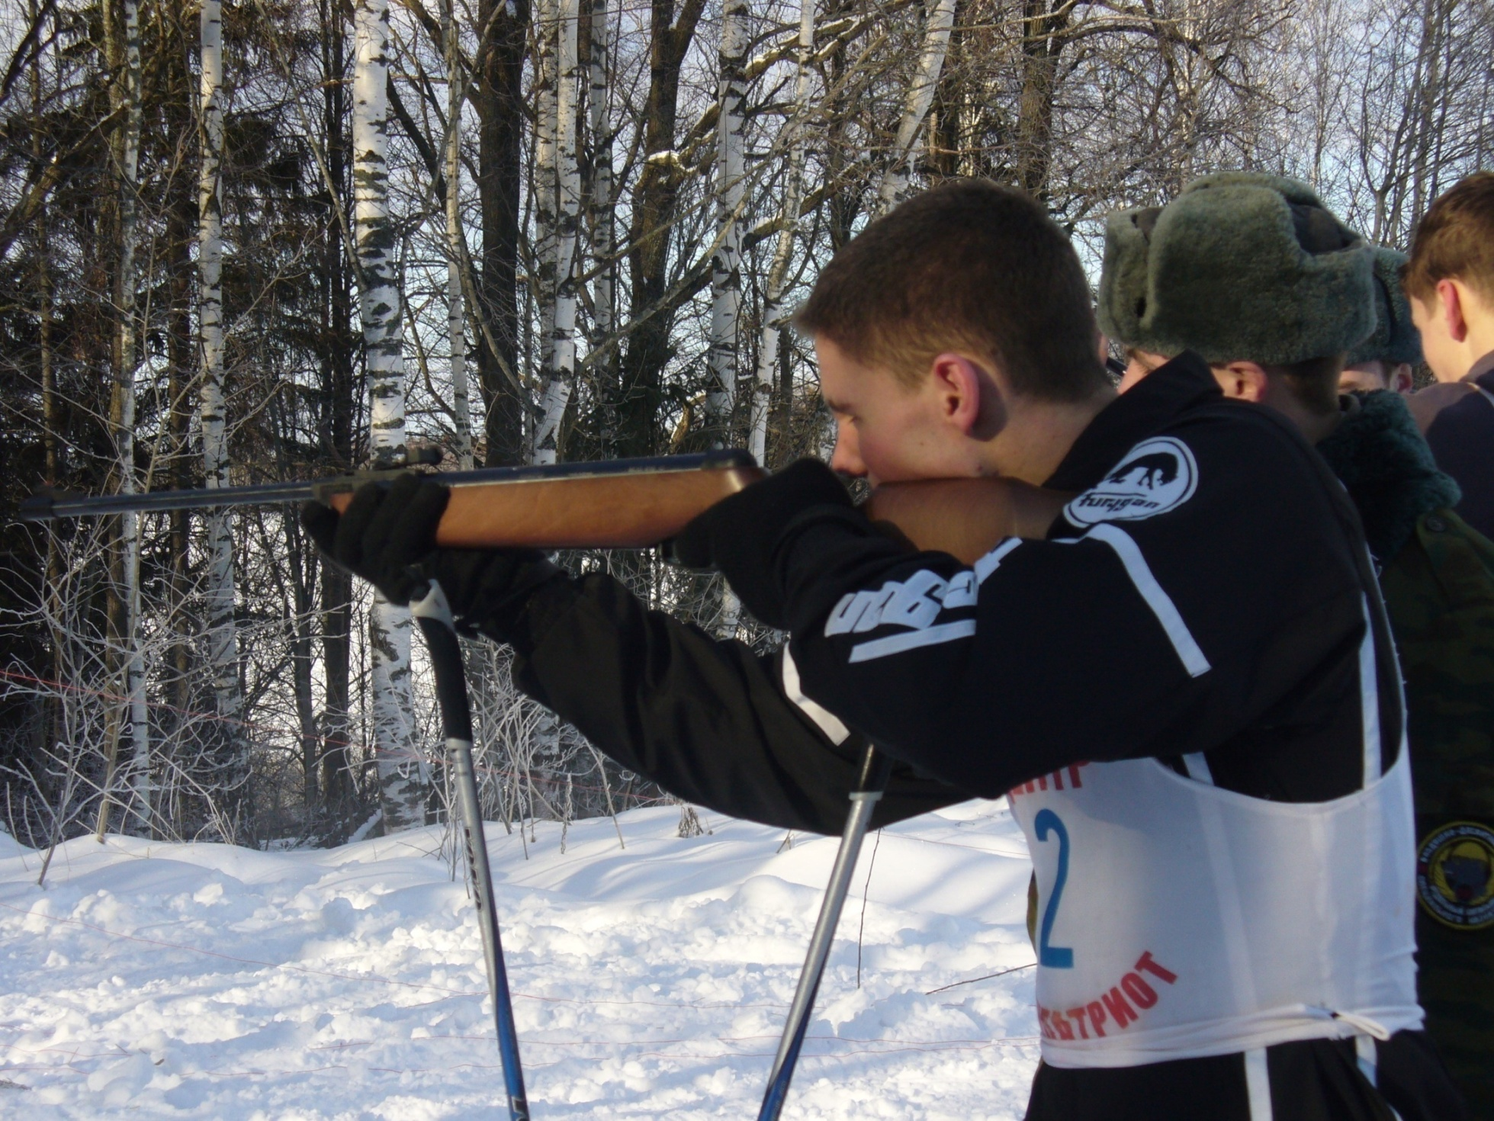

Slide 12
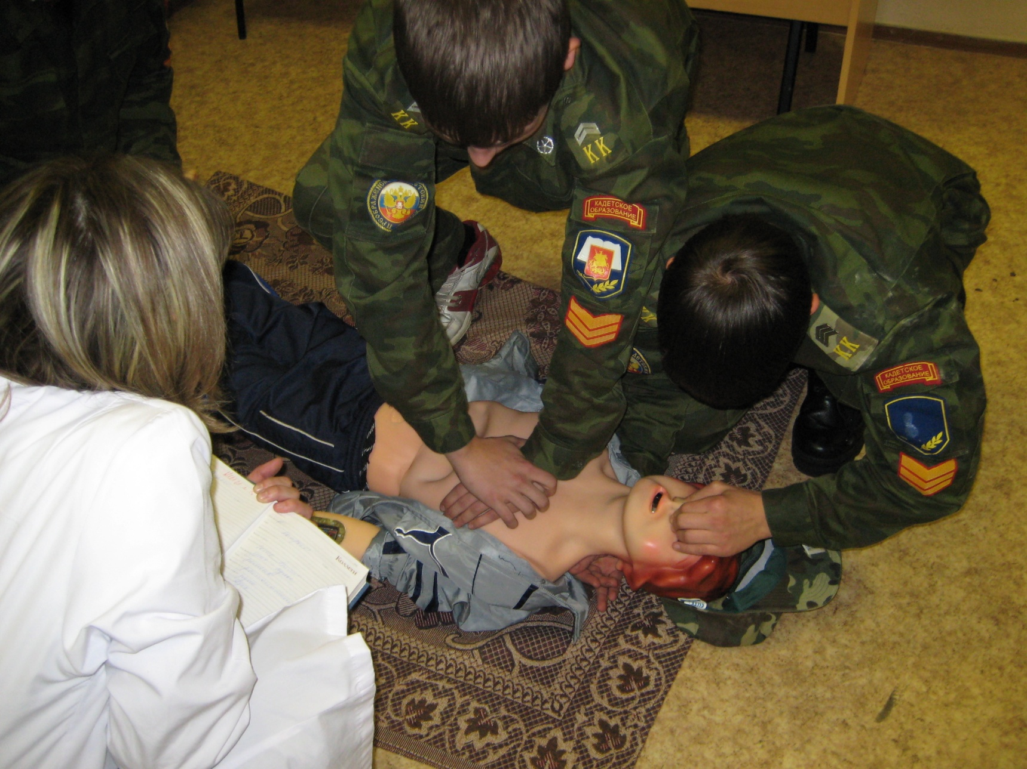

Slide 13
They are our best actors

Slide 14
They are live music lovers

Slide 15
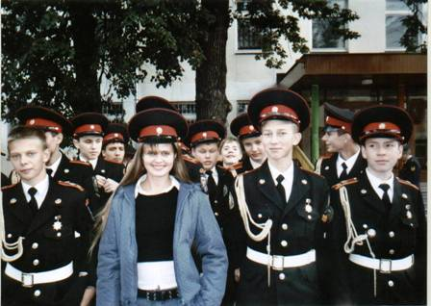
We have no girls!!!

