Slide 1
HUMBOLA
SHALAKA PHALNIKAR VD

Slide 2
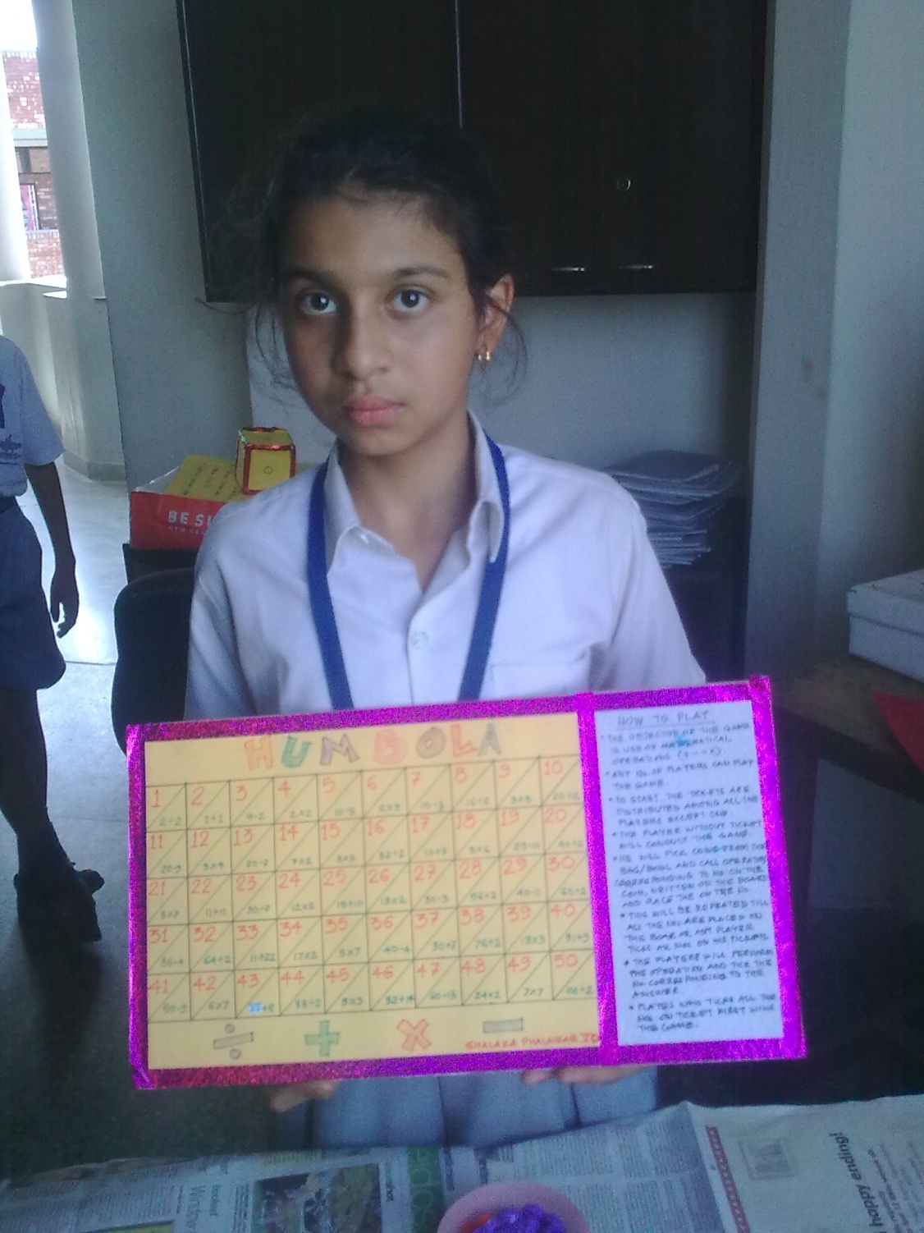

Slide 3
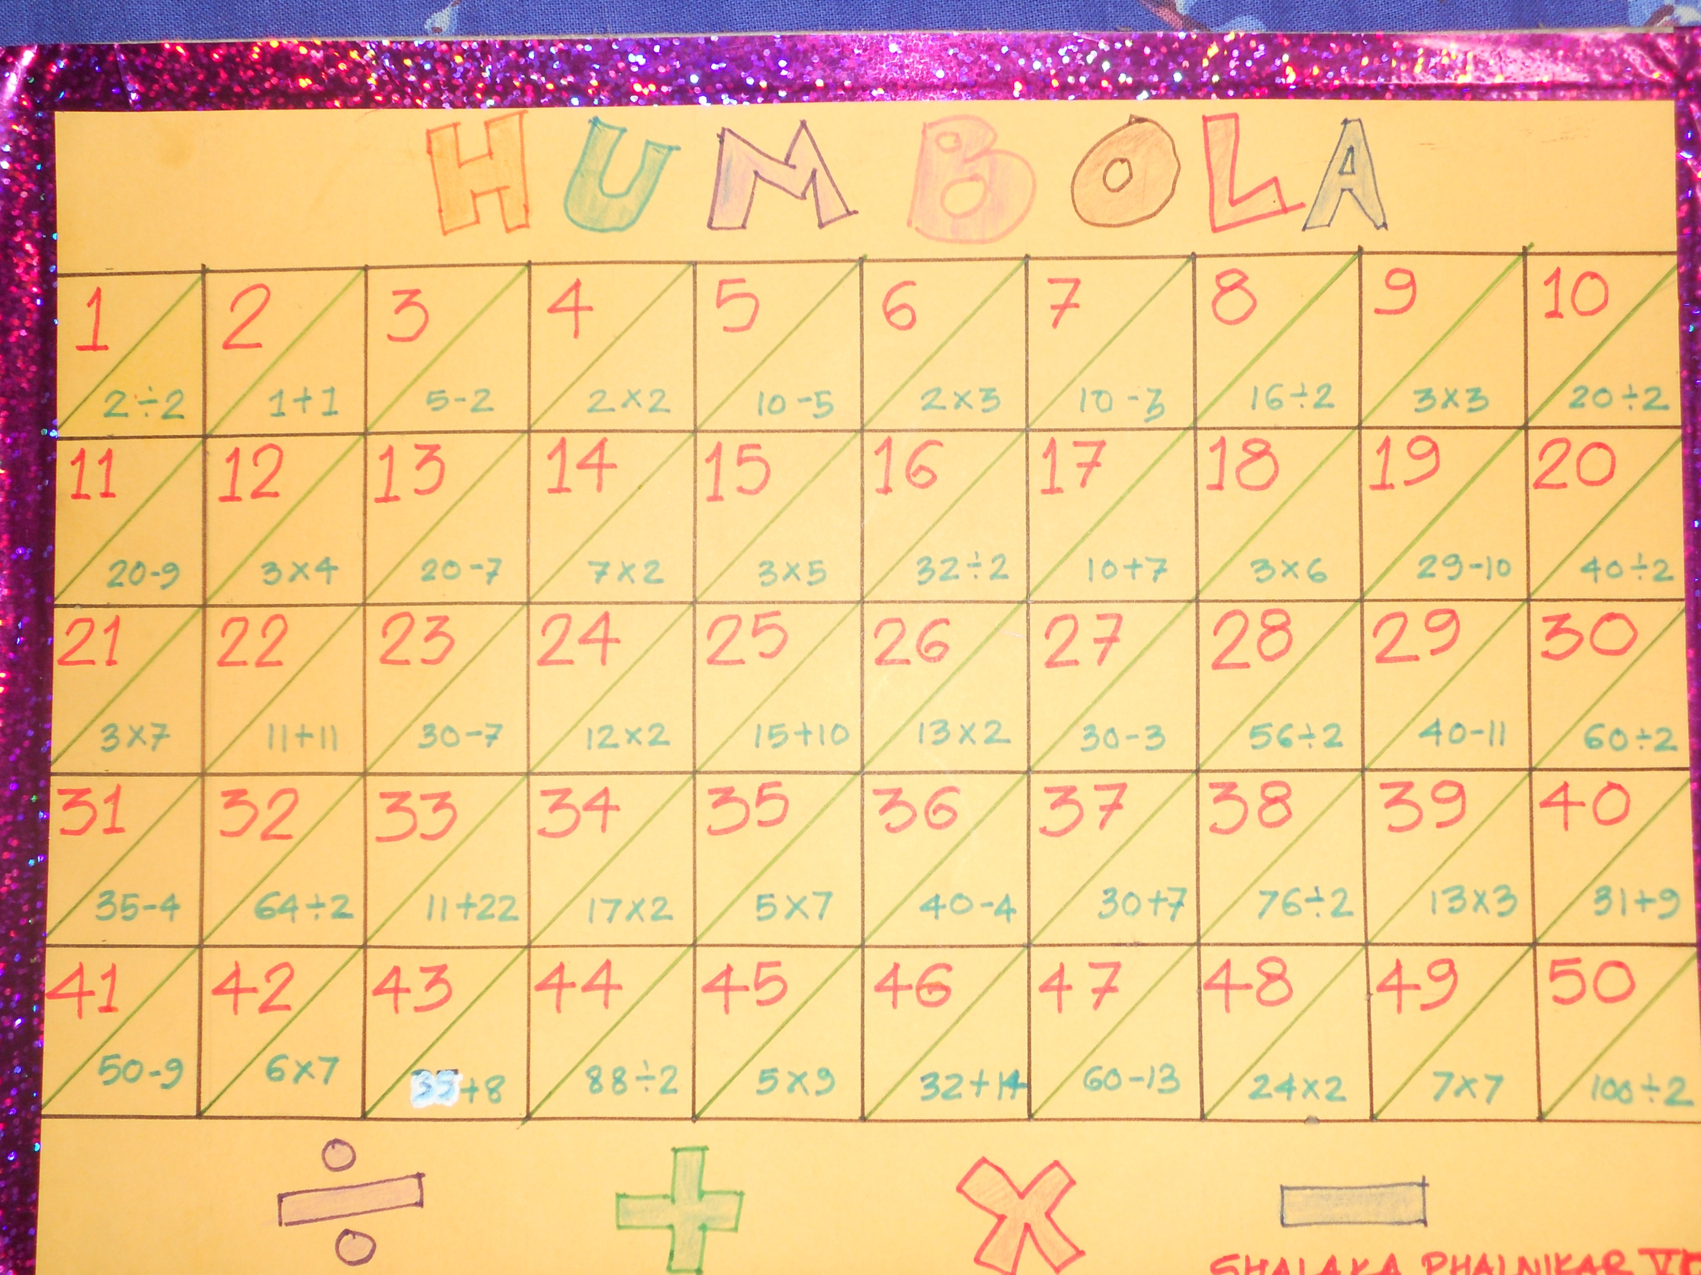

Slide 4
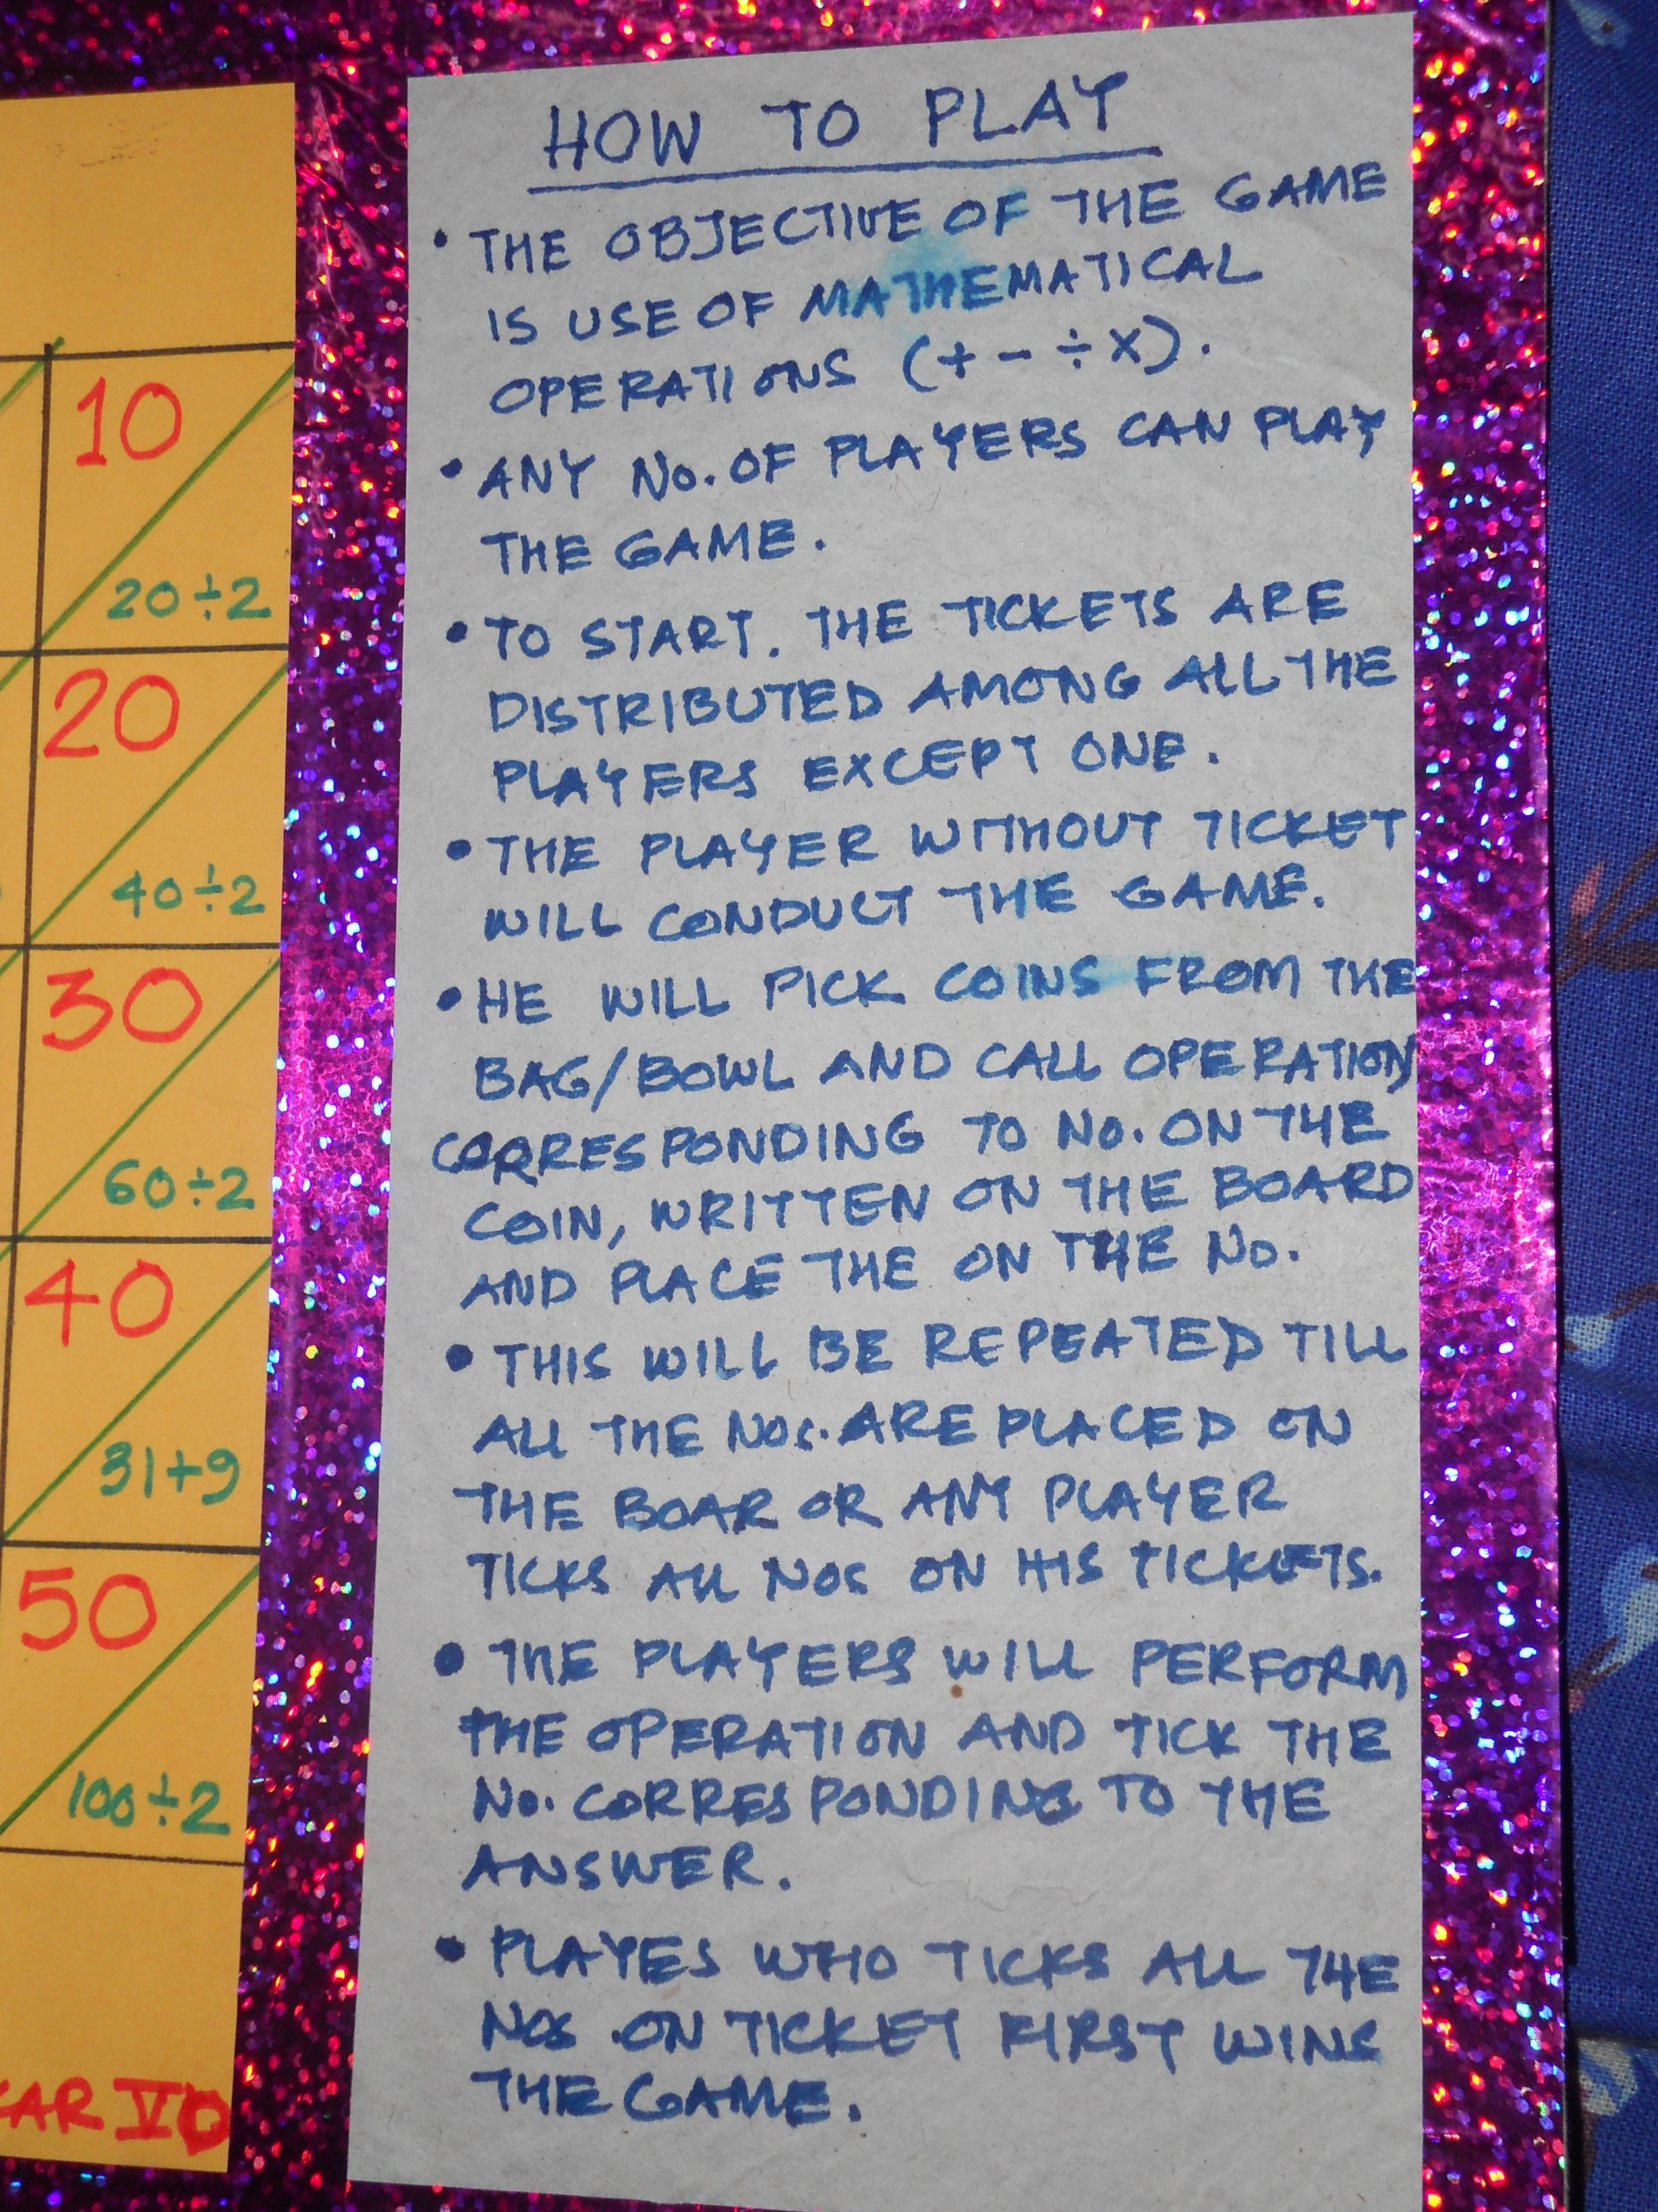

Slide 5
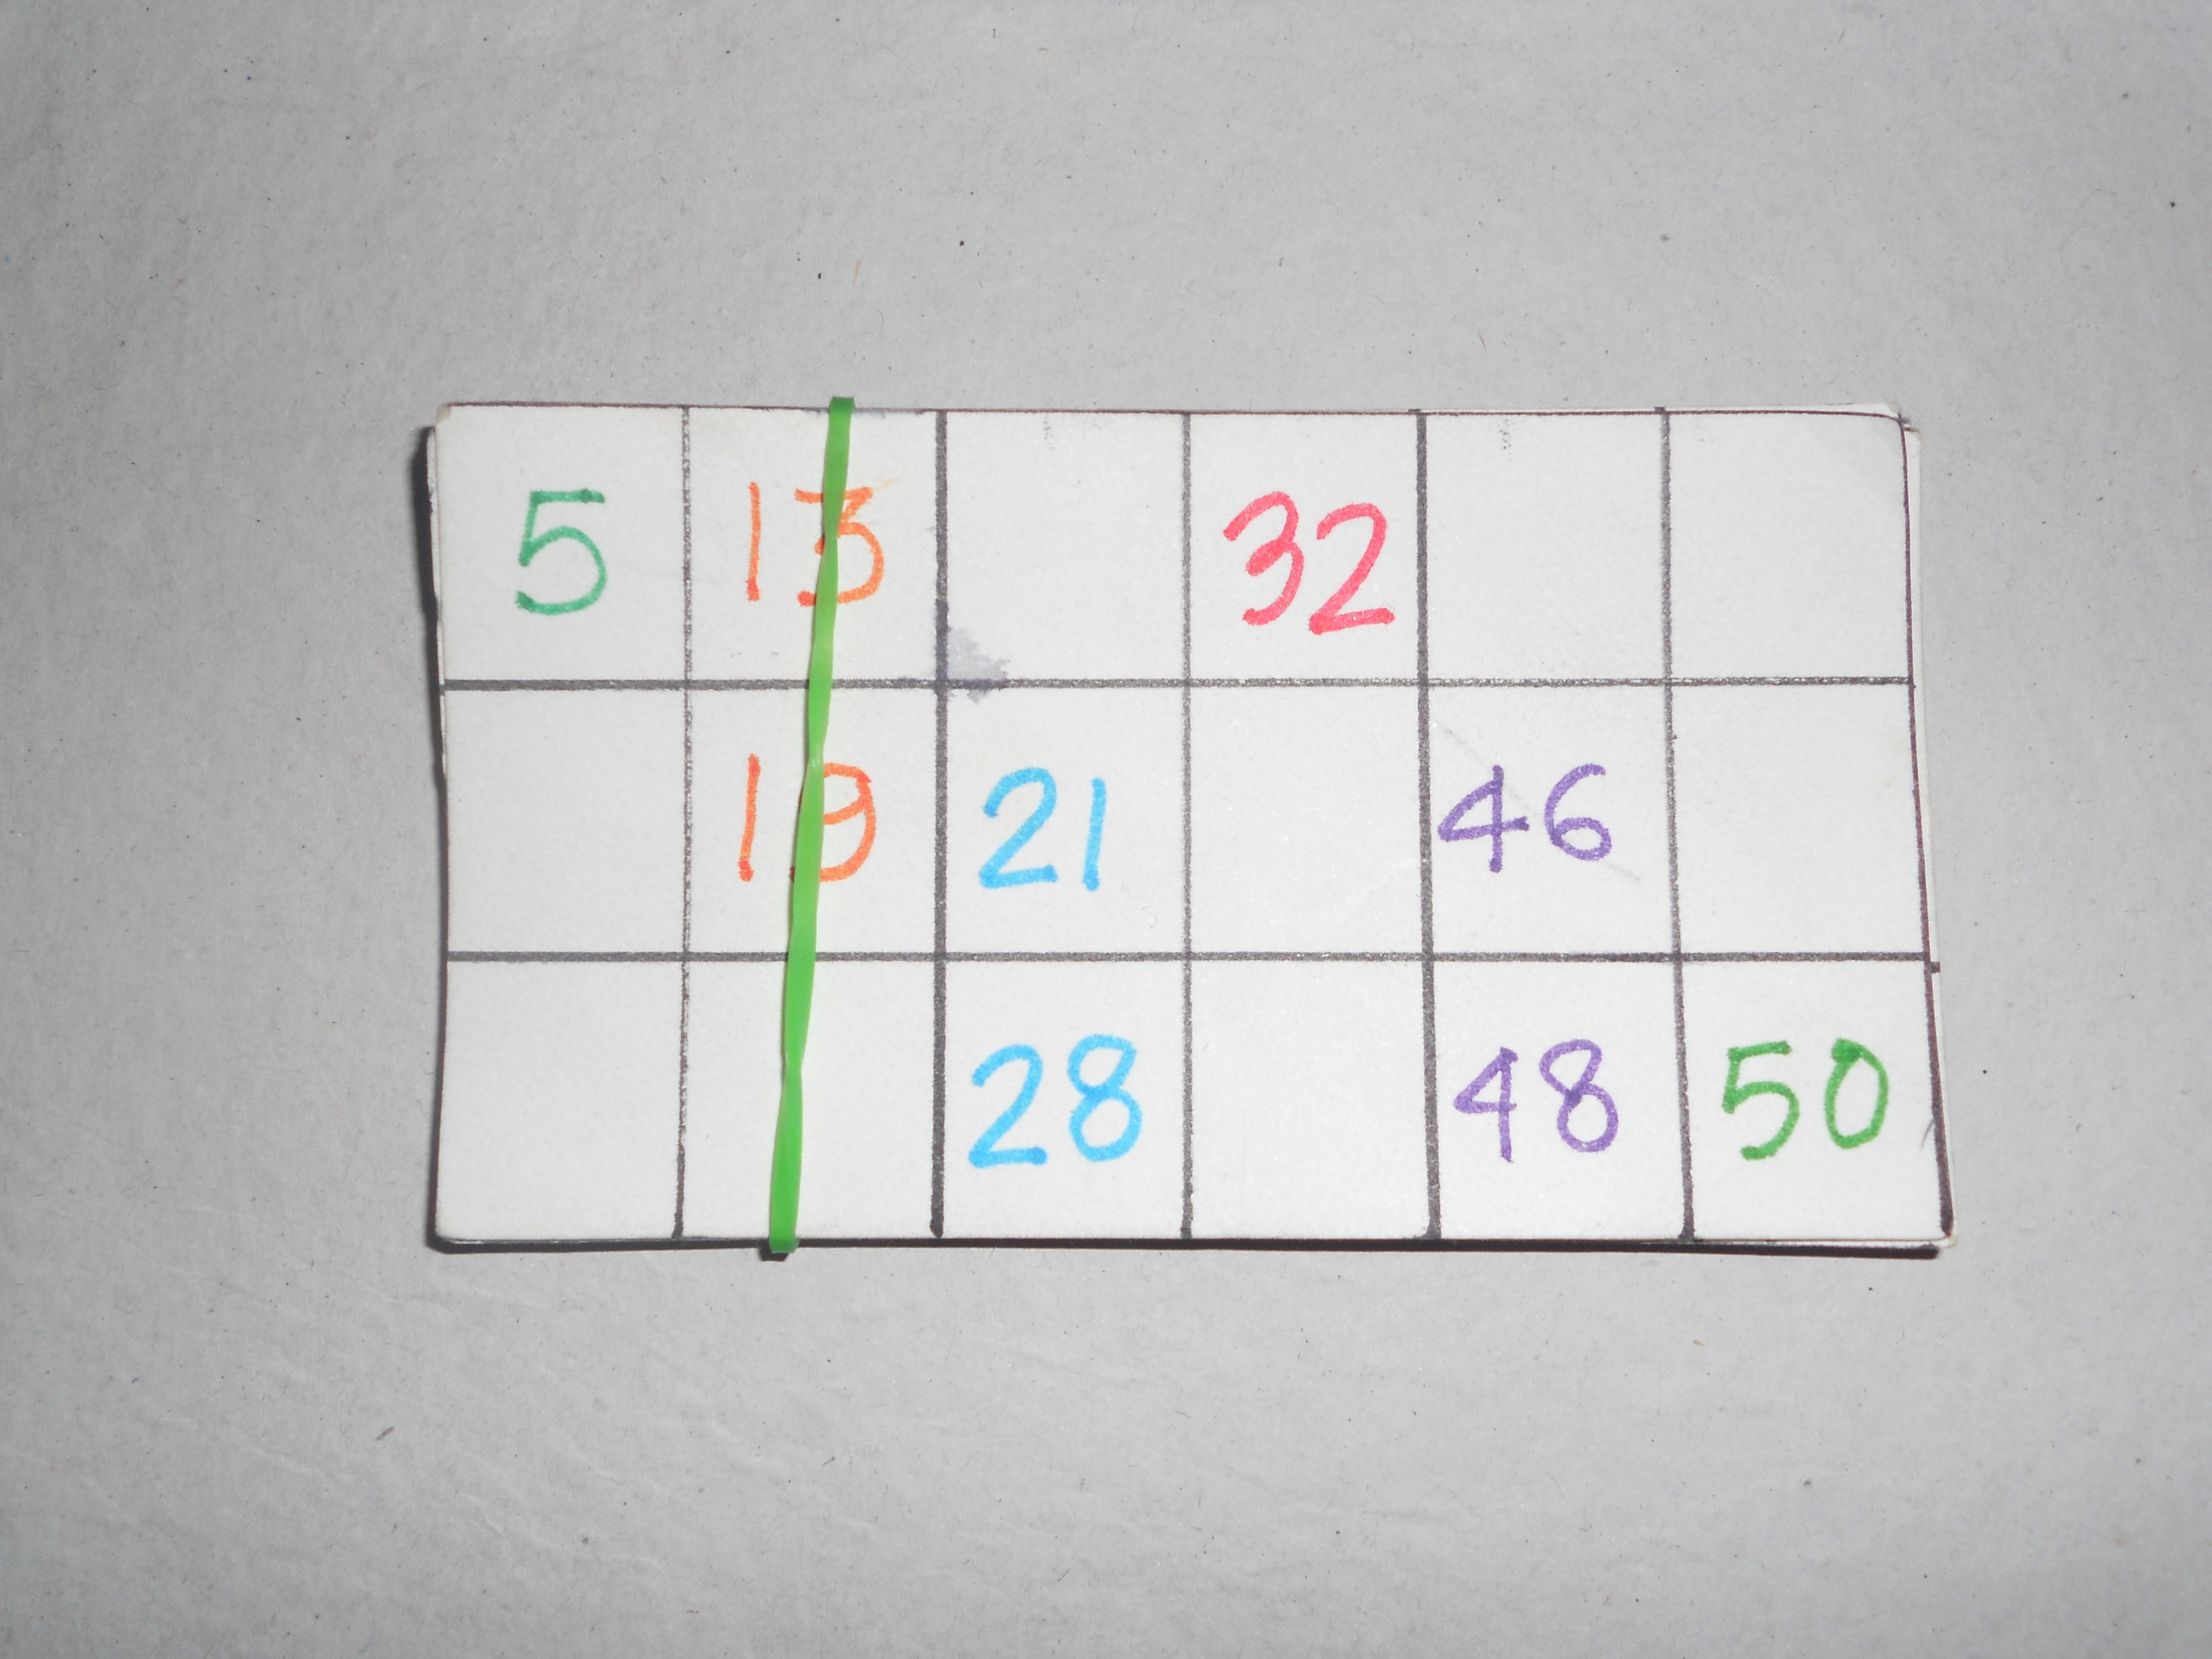
Notes:
Tickets for players

