Slide 1
Mental Ability Game By
Somya Samridhi VD

Slide 3
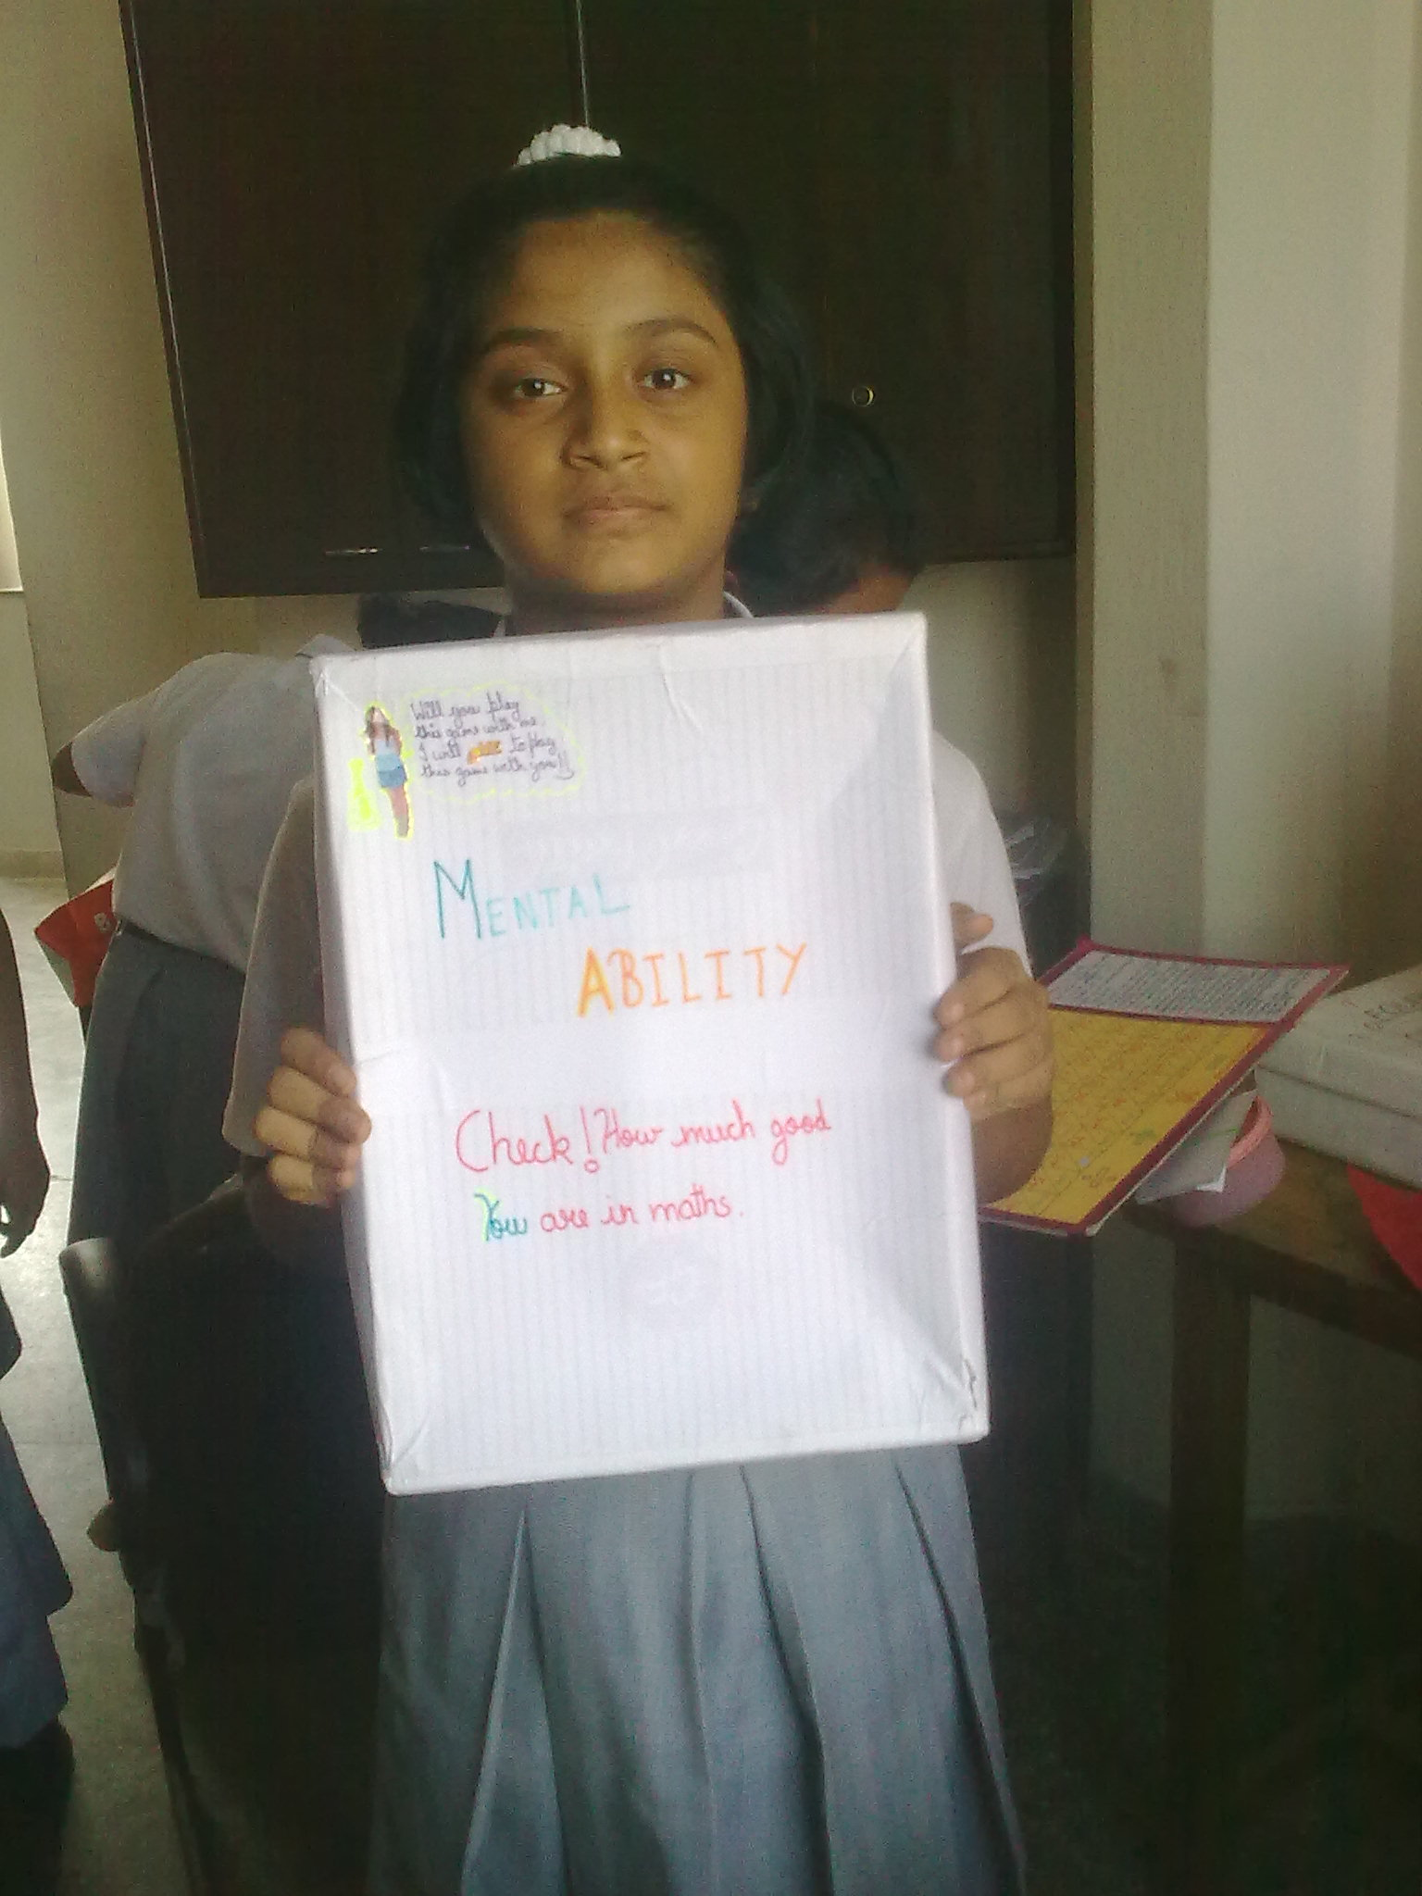

Slide 6
