Slide 1
NATIONAL
TOYS
BLUE FLOWER
KINDERGARTEN
BUCHAREST
R O M A N I A
AROUND
THE
WORLD

Slide 2
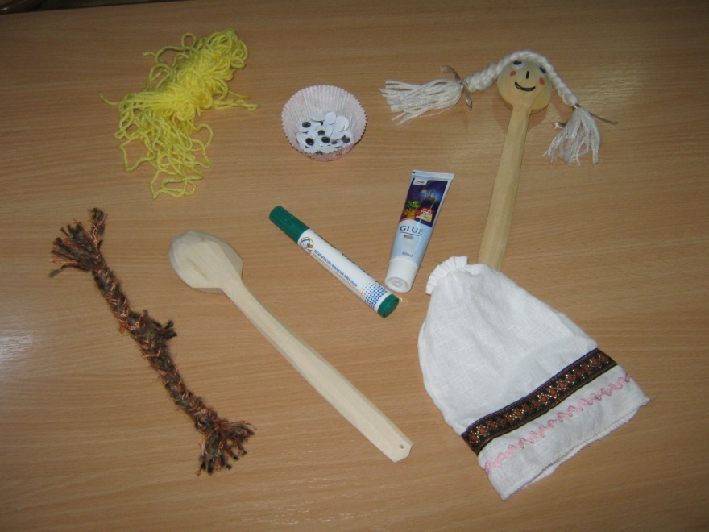
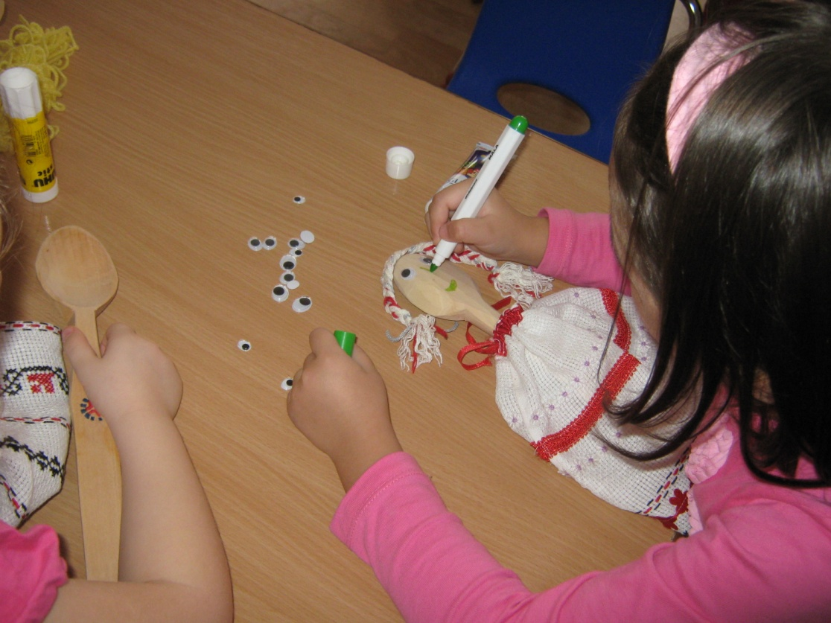
HERE IS WHAT YOU NEED:
Pieces of textile materials
Some wool for the puppet hair
Googly eyes
Several wooden spoon
Glue
Markers
After you glue the eyes and the hair of the puppet you draw her mouth, her chick and her nose.

Slide 3
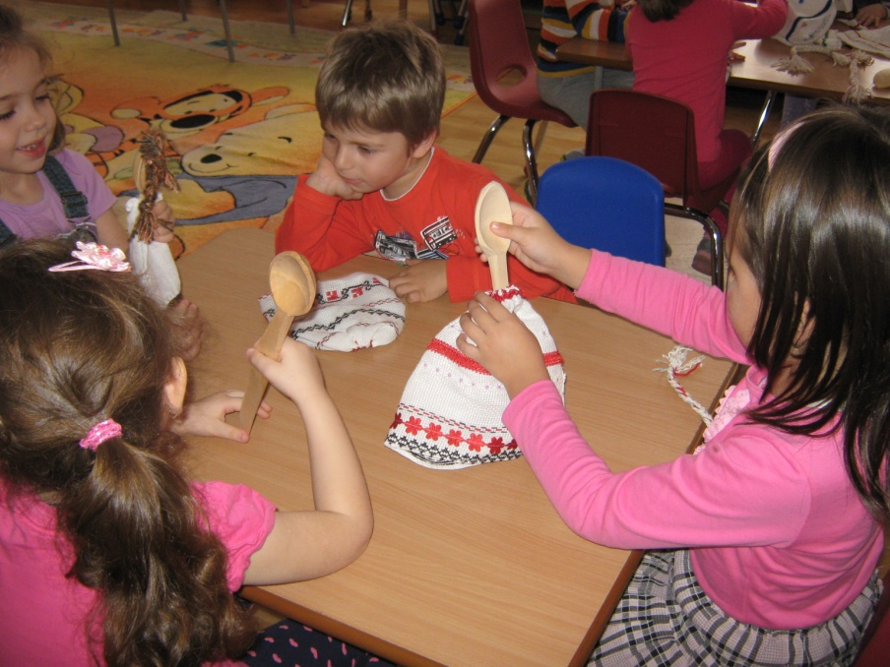
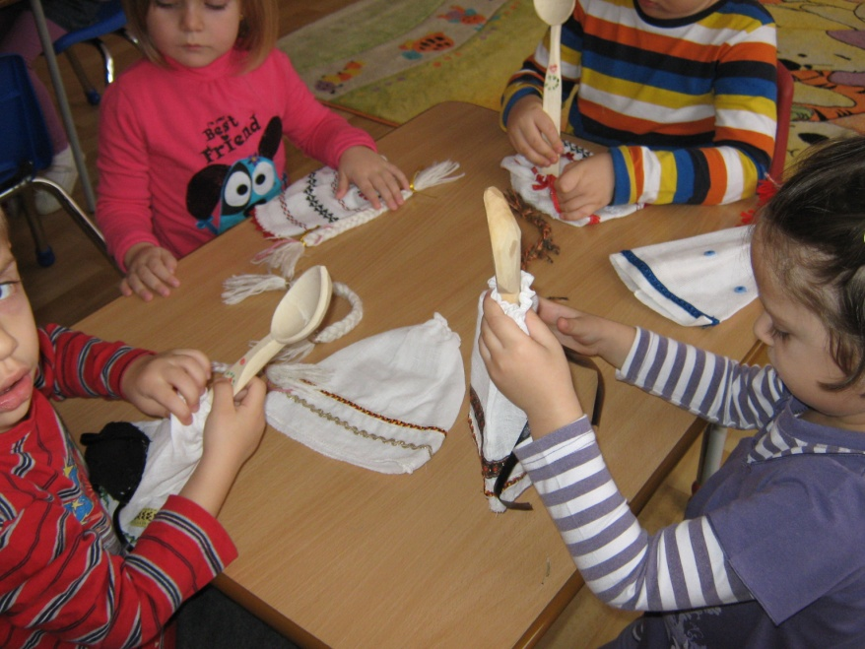
Then you attach her dress made from old pieces of textile materials which it will be wrapped around the “neck” of the puppet with an elastic string.

Slide 4
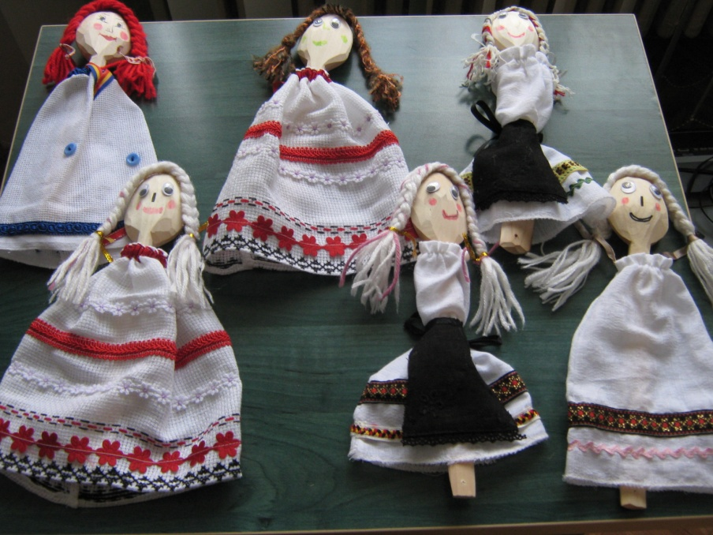
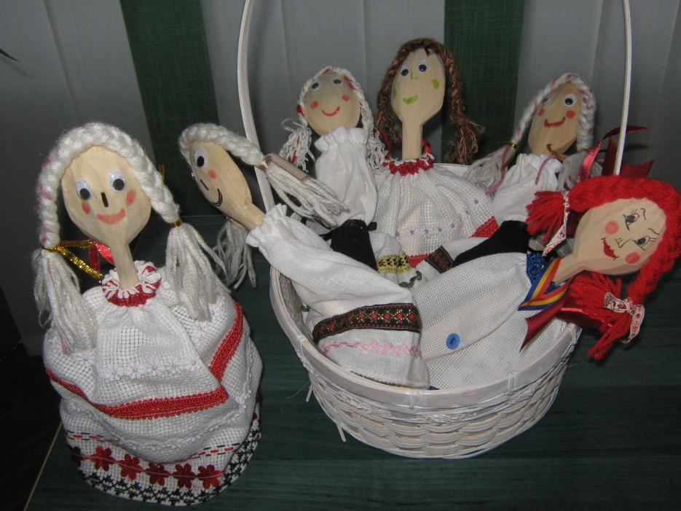
In the end our toys looks like this….
What it’s important to specify is that our dresses that our puppets wear are made of materials which immitates our Romanian traditional sewn blouses and our girls folk costumes.
WE HOPE
YOU’LL ENJOY AND
FIND THEM USEFULL !

