Slide 1
Games: An Instructional Strategy
By
Elizabeth Richmond

Slide 3
Playing games in the classroom
Is a motivating and challenging way to learn new concepts.

Slide 4
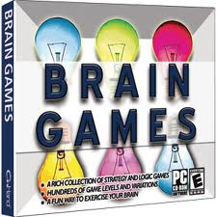

Slide 5
Advantages of Games in class. . .
Attention grabbers
Engaging for students
May be simplified for learning outcomes
May be used in a variety of classroom settings

Slide 6
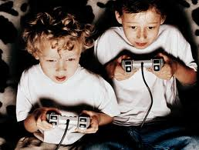

Slide 7
Disadvantages to games in class. . .
Student competition
Game structure may be too difficult
May be too expensive
Learning outcomes may be “lost” in the winning of the game

Slide 9
Classroom game ideas. . .
Puzzles: crosswords, logic or jigsaw
Board games
Jeopardy
Bingo
Playing “store”

Slide 11
Make learning fun!
By using games in the classroom,
important concepts are practiced in an enjoyable way.

