Slide 1
Preface

Slide 2
Alice A Collaborative story Relay Project
Bal Bharati Public school, Dwarka
And
Jervoise school,UK

Slide 3
Content
1.The amazing adventures of Alice
2. Alice in the magic world
Alice and the magic castle
Alice in her magic toyland
Poisonous apple
Mysterious Snake
Alice the kind girl
Alice in clouds

Slide 4
THE AMAZING ADVENTURES OF ALICE
Alice was very cheerful and naughty . One day, when she was roaming in the neighbouring forest, she happened to see a magician. She asked the magician, “Would you like to play with me?” But the magician was in an angry mood. So he shouted, “You don’t know who I am.” Without a second thought, he said,” May you become a bear”.
So the next moment she became a bear who was born in a fox family. The family didn’t know he was a bear. Alice also didn’t know she was a bear. Days passed. Everyone found it difficult to live in that cave. So the father fox said, “I have found a new house for us. It is bigger but lions frequently roam around that cave. But don’t worry, our children have become old enough to run away from the lion.”
One day when the father fox was away for hunting a lion came into the cave. The three foxes and the bear heard the lion’s footsteps and the foxes ran away. But the bear was slow. So he could not run. But when the lion came in, he became frightened on seeing the bear and ran away. So when the fox family came in the cave, they all realized that it was a bear. They all prayed together for the bear’s release. At last the curse was lifted and the bear became Alice once again.
Dhananjay Raman ( V B)
Bal Bharati Public School , Dwarka

Slide 5
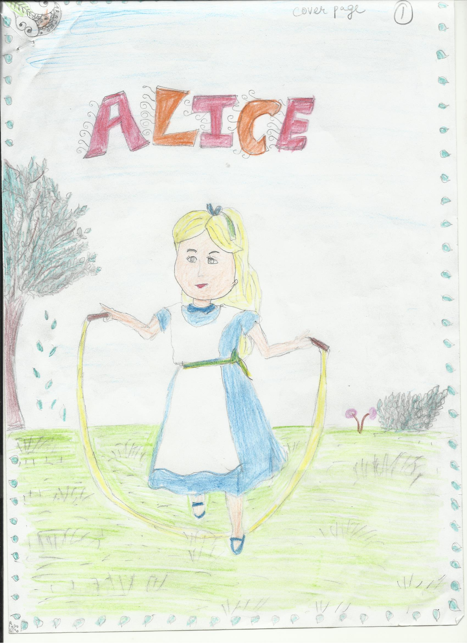

Slide 6
ALICE IN A MAGICAL WORLD
There was a girl named Alice. She lived in a town named ‘Home Town’. She had a great relationship with all the villagers. Alice loved to do magic and go to magic shows. One day her mother asked her to bring some curd from the nearby market. She was walking, and suddenly there was a tunnel from which a magical world was starting. She went inside it and there was a ‘Magician’ and he was doing some magic with his magical wand. Alice saw him and quickly ran to him. She asked to him “Are you a magician?” He said “Yes! I am a Magician”. Alice touched his hat and the magician got very angry. “Do you know what have you done little girl” the magician said with anger. The magician changed Alice into a frog and said “You will be normal after a frog will kiss you”. Alice got very scared and she started finding a frog. After sometime she saw a frog and then she said to the frog “Please kiss me because I am a girl. A magician cursed me. Please help me”. The frog then kissed Alice and then she became a normal girl. She was very happy and she quickly ran to the entrance because it was closing forever. Then she got out of that magical world. Asavari Bansal ( V-D) Bal Bharati Public S hool, Dwarka

Slide 7
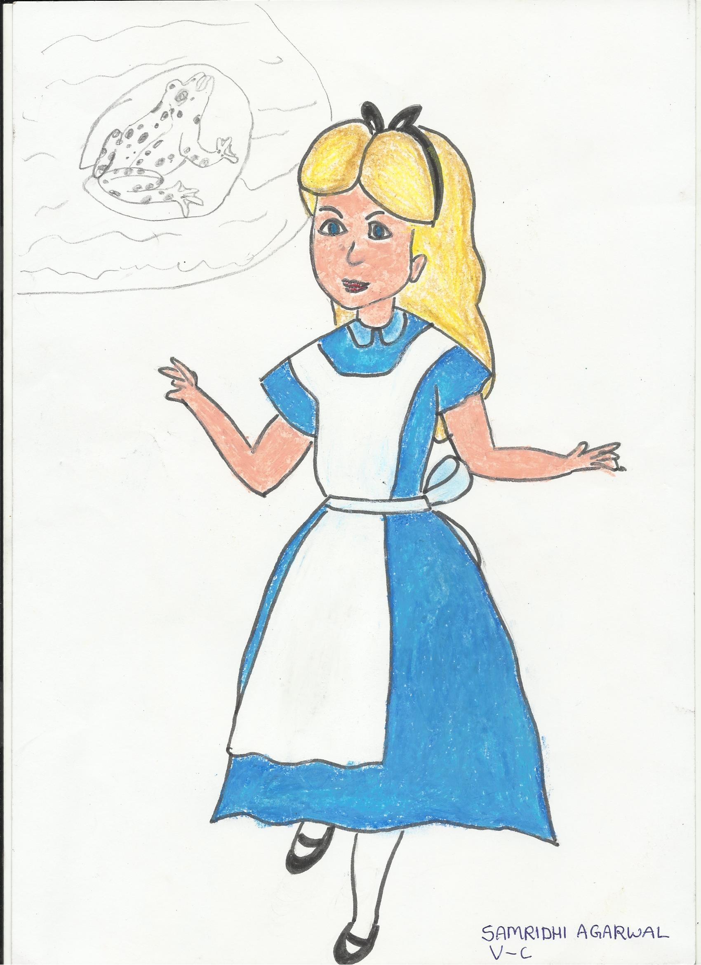

Slide 8
ALICE AND THE MAGICAL CASTLE
. Alice was very intelligent and had a friend named Angelina. They were best friends. It was a exam time. Alice worked hard to learn for the exams but Angelina was not prepared. When the exams were going on Angelina asked one question from Alice as he was telling Angelina the answer the teacher saw them and took their papers and cancelled their exam and made them stand outside . Alice was feeling very bad so he thought of taking revenge. So he went to a magical castle there lived a giant. Alice told him all the story. The giant told him that he will give him a magical diamond. He told him that when he will take this diamond to the library how many books he would read that night he will get the magical knowledge. So Alice read thirty books that night then he thanked the giant and went home. From his magical powers he teased Angelina a lot but Angelina didn’t know who was doing it so he called the police. When Alice heard this he hided himself where no one could see him. The police tried to find him a lot
But failed to find yet. Om (V B) Bal Bharati Public School , Dwarka

Slide 9
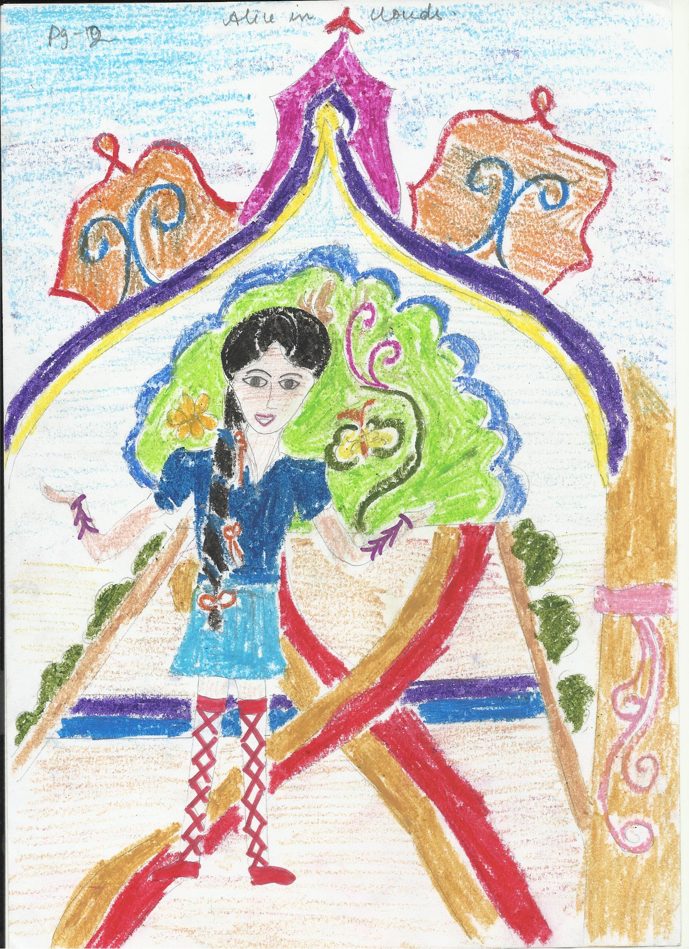

Slide 10
ALICE IN HER MAGICAL TOYLAND
Long time ago, there once lived a little girl named Alice. She lived in a small town named ‘Toyland’. She was very fond of playing with toys and had many toys. One day as she was playing she peeped through her window and saw a very cute doll lying idle on the ground. It was so attractive that she ran towards it and as she was just about to pick it up a dark, old man came and held her hand. He shouted “STOP! Don’t pick it up “. Alice was shocked. She asked him “Does this doll belong to you? Please can I have it? It is very adorable”. He replied “It is a magical doll and once you touch it you will turn into a monkey”. Alice did not believe him and she picked it up. And suddenly she became a monkey. On realizing just what had happened she was weeping. The old man consoled her and told her that once she helps someone who is in trouble she will be back to being Alice again.
Days passed by, Alice was struggling to survive and one fine day she saw a flock of pigeons trapped in a net, they were crying for help. She helped them to tear open the net and all the birds flew away thanking the monkey. Just then the monkey transformed back again to a normal girl. Alice was very happy and she quickly ran home and told her worried parents about her adventurous incident………
Lakshya… (V A)
Bal Bharati Public School ,Dwarka

Slide 11
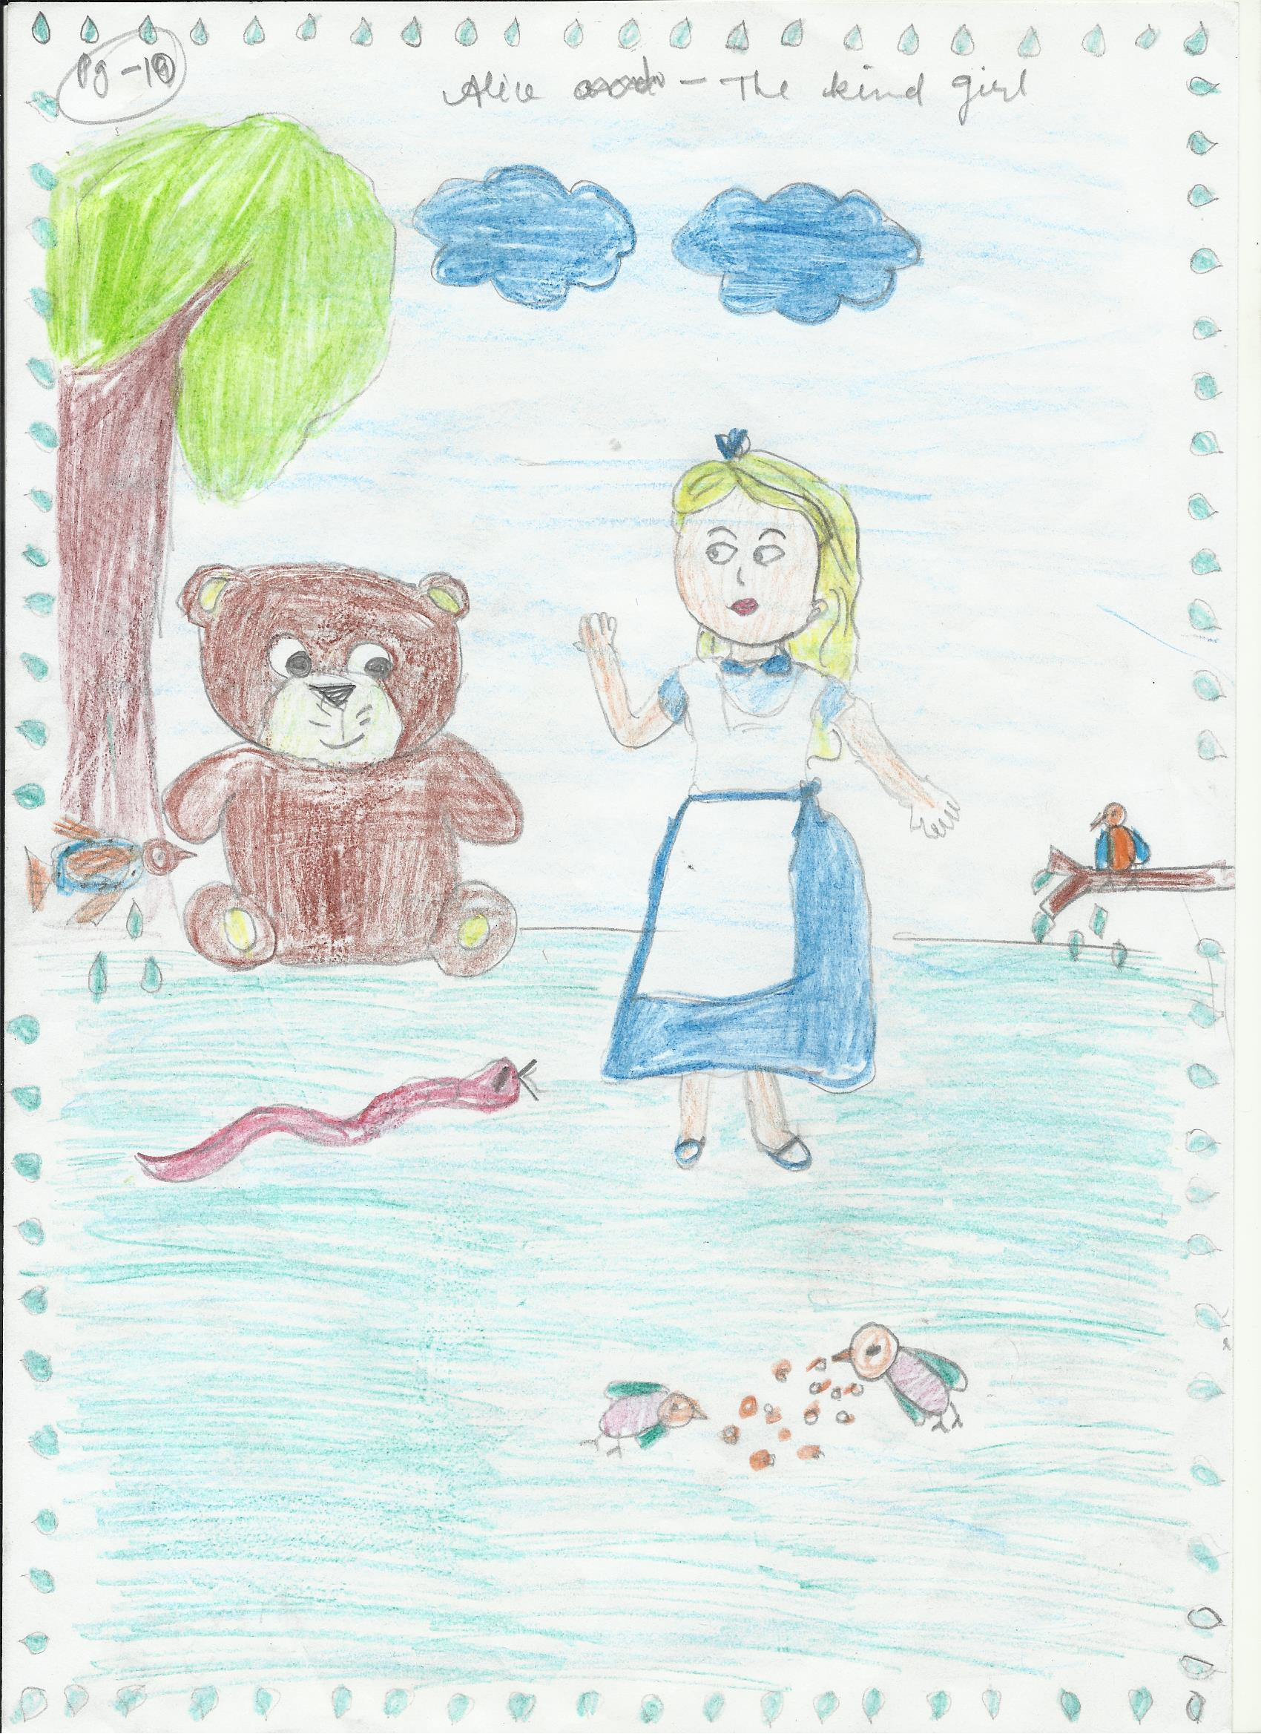

Slide 12
Poisonous Apple One sunny day, the beautiful girl Alice and one of his friend called Dylan were playing together. He was magical. Suddenly Dylan touched Alice and she said "Will you come along with me to my house? Please! Please!"We will go to a wedding function. The wedding was near Big Ben in London and it was posh as there was a lift and delicious food!
After attending the wedding function, Dylan and Alice were returning home. Dylan offered an apple and Alice thought it was lovely and juicy but it was a trick as it was poisonous! Dylan was fed p of Alice bossing him around so he thought the poisonous apple would stop her! Dylan wanted to find a lovely place far far away so he raced off in Alices fast car whilst Alice slept silently. As she slept she dreamt of living happily ever after.
Alice's family began to wonder why she want answering her phone or why she hadn't visited. They were worried, very worried! Together they smashed through the door to let themselves into her little cottage. When they saw the half eaten apple and that she was fast asleep, they rang the police and the doctor.
Police cars soon chased after Dylan. Eventually he was caught and put in jail for a very long time. Doctors tried to wake Alice with different medicines and potions but they couldn't do it! Nathan ( Class 3) Jervoise School, U.K

Slide 13
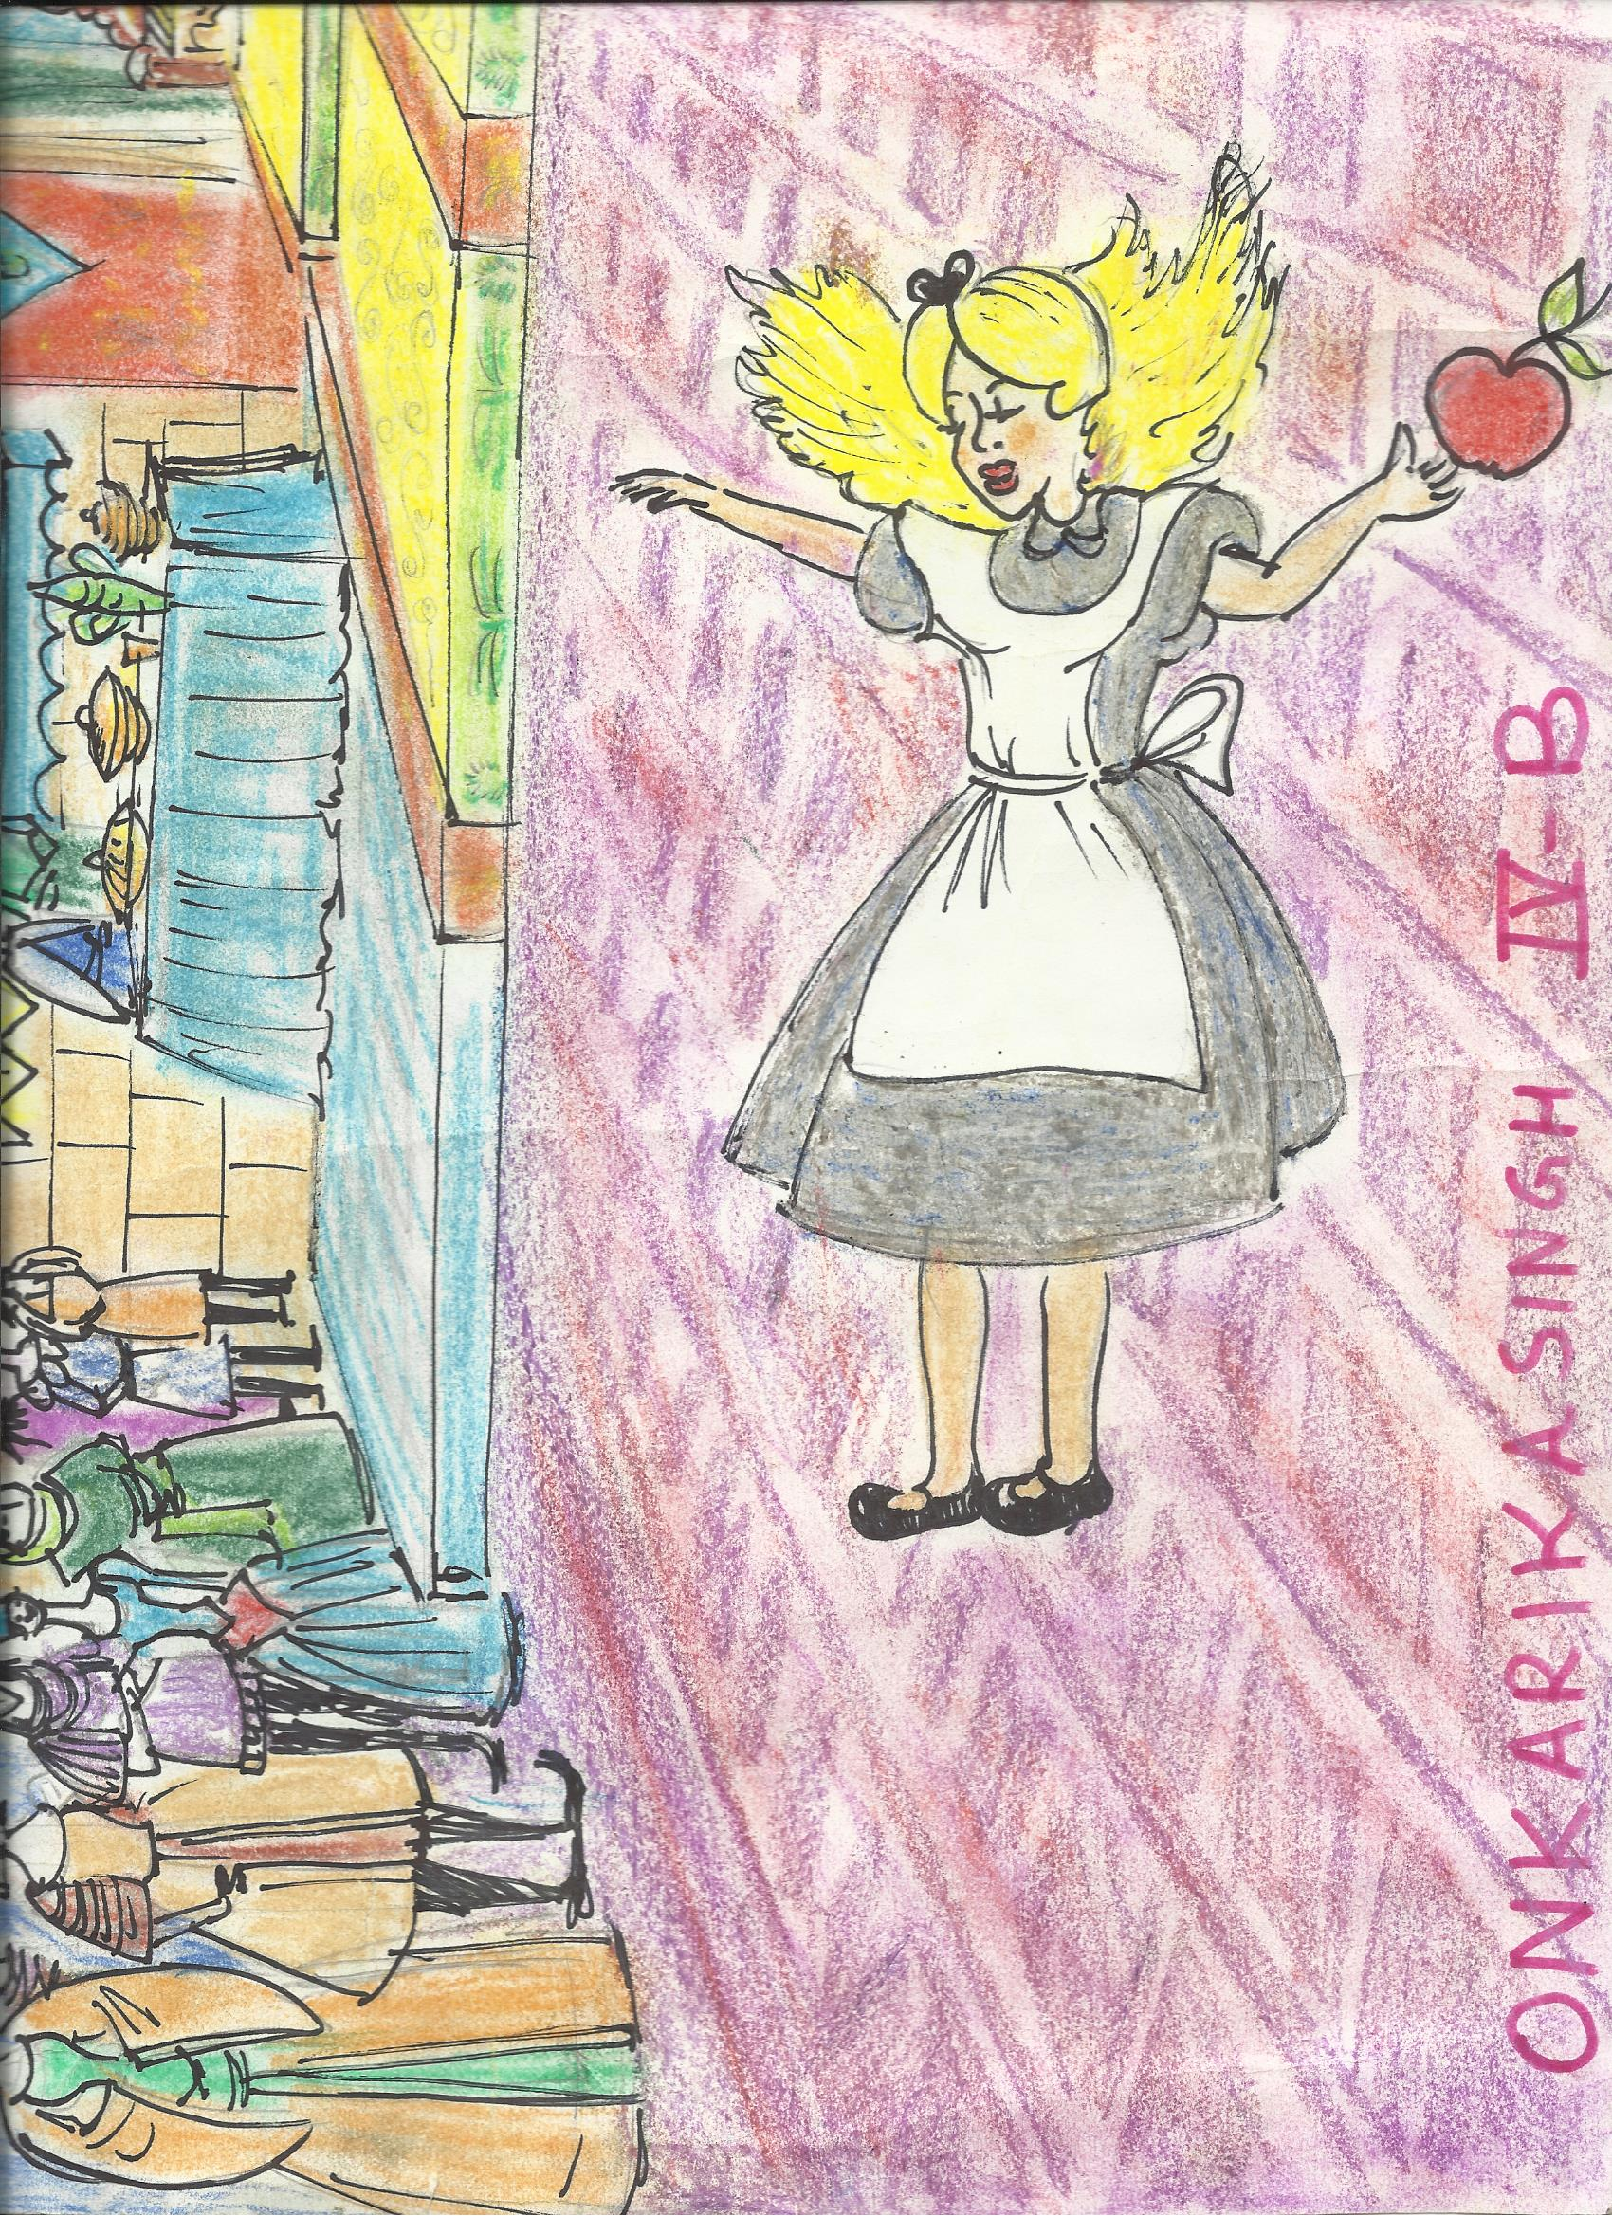

Slide 14
Mysterious Snake Everyone was worried about Alice, the beautiful girl, as she did not wake up in spite of the best efforts done by the doctors. On realizing that the efforts of the doctors are not producing any positive result, people became very sad as Alice was quite young girl and liked by everyone in the village for her caring and helping nature.
At the time when each one was discussing the fate of beautiful girl Alice who was literally lying in the cottage in unconscious condition for more than half a day, suddenly a mystifying snake with wings on its body, appeared at the scene from behind the door of the little cottage. All people, young and old, present in the cottage got frightened on looking the strange snake and starting running here & there in fear.
Soon they started collecting stones and sticks from the nearby field to kill the snake as they were afraid that snake will bite Alice and eventually she will die. As soon as the people gathered stones and sticks to hurl at the snake, to their dismay they found that the mysterious snake was sitting on the body of Alice! DebashishDabral (Class IV A ) Bal Bharati Public School , Dwarka

Slide 15
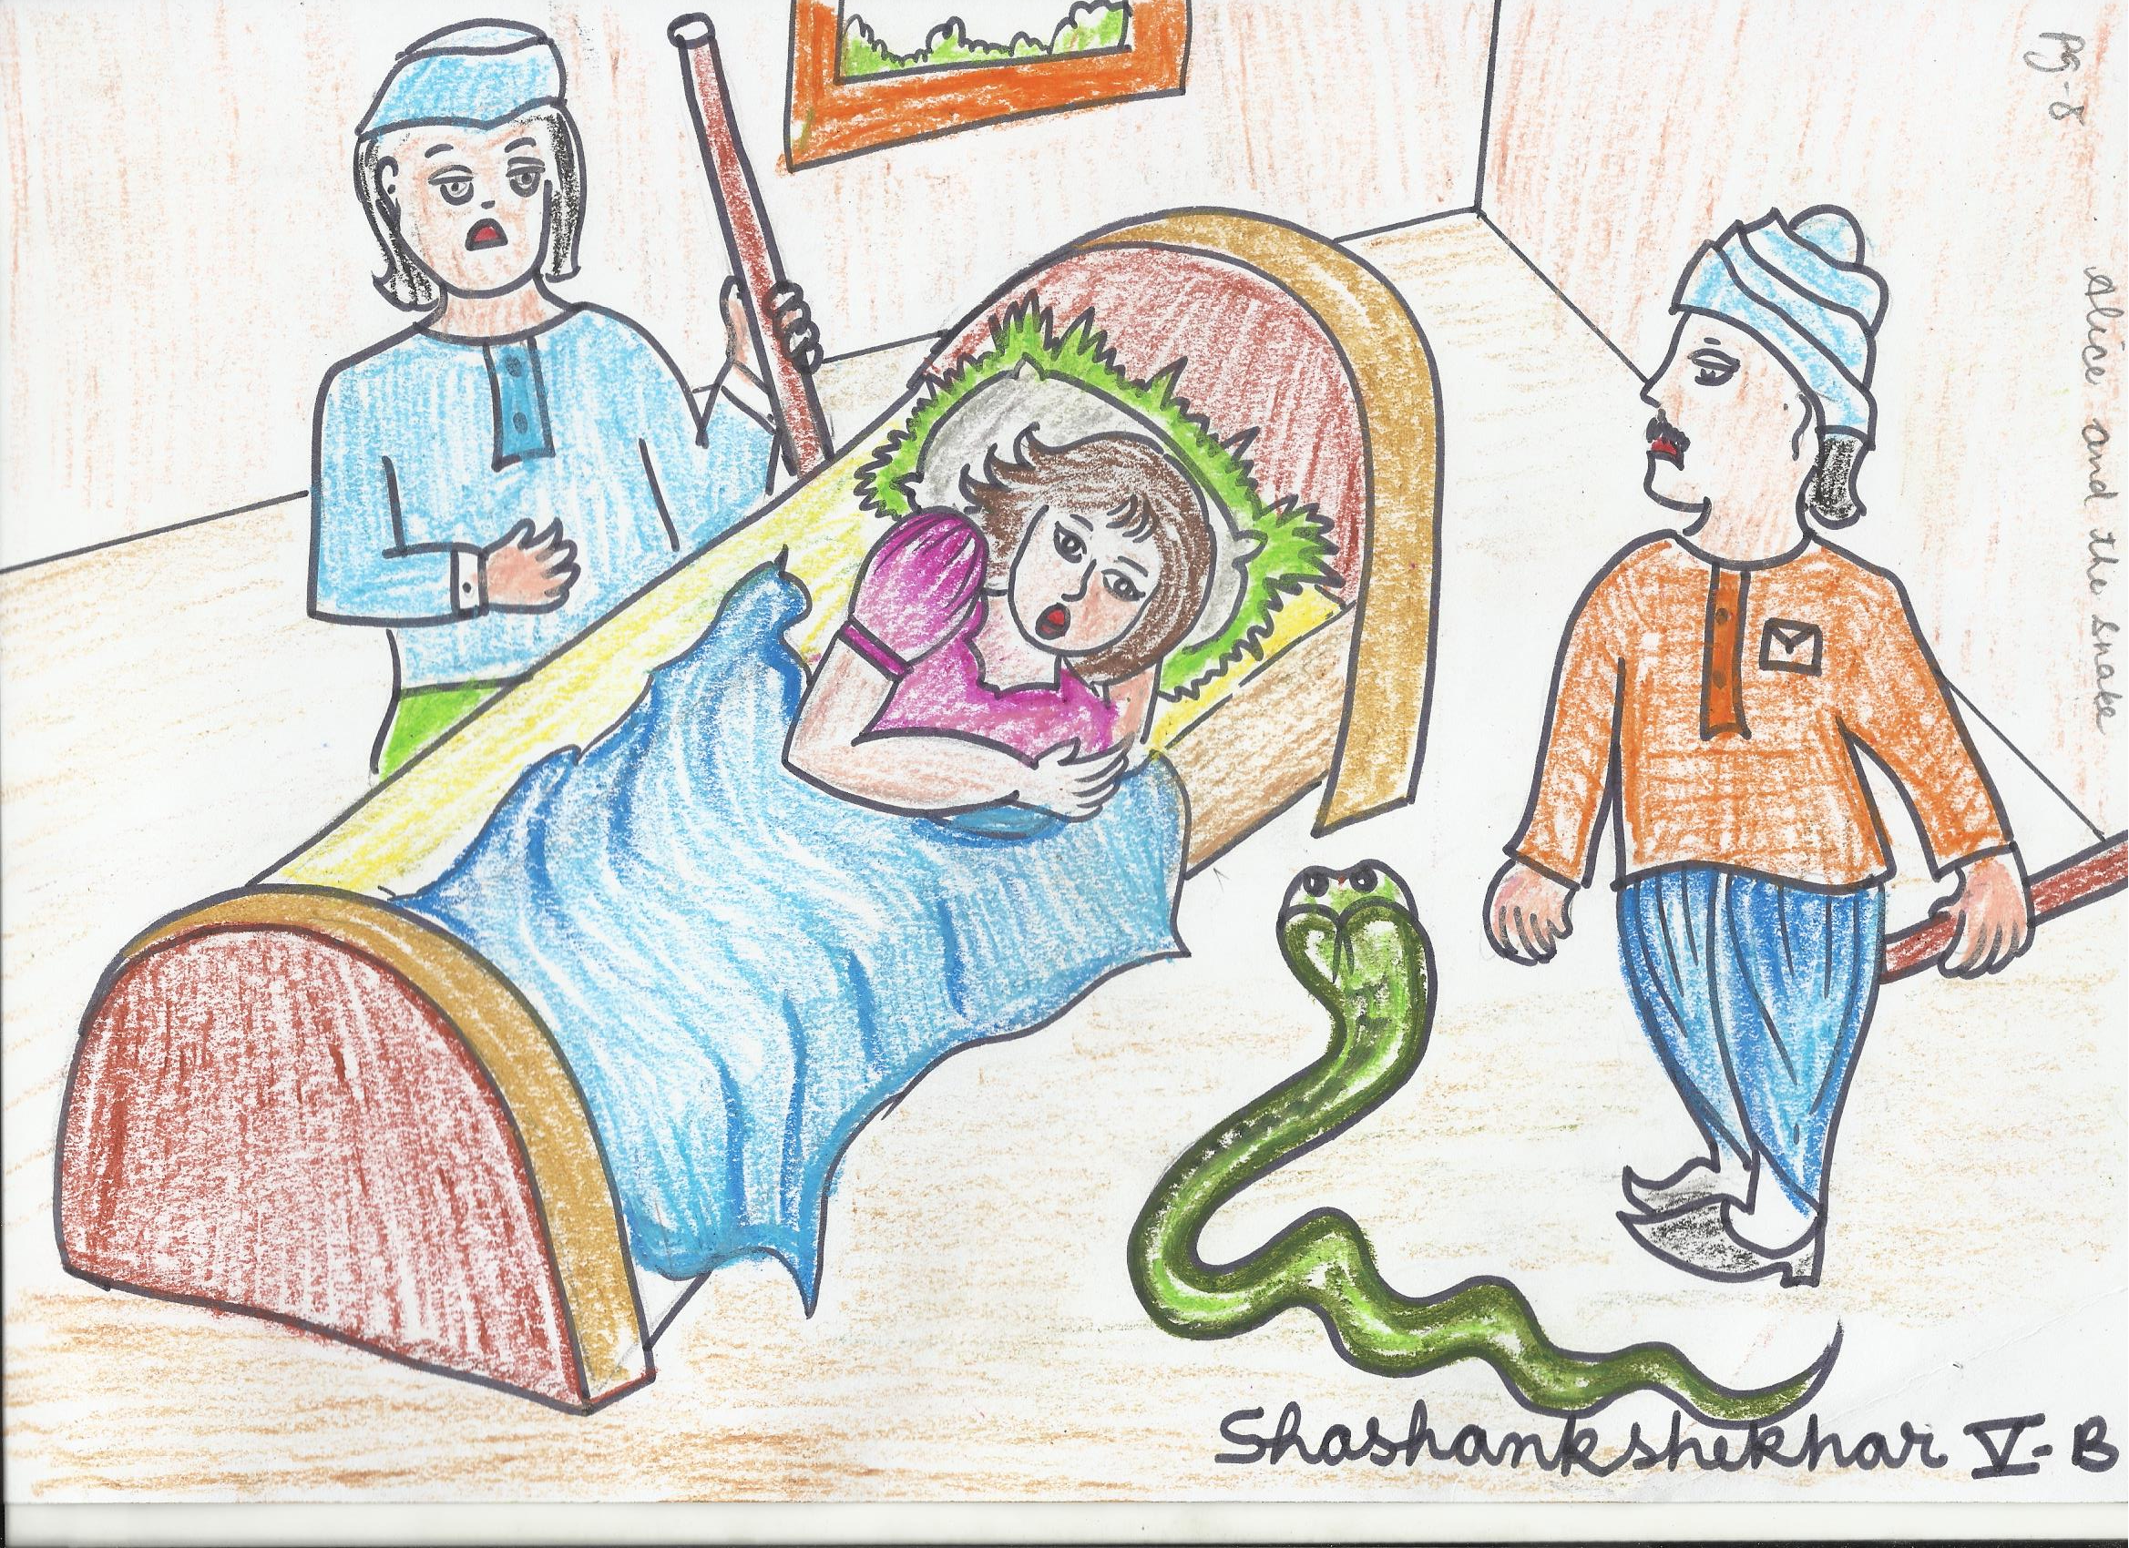

Slide 16
Alice the kind girl
The villagers threw stones at the snake and it had to flee from the scene. Before the snake fled, it bit Alice’s arm! However, the bite made Alice wake up. After a while, Alice sat up, rubbed her eyes then she started to feel better. Sadly the poison from Alice had transferred into the snake so it was slowly dying in another part of the village. Alice felt terrible for the pain that she had caused the snake so she thought of an idea because she is such a good natured, kind girl. Her idea was that she needed to give the snake some of her blood, in hope that the helpful, slithering snake could survive however….
Students of Jervoise school, U.K

Slide 17
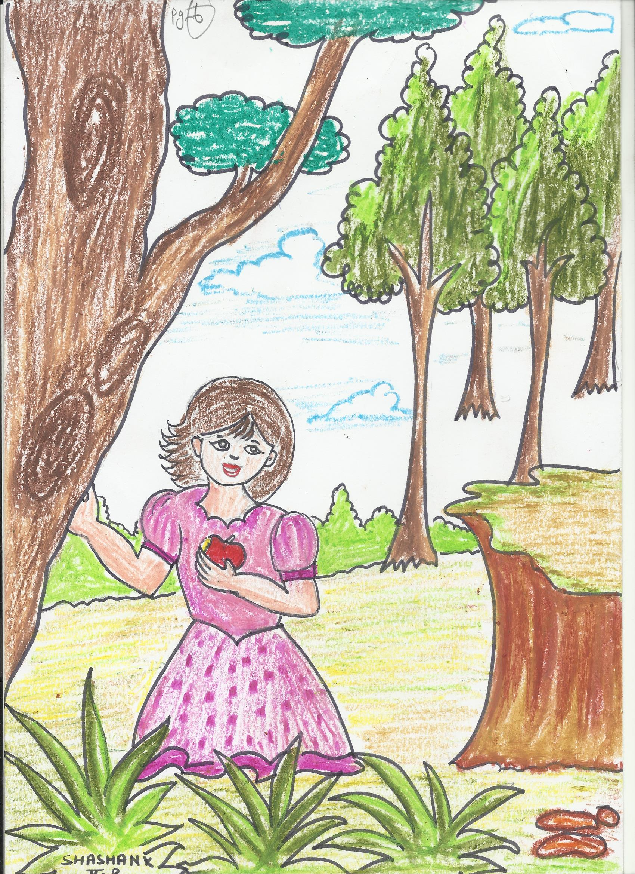

Slide 18
Alice in the clouds Alice went to find the snake however she was not so well. She ran towards her home. While running her home was visible to her but she was not able to reach the home as the road was getting longer and longer. After few minutes of running she was very tired and sat down to rest . she sat down with her eyes closed. When she opened her eyes she found herself in a jungle. She had many questions in her mind at that time. Now she was in a puzzled path. In the jungle when she was walking slowly, her foot entangled in a root coming out of a tree and she fell down on a huge wall which launched Alice towards up in the sky like a spring and she was continuously shouting AHHH AHHH AHHHH!! She fell on a very big cloud and she become senseless. After sometime when she woke up............................ Shaswat Bisoyi (VI-D) Bal Bharati Public School, Dwarka

Slide 19
