Slide 1
Monuments of India
Bal Bharati Public School

Slide 2
MONUMENTS
It is an undeniable fact that India has been one of the best places from historical point of view. Its unique places and ancient monuments truly depict the antique architecture. If we talk about the famous monuments of India then we will find that there is a long list of places that are counted as finest in their own sense.

Slide 3
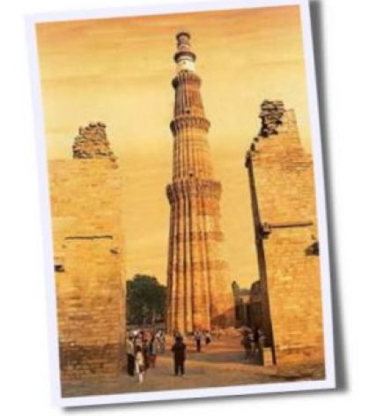
QUTUB MINAR
Qutub-ud-din Aibak laid the foundation for Qutub Minar in 1199 AD and his successor and son-in-law Shamsu’d-Din- Iitutmish completed the structure by adding three more stories. Standing at 72.5 meters, it is the highest stone tower in India. Its base diameter is 14.3 meters and its top diameter is 2.7 meters. It has 379 steps leading to its top story.

Slide 4
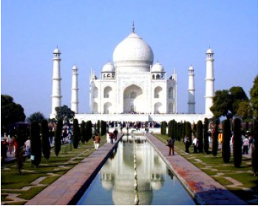
TAJ MAHAL
Taj Mahal, the pinnacle of Mughal architecture, was built by the Mughal emperor Shah Jahan (1628-1658), grandson of Akbar the great, in the memory of his queen
Arjumand Bano Begum, entitled ‘Mumtaz Mahal’. Mumtaz Mahal was a niece of empress Nur Jahan and granddaughter of Mirza Ghias Beg I’timad-ud-Daula, wazir of
emperor Jehangir

Slide 5
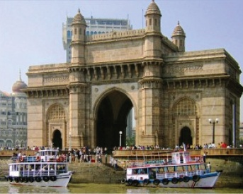
GATEWAY OF INDIA
The majestic Gateway of India is a glorious historical memorial built during British rule. This magnificent monument has been built in Indo-Sarcenic style to
commemorate the visit of King George V and Queen Mary to Bombay. Gateway of India is one of the finest example of colonial architectural heritage in India.

Slide 6
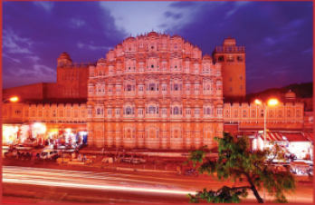
HAWA MAHAL
Hawa Mahal stands upright as the entrance to the City Palace, Jaipur. An important landmark in the city, Hawa Mahal is an epitome of the Rajputana architecture. The
splendid five-storey “Palace of the Winds” is a blend of beauty and splendor much close to Rajasthan’s culture.

Slide 7
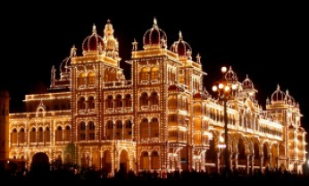
MYSORE PALACE
The Mysore Palace, Karnataka is popularly known as the the Maharajah’s Palace, situated at the city center at Mirza Road. Mysore Palace is one of the most
fascinating monument of Mysore city. The other name of the Mysore Palace is Amba Vilas and is the largest palaces of India. Mysore’s Wodeyar Mahararajas resided in the Mysore Palace of Karnataka.

Slide 8
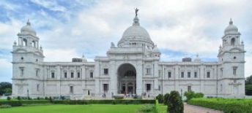
VICTORIA MEMORIAL
Victoria Memorial, one of India’s most beautiful monuments, represent a unique combination of classical European architecture and Mughal motifs. The domed and white marble museum sprawls over 64 acres and is set in a landscaped garden at the southern side of the Kolkata’s maidan (ground) near Jawaharlal Nehru Road.

Slide 9
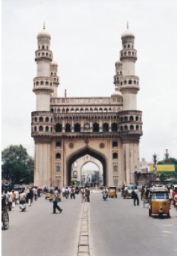
CHARMINAR
The charminar Hyderabad’s best known landmark was built 1591 by Sultan Mohammed Quli Qutub Shah to appease the force of evil savaging his new city with
epidemic and plague. Standing in the heart of the old walled city and surround by lively bazaars, the charminar (‘four tower’) is a 56m high triumphal arch.

Slide 10
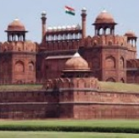
RED FORT
Also constructed by Shah Jahan, the Red Fort served as his fortress-cum-palace. It was the capital of the Mughal Empire till 1857 when Bhahadur Shah Zafar surrendered to the British. They say this fort of Red Sand Stone was originally called “Quila-i-Mubarak” or the blessed fort and took 10 years to build. It was built on the banks of the Yamuna

Slide 11
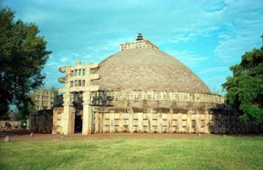
SANCHI STUPA
Sanchi is situated in the state of Madhya Pradesh in India. It lies at a distance of approximately 52 km from the capital city of Bhopal and 10 km from Vidisha. The major
attractions of Sanchi include a number of Buddhist stupas, monasteries, temples and pillars. All these structures date back to somewhere between 3rd century BC and 12th century AD.

Slide 12
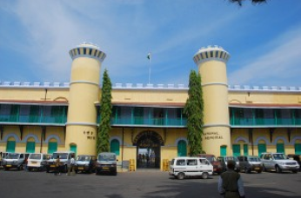
CELLULAR JAIL
The Cellular Jail, also known as Kālā Pānī literally ‘black water’, in the sense of deep sea and hence exile), was a colonial prison situated in the Andaman and Nicobar Islands, India. The prison was used by the British especially to exile political prisoners to the remote archipelago. Many notable freedom fighters such as Batukeshwar Dutt and Veer Savarkar, among others, were imprisoned here.

Slide 13
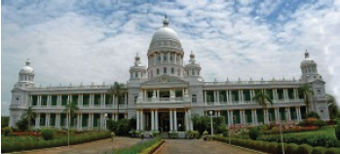
VIDHANA SOUDHA
Vidhana Soudha counts amongst the most impressive as well as the most magnificent buildings in the Bangalore city of India. It is mainly famous for housing the Legislative Chambers of the state government. The three hundred rooms of Vidhan Soudha accommodate approximately twenty-two departments of the state government.

Slide 14
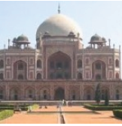
HUMAYUN’S TOMB
Emperor Humayun’s tomb was built 15 years after he died. His body was first buried in his palace, and then moved to Sirhind in Punjab and his widow commissioned the tomb some 9 years later. Other than the tomb enclosue, there are several smaller monuments and tombs of other Mughal dignitaries along with a well planned Persian garden, called the Charbagh Gardens.

Slide 15
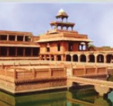
FATEHPUR SIKRI
Constructed by Emperor Akbar, Fatehpur Sikri on the outskirts of Agra was the first planned Mughal city designed in Mughal architecture (which is an amalgamation of Indian, Persian and Islamic styles). Interestingly, while it took 15 years to build the city, it was soon abandoned in 14 years as the water supply could not sustain the thriving population.

Slide 16
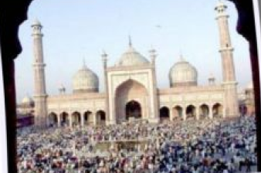
JAMA MASJID
Not too far from the Red fort is the Jama Masjid which till today is the
principal mosque of Old Delhi. Also commissioned by Shah Jahan, it was built before the fort and can hold
up to twenty five thousand worshippers at a go. An architectural marvel, the courtyard of the mosque has three grand flights of steps.

Slide 17
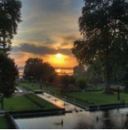
SHAMILAR BAGH
Shalimar Bagh is considered to be the high point in Mughal horticulture
and has three elaborate terraces, fountain pools, waterfalls, pavilions and marble thrones for the Emperor’s.
Nishat Bagh is also known as the “Garden of Pleasure” and has a magnificent view of snow capped
mountains. It was built and designed by Asif Khan, brother of Noor Jehan.

Slide 18
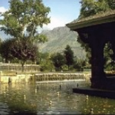
DAL LAKE
Known as “Srinagar’s Jewel”, the Dal Lake was patronized by the Mughal rulers of
India as their summer resort and they developed the neighbouring areas around the lake into sprawling Mughal stlye gardens and pavilions. Shalimar Bagh is considered to be the high point in Mughal horticulture and has three elaborate terraces, fountain pools, waterfalls, pavilions and marble thrones for the Emperor’s.

Slide 19
THE END
THANKS

