Slide 1
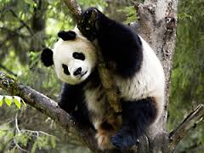
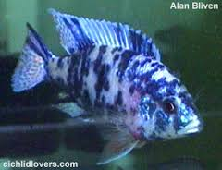
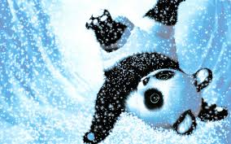
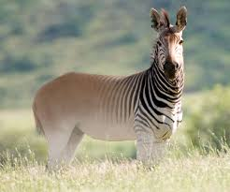
Animals Care !
Caring other don’t means treat human with love , it also means
have a good and caring phase to animals who are left so few .

Slide 2
The primary cause of human-induced extinction events is simply human overpopulation of planet Earth. The most important causal anthropogenic activities are habitat destruction, overexploitation, pollution and the introduction of alien species to an environment

Slide 3
Pandas
Estimates of wild panda populations vary wildly. Some experts believe there are as few as 1,000 giant pandas left in the wild. Other scientists believe there are about 1,600 pandas left. A recent study using DNA analysis, however, concludes that there could be as many as 3,000 pandas still in the wild. In addition to wild pandas, there are about 250 pandas in zoos, mostly within China.

Slide 4
Rhinocerousous
The West African black rhinoceros (Diceros bicornis longipes) was a subspecies of the black rhino that was declared extinct in 2011. The subspecies last existed in Cameroon, but an extensive survey in 2006 did not find any signs of living West African black rhinos. According to the IUCN, “it is highly probable that this subspecies is now extinct” thanks to increased poaching and demand for rhino horn.

Slide 5
Quagga
he Quagga (Equus quagga ssp. quagga) was a subspecies of the common plains zebra and a native of South Africa. Known for its unique stripes, the Quagga was hunted for its hide and killed by ranchers who believed the animals competed with livestock for grazing area, according to PBS.

