Slide 1
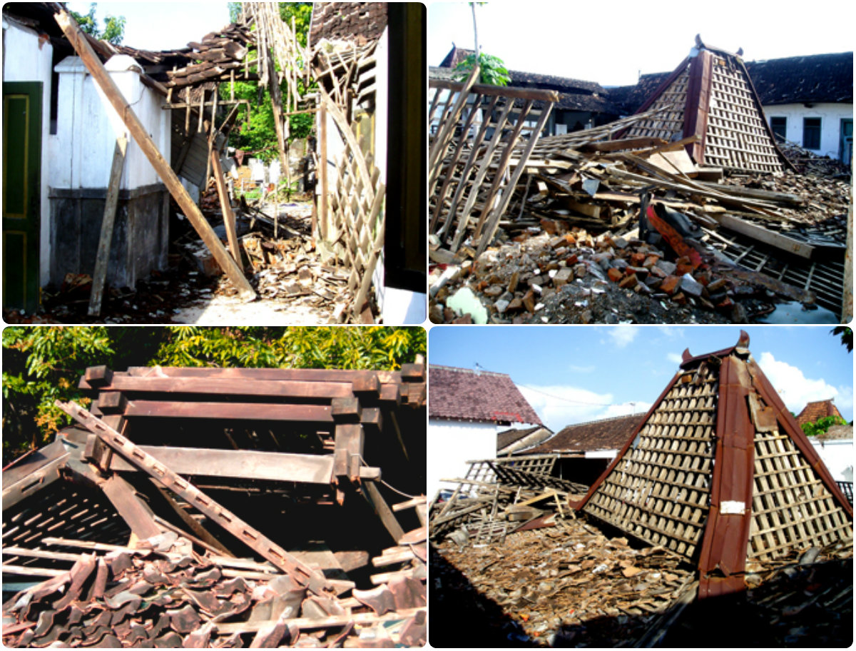
Earthquake

Slide 2
contents
What is an earthquake?
Causes of earthquakes
Nepal 2015 Earthquake
Preventions
Before
During
After
Earthquake distribution around the world

Slide 3
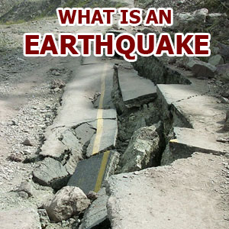
An earthquake is a shaking of the ground caused by the sudden breaking and movement of large sections (tectonic plates) of the earth's rocky outermost crust.
The edges of the tectonic plates are marked by faults (or fractures).
Most earthquakes occur along the fault lines when the plates slide past each other or collide against each other.

Slide 4
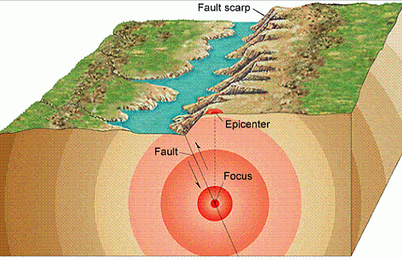
Causes of earthquakes
There are two main causes of earthquakes.
Firstly, they can be linked to explosive volcanic eruptions; they are in fact very common in areas of volcanic activity where they either proceed or accompany eruptions.
Secondly, they can be triggered by Tectonic activity associated with plate margins and faults. The majority of earthquakes world wide are of this type.

Slide 6
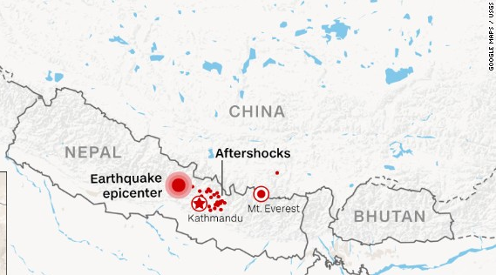
Nepal Earthquake 2015

Slide 9
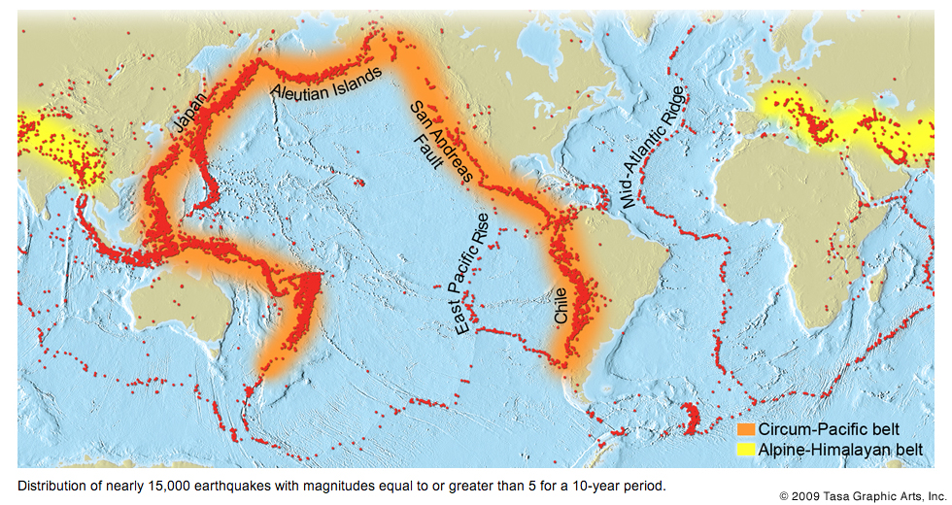
Earthquake distribution

Slide 12
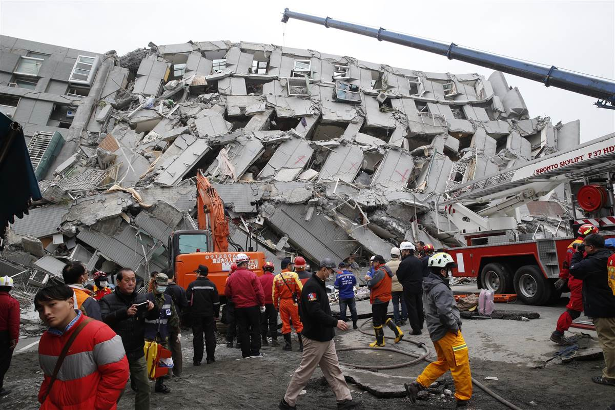
During an earthquake:
Stay calm……… If inside: stand in a doorway or crouch beside a desk or table. hold on, don’t let the table slide or the door swing and hit you
If outside: stand away from buildings, trees, telephone, and electrical lines. Prepare a disaster preparedness kit. Have an emergency evacuation plan.

Slide 13
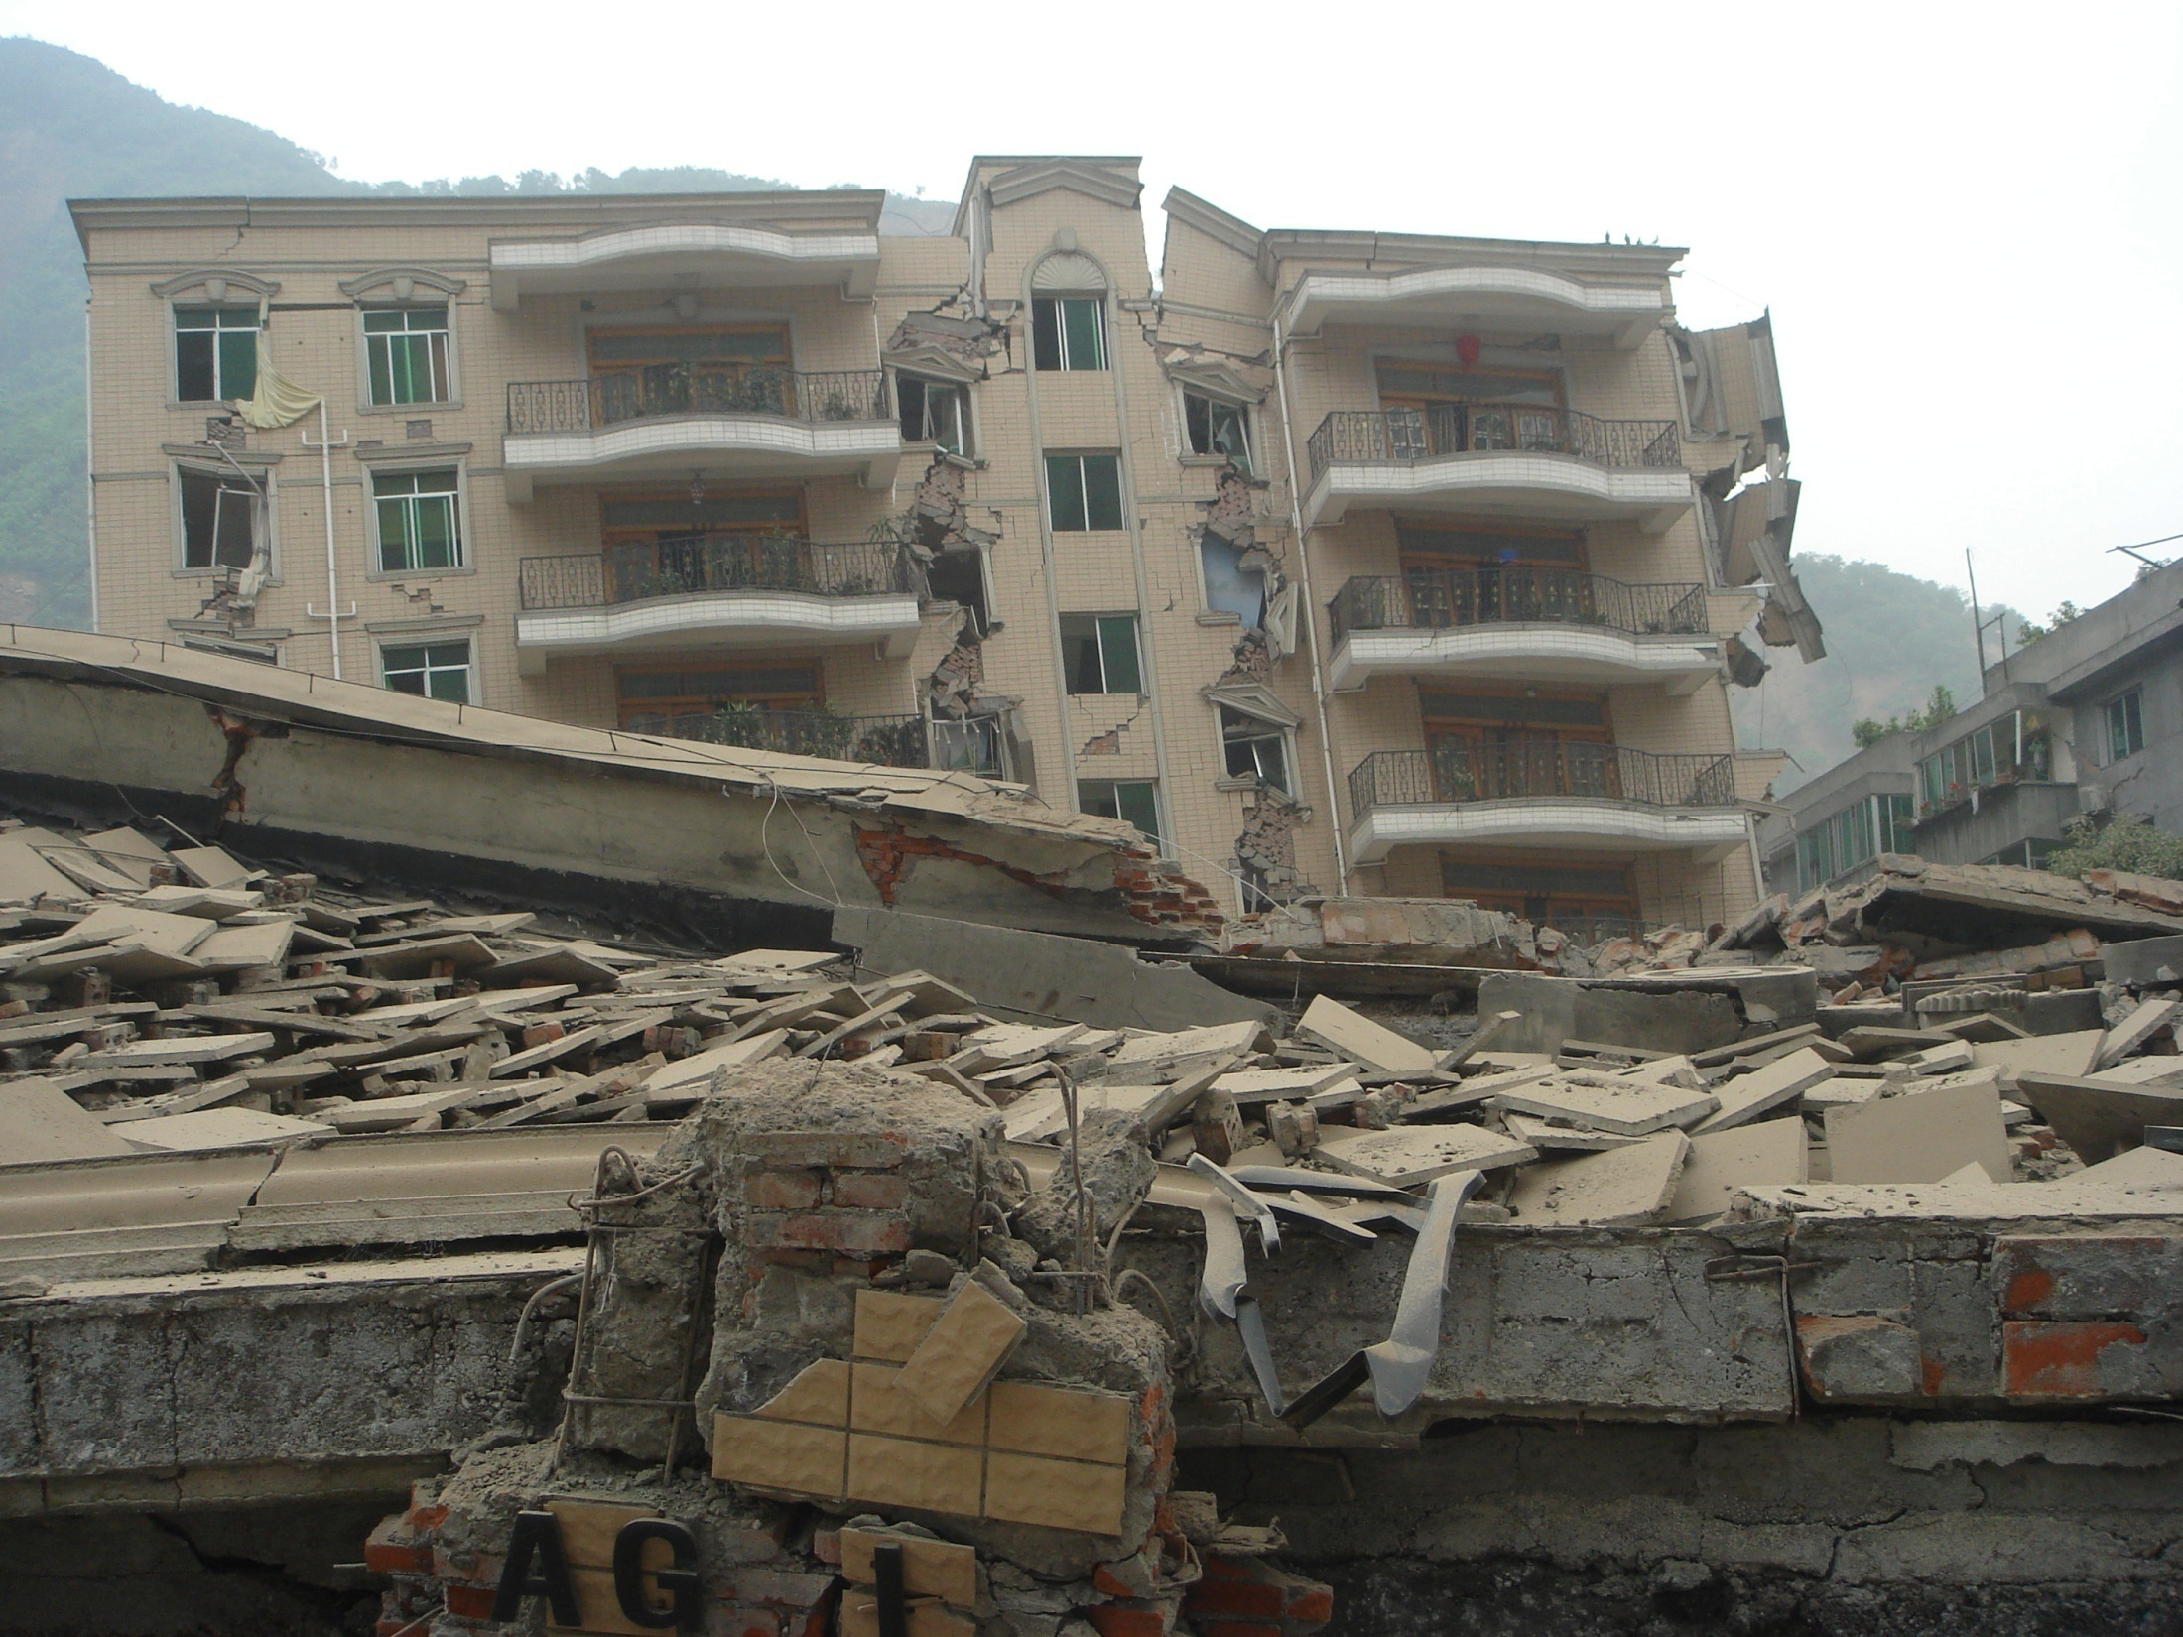
After an earthquake:
Check for injuries and provide first aid.
Do a safety check: check for gas, water, downed power lines and shortages.
Turn off appropriate utilities; Check for damage.
Turn on the radio and listen for instructions on safety or recovery actions.
Use the telephone for emergencies only.

Slide 14
Thank You!
Made by Harjot Singh
Indraprastha World School

