Slide 1
ACTIVE VOLCANOES OF THE WORLD
Shivika Duggal
Indraprastha World School

Slide 2
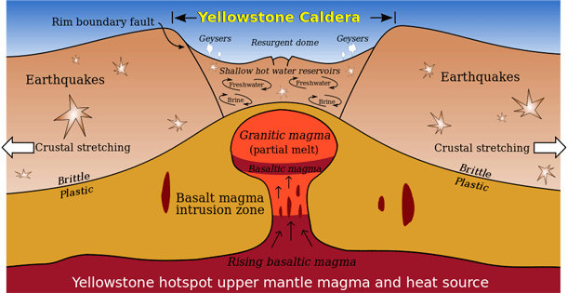
1. Yellowstone Caldera, United States of America

Slide 3
2. Mt. Vesuvius, Italy

Slide 4
3. Popocatépetl, Mexico

Slide 5
4. Sakurajima, Japan

Slide 6
5. Galeras, Columbia

Slide 7
6. Mt. Merapi, Indonesia

Slide 8
7. Mt. Nyiragongo, Democratic Republic of Congo

Slide 9
8. Ulawun, Papua New Guinea

Slide 10
9. Taal Volcano, Philippines

Slide 11
10. Mauna Loa, Hawaii

