Slide 1
Our Favourite Holidays
Chernivtsi school #6, Ukraine

Slide 2
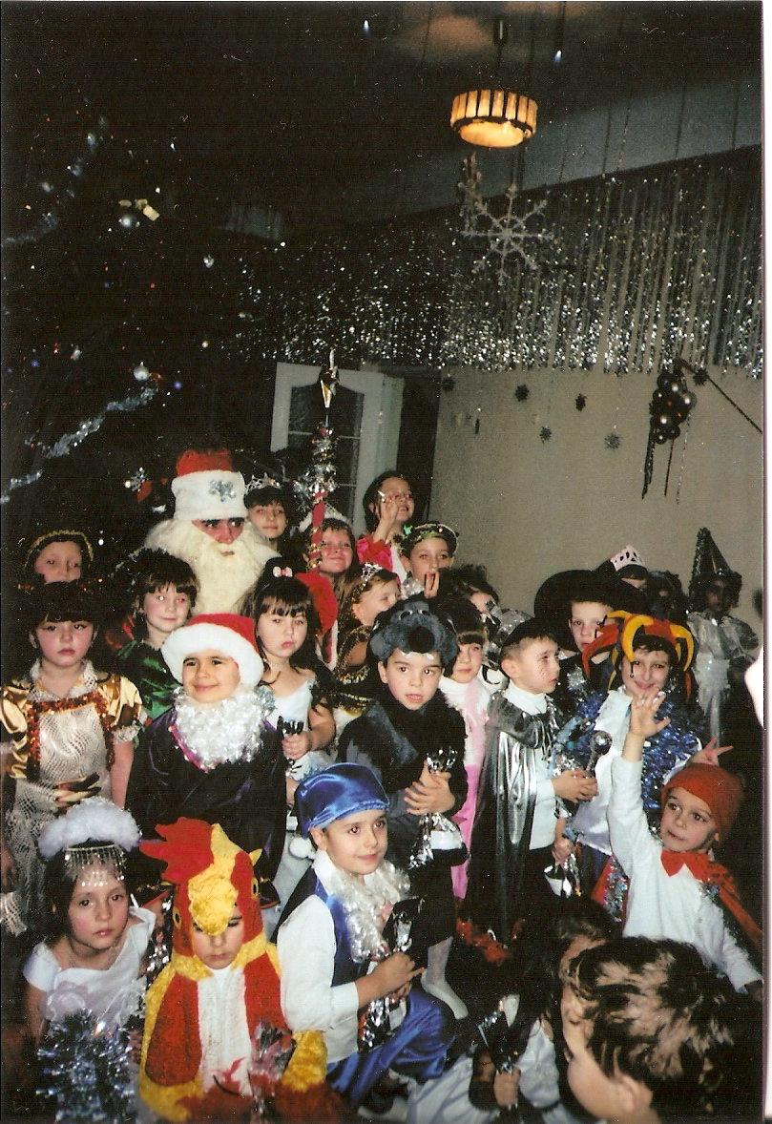
The 1st of January. New Year`s Day.

Slide 3
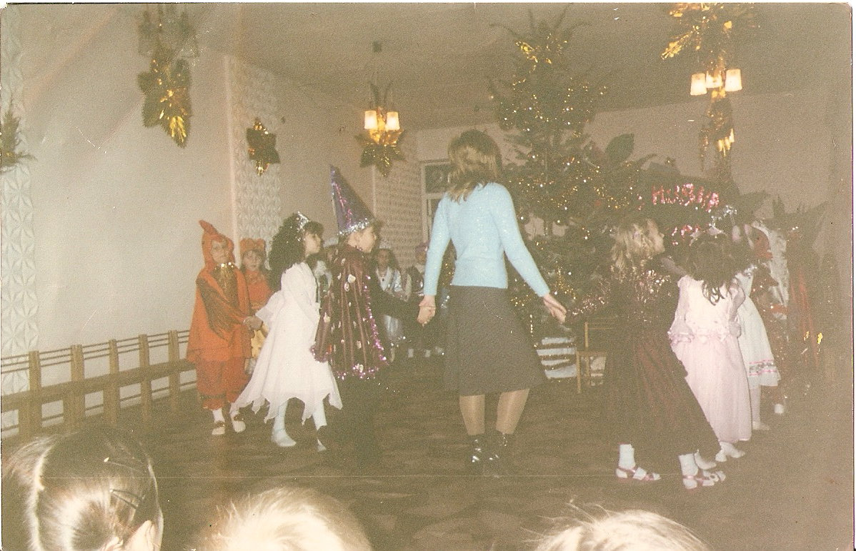
New Year Tree
During New Year Day we dance around our New Year Tree, sing songs and greet each other. Joy and happiness is everywhere.

Slide 4
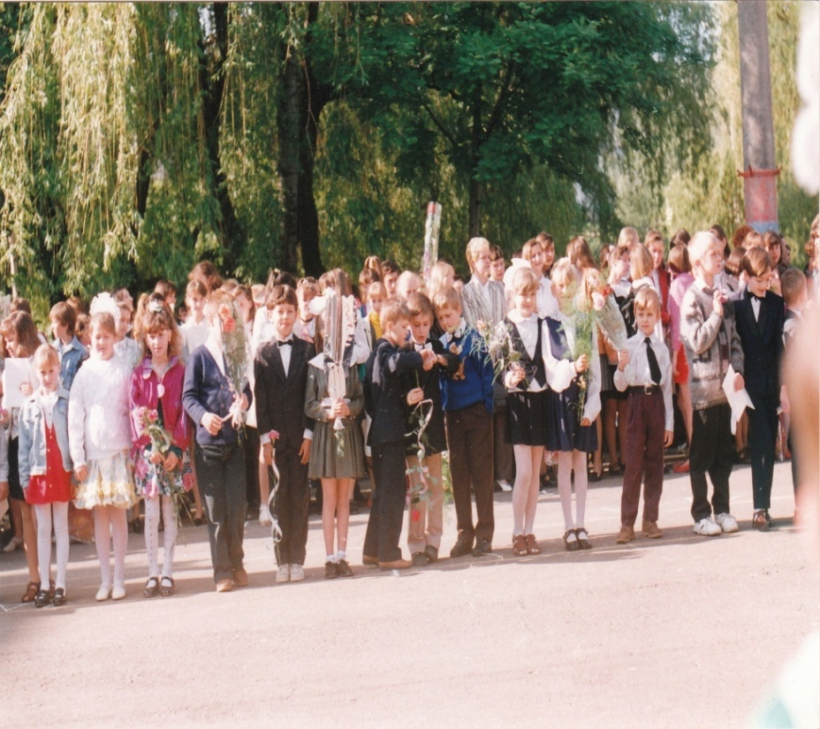
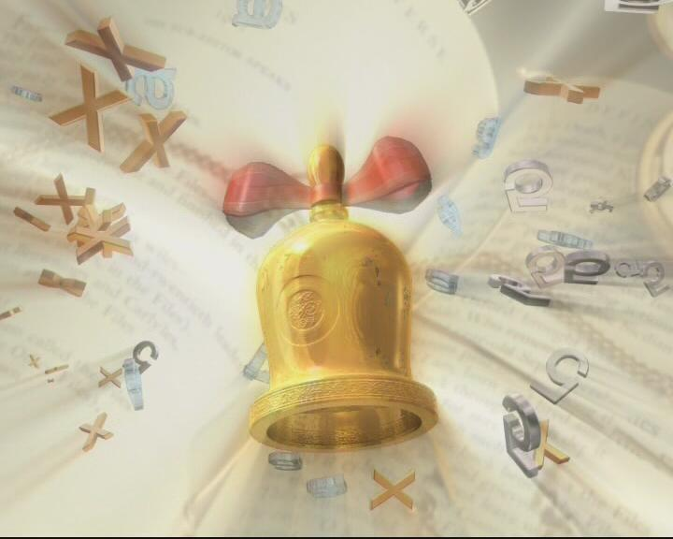
1st of September. The Day of Knowledge.

Slide 5
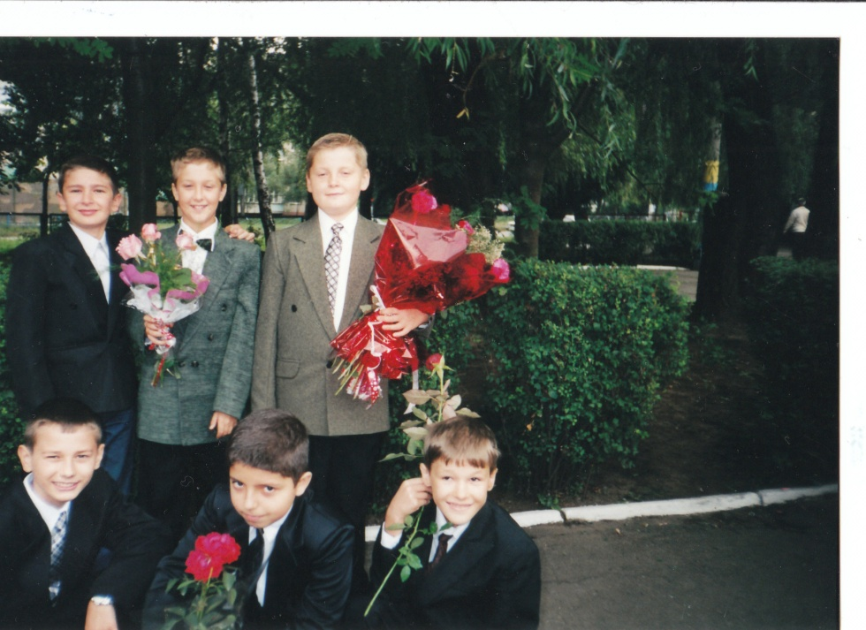
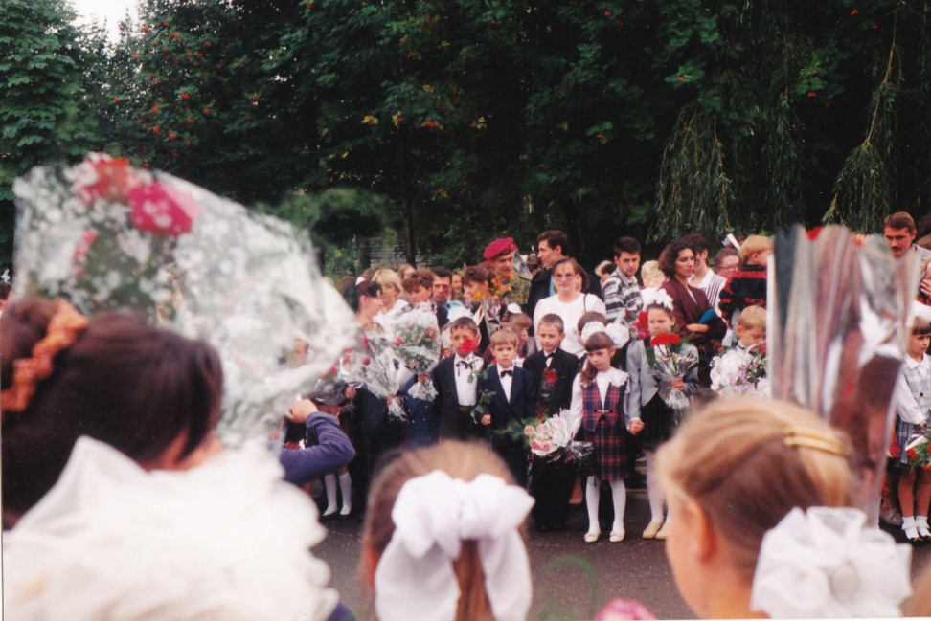
The Day of Knowledge
On that day we give flowers to our teachers.
We are happy to meet our classmates and teachers after 3 months of summer holidays.

Slide 6
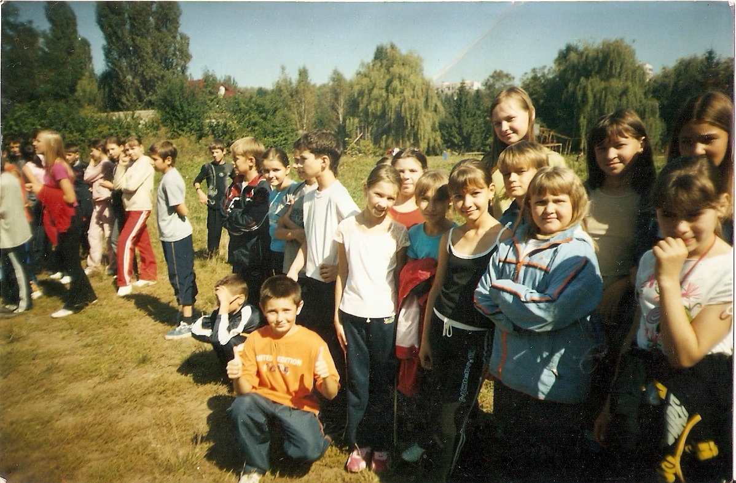
September. Health Day

Slide 7
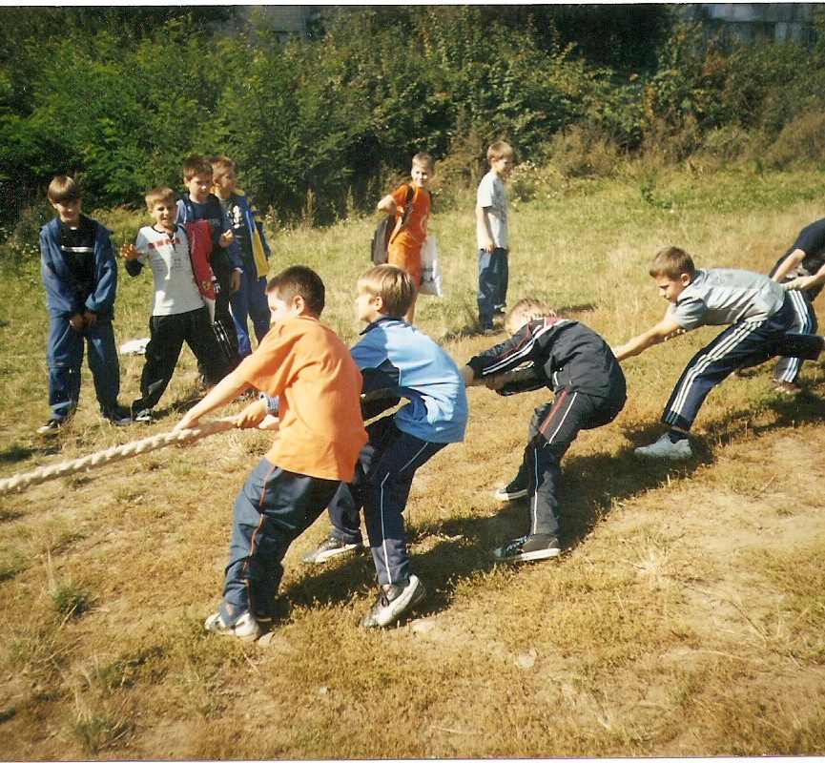
Health Day – great and gay!
Every September we have a special holiday in our school. During this day we have competitions in different kinds of sport, we go on a field trips, play games and have fun.

Slide 8
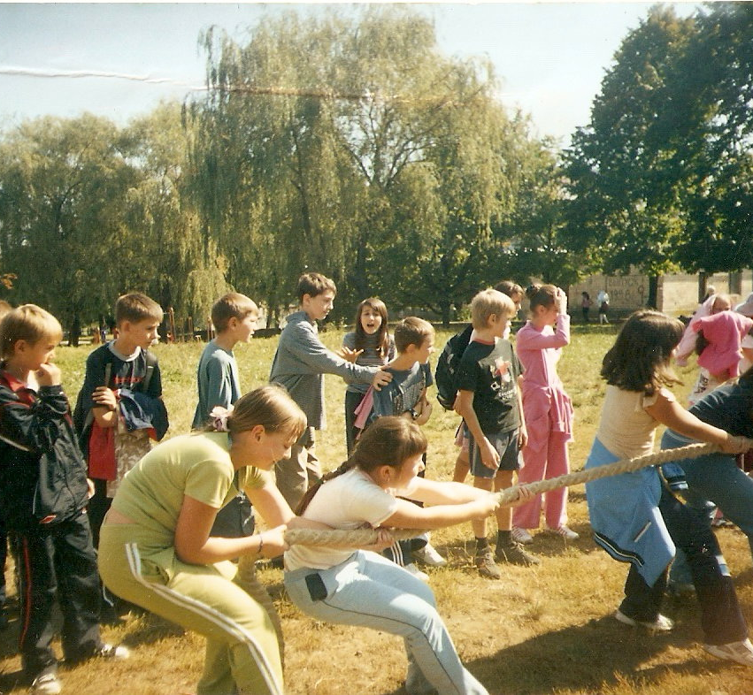
The Day of Health
The Day of Health
The Day of Health – important day `cause we can jump and run and play, be healthy, strong and friendly too and show the real life to you.

Slide 9
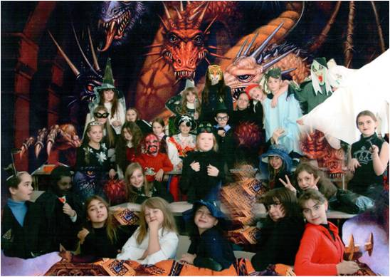
31 st of October. Halloween.

Slide 10
Halloween
We always celebrate this holiday with great pleasure. We have an opportunity to dress fancy clothes, play tricks, sing songs and compete for the most horrible costume. The winner gets a prize. There is also a disco after the competition. We like this holiday very much!

