Slide 1
EMBROIDERY IN OUR HOMES
Embroidery has always been very popular in Ukrainian homes

Slide 2


The towel (“rushnyk”) is one of the oldest Ukrainian “oberehy” – things which protect people, help them to cope with problems.

Slide 3
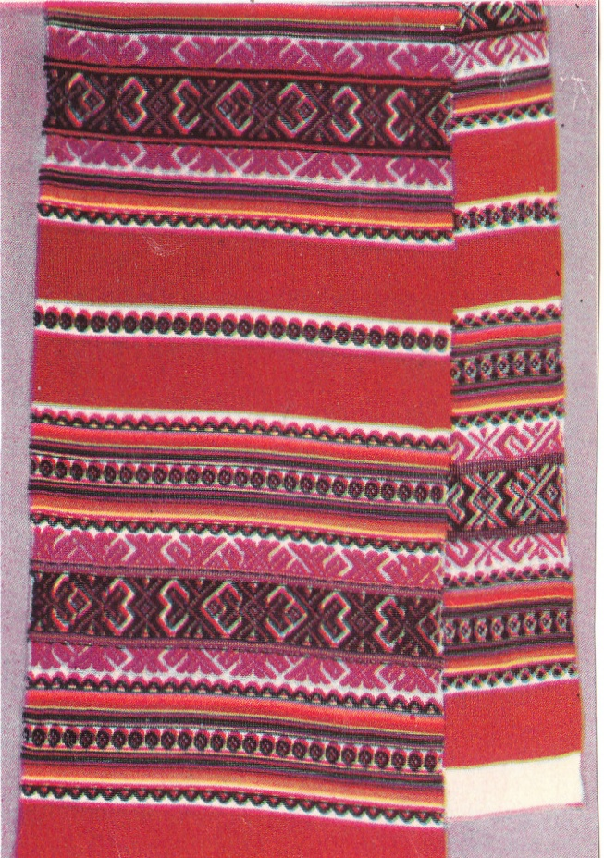

Special significance is attached to the embroidery on towels.Every region of Ukraine has its own favourite colours, style and pattern .

Slide 4


The patterns on the towels are ancient symbols : a rhomb with the spot in the centre means a field, a sign of Berehynia, the Goddess of the family life.

Slide 5


Embroidered “rushnyky” have been used in folk rites, for weddings and for decorating holy icons.

Slide 6


There are special “rushnyky” for decorating Easter baskets, when people go to the church to bless food on Easter Sunday.

Slide 7


In Ukrainian homes there are also other embroidered things – tablecloths, pillowcases, napkins, etc.

Slide 8


The pictures were made in Chernivtsi region, Ukraine.

