Slide 1
The
Most Magnificent Trees
In
The World

Slide 2
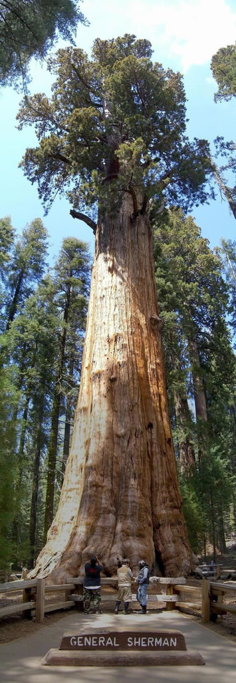
Giant Sequoias
(Sequoiadendron giganteum), which only grow in Sierra Nevada, California, are the world’s biggest trees (in terms of volume).
The biggest is General Sherman in the Sequoia National Park - one behemoth of a tree at 275 feet (83.8 m), over 52,500 cubic feet of volume
(1,486 m³), and over 6000 tons in weight.
General Sherman is approximately 2,200 years old - and each year, the tree adds enough wood to make a regular 60-foot tall tree. It’s no
wonder that naturalist John Muir said "The Big Tree is Nature’s forest masterpiece, and so far as I know, the greatest of living things."

Slide 3
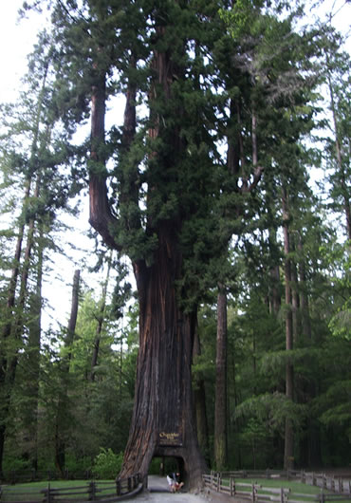
The Chandelier Tree
The most famous of the drive-through trees is the Chandelier Tree in Leggett, California. It’s a 315 foot tall redwood tree, with a 6 foot wide by 9 foot tall hole cut through its base in the 1930s

Slide 4
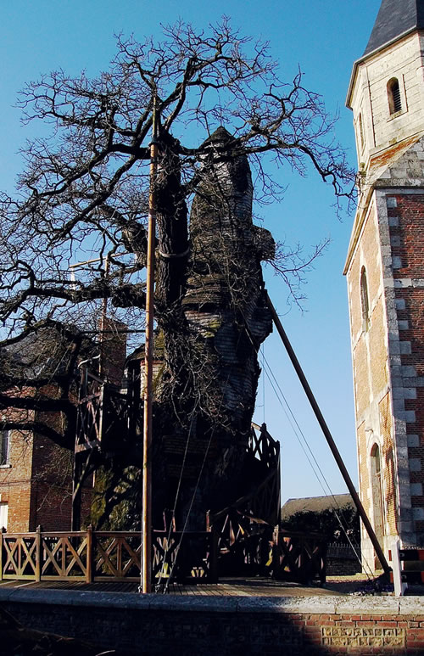
The Chene Chapelle (Chapel Oak) of Allouville-Bellefosse is the most famous tree in France - actually, it’s more than just a tree: it’s a building and a religious monument all in one.
In 1669, l’Abbe du Detroit and du Cerceau decided to build a chapel in (at that time) a 500 years old or so oak (Quercus robur) tree made hollow by a lightning bolt. The priests built a small altar to the Virgin Mary. Later on, a second chapel and a staircase were added.
Now, parts of the tree are dead, the crown keeps becoming smaller and smaller every year, and parts of the tree’s bark, which fell off due to old age, are covered by protective oak shingles. Poles and cables support the aging tree, which in fact, may not live much longer.
As a symbol, however, it seems that the Chapel-Oak of Allouville-Bellefosse may live on forever.

Slide 5
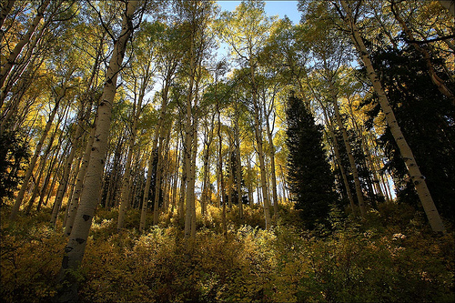
Pando or the Trembling Giant in Utah is actually a colony of a single Quaking Aspen (Populus tremuloides) tree. All of the trees (technically, "stems") in this colony are genetically identical (meaning, they’re exact clones of one another).
In fact, they are all a part of a single living organism with an enormous underground root system.
Pando, which is Latin for "I Spread," is composed of about 47,000 stems spread throughout 107 acres of land. It estimated to weigh 6,600 tons, making it the heaviest known organism.
Although the average age of the individual stems are 130 years, the entire organism is estimated to be about 80,000 years old!

Slide 6
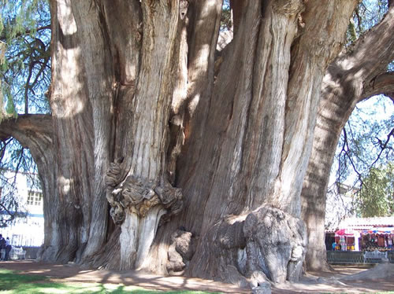
El Arbol del Tule ("The Tule Tree") is an especially large Montezuma cypress (Taxodium mucronatum) near the city of Oaxaca, Mexico. This tree has the largest trunk girth at 190 feet (58 m) and trunk diameter at 37 feet (11.3 m). The Tule tree is so thick that people say you don’t hug this tree, it hugs you instead!

Slide 7
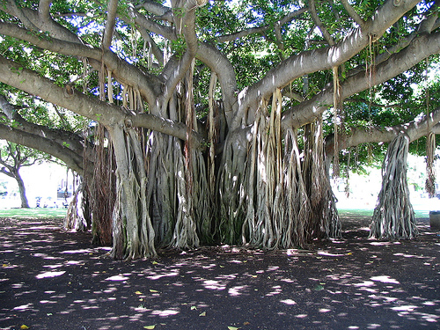
The Banyan Tree

Slide 8
One of the most famous species of Banyan, called the Sacred Fig or Bo tree, is the Sri Maha Bodhi tree in Anuradhapura, Sri Lanka. It is said that the tree was grown from a cutting from the original tree under which Buddha became enlightened in the 6th century BC.
Planted in 288 BC, it is the oldest living human-planted tree in the world, with a definitive planting date!

Slide 9
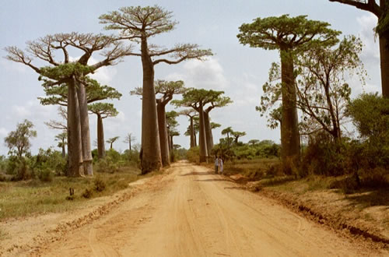
The Amazing Boabab (Adansonia)or monkey bread tree can grow up to nearly 100 feet (30 m) tall and 35 feet (11 m) wide. Their defining characteristic: their swollen trunks are actually water storage - the baobab tree can store as much as 31,700 gallon (120,000 l) of water to endure harsh drought conditions.
Baobab trees are native to Madagascar (it’s the country’s national tree!), mainland Africa, and Australia. A cluster of "the grandest of all" baobab trees (Adansonia grandidieri) can be found in the Baobab Avenue, near Morondava, in Madagascar:

Slide 10
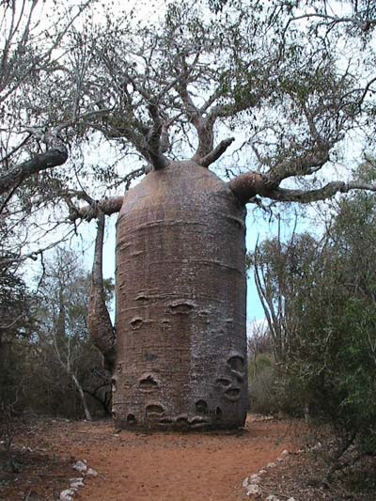
Teapot Baobab

