Slide 1
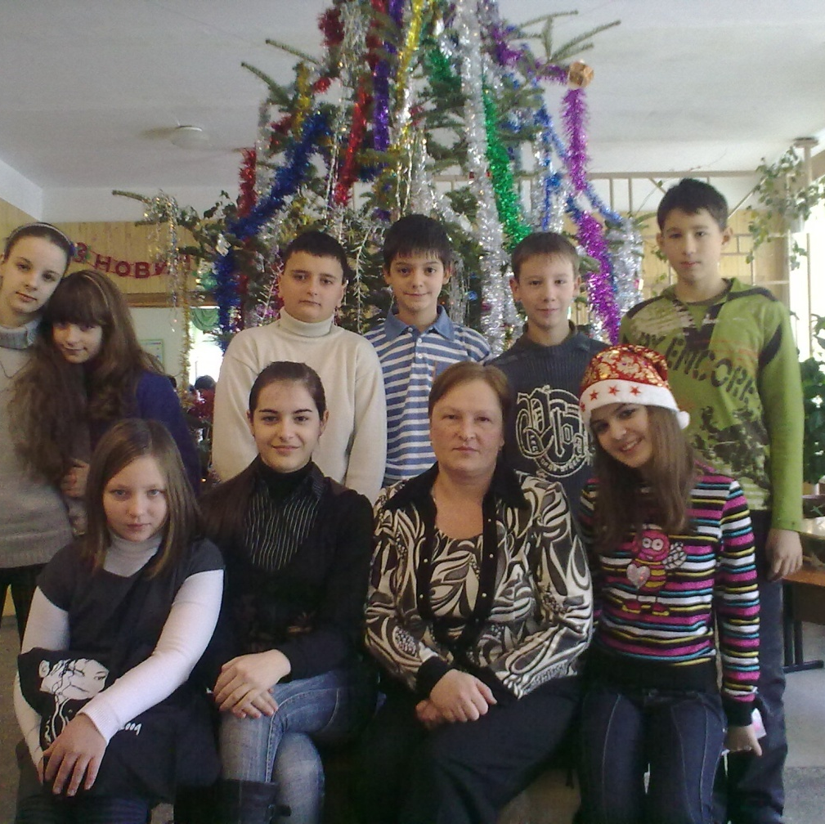
OUR FAVOURITE HOLIDAYS
Students of class 7B tell us about their favourite holidays.

Slide 2
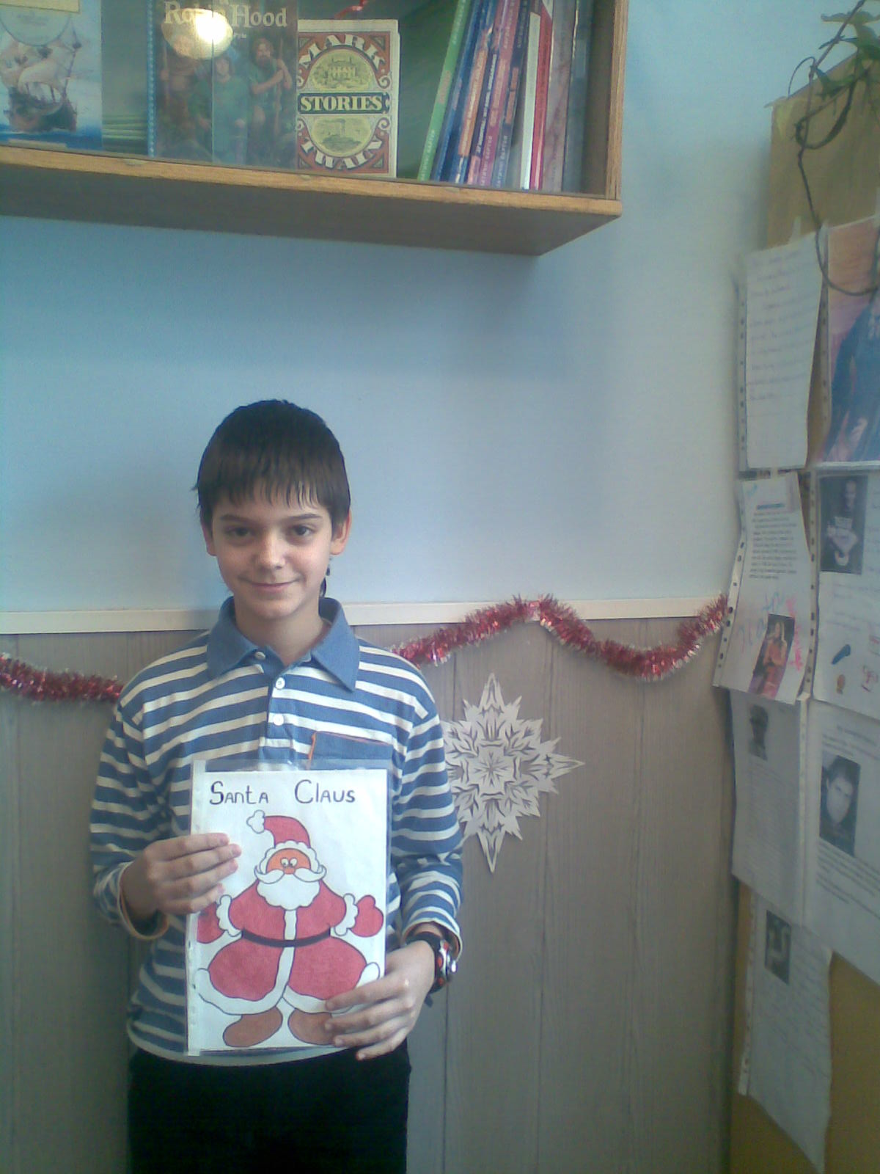
CHRISTMAS
My favourite holiday is Christmas. In Ukraine Christmas comes on January 7, after New Year’s Day.
On Christmas Eve people prepare Holy Supper. It has 12 lean dishes symbolic of the twelve Apostles. As soon as the first star appears in the sky the family gathers around the dining table. The first dish is “kutia” which is cooked of wheat with honey, poppy seeds, fruit and nuts. Usually there are many dishes with mushroom, varenyky with potatoes or cabbage. All dishes are prepared without meat.
During this holiday children sing carols. Christmas celebrations are different in different places, but giving presents and sending greetings with good wishes are very popular.
I like Christmas, but a folk proverb says “Christmas comes but once a year”.
Written by Dima.

Slide 3
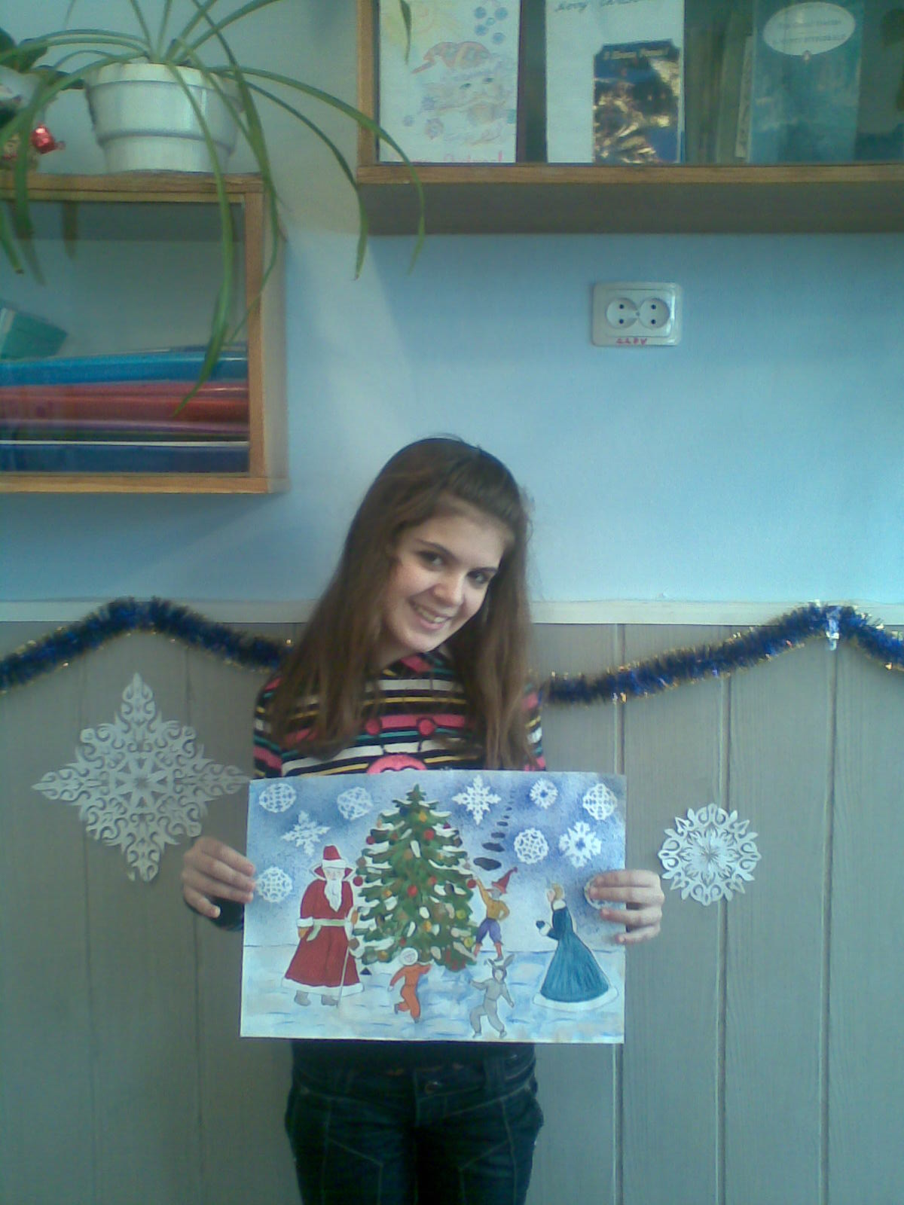
New Year’s Day
My favourite holiday is New Year’s Day. In our country it is celebrated at night on the 31 of December. It is a holiday of something new, unusual and unexpected. They say it is a family holiday.
Almost every family prepares to this holiday. My parents buy a fir tree. My mum and I decorate it on the 31st of December. But before that my mum and I usually clean our flat, wash the clothes and windows, because people say that in new year everything must be neat and clean.
My mum tries to cook something delicious for this holiday. We lay the table, invite our friends and relatives and sit down to holiday table at nine o’clock. In this way we say “Good bye” to the old year.
At midnight adults drink champagne and we say to each other “Happy New Year!”
Written by Alina

Slide 4
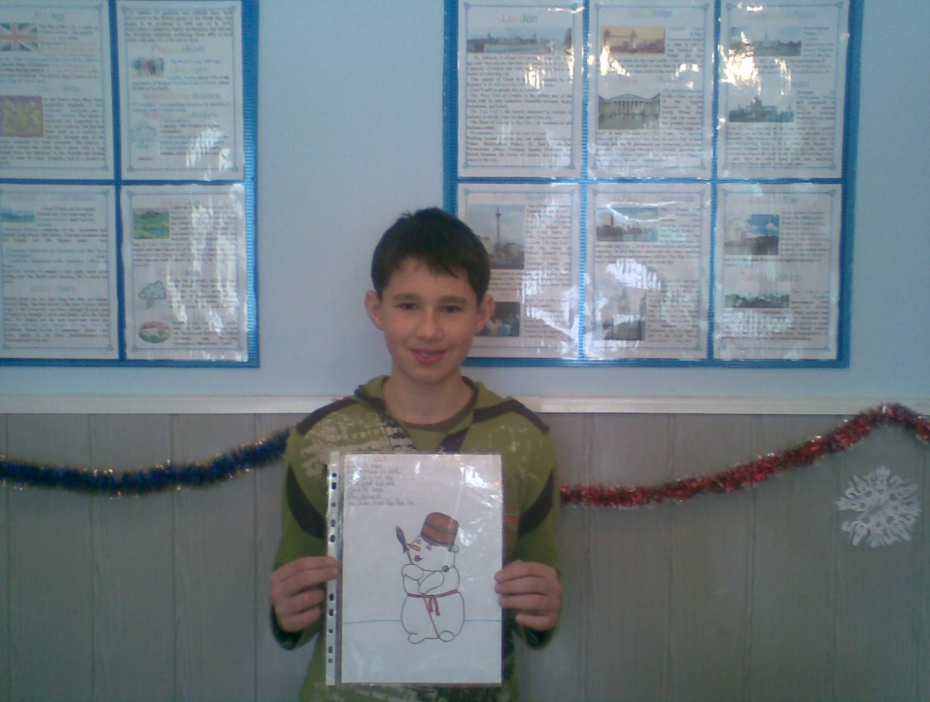
new year’s day
My favourite holiday is New Year’s Day, because it is a family holiday.
First my mum cooks many delicious things, while the other family are tidying the rooms.
Of course we decorate the New Year tree all together. We also write greeting cards to our grandparents and relatives.
At midnight we say “Happy New Year” and wish each other health, happiness and wealth.
Then we go outside and set off fireworks. That’s wonderful! We all laugh and sing “Happy New Year!”
Written by Ihor

Slide 5
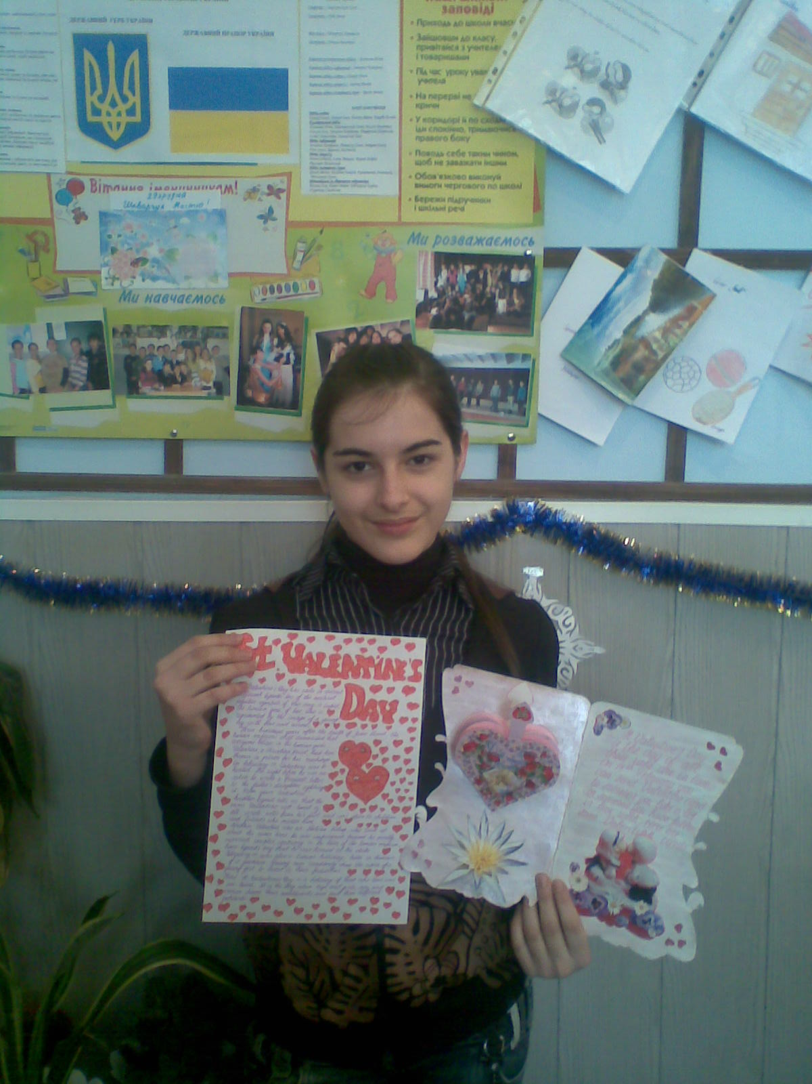
st valentine’s day
My favourite holiday is St Valentine’s Day. It’s an amazing holiday of great love. You can say about your feelings and give some presents and cards to the person you like (or love). If you don’t want them to know that it’s you, you don’t have to sign you card and it will become a little secret.
On St Valentine’s Day you can decorate your room and flat or your class. All decorations and cards are with hearts.
That holiday has become my favourite one since I started to write poems, listen to songs and read books about love. It’s very interesting and exciting!
I have listened to the history of this holiday several times and every year I understand more. Though this story is sad it has one happy moment: since that time on 14 February people celebrate the Day of love!
Written by Cristina.

Slide 6
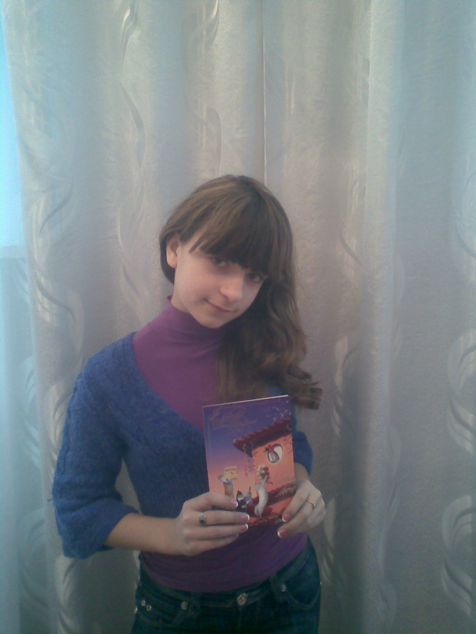
my favourite holiday is my birthday
My favourite holiday is my birthday.
It’s in December . It is the best day because this day is devoted to me!
I invite many friends and they give me interesting and beautiful presents. I decorate my home with balloons.
On this wonderful day my parents cook many tasty foods. And in the end of the party my mum brings a big tasty cake!
Written by Tania.

Slide 7
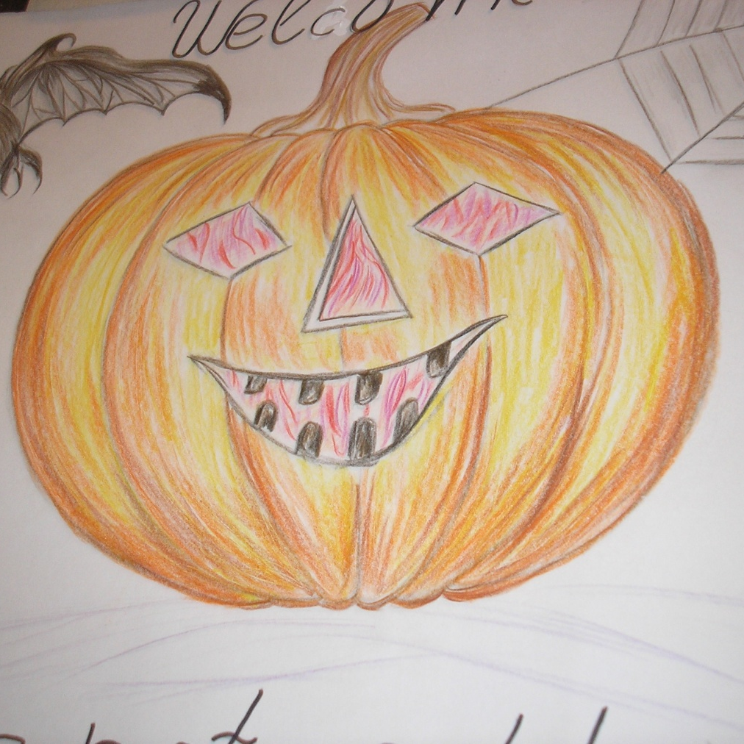
HALLOWE’EN
My favourite holiday is Hallowe’en. I am going to have a party on Hallowe’en, because I want to see all my friends and have fun.
I’m going to dress up as a witch. I’m going to wear a long plain black dress, a black pointed hat and black gloves.
Before the party I want to buy a pumpkin, candles, sweets and biscuits. I am going to ask Dad to carve a face on the pumpkin and put there a candle. I’ll decorate the room with black and orange balloons, toy frogs, snakes and spiders. I am going to ask my mum to help me to paint my face.
During the party we’ll eat pumpkin pie and tell scary stories about ghosts and witches. I’ll have some competitions at my party. The first competition will be to draw a pumpkin with closed eyes, the second competition will be a witches’ race on the broom stick.
In my opinion the party will be very funny and interesting. I’ll have a great time with my friends.
Written by Yulia.

