Slide 1
YAMUNA RIVER

Slide 2
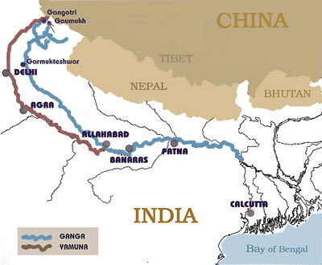
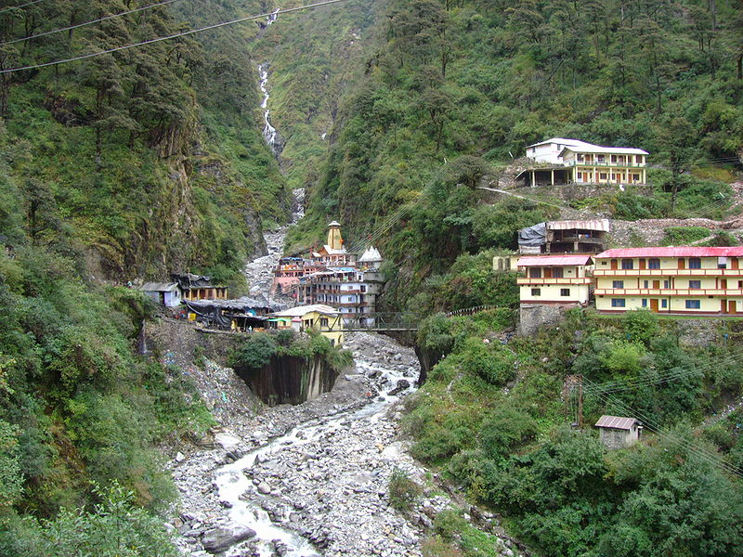
INTRODUCTION
The Yamuna is the largest tributary river of the Ganges (Ganga) in northern India. Originating from the Yamunotri Glacier at a height 6,3 87 mtrs.

Slide 3
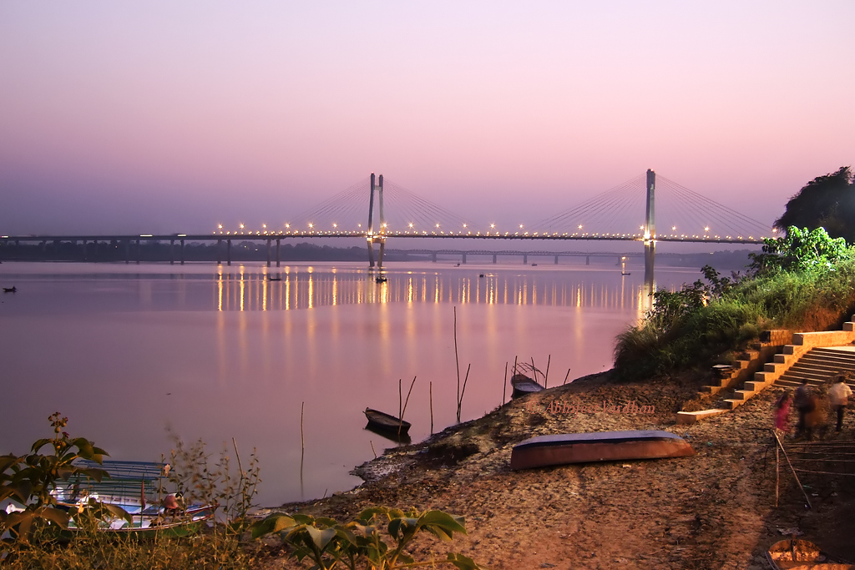
It travels a total length of 1,376 kilometers. Before merging with the Ganges at Triveni Sangam, Allahabad, the site for the Kumbha Mela every twelve years.

Slide 4
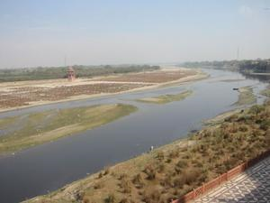
It crosses several states, Uttarakhand, Haryana and Uttar Pradesh, passing by Himachal Pradesh and later Delhi, and meets several of its tributaries on the way.

Slide 5
YAMUNA BEFORE DELHI

Slide 6
Yamuna in Delhi

Slide 7
History: According to legend, the Yamuna is the daughter of Surya and Sharanyu and the twin sister of yama, the god of Death. It is said that Sharanyu, unable to bear the luster of the quivering Surya, closed her eyes upon which he cursed her. It was then that Yamuna was born.

Slide 8
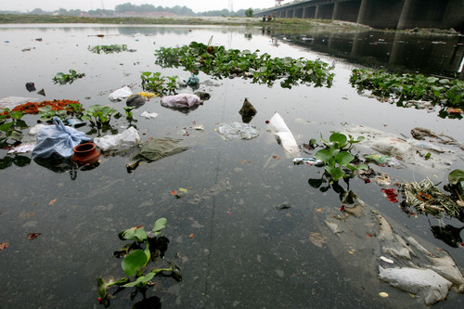
Pollution in Yamuna River
The rapid growth of Delhi in recent times has resulted in significant increase in environmental pollution. It is widely perceived that the problem is threatening to get out of hand.

Slide 9
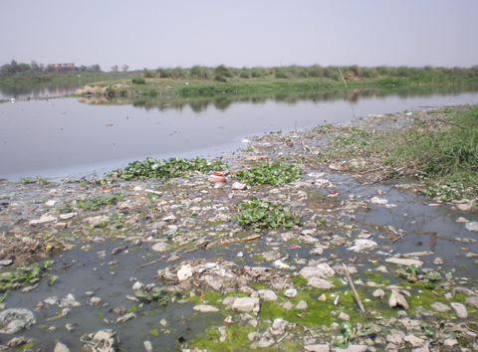
Hence, effective and co-ordinated measures for controlling pollution need to be put in place without delay. Rise in population and growth in economic activity has led to increase in pollution in Delhi.

Slide 10
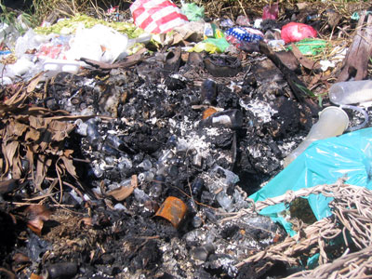
Solid Waste Management
About 5,000 mt of municipal solid waste is generated every day in Delhi. Disposal is mainly in landfills.. Four landfill sites at Ghazipur (East Delhi), Bhalswa (North), Hasthal (South West) and Okhla (South East) are operational present, though these will soon get filled.

Slide 11
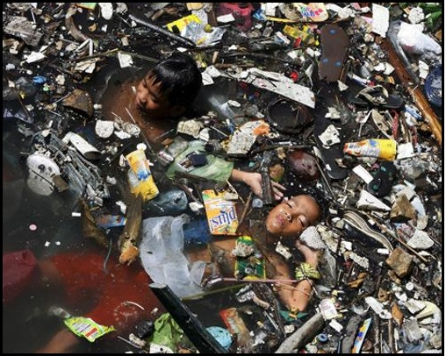
Due to growing pressure on land in Delhi and the projected increase in the quantum of solid wastes, the scope for disposal through landfill sites is limited. Too much land is being consumed accompanied by increasing danger of ground and surface water contamination

Slide 12
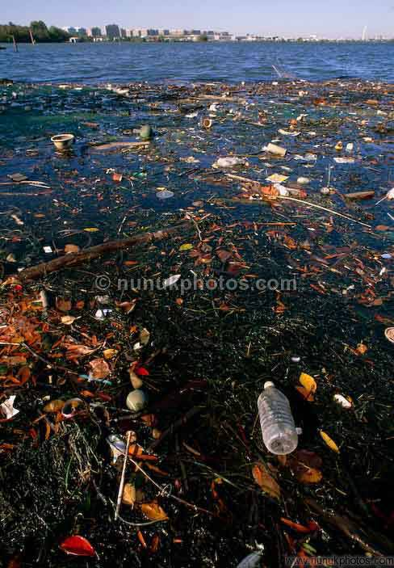
Water pollution
The effluents flowing into the river Yamuna comprise of municipal and industrial wastes. The Central Pollution Control Board has been monitoring the water quality of the Yamuna at the upstream of Wazirabad and at Okhla.

Slide 13
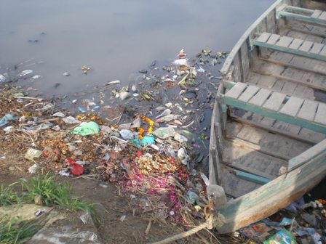
Upstream of Wazirabad, the dissolved oxygen (DO) level is 7.5 mg/l and biochemical oxygen demand (BOD) level is 2.3 mg/l, whereas, downstream at Okhla, the DO level declines to 1.3 mg/l with the BOD at 16 mg/l, indicating considerable deterioration in water quality in the stretch due to discharge of sewage and industrial effluents.

Slide 14
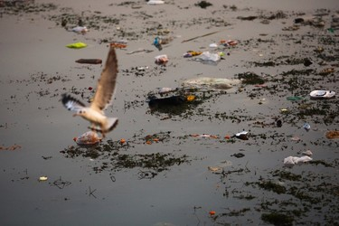
The prescribed ambient water quality in terms of DO is 5mg/l or above, and 3mg/l or below in terms of BOD. The stretch between Wazirabad and Okhla is designated as bathing quality standard in terms of its water use.

Slide 15
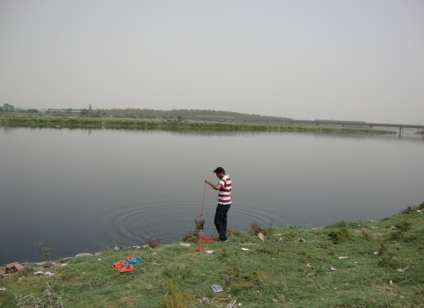
The coliform count at Wazirabad is 8,506/100 ml whereas at Okhla, it increases to 3,29,312/100 ml, as against the prescribed standard of 500/100 ml.

Slide 16
Industrial Pollution
The major sources of industrial pollution in Delhi include thermal power plants, brick kilns, hot mix plants and industrial units. The thermal power plants in Delhi are at Indraprastha, Badarpur and Rajghat.

Slide 17
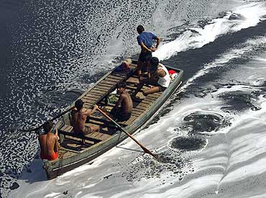
Idustrial pollutants are on the rise. In the current year it is estimated that some 30,000 million litres of pollutants are entering our river systems every day, 10,000 million litres from industrial units alone. With industrial development on the rise, industrial pollution accounts for 33 per cent of the total pollution as against 20 per cent a decade ago.

Slide 18
Reflection of Taj Mahal in Yamuna

Slide 19
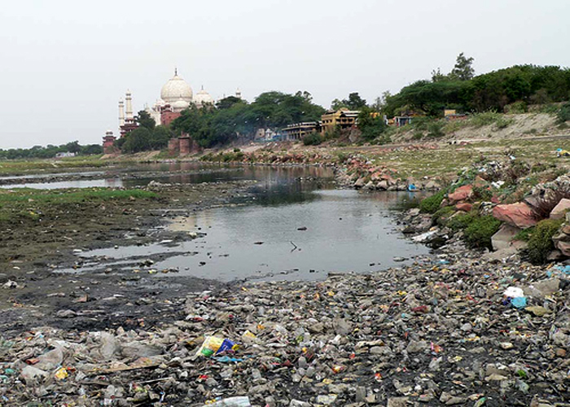
There was a time when people in Agra would flock to the Yamuna banks during the monsoon to watch the river dance in whirlpools or the muddy water form ripples and loops. Or kids would come to watch tortoises lazily floating. Now the heavy pollution level in the water is keeping everyone away. The number of swimmers and divers has gone down drastically due to reports of heavy pollution caused by discharge of effluents and sewer wastes.

Slide 20
The debris of the controversial Taj Corridor project between the fort and the Taj is such a depressing and ugly sight that foreign tourists avoid moving along the river front,' said Surendra Sharma, president of the Braj Mandal Heritage Conservation Society.
'When the tourists look towards the Taj from the Agra Fort, the ill-conceived Corridor which is turning into an unofficial graveyard with heaps of dirt and garbage is such a put off,' said Sharma. Though the river offers a pretty sight nowadays, the people of Agra have long forgotten its beauty and look at it merely as a sewer that brings diseases and pollution.
'What should have been a protected heritage of the country has been reduced to a river, if one can call it that, of sorrow and misery, and unfortunately no government agency, commission, pollution board, department or NGO has been able to arrest the rot,' lamented Pandit Ashwini Mishra

Slide 21
Steps taken by Delhi Govt. to Conserve Yamuna
Khanna, who is chairman of the Prime Minister-appointed Yamuna River Development Authority (YRDA), announced at a recent meeting of the Resource Persons Group on Environment and Ecology that it has been “decided” to create a bio-diversity zone on the Yamuna banks, sources said. This will be along the 22-km stretch of the river from Wazirabad in the upper reaches to Okhla in South Delhi, according to sources.
It appears that despite heavy investment in the Ganga and Yamuna Action Plan, the pollution levels in the rivers have remained unacceptably high. Clearly the approach to reducing pollution has to be improved and overall a more comprehensive approach is needed to tackle the many-sided threats faced by these rivers.

Slide 22
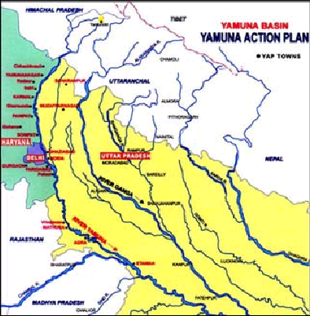

Slide 23
The Indian government has spent half-a-billion dollars trying to clean up Delhi's Yamuna river .It’s only gotten worse.
Sheila Dikshit, New Delhi's chief minister, says the government simply followed the recommendations of outside consultants who encouraged the building of expensive sewage-treatment plants but didn't anticipate the surge in migration of rural poor to New Delhi. "We're tired and frustrated from spending money” she says.

