Slide 1
DREAM DESTINATION
INFORMATIVE TALK ON AROUND THE WORLD

Slide 2
PICTURES OF STUDENTS
GIVING PRESENTATION ON AROUND THE WORLD.
HISTORICAL AND EDUCATIONAL PLACES IN EUROPE.

Slide 3
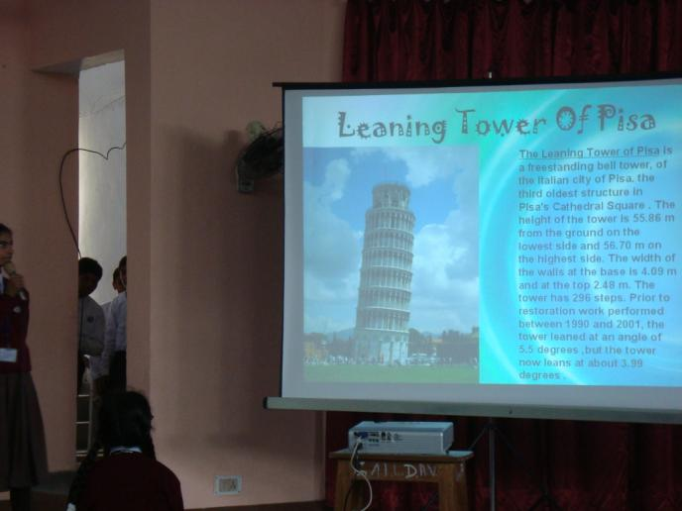
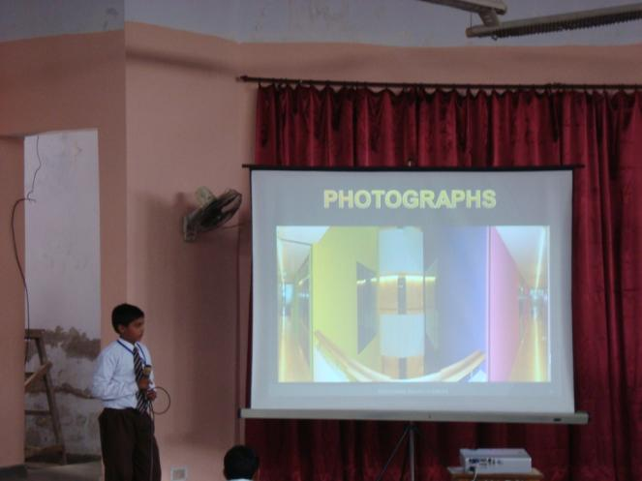

Slide 4
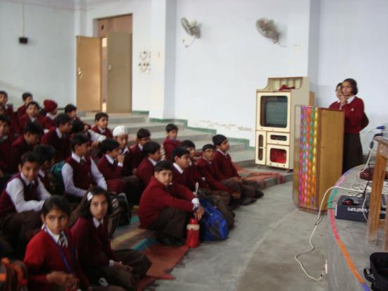
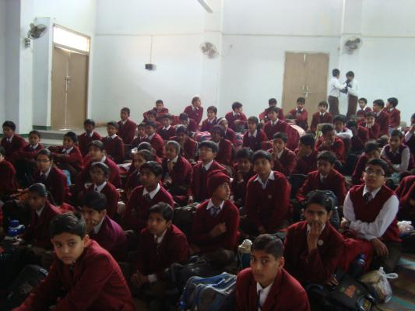
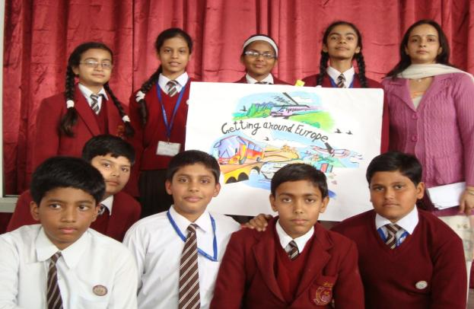
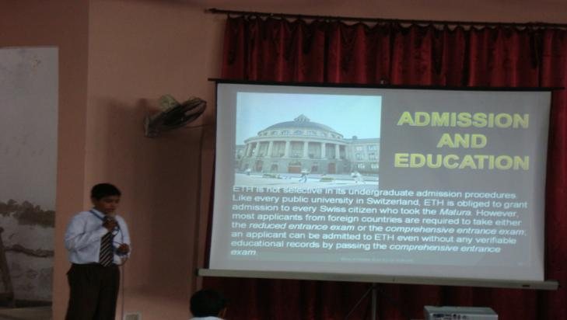

Slide 5
THANK YOU
BY
MRS.POOJA SINGHAL
OF
GAIL D.A.V PUBLIC SCHOOL
BY

